Slide 2
2016 in numbers

Slide 3
^{Engagement}
1 Dedicated website of Family Business Management Resources
2 Social Media Channels
4 Family Business Newsletter
8 Family Business Events
17 Practitioner articles &
projects
90% Event satisfaction rate
30K+ Website Visits

Slide 4
^{Research}
1 New Professor
1 New Postdoctoral
Researcher
1 New Research Assistant
1 Runner-up Best Paper Award
1 Policy Based Research
Project
1 Journal Publication
5 Academic conferences
4 Visiting Professors
13 Research Papers on Family Business

Slide 5
Our research team is global
Edinburgh
Chicago
Dublin
Colorado
Saudi Arabia
Spain
France
Oklahoma
Mississippi
Mexico
Kenya

Slide 6
^{Families}
18 Irish Family Businesses involved in our Research Projects
22% Contact base growth
247 Family Business Managers and Owners attended our events
1500+ Family Businesses engaged through events, newsletters and social media

Slide 7
2016 in pictures

Slide 8
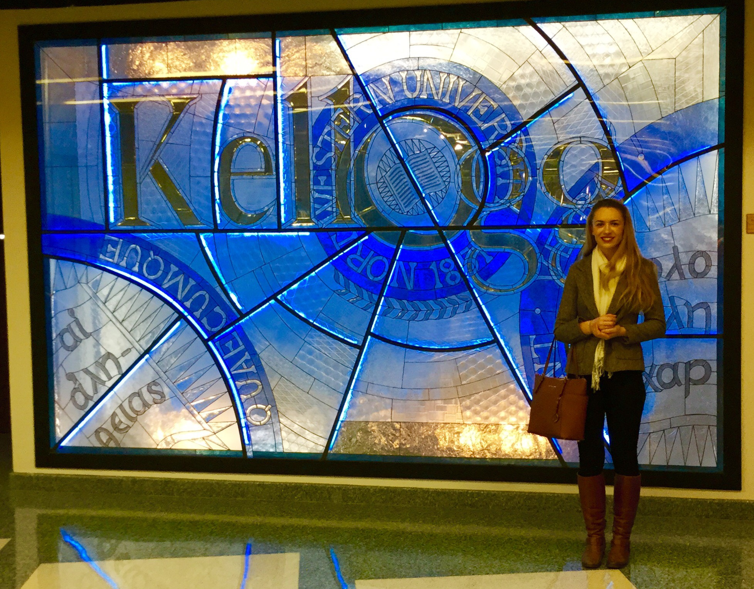
January
CFB Scholar Catherine Faherty embarks on a month-long research
visit to the Kellogg School of Management, Northwestern University, Chicago.

Slide 9
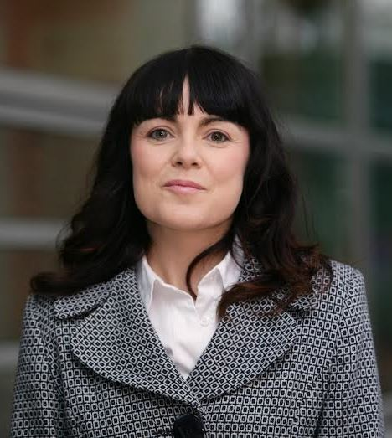
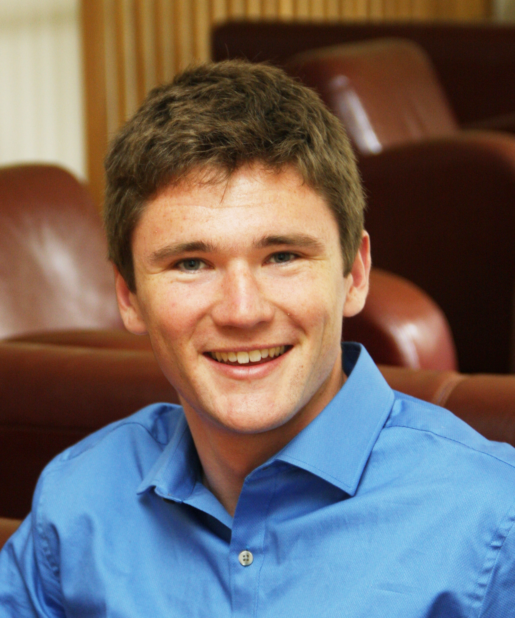
February
Maura accepts position/ Philip plans for Kenya

Slide 10
March
The CFB hosts its first webinar entitled Talent in the Family Business: The Role of Non-Family Members.

Slide 11
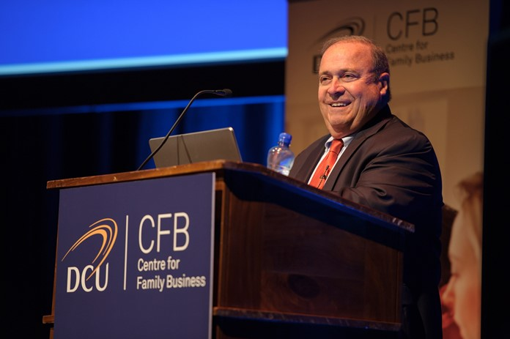
April
The CFB hosts its Annual Family Business Conference with keynote speaker, Mr. Jim Ethier. 159 guests attended

Slide 12
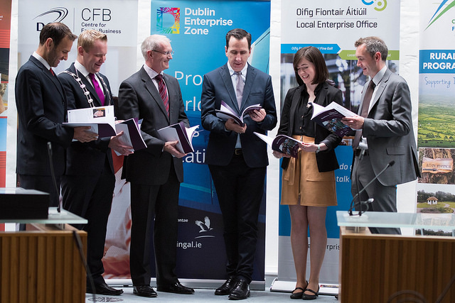
May
The CFB and Fingal County Council launch Lessons in Resilience and Success: A Snapshot of Multigenerational Family Businesses.

Slide 13
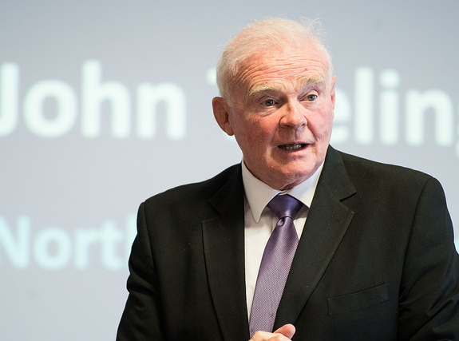
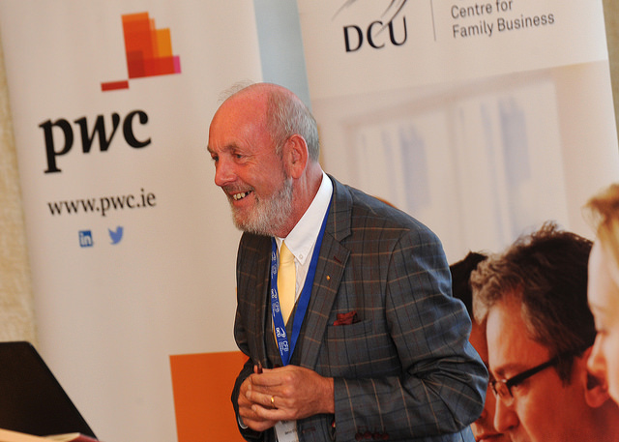
June
Working with Family Talent roadshow kicks off in Dublin and Cork. Keynotes are John Teeling (Dublin) and James O’Sullivan (Cork)

Slide 14
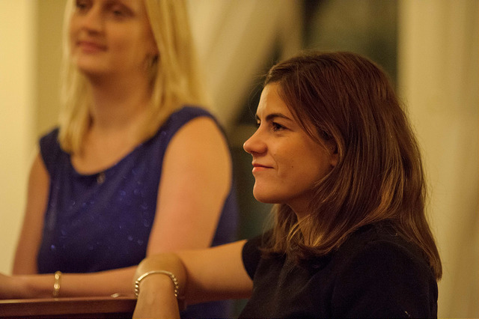
July
CFB scholar, Vanessa Diaz, earns her PhD on Long-term orientation in multi-generational family firms

Slide 15
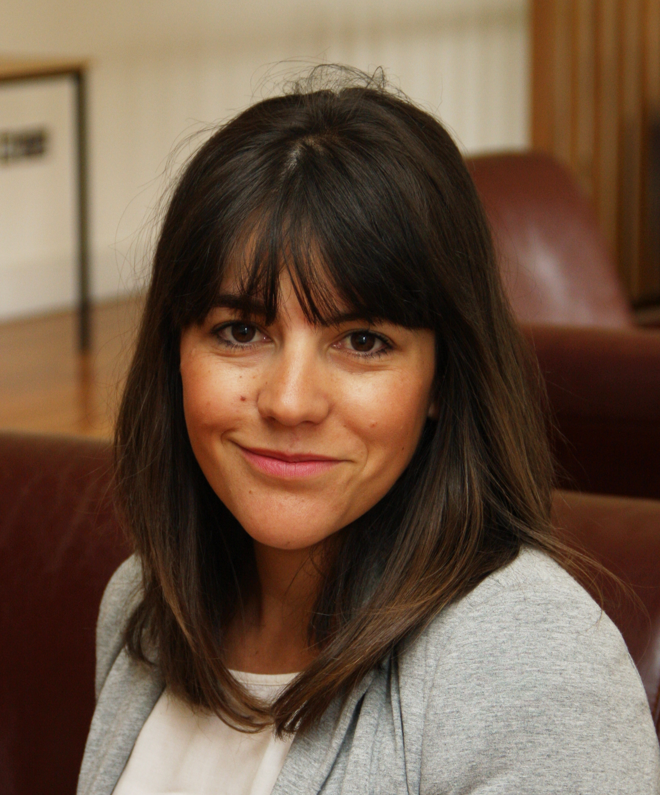
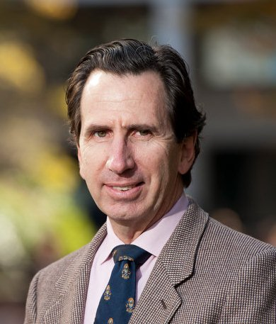
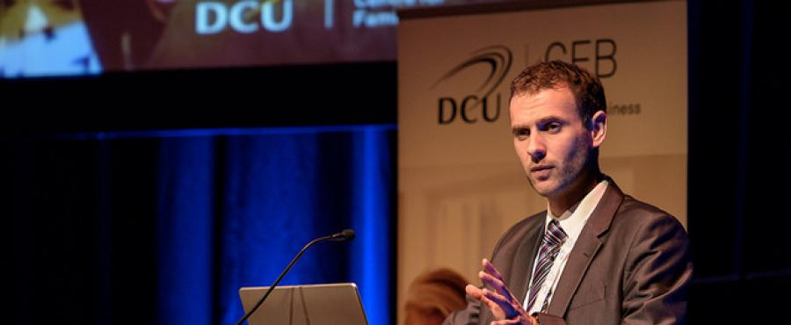
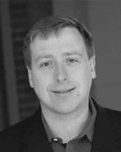
August
The CFB secures research funding from IFB, the UK’s family business organisation, to examine long-term orientation in family firms
Notes:
Eric: Should the whole team be added?

Slide 16
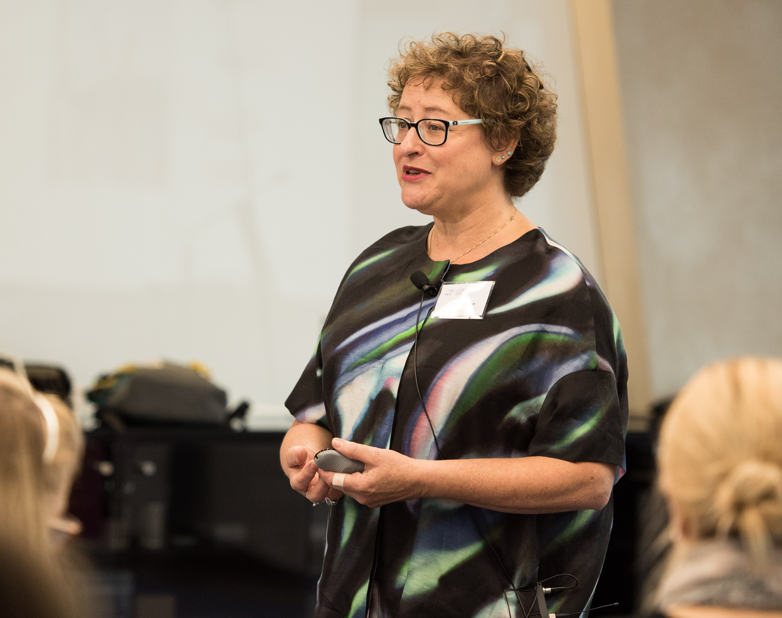
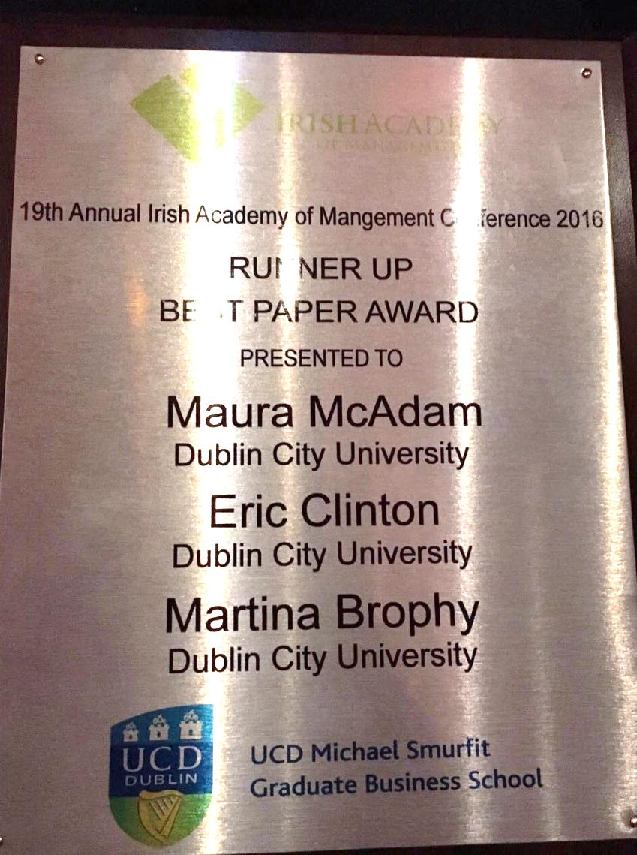
September
- HR expert Amy Schuman advises family businesses on talent nurturing
- Prof. Maura McAdam, Dr. Eric Clinton and Ms. Martina Brophy place runner up in the Best Paper Award at IAM

Slide 17
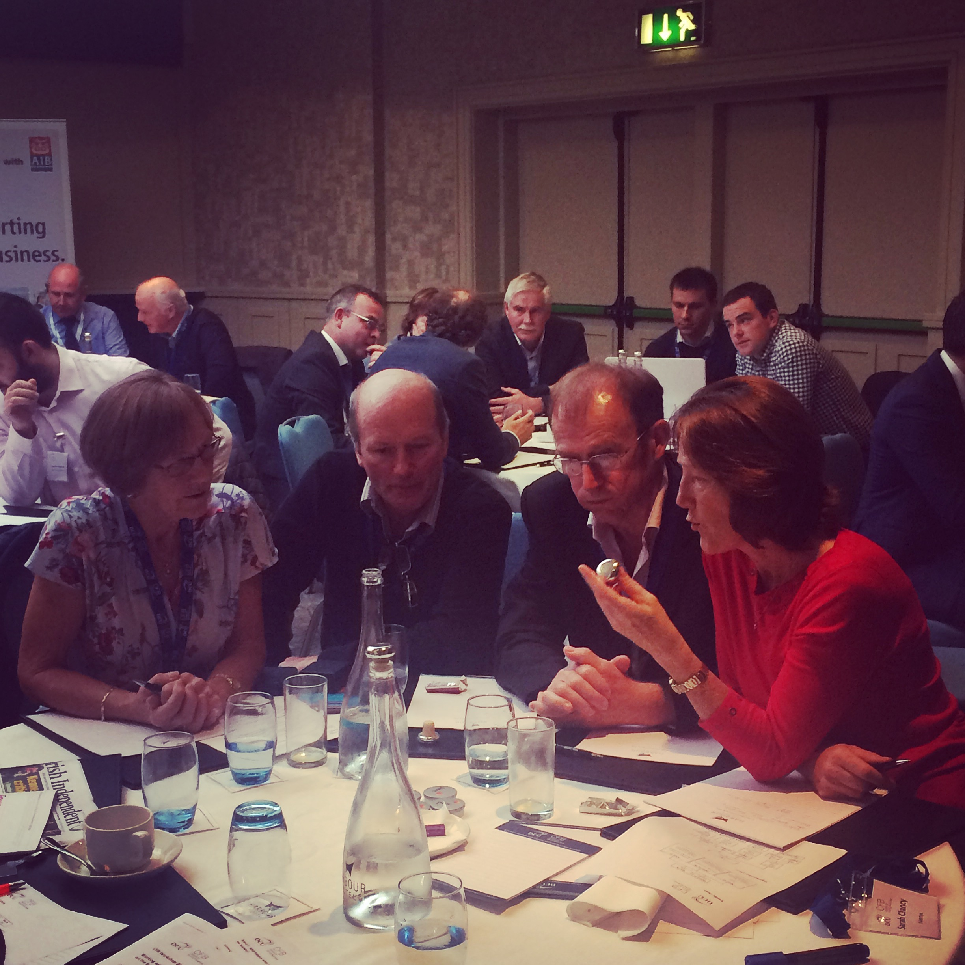
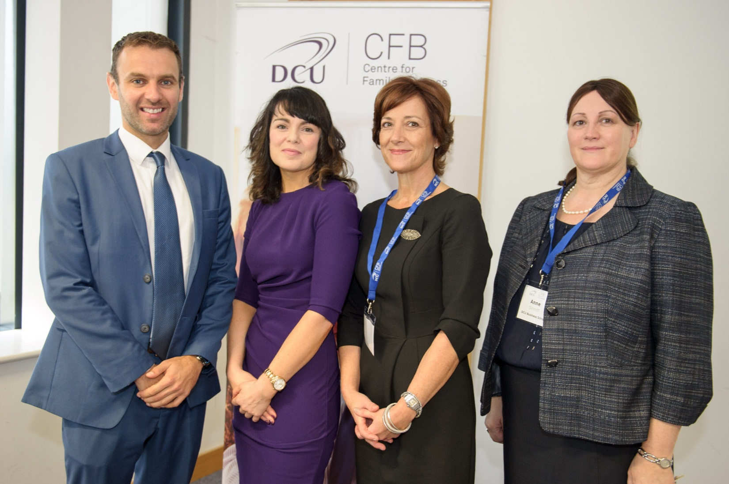
October
The final leg of the roadshow takes place in Galway with keynote speaker, Noel Conroy, Head of Irish Operations at MJ Conroy
The CFB hosts its first Women in Family Business & Leadership event. Keynote by Ms. Vicki O’Toole, CEO of JJ O’Toole’s Ltd

Slide 18
November
Dr. Eric Clinton speaks at the launch of the PwC Global Family Business Survey 2016 in London

Slide 19
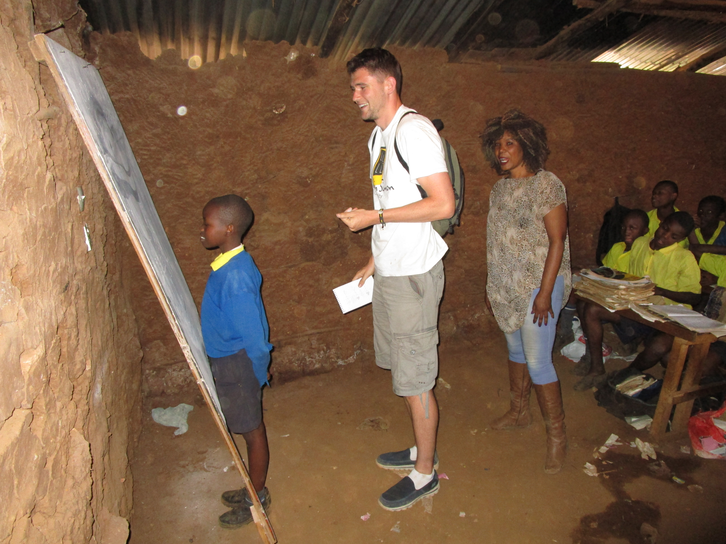
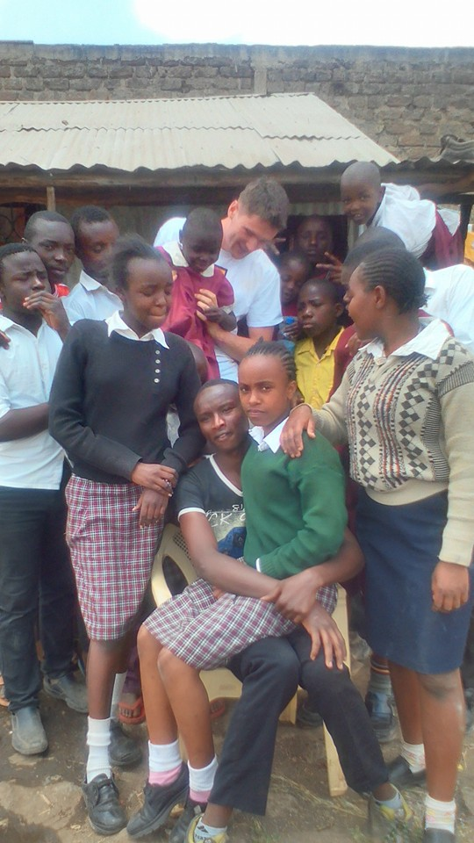
December
Philip’s entrepreneurship research in the slums of Kenya

Slide 20
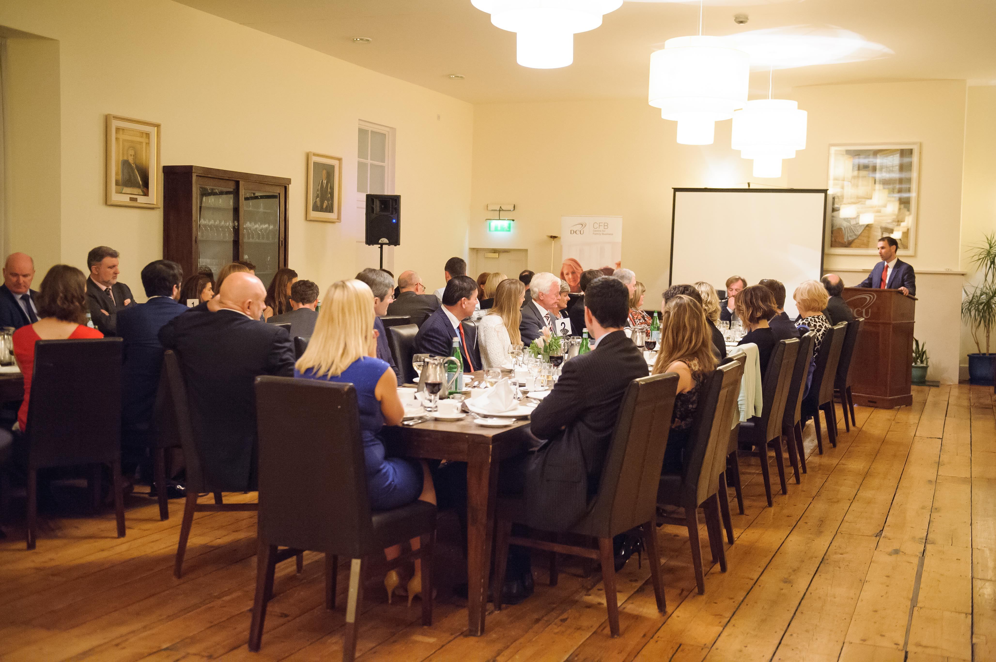
December
The CFB Annual Family Business Dinner takes place for a third consecutive year – the first in PwC.

Slide 21
All with thanks to
Our Partners

Slide 22
And to you, our
Irish Family Businesses!

Slide 23
Why not get involved with the DCU Centre for Family Business:
www.dcu.ie/centreforfamilybusiness
familybusiness@dcu.ie
+353 1 700 6921
@DCUCFB

