Slide 1
Effective Reading
DCU Student Learning
www.dcu.ie/studentlearning

Slide 3
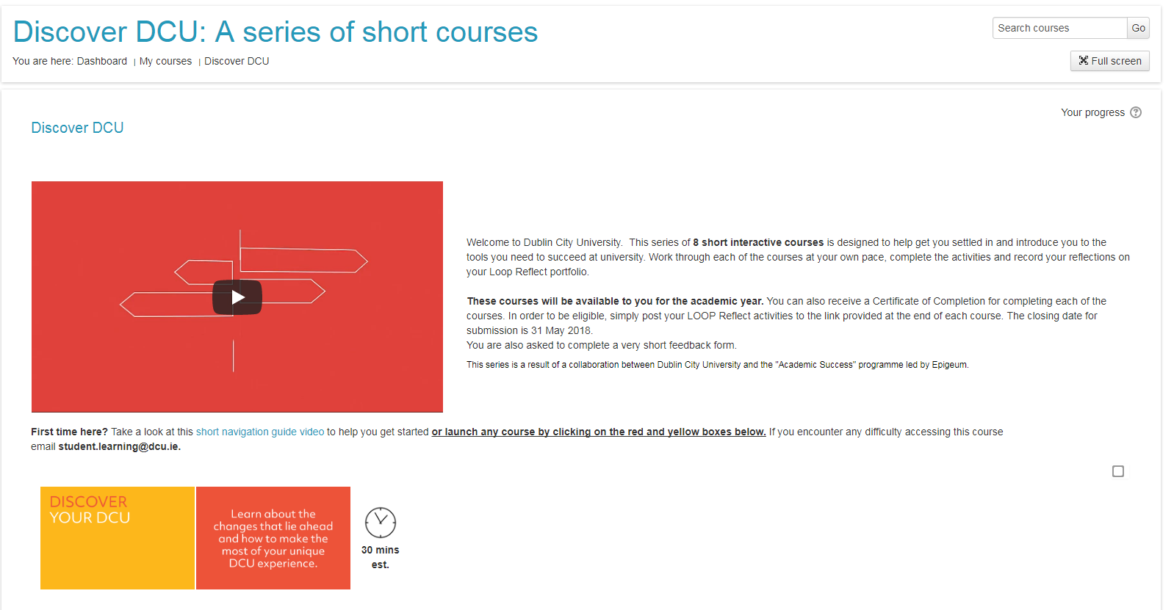

Slide 4
Learning outcomes
Identify the difficulties in navigating academic text
Know what to read
Know how to find readings
Learn a proven reading method
Practice!

Slide 5
Issues
2 minute chat
What difficulties can occur in reading academic texts?

Slide 6
Selecting What To Read
Group Brainstorm
How do we know what to read?

Slide 7
Selecting what to read; reading list
Notes:
How to negotiate essential and further reading – choosing and selecting thwetexts to go through rather than wading through them all.

Slide 8
Selecting what to read; other ways
Tips in class
Ask lecturer
Library subject guides
Database search
Subject librarian
Reference list of a recommended textbook/reading
Notes:
There are many ways to select what to read – as you progress through college you will have to source more and more readings yourself with less guidance.

Slide 9
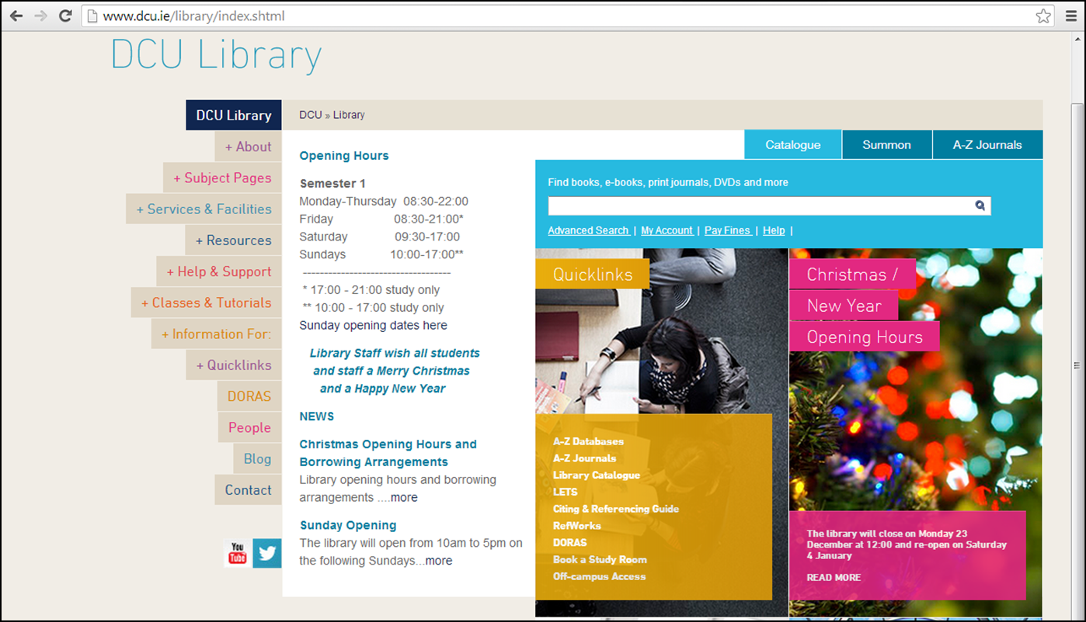
Finding what to read; the library
Notes:
Go to library webpage and show students how to use the subject pages and databases.

Slide 10
Reading techniques
Survey
Question
Read
Recall
Review
= SQ3R
Source: Robinson (1978); as cited by University of Notre Dame (2017)
Notes:
Give students SQ3R hand-out. Use flipchart board to go through each letter in order – S-Q-R-R-R
SQ3R Technique
(Read with a purpose, focus, make notes)
S – survey: what is this reading material about – cues to get a quick overview
Q – question: why am I reading this?
R – read: read one paragraph
R – recite: what have I just read?
R – Review: read whole passage/chapter & review

Slide 11
Practice!
Notes:
Provide the group with a hand-out of an article to read using the SQ3R method.

Slide 12
Reading technology
Claroread screen reading technology available from the ISS website.
Notes:
Claro Read freely available to all DCU students. Go to you tube demo to show how it works.
Or use your iphone or tablet – apps available that function like Claro Read e.g. Azzapt. Or simply record yourself reading and listen back.

Slide 13
Top 5 take home points
Start reading now!
Use your reading list to its full potential
Use databases for web search
Try the SQ3R method
Embrace technology

Slide 14
References
Claro Software 2014. Claroread for PC overview video [Online]. Available from: https://www.youtube.com/watch?v=7gFy7o9vqMM#t=107 [Accessed 28 August 2014].
DCU 2014. DCU library [Online]. Available from: http://www.dcu.ie/library/index.shtml [Accessed 28 August 2014].
Robinson, Francis Pleasant (1978). Effective Study (6th ed.). New York: Harper & Row.
University of Notre Dame (2017). SQ3R reading technique. Available at: http://library.nd.edu.au/studyskills/reading (Accessed 12 October 2017).

