Slide 1
Revision Strategies
Student Learning

Slide 3
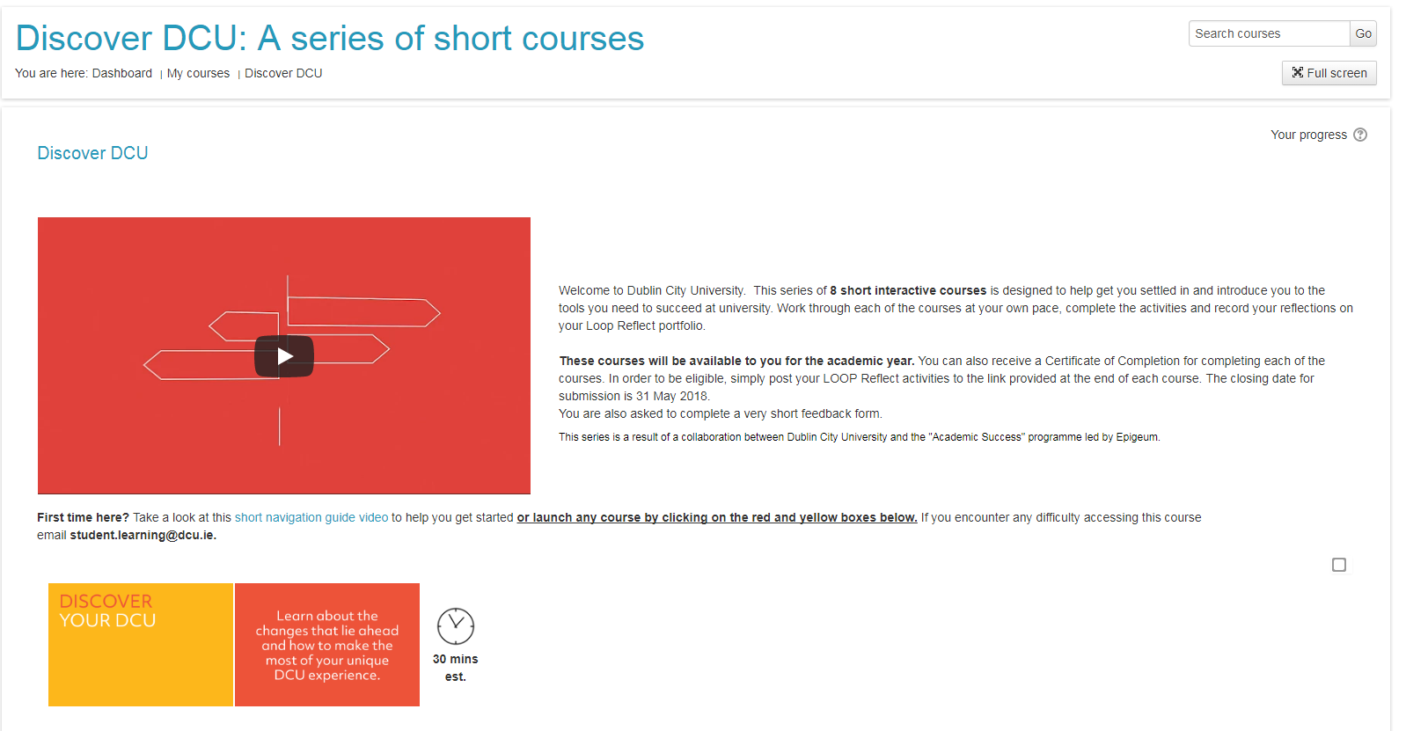

Slide 4
Steps to success
WHAT to study
WHEN to study it
HOW to study it

Slide 5
1. WHAT

Slide 6
Look up the module specifications
Notes:
http://www.dcu.ie/registry/modules.shtml

Slide 7
Learning Outcomes
e.g. social psychology 2014-15
Notes:
http://www.dcu.ie/registry/module_contents.php?function=2&subcode=NS123
e.g. social psychology 2014-15

Slide 8
Topics
Notes:
http://www.dcu.ie/registry/module_contents.php?function=2&subcode=NS123
e.g. social psychology 2014-15

Slide 9
Reading List

Slide 10
Prioritising
Use past exam papers
http://www.dcu.ie/internal/examinations/papers.php3
Link questions to areas of the course
Work out the minimum number of topics you need to revise for each paper
Find the common thread!

Slide 11
Past Papers
Social psych 2013

Slide 12
Revision Plan
Module: Social Psychology
1)Attitudes and Behaviour Change
Lecture notes
Tutorial notes
Textbook chp 1
Ajzen (2005)
Exam Papers 2013, 2012, 2011
2)Group Processes
Lecture notes
Textbook chp 4
Aronson(2011)
Kenrick et al (2010)
Exam Papers 2013, 2012, 2011
Notes:
See handout

Slide 13
2. WHEN

Slide 14
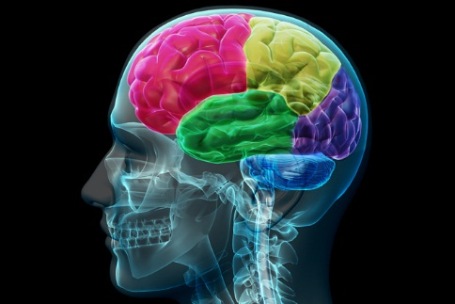
The science of procrastination
Unhappy feeling
Shift attention to more pleasant task
Feel happy (temporarily)
Habit formed
Source: Oakley, Sejnowski, & Judd (2016).

Slide 15
Use lists
Set goals!
To do;
Read over lecture 3 developmental psych and make notes (1 hour)
Print exam papers for module 1 and 2, file in ring-binder (45 minutes)
Download mindjet and practice 1 mind map from notes made earlier (1 hour)
Ask Sharon to test me on my notes learnt earlier (30 minutes)
Specific
Manageable
Action-based
Realistic
Time limited

Slide 16
Timetable
time | mon | tues | wed | thurs | fri | sat | sun
9.00
10.00
11.00
12.00

Slide 17
Short study periods
25 minutes study
5 minutes break
Source: Cirillo (2017)

Slide 18
3. HOW
Notes:
Discuss with partner; How do you commit information to memory?

Slide 19
Reflection
What study techniques do you currently use?

Slide 20
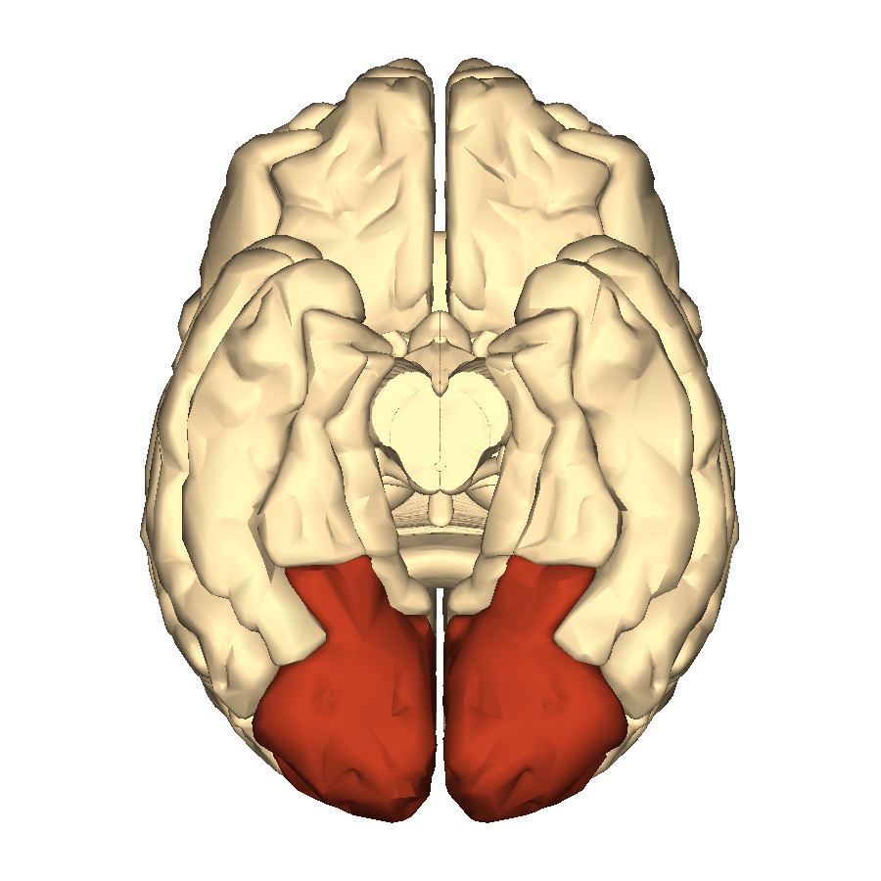
Visual Strength
You will remember this info easier than lists of people, dates or information
Extremely developed visual memory – evolutionary basis
Source: Oakley, Sejnowski, & Judd (2016).

Slide 21
‘Hooks’
Use your visual and auditory strengths to ‘hook’ learning material onto!

Slide 22
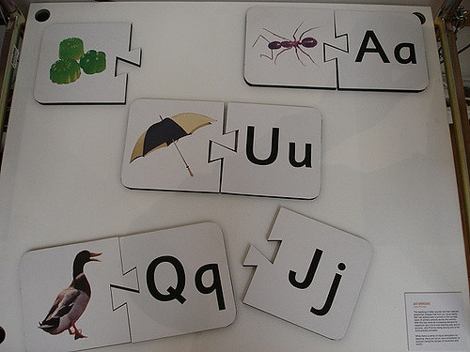
Example
The child is learning the letters through images, sounds and movement

Slide 23
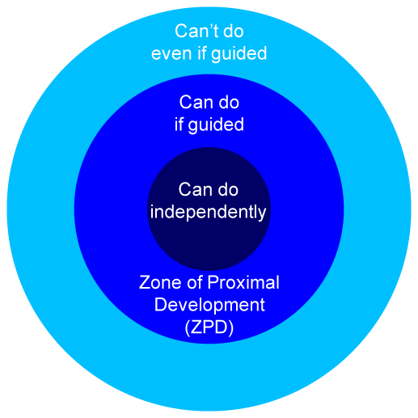
Flashcards
Z.P.D.
Zone of proximal development: difference between what a learner can do without help and with help
Z.P.D.

Slide 24
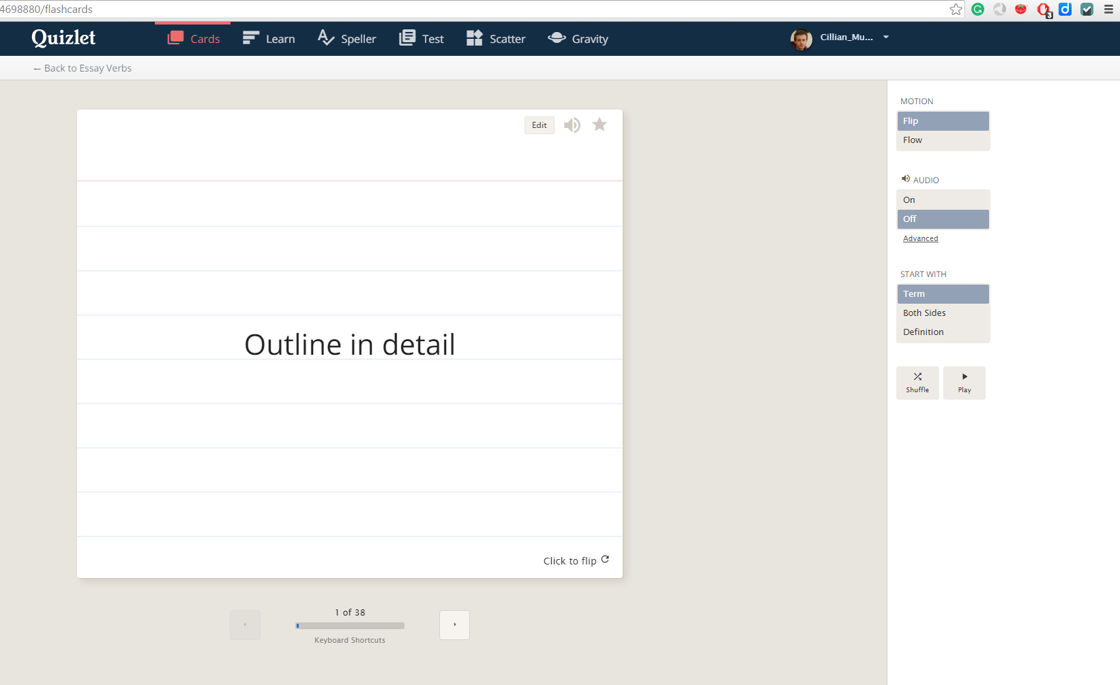
Quizlets

Slide 25
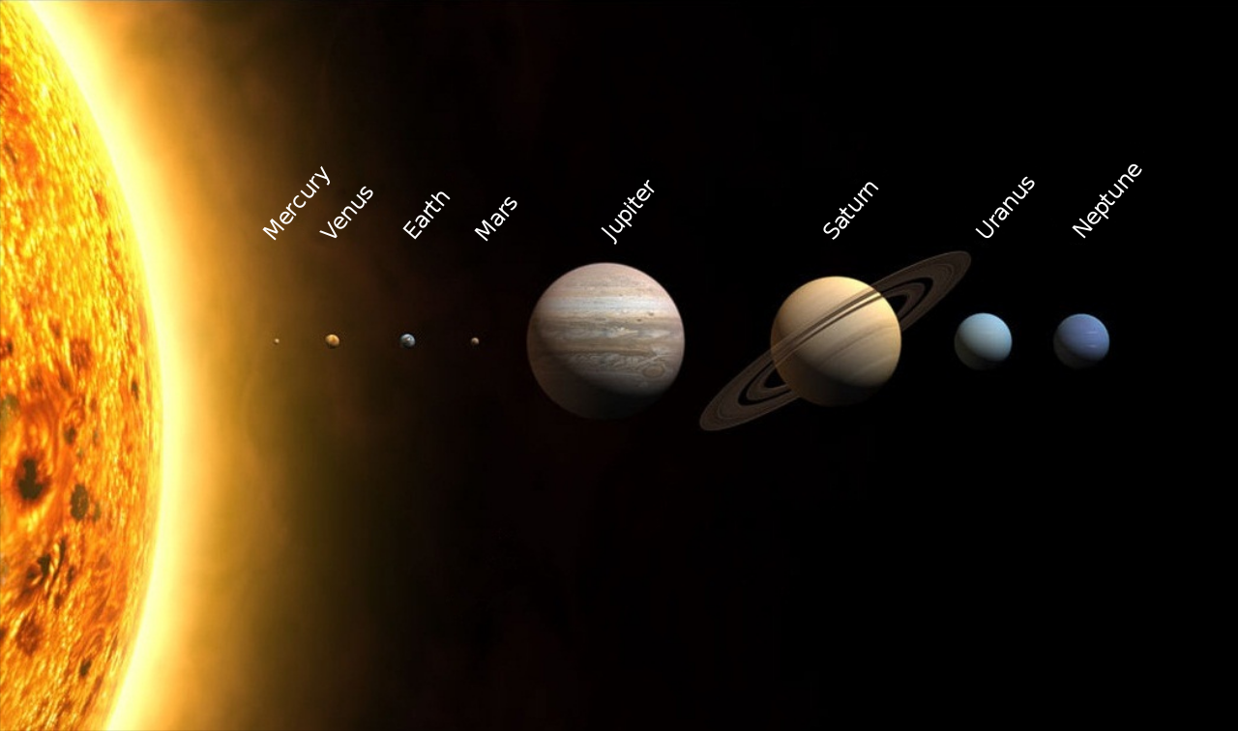
Meaningful groups to simplify material
My Very Easy Method Just Sums Up Nine Planets

Slide 26
Recall better than recitation
Don’t just read over notes!
Summarise!
Test yourself!
Cohen, Kim, Tan and Winkelmas (2013): students who completed a task requiring them to restructure their notes and submit a summary of them achieved on average 11 percentage points higher in the module examination
that’s one whole grade!!

Slide 27
Combine a mixture of memory strategies
Look at it
Repeat it with rhythm
Write it
Number it
Give it a shape
Turn it into
a diagram
Say it aloud + record
Video it
Draw it
Colour it
Act it out

Slide 28
Summary; steps
WHAT to study
WHEN to study it
HOW to study it

Slide 29
References
Cirillo Company (2017). What is the pomodoro technique [Online]? Available from: https://cirillocompany.de/pages/pomodoro-technique [Accessed 11 October 2017].
Cohen, D., Kim, E., Tan, J. & Winkelmes, M. (2013) A note-restructuring intervention increases students’ exam scores. College Teaching , 61(3), pp. 95-99.
Oakley, B., Sejnowski, T. & Judd, B. (2016). Learning to learn: powerful mental tools to help you master tough subjects [Online]. Available from: https://www.coursera.org/learn/learning-how-to-learn#creators [Accessed 16 September 2016].

