Slide 1
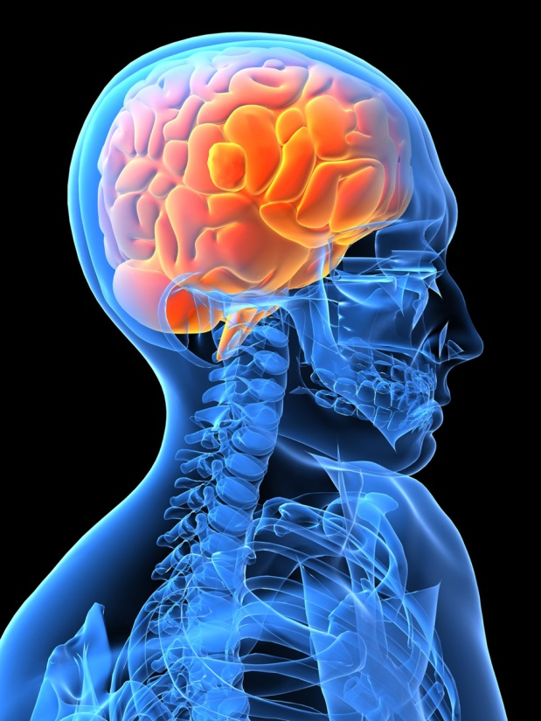
“I Don’t Think That Way”
Student Learning
Learning Styles
www.dcu.ie/studentlearning

Slide 2
Learning Objectives
Understand what a learning style is
Comprehend multiple intelligences
Understand how we learn best
Know how to study to our strengths

Slide 3
What is a learning style?
“Specified patterns of behaviour and/or performance according to which the individual approaches a learning experience; a way in which the individual takes in new information and develops new skills”
(Sarasin 1999; p. 1)

Slide 4
Multiple Intelligence Theory
Intrapersonal
Bodily / kinaesthetic
Musical
Visual/spatial
Interpersonal
Logical / mathematical
Linguistic
Notes:
Are people familiar with the idea of IQ? What do you think it measures? What do people think about multiple intelligence theory – do you believe it? What do you think you’re strongest on?

Slide 5
Reflection
Think back to primary or secondary school. Who was your favourite teacher? Why?
Notes:
Now we have to think about how learning styles relate to our education. Let’s take a moment and think backwards. Pass a soft beanbag around the group, to maybe 5-10 people who answer the question. Draw from the students that their favourite teachers were active, got out to explore the environment etc, not just learning by sitting at a desk

Slide 6
How do you study best?
Chat to the person next to you – when you were studying for the leaving cert/past exams etc, what methods worked for you?

Slide 7
VARK (1)
VARK learning questionnaire
Identifies individual’s learning strengths along 4 modalities
Identifies what works best for you as an individual to guide your learning

Slide 8
Vark (2)
Complete a VARK Questionnaire

Slide 9
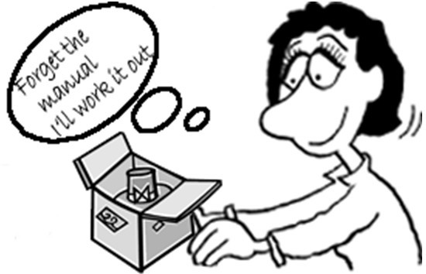
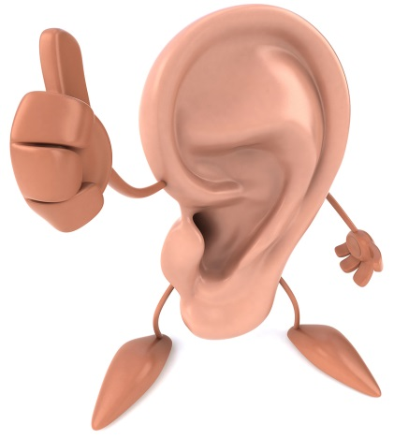
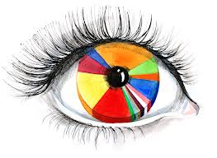
The Modes (1)
What type of learner are you?
Notes:
Go through each style, asking how many people fell in this category, was it accurate etc. Go through what each style means.

Slide 10
The Modes (2)
In groups of 4, come up with some ideas for methods that will work with different types of learners
Notes:
Go through each style, asking how many people fell in this category, was it accurate etc. Go through what each style means.

Slide 11
Top 5 take home points
Everyone learns differently
Be your own favourite teacher
Remember your learning mode
Embrace the methods that work for you
Effective learning is more than just reading and writing

Slide 12
References
Gardner, H. 2004. Frames of mind: the theory of multiple intelligences. New York: Basic Books.
Sarasin, L. C. 1999. Learning style perspectives: impact in the classroom. Madison, WI: Atwood Pub.
VARK 2014. The VARK questionnaire [Online]. Available from: http://www.vark-learn.com/english/page.asp?p=questionnaire [Accessed 28 August 2014].

