Slide 1

Student Learning
‘Take Charge’
Time Management
www.dcu.ie/studentlearning

Slide 2

Learning Objectives
Identify the difficulties in your time management
Beat procrastination
Plan your time
Set achievable goals

Slide 3


Time management and procrastination
scheduling your time
goal setting
prioritizing what to do
analysing your time
organizing workspace
keeping focus
motivating yourself
The opposite!

Slide 4
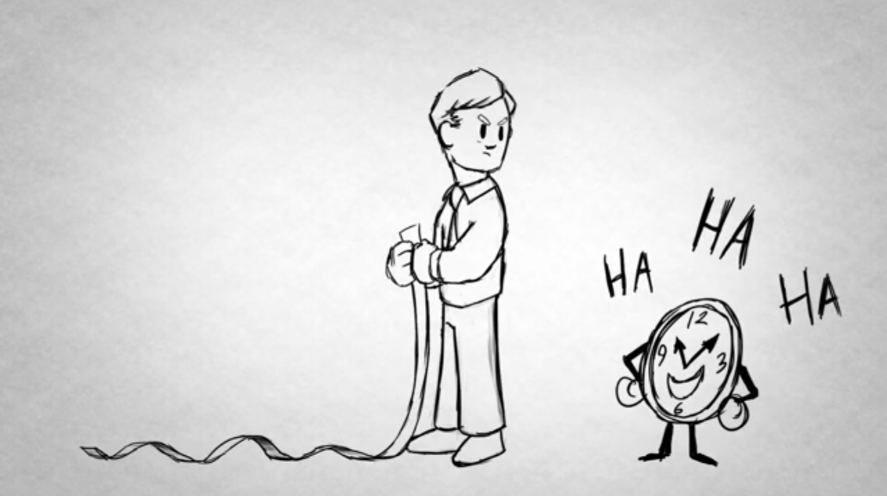
What are the difficulties in managing your time?
Notes:
Here’s a technique to help you analyse your difficulties! RAC – record – analyse – chan. Discuss worksheet handed out. http://www.youtube.com/watch?v=VUk6LXRZMMk

Slide 5
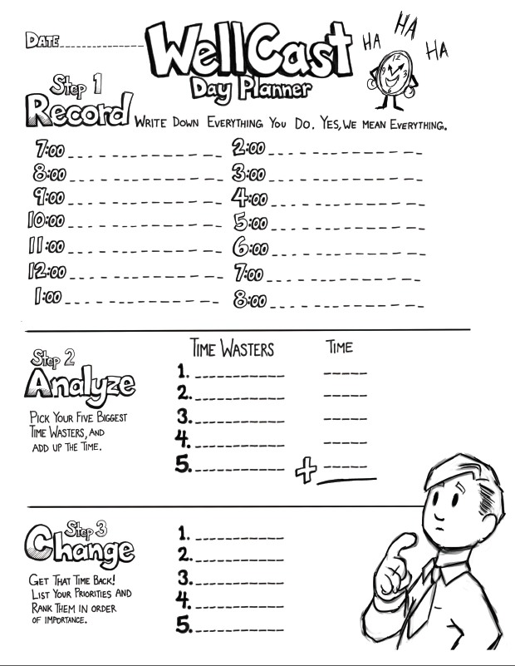
Diagnose your difficulties

Slide 6
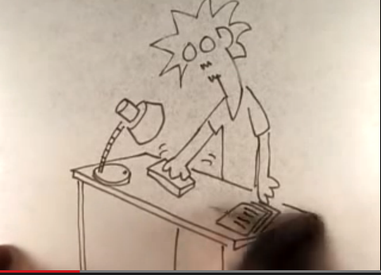
Procrastination
3.5 million youtube hits!
Notes:
https://www.youtube.com/watch?v=4P785j15Tzk&list=PLBFC28BC766E0B638

Slide 7
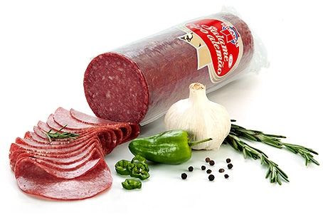
Strategies to prevent procrastination
Take action
Salami technique
Five minutes
Work on related tasks
Do the hardest bits first
Set goals
Reward yourself for achievement
Make commitments
Change subjects regularly

Slide 8
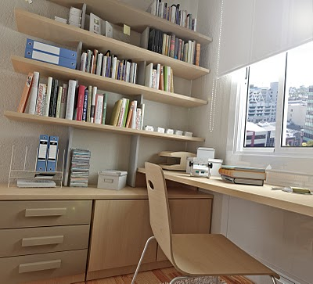
Control the environment
Structure study environment
  library
  home
Establish a routine
Physical changes
  E.g. unplug TV!

Slide 9

The lure of Facebook….
Anyone ever have any difficulties with this? How do you overcome them?
Notes:
Disable wi-fi
Leave phone at home
Budget in Facebook time in your daily plan

Slide 10
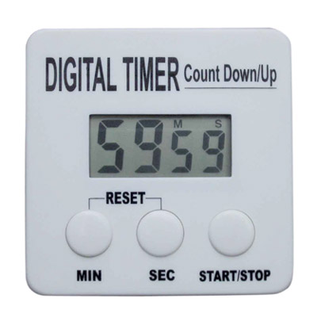
Schedule
Limit your web access using a stopwatch/timer on your phone
Notes:
We concentrate for maybe 20-30 minutes at a time. Use these parcels of time, with short breaks in-between.

Slide 11
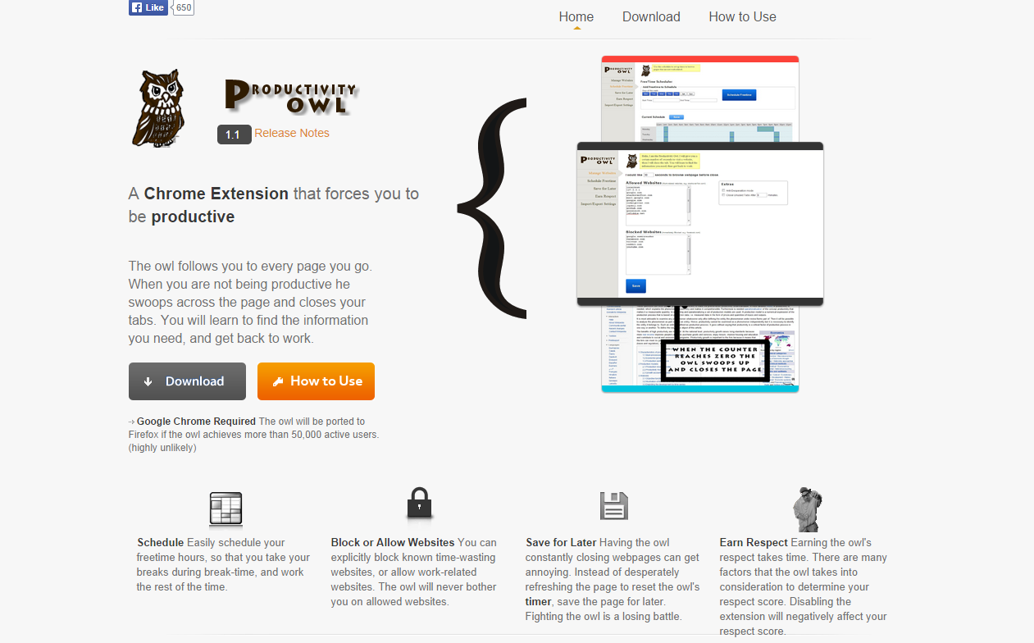
Productivity Owl
Notes:
Free software to help you keep focused on the internet.

Slide 12
Organise your term
 | Week 1 | Week 2 | Week 3 | Week 4 | Week 5
Jan
Feb
Mar
Apr
Create a yearly planner – use gmail calendar/
mind map/
pen and paper
Sync calendars:
http://www.dcu.ie/iss/video/google/gcal/ProgrammeTime.shtml

Slide 13
Organise your week
time | mon | tues | wed | thurs | fri | sat | sun
9.00
10.00
11.00
12.00

Slide 14


Activity
Mark in on a weekly calendar when you are busy this week
  Include lectures, social engagements, part-time work, sports/societies commitments etc
Can you find time in the week which you could put towards study?
  Highlight these hours with a highlighter or pen

Slide 15


SMART goals
Remember to break the task down
Activity:
Now make sure your to-do tasks are SMART goals
Notes:
http://www.youtube.com/watch?v=1-SvuFIQjK8

Slide 16
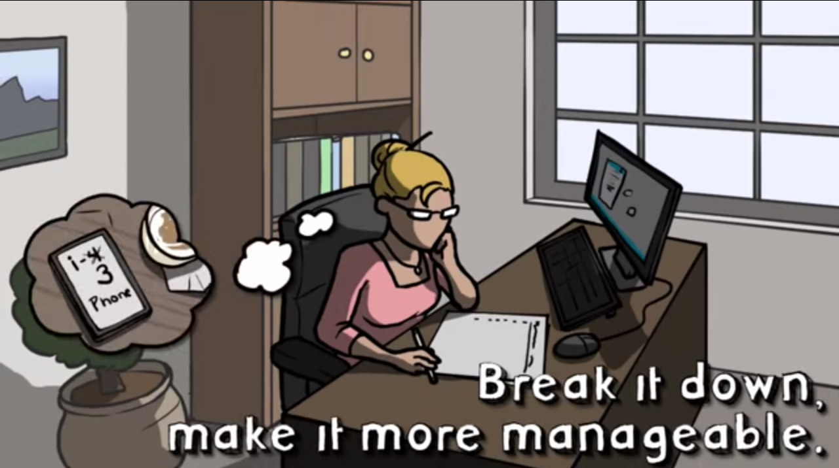
How to create a to-do list
Notes:
http://www.youtube.com/watch?v=fjjKuoeYP5A
Activity: Create a to-do list for tomorrow, and prioritise the tasks

Slide 17
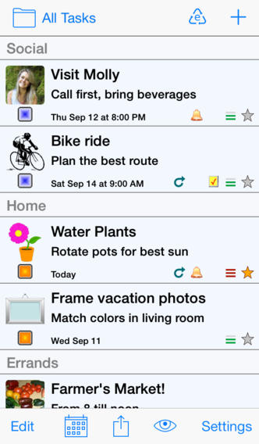
To-do list
Check out the ‘Errands’ app (ios) or ‘Any Do’ (android)
To Do | Priority
e.g. lecture notes

Slide 18
Organise your week (2)
time | mon | tues | wed | thurs | fri | sat | sun
9.00 | Psych L1 read notes and create mind-map
10.00
11.00

Slide 19

Activity (2)
Plan out SMART goals for tomorrow
3 mins
Now turn to your small group:
  How did it work?

Slide 20
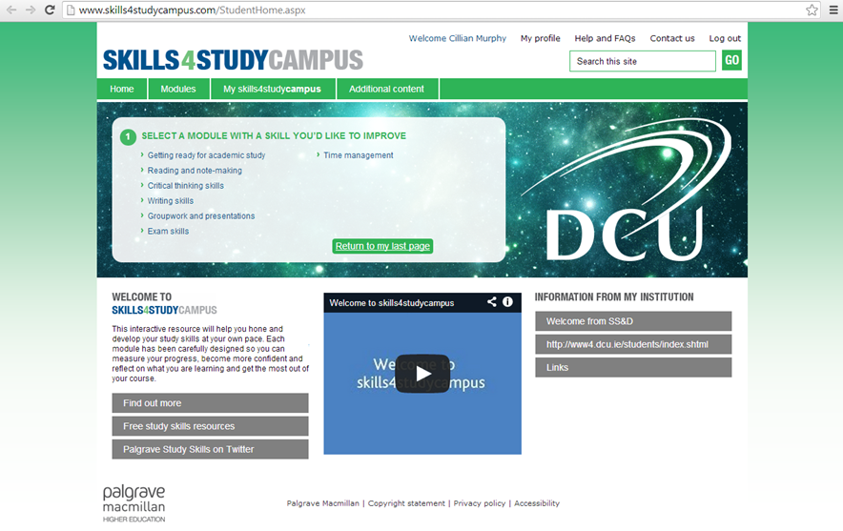
Further resources

Slide 21
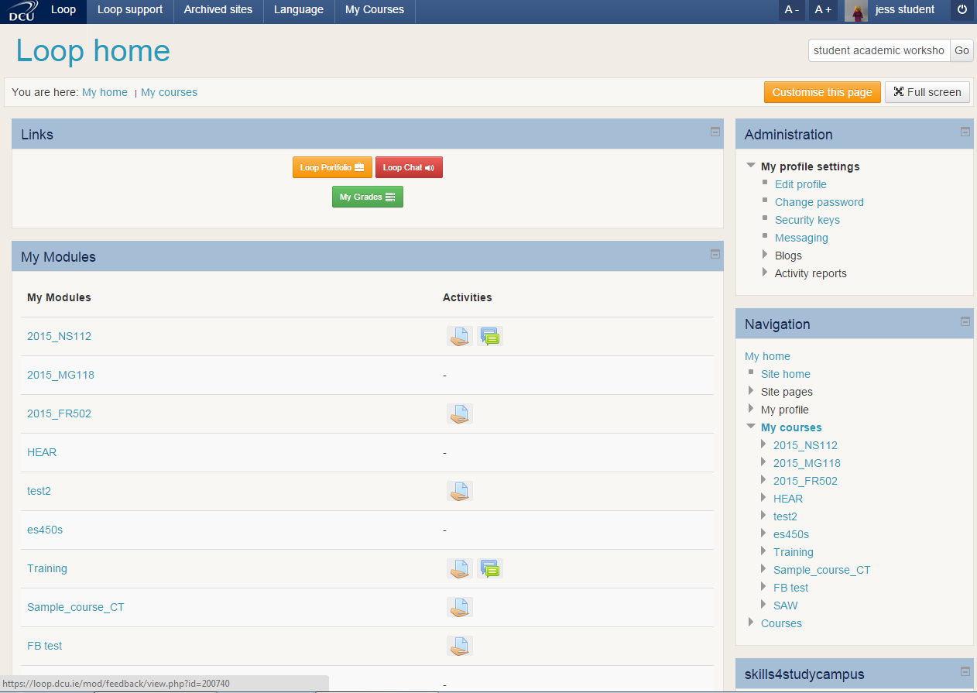
Access these slides through loop

Slide 22

Summary
Control your environment
Tackle procrastination
Use a calendar
Be SMART!

Slide 23
References
Any Do 2014. Make things happen [Online]. Available from: http://www.any.do/ [Accessed 28 August 2014].
Productivity Owl 2015. Productivity owl [Online]. Available from: http://www.productivityowl.com/ [Accessed 14 January 2015].
Skills4Study Campus 2014. Time Management [Online]. Available from: http://www.skills4studycampus.com/StudentHome.aspx [Accessed 28 August 2014].
Yoctoville 2013. Errands to-do list [Online]. Available from: https://itunes.apple.com/ie/app/errands-to-do-list/id318095638?mt=8 [Accessed 28 August 2014].

