Slide 1
‘To Take Or Not To Take’
Student Learning
Note Taking
www.dcu.ie/studentlearning

Slide 2
Learning objectives
Why we should take notes?
Discuss filing options
Explore what to do before, during and after a lecture
Learn different methods of note-taking
Consolidate the learning!

Slide 3
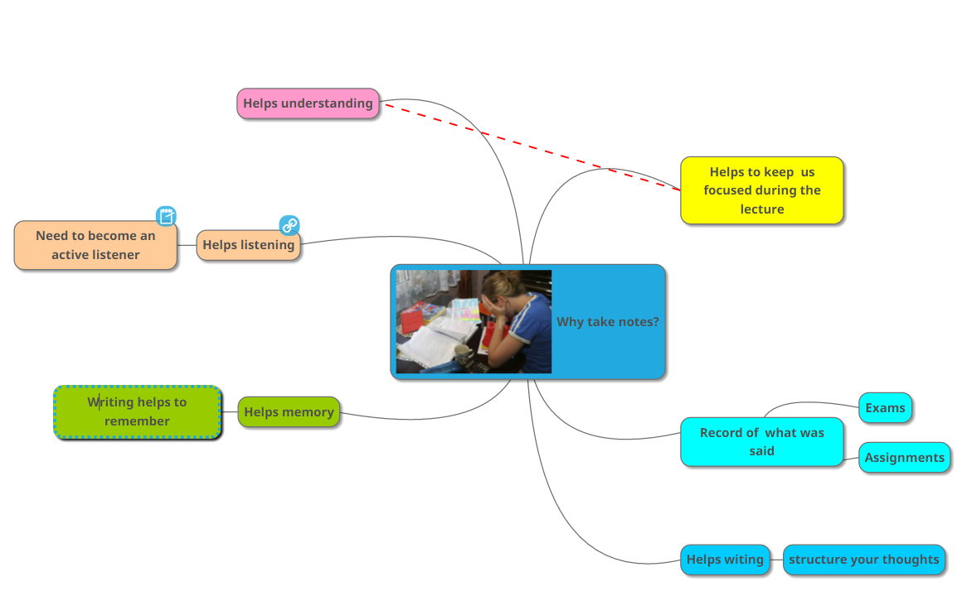
Why take notes?

Slide 4
1. Why take notes?
Turn to the person next to you
Why should you take notes?
What difficulties do you experience in taking notes?
Notes:
Take feedback from group, put onto flipchart

Slide 5
2. Filing options
Put in place a filing system that breaks each module down by topic
Keep materials together under each topic from the start
Digital or paper

Slide 6
Know the module - module specifications
Notes:
http://www.dcu.ie/registry/modules.shtml

Slide 7
Learning Outcomes
e.g. social psychology 2014-15
Notes:
http://www.dcu.ie/registry/module_contents.php?function=2&subcode=NS123
e.g. social psychology 2014-15

Slide 8
Topics
Notes:
http://www.dcu.ie/registry/module_contents.php?function=2&subcode=NS123
e.g. social psychology 2014-15

Slide 9
Reading List

Slide 10
Past Papers
Social psych 2013

Slide 11
3. The key to note taking success
Before
During
After

Slide 12
Before the lecture
Group brainstorm! What could you do before a lecture to get the most out of your note-taking?

Slide 13
Before the lecture – top 5 tips
Read previous lecture notes
Download & read new lecture notes from Loop.
Formulate questions to answer
Prepare your note-taking material e.g. use a separate notebook for each module.
Arrive 3-5 mins before the lecture.

Slide 14
4. Note-taking methods
Several methods of note-taking frequently used;
Annotating powerpoint
Linear/prose style
Mind map
Cornell notes
Notes:
Quick feedback question; what do students use at present? Typically linear/prose style

Slide 15
Annotating powerpoint
Highlight important slides
Add detail

Slide 16
Linear/prose style
Notes:
Do people use this? Does it work? What type of things do you take note of?

Slide 17
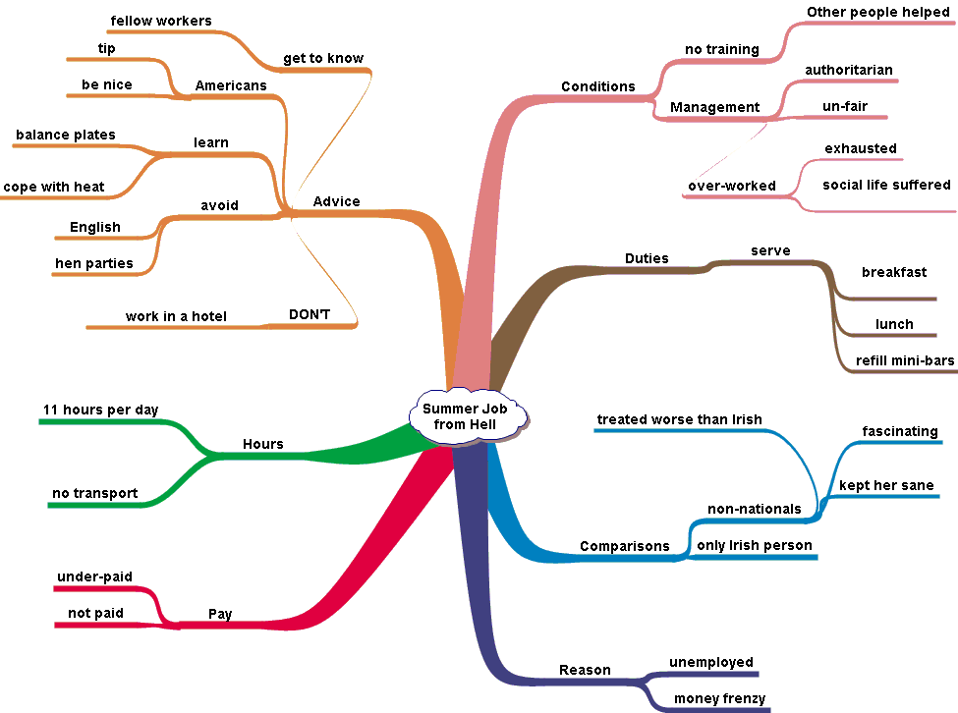
Mind map

Slide 18
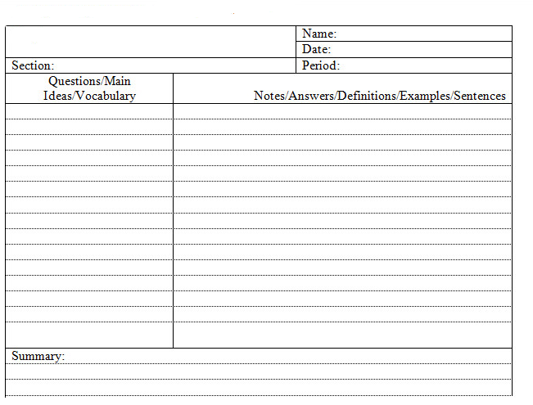
Cornell style
Dedicated notebook
Date, module etc listed
https://www.youtube.com/watch?v=WtW9IyE04OQ
Notes:
https://www.youtube.com/watch?v=WtW9IyE04OQ
Or https://www.youtube.com/watch?v=Y4uzQEWj0X8

Slide 19
Abbreviations & Symbols
Only in notes, not assignments / exams
Abbreviations
experiment | expt
Education | ed
Curriculum | curr
Probably | prob
support | supp
exercise | exer
strategy | strat
Important | NB
Symbols
Increase / goes up / rises
Decrease / lowering
leads to, produces, causes, makes
comes from, is the result of

Slide 20
5. Consolidate your learning!
Cohen, Kim, Tan and Winkelmas (2013): students who completed a task requiring them to restructure their notes and submit a summary of them achieved on average 11 percentage points higher in the module examination
that’s one whole grade!!
Notes:
Whatever style you choose – be organised! Have an individual notebook for each module. Label each lecture clearly.

Slide 21
Helpful Hints
Need to take notes in a way that is meaningful to you
Develop a positive attitude towards lectures
Keep notes brief - phrases
Leave spaces
Make just ONE set of notes
Number pages
Use abbreviations, headings and colour

Slide 22
Study!
Remember
You must study your notes!

Slide 23
Further resources
Notes:
Link to youtube video:
http://www.youtube.com/watch?v=DGUmF77Puoc

Slide 24
Access these slides on our website

Slide 25
Summary
Before
During
After

Slide 26
References
Cohen, D., Kim, E., Tan, J. & Winkelmes, M. (2013) A note-restructuring intervention increases students’ exam scores. College Teaching , 61(3), pp. 95-99.
Desrochers, J. 2012. How to take Cornell notes [Online]. Available from: https://www.youtube.com/watch?v=WtW9IyE04OQ [Accessed 28 August 2014].
Skills4Study Campus 2014. Reading and note-making [Online]. Available from: http://www.skills4studycampus.com/StudentHome.aspx [Accessed 28 August 2014].

