Slide 1
The Interoperability Lab
Towards a sandpit for interoperability
Dr Pamela Hussey and Dr Subhashis Das

Slide 2
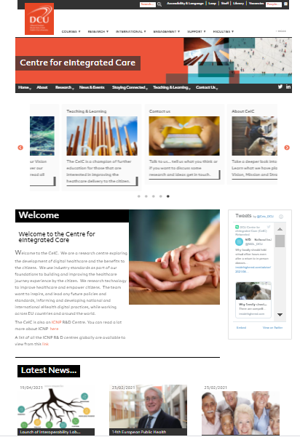
Access to the Lab Resource
Is through the CeIC website in DCU
https://www.dcu.ie/ceic
Follow the prompts to the development area and the required password to link into the resource.
Notes:
The interoperability lab resource is accessible through the DCU Centres website and a required password is required. This password may change from time to time so will provide the detail on the webpage which we have included here on this slide.

Slide 3
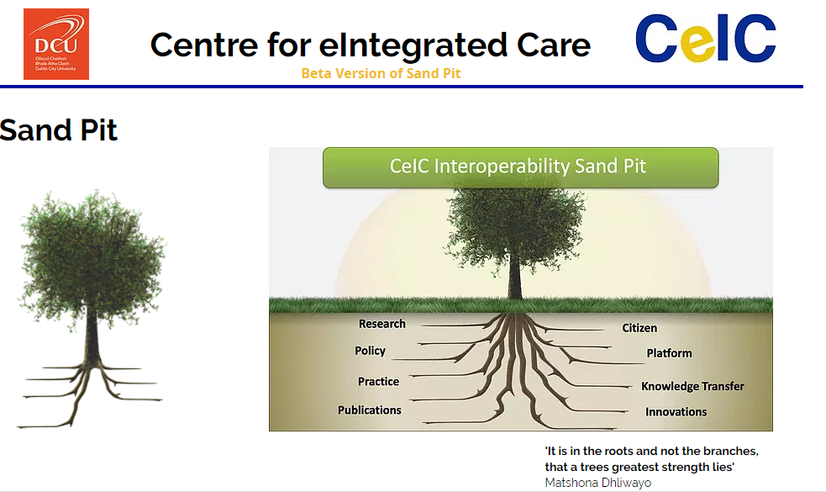
Sections on the Resource
Notes:
We call the resource an interoperability sandpit as in the future we will be working with our public service providers to progress an interoperability sandbox providing a safe isolated environment that replicates an end user operating environment. These public service resources provide a space where you can run code, observe and test performance. In this online resource we provide eight distinct sections. We present a visualisation of the sections as roots on a tree structure which supports the idea that for true interoperability to succeed a multi layered approach is required. In this micro credential we will visit and explain each layer. Suffice to say at this stage if any of the layers are not understood and addressed it is difficult to achieve interoperability for digitalisation of health and social care.

Slide 4
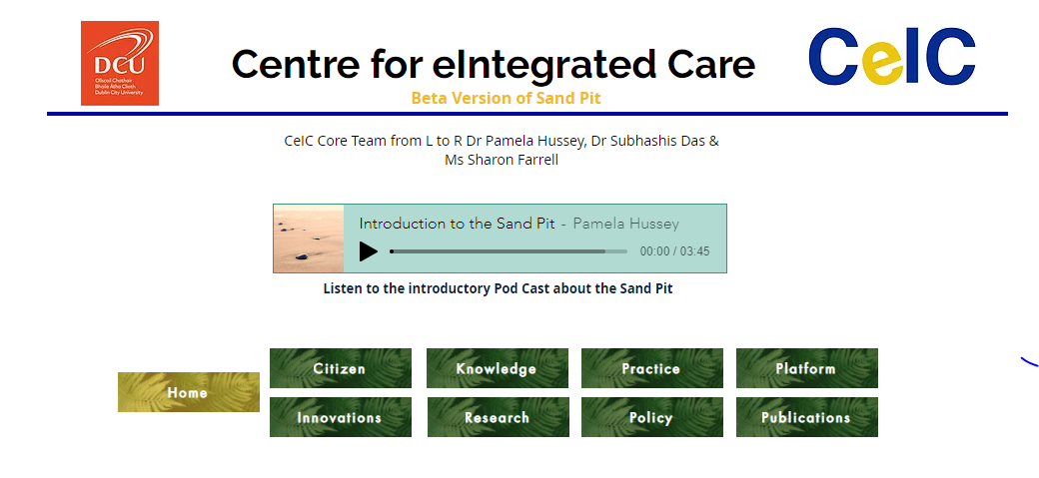
Eight Sections
Notes:
The eight sections are accessible at the end of each page of the online resource. On this home page I have also included a short podcast on the use of the resource for general access.

Slide 5
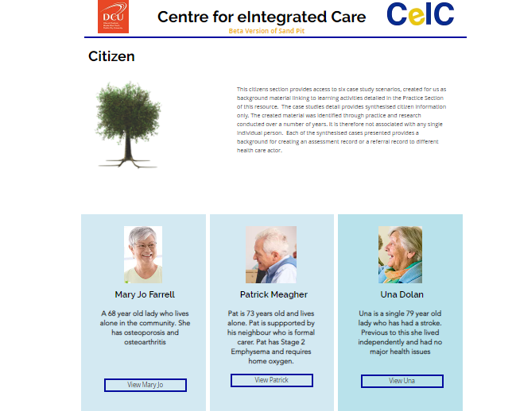
Citizen Information
Notes:
The citizen information is provided here for participants to review and consider. The cases included are synthesised cases which are based on research conducted over the years. Each of the cases presents an opportunity to progress with a small discrete use case for this micro credential, alternatively you can consider developing a use case from your existing role of practice. For example Mary Jo suffers with pain from her diagnosis of osteoarthritis and osteoporosis. A small use case on a prescription for pain medication or creation of food diary might be useful to consider in this particular citizen case.

Slide 6
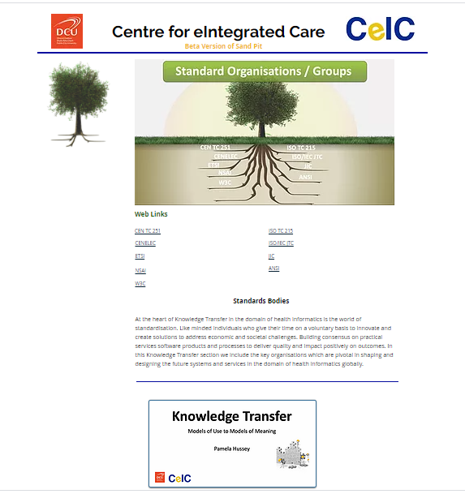
Knowledge Transfer
Notes:
The knowledge transfer provides detail on standards organisations and groups which are driving the agenda globally to advance interoperability and eHealth at a national and regional level. In the micro credential we will discuss the standards work that we are involved with and signpost you to specific standards which we consider are relevant and useful to the interoperability challenge. It is important to note that not all standards group are listed here just the main standards development organisations (SDO’s) that we are involved with and using open source resources from. We also include in this section a powerpoint presentation on Models of Use and Models of Meaning and why we need to distinguish between the two.

Slide 7
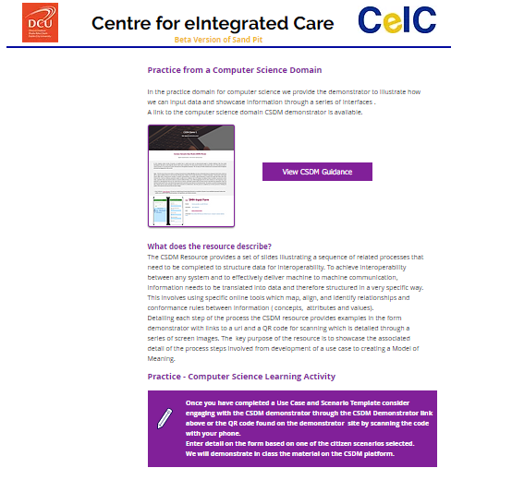
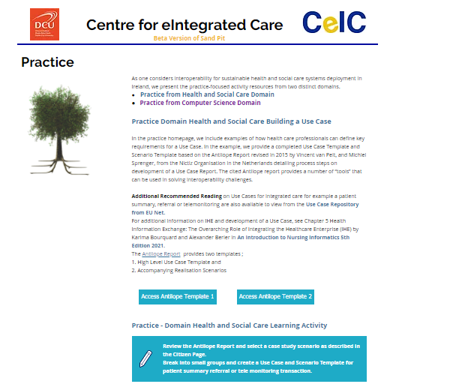
Practice: From clinical practice to computer science practice
Notes:
In the practice section we provide resources to progress with a citizen centric use case. We recommend selecting a small bounded example such as a referral prescription or food diary to progress with an associated data set in this micro credential. There are a number of links on this site for participants to review. For example there is a link to the Antilope Report revised and published in 2015 by the EU Authors were Vincent van Pelt, and Michiel Sprenger, from Nictiz, in the Netherlands. The Antilope Report was part of the Antilope project entitled “ANTILOPE - Adoption and take up of standards and profiles for eHealth Interoperability”.
Available from this link https://www.antilope-project.eu/wp-content/uploads/2013/05/D1.1-Refinement_of_Antilope_Use_Cases_v1.2.pdf

Slide 8
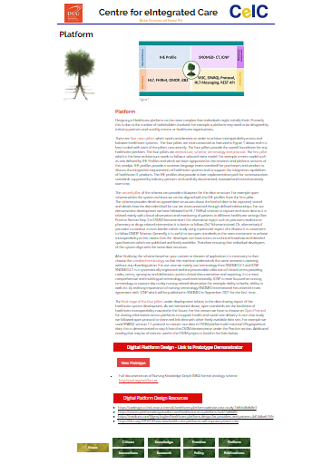
Platform
Notes:
The platform section provides a link to a demonstrator created by Dr Subhashis Das as part of
the Elite S Adapt Research Project. The demonstrator uses a FHIR based schema designed for use with new technologies to message information across and between service providers for shared care. The platform section also provides work completed on a nursing knowledge graph underpinned by an owl based ontology to progress standards for continuity of care.

Slide 9
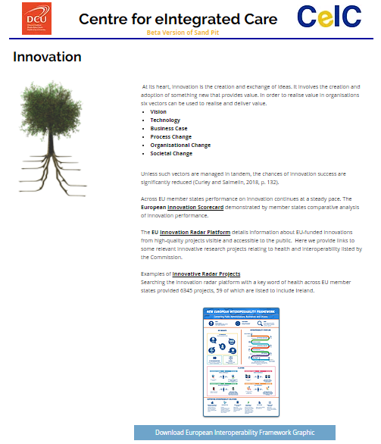
Innovation
Notes:
The innovation section offers a snap shot of the latest development in digitalisation of health from the European Union . It presents access to the strategic plans in flight across the EU and provides examples of award winning programmes of research, which our colleagues in the University of Trento are engaged with. This section also includes a link to the European Open Data Space an exciting new initiative which forms part of the new digital strategy of the Commission.

Slide 10
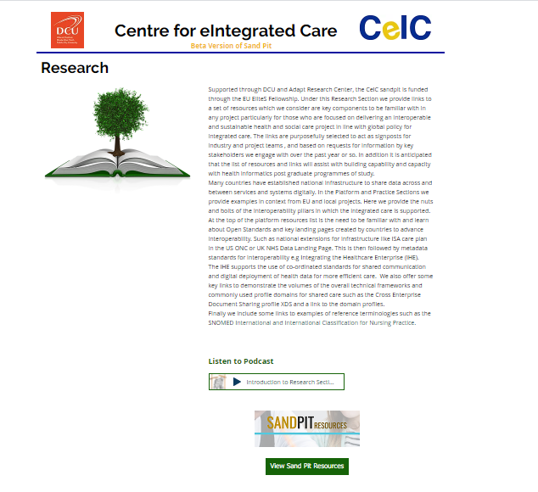
Research
Notes:
The research section of the interoperability lab and sandpit provides a podcast and set of detailed links and resources which we will discuss in class. A number of the resources are signposted on specific weeks as part of the reading list for this micro credential (weeks 4-7). Tools and resources which we have found useful to inform the Common Semantic Data Model (CSDM) research project with our clinical and social care partners in St Michaels House in Ballymun through the Marie Curie Elite S Research project from 2020-2022 are included in this section.

Slide 11
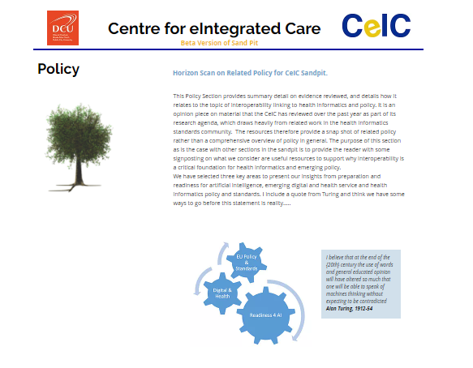
Policy
Notes:
The policy section offers a brief reflection using a PESTEL analysis on the current thinking from global leaders and policy analysts on technologies of the future and what the key perspectives are on such technologies in regards to interoperability.

Slide 12
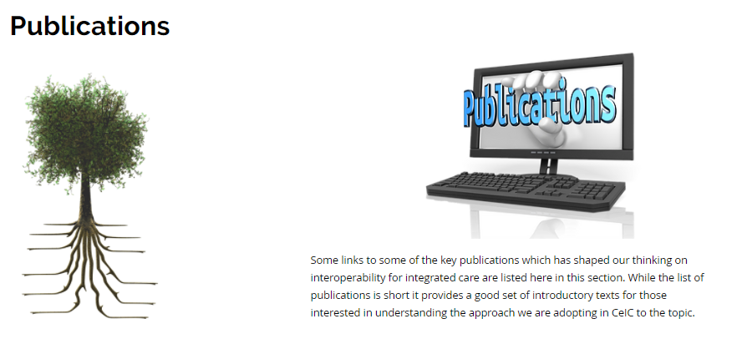
Publications
Notes:
The eight and final section on publications provides the core reading material for this resource which has informed the thinking behind the material included. This publication list provides seminal material and latest copies of texts which we would recommend reading.

