Slide 1
Mentoring Programme 2020 - 2021

Slide 2
Welcome to the 2020-2021 Structured Mentorship Programme
Overview of the Mentorship Programme
Challenges of Mentoring through Covid-19
Some guidelines for Mentors
Resources for Mentors
The desired outcome for the mentees

Slide 3
Overview of Programme
Virtual launch event
Online activities for mentees arranged by the Careers Service and Alumni Relations
Virtual coffees – encourage mentees to have a minimum of three – ideally 5 virtual meetings
Work shadow day during Covid-19
  Ensure you are following Government guidelines
Mentors will be invited along to virtual Closing Event
Closing event in April 2021

Slide 4
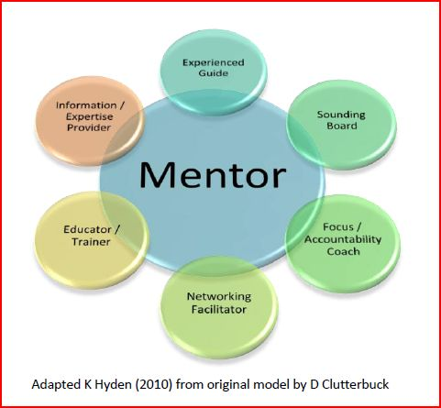
Role of the Mentor

Slide 5
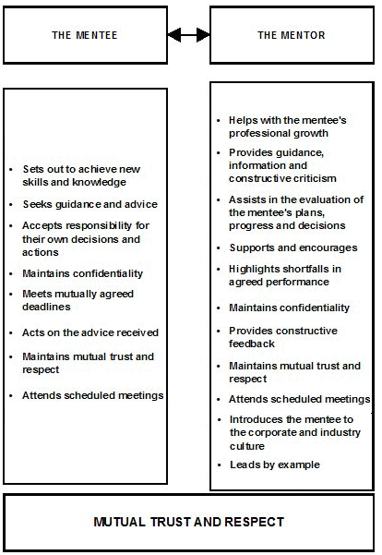

Slide 6
Guidelines for Mentors
Virtual meetings – via Zoom, MS Teams, Skype, Facetime, Google Hangouts etc.
Encourage the mentee to prepare in advance of your meetings
  E.g. emailing you in advance with any questions/challenges they have
The mentee should take ownership of the process – e.g. to contact you at latest 24 hours before meetings to confirm their attendance
Have a plan for communicating agreed in advance – e.g. what happens if one or other of you has to change the time/date of a meeting
Vital to ensure ‘Contracting’ up front and setting the expectations of both parties can avoid misunderstandings arising
Explain that there may be a degree of discomfort at times as they expand their Comfort Zone.
Do remember – while these guidelines may assist the process – each individual is unique, so don’t be afraid to make any amendments you think will benefit your mentee!

Slide 7
Guidelines for Mentors
Trust is vital to the successful mentoring relationship
Confidentiality must be discussed and observed by mentor and mentee
The key messages:
  You know what you are doing
  You are confident in the process
  The mentee is safe in your hands
Remember although you may not be experienced as a mentor this in an invaluable experience for your mentee
Some mentors may be working with students outside their own discipline
  Make sure that your mentee understands the value of the experience
Mentee should contact you to arrange meetings – may be useful to diary them all in advance
You should make contact with the mentee if you don’t hear from them
Escalate to the Alumni Office if there has been no contact

Slide 8
Resources for Mentors
Feedback from past programmes suggests that new mentors have some concerns
  For new mentors, there is help available through the Alumni Relations office should you need support – we have a number of people available to act as a sounding board
Mentors may sign up for a mentor of their own at any point during the programme – by giving your details to the Alumni Relations Office who will give you contact details of your mentor - you may contact them at any stage throughout the process
It may be just a one off contact or you may wish to have a few calls with your mentor
Should you be available to mentor a new mentor – please give your name to Alumni Relations

Slide 9
Relationship between goal clarity and rapport in Mentoring relationship
High Clarity
Open dialogue
Shared expectations
Openness to mutual benefit
Sense of urgency
Task Focussed
Debate rather than dialogue
High Rapport
Low Rapport
Friendship
Lack of direction
Opportunistic in dealing with issues
Short term perspective but….
May be long term relationship
‘Going through the motions’
Low Clarity
(Clutterbuck & Ragins)

Slide 10
Outcomes for Mentees
The Careers Service have introduced a Learning agreement – the mentee will complete a form which you will discuss agreeing to the broad parameters
This covers what have been identified as important skills for the mentee
By the end of the programme the mentee will be expected to have completed a reflective journal on their mentorship experience.
In addition they should complete a minimum of two of the following:
  Work Shadow Day
  CV
  Interview Skills
  Career Action Plan
Mentors will sign off to that effect at the end of the programme

Slide 11
Work Shadow Day during Covid-19
Ensure you are adhering to Government guidelines that will apply at the time
There is an opportunity to be creative around this as it may not be possible to bring your mentee into your workplace
Consider setting up some virtual meetings with some colleagues – approximately half an hour for each
They may wish to have an hour with someone in their specific area of interest
Virtual meetings can be intense - consider 3 – 4 meetings in a day
  It may stretch to a second session
If this is not possible – arrange with your mentee to offer something of value to them – perhaps your HR dept could offer mock interview with some feedback or psychometric testing
Check with your mentee when they have exams or important assignments to avoid unnecessary pressure

Slide 12
Some Pitfalls to Avoid
Placing yourself under too much pressure
  Too much pressure reduces your resourcefulness
Having an agenda
  Strategising (I know what I want them to do – ‘fixing’ the mentee)
Allowing the idea of mentoring suggest superiority or prestige
  Consider if the relationship is more of a privilege for you or your mentee!
Low levels of engagement
  Consider the component parts: Intellectual, Emotional and Enabling
Avoid creating dependency/mutual dependency
  Mentor likes to feel needed – mentee likes ‘feel good factor’ – ‘I’d be lost without my mentor’

Slide 13
Avoiding Pitfalls
Key to avoiding the pitfalls is self awareness
Reflection is a very useful tool
Consider keeping a journal – very useful for new mentees
Prepare in advance of your meeting
Reflect as soon as you can after the meeting
Check in regularly with your mentee to see how mentoring is working for them
Refer to the mentor guidelines document

Slide 14

Questions
Should you have any questions, they can be addressed at the launch event
If you have a question following the launch, your first point of contact should be the Alumni Relations Office

