Slide 1

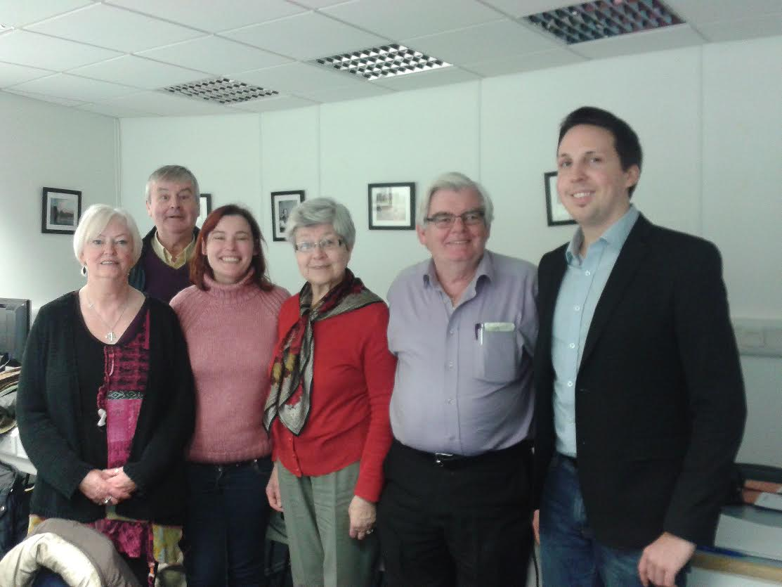




FINGAL SENIOR FORUM NEWSLETTER PROJECT
An Example of Civic Engagement
A partnership between:
Age Friendly University
Initiative DCU (AFUI)
Intergenerational Learning
Programme DCU (IGLP)
Fingal Age Friendly Council (FAFC)
Fingal Senior Citizens Forum (FSCF)
Realising:
The Principles of DCU Age Friendly Principle no. 4:
To promote intergenerational learning to facilitate the reciprocal sharing of expertise between learners of all ages
Campus Engage Charter:
Contribute to the widening participation and lifelong learning agendas by promoting civic and community engagement, combatting disadvantage and furthering the social inclusion mission of higher education
DCU’s Student 21 Attributes
The Fingal Age Friendly County Initiative:
“Is all about agencies and organisations working together to deliver on projects such as this, the success of the project is down to the willingness of DCU and its students to collaborate and the willingness of the senior citizen’s in Fingal to learn new skills and put them to good use for the benefit of all older people in the county”
The Newsletter has a potential readership of c.9,000 older people in the Fingal county
Eithne Mallin, Fingal’s Age Friendly Officer approached DCU’s Age Friendly Coordinator, Christine O’Kelly with an appeal for technical support /training for the Fingal Senior Citizen’s Editorial Team on the production of a Senior Citizens Newsletter for Fingal.
A call for a volunteer through the IGLP was circulated to DCU students and mature student, Rachel Gallen stepped up to the challenge immediately providing classes in Microsoft publisher for the group and helping them with the production of the newsletter. Student Florian Badelt also assisted, and with help the group learned new skills and have delivered a Newsletter of which they can be very proud.
Patricia Martin, Brendan MacHugh, Rachel Gallen (Student/Tutor) Margaret Tobin, Greg Farrell and Florian Badelt (Student) pictured at DCU.
Knowledge & Skills Transfer
Collaboration
Empowerment

