Slide 1
DCU Power BI 101 Guide for End Users
Dr. Jing Burgi-Tian
Quality Promotions Office
Jing.burgitian@dcu.ie

Slide 2
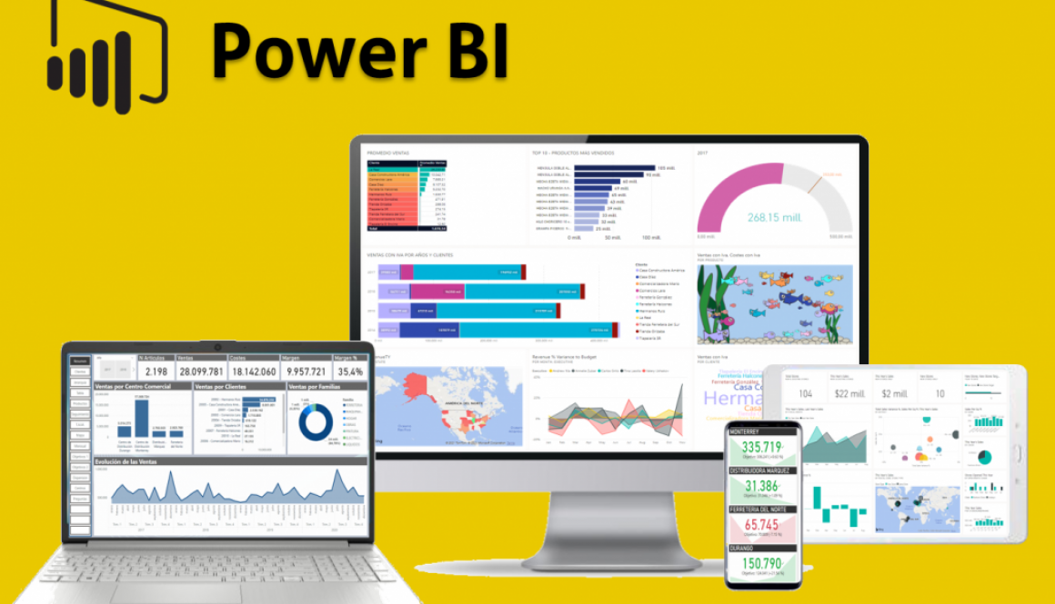
What is Power BI
Power BI is an interactive data visualization software product developed by Microsoft with a primary focus on business intelligence.

Slide 3
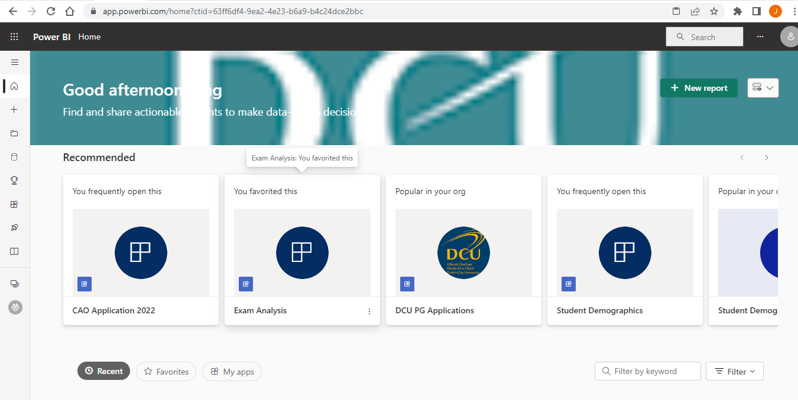
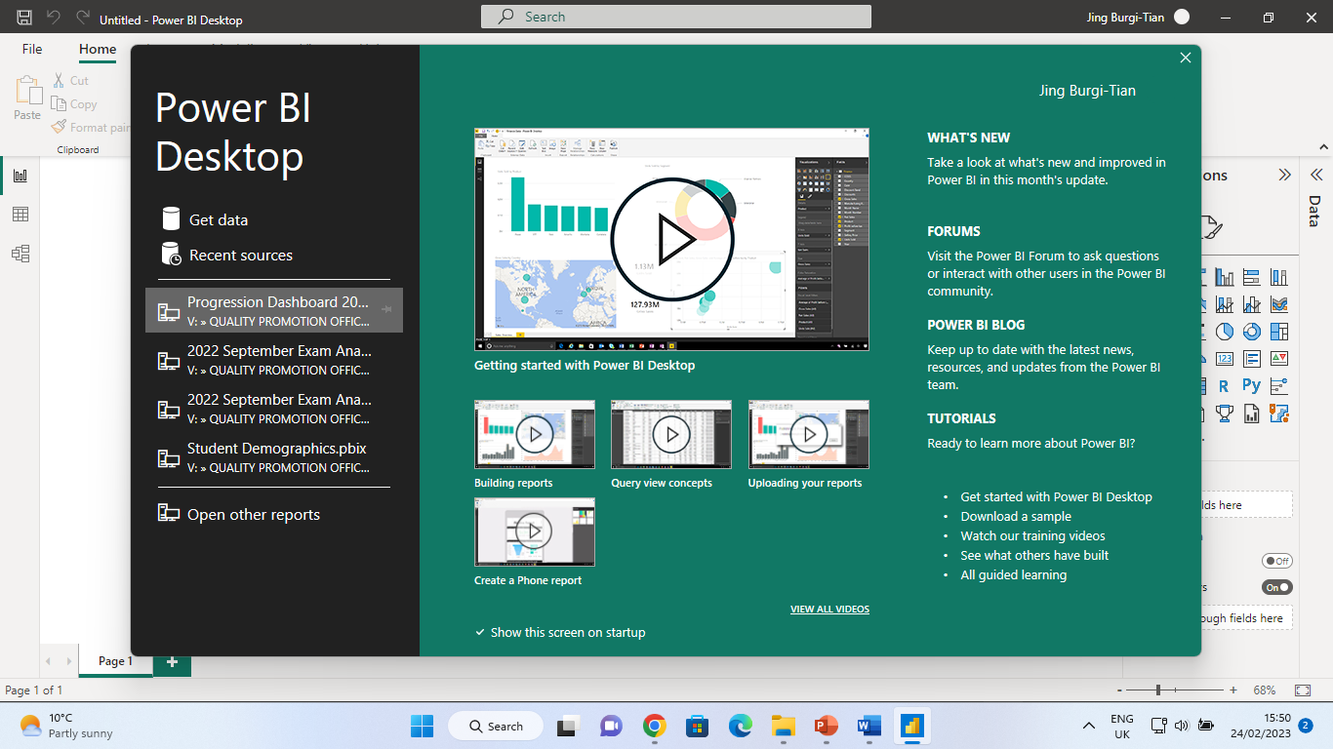
Service v.s. Desktop
Service: on web, for viewing
Desktop: installed, for creating

Slide 4
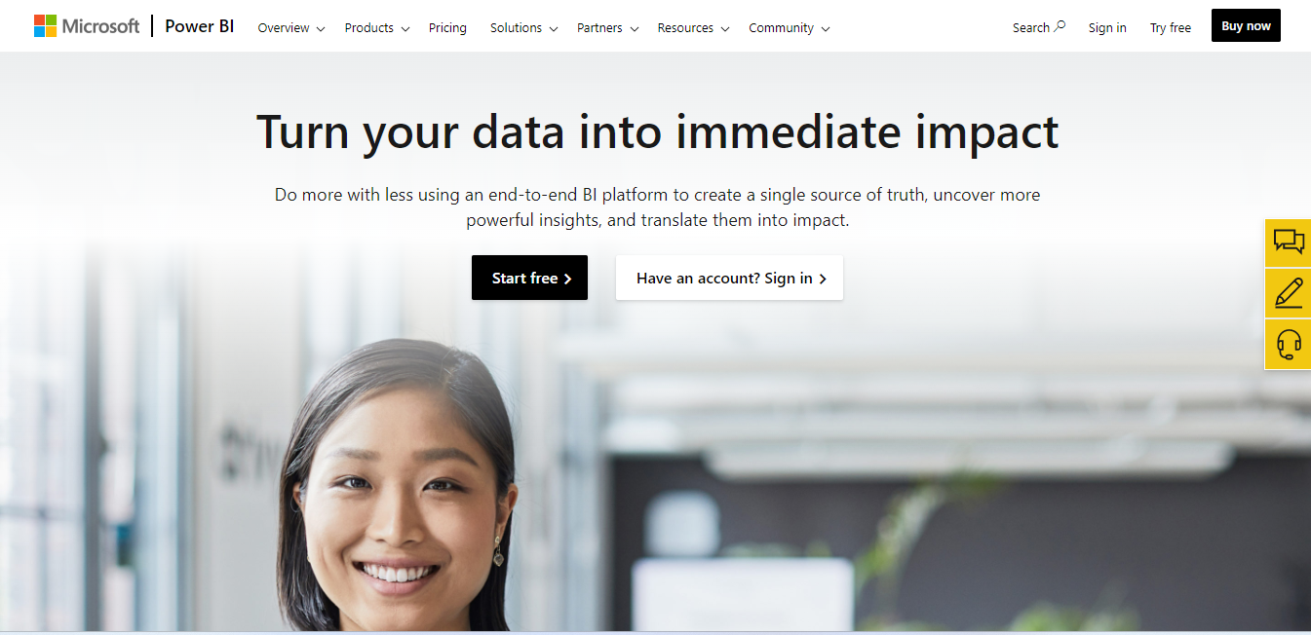
Getting Started
Go to Power BI (https://powerbi.microsoft.com/en-au/)
Log in with your DCU email address
  If this is your first-time using Power BI, sign up for a free account.

Slide 5
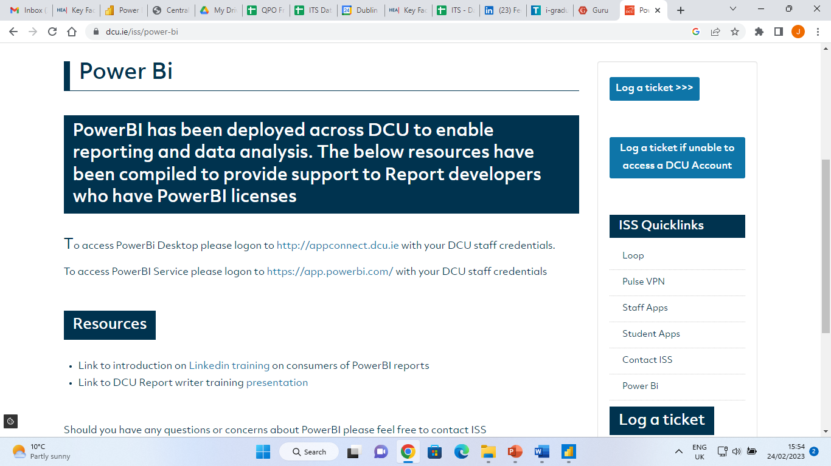
Getting Started
Go to DCU ISS’ website, click on ISS quicklinks – Power BI
Make sure to select “Power BI Service”

Slide 6

Getting Started
Click on Apps on the left-hand side.

Slide 7
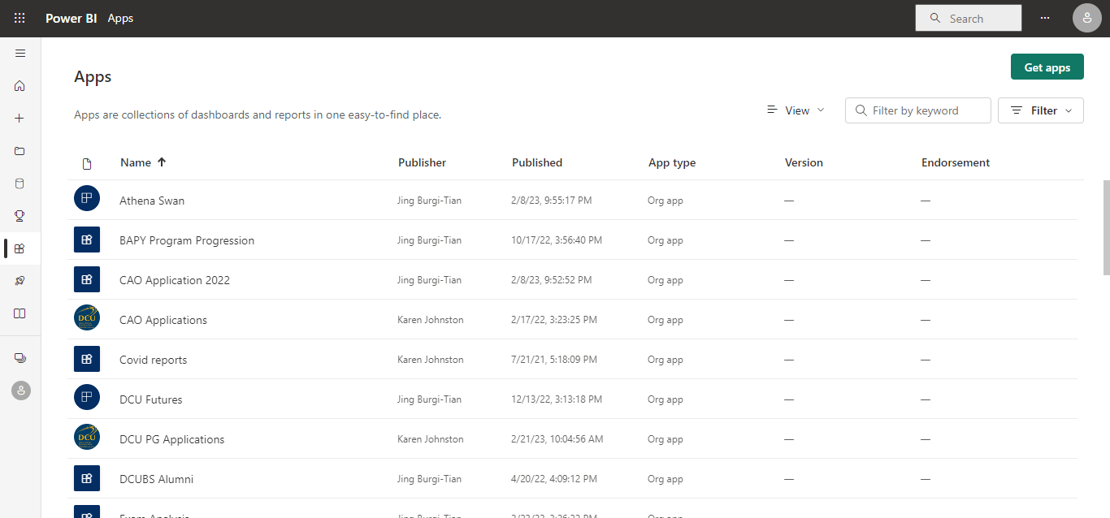
Getting Started
Click on green button “Get Apps” on the top right corner

Slide 8
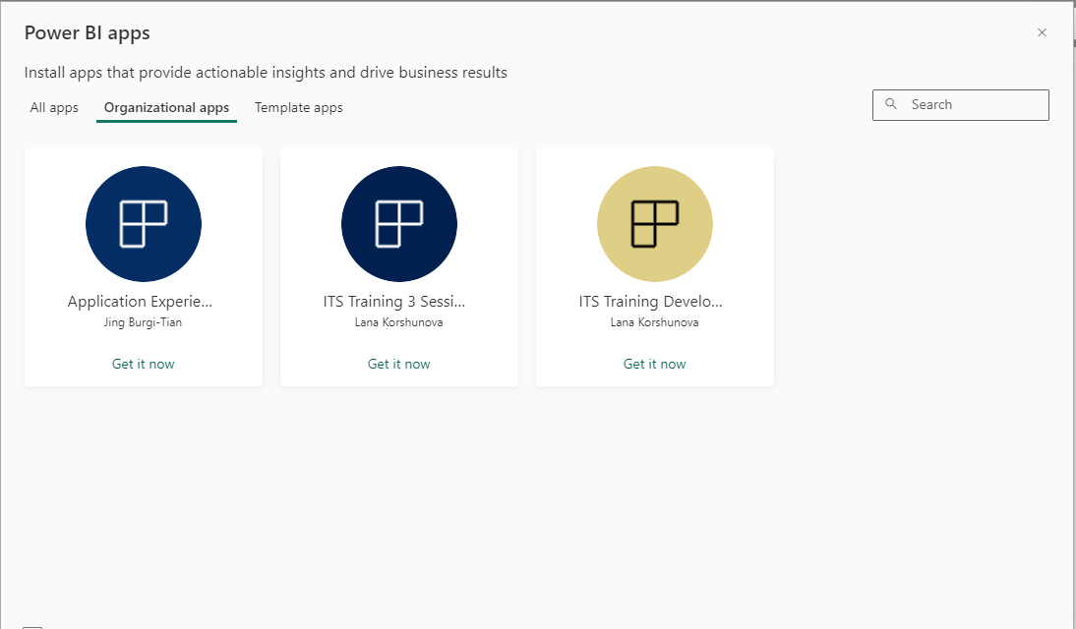
Getting Started
Click on “organizational apps” to look for apps developed by DCU staff, and click on “get it now” for any apps you are interested in

Slide 9
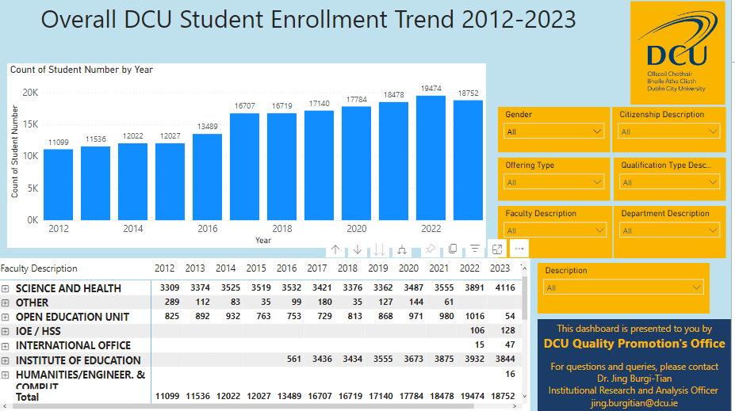
My data seems wrong. What happened?
Check filters

Slide 10
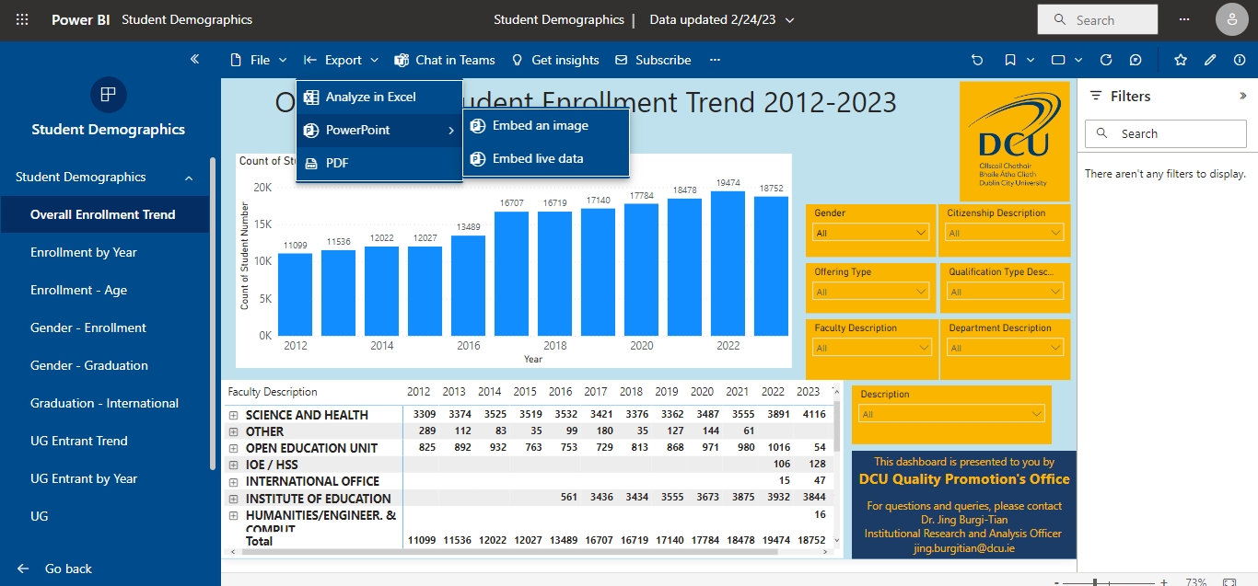
Downloading the reports into PPT or PDF

Slide 11
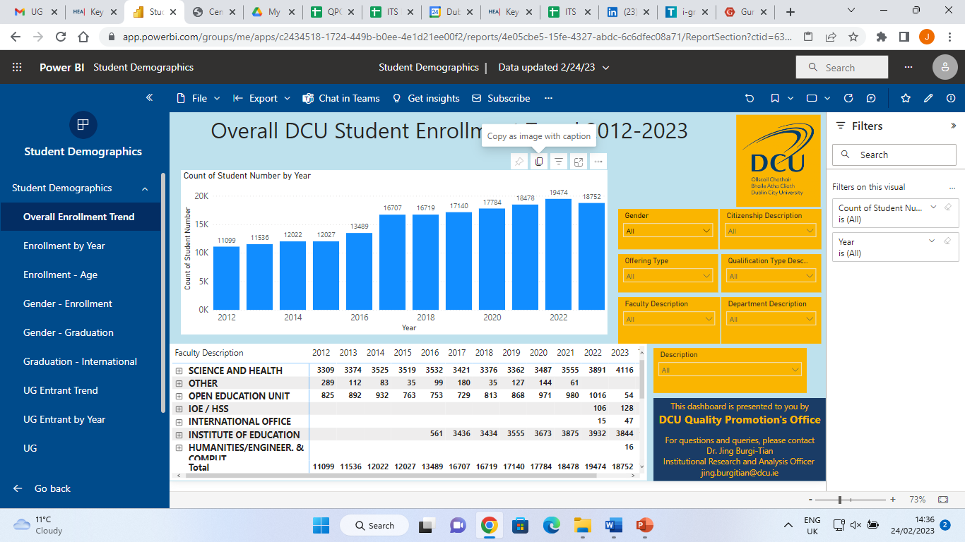
Downloading the visuals as image
Hover over the visual you want to download, and click on “copy as image with caption”

Slide 12
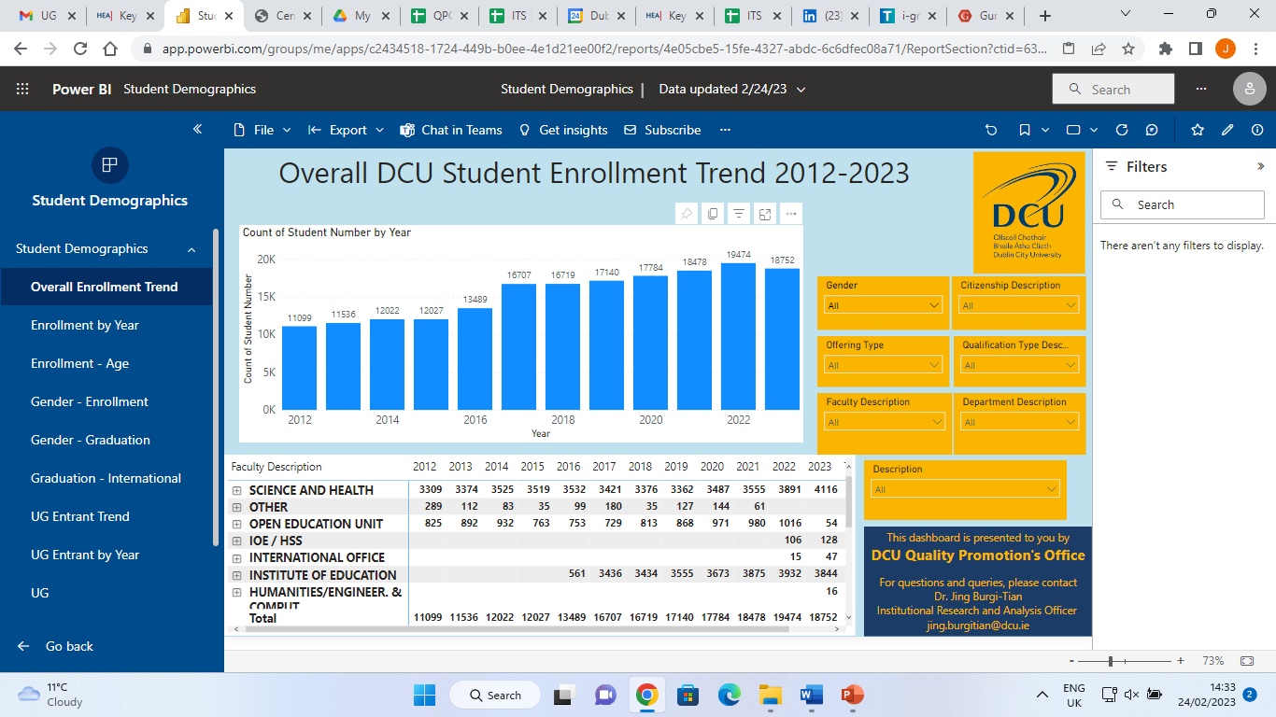
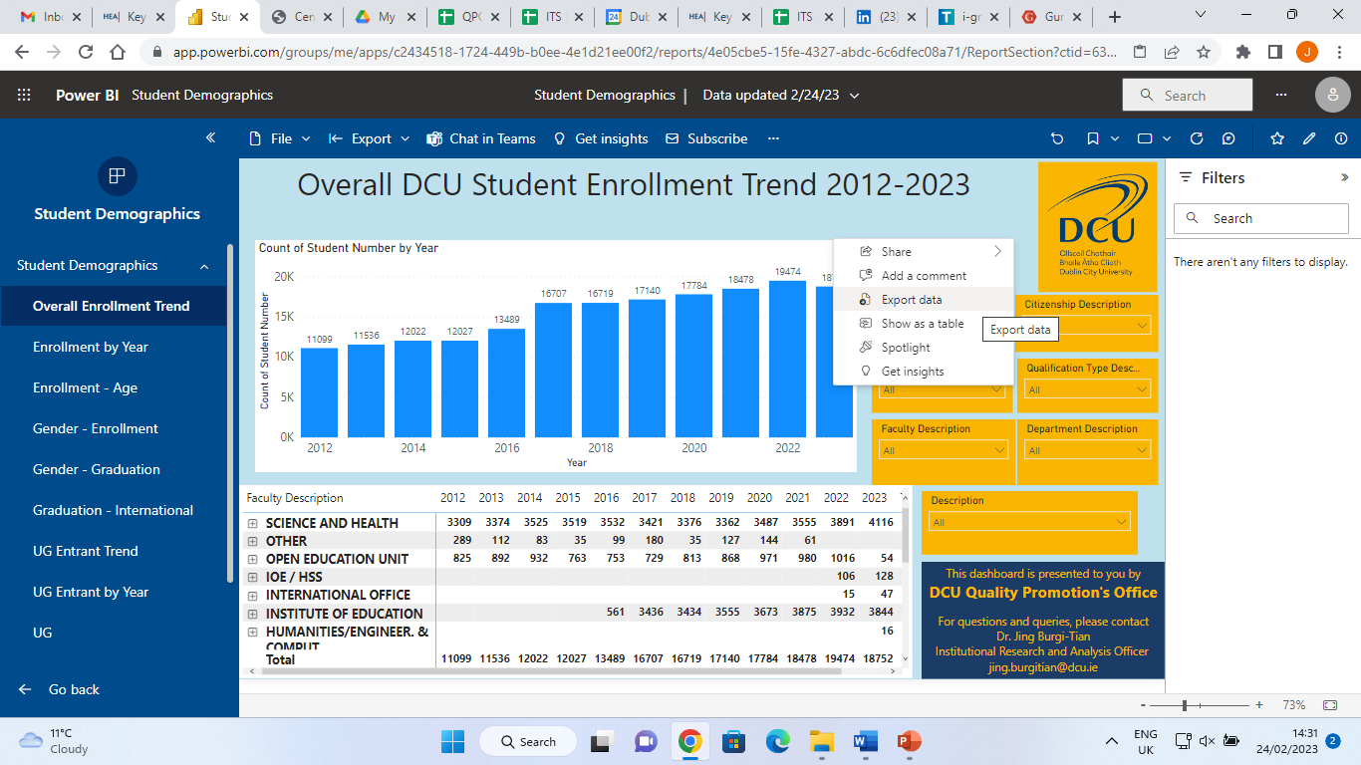
Downloading summary data from visuals into Excel
Click on “more options” (icon with 3 dots)
Click on “Export Data”
Underlaying data is usually disabled, you may choose to download summary data, or current layout

Slide 13
Jing Burgi-Tian
jing.burgitian@dcu.ie

