Slide 1
DCU Power BI 101 Guide for Super Users
Dr. Jing Burgi-Tian
Quality Promotions Office
Jing.burgitian@dcu.ie

Slide 2
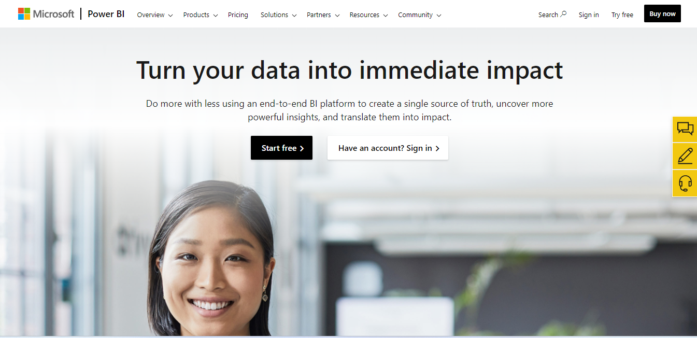
Getting Started
Go to Power BI (https://powerbi.microsoft.com/en-au/)
Log in with your DCU email address
If this is your first-time using Power BI, sign up for a free account.

Slide 3
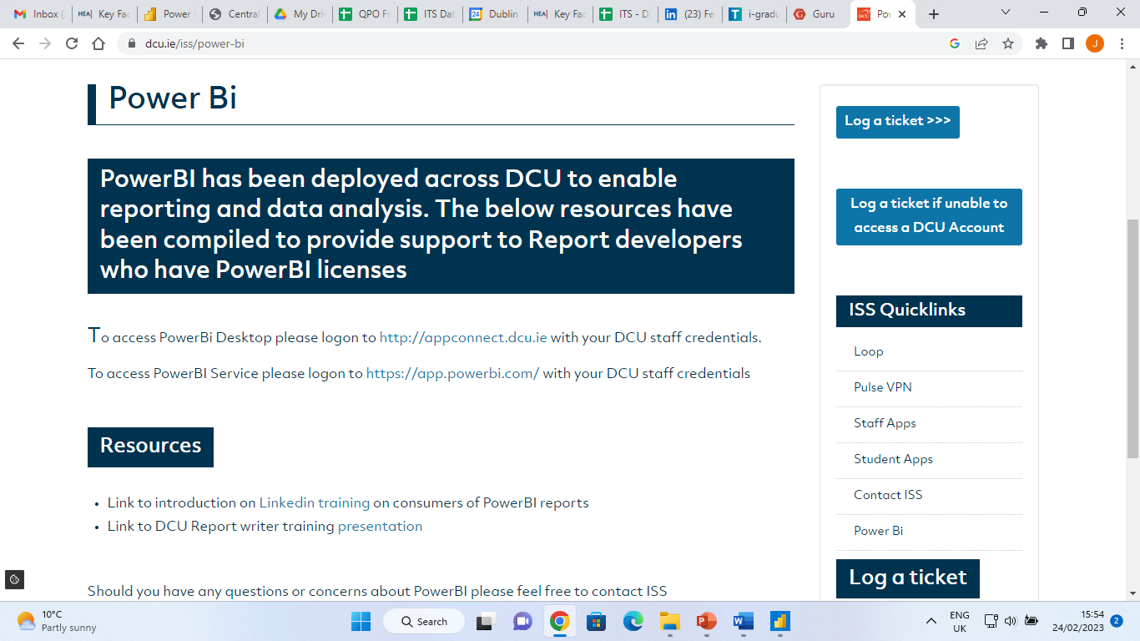
Getting Started - Alternative
Go to DCU ISS’ website, click on ISS quicklinks – Power BI
Make sure to select “Power BI Service”, not “desktop”
https://www.dcu.ie/isshttps://www.dcu.ie/isshttps://www.dcu.ie/iss

Slide 4
Where are my reports?
Click on “Workspaces” (last icon in the bottom)

Slide 5
Where are my reports?
In the spin-off tab, click on “ITS Dev/Prod/UAT” of your faculty or unit

Slide 6
What’s the difference?
Dev
When a report is developed and shared with users for the first time
UAT
Reports in the process of refinement and validation
Can be edited and changed by super users
Prod
Finalized reports after refinement and validation
Cannot be edited or changed by super users

Slide 7
So, in summary
If you want to build a report for yourself from an existing, baseline report, go to “Dev”
If you are in the process of refining and validating a report, go to “UAT”
If you are ready to download data without making any changes, to go “Prod”

Slide 8
Downloading data into Excel
Make sure all filters are set correctly to what you need
Click on “more options” (icon with 3 dots on top of the table)
Click on “Export Data”

Slide 9
Jing Burgi-Tian
jing.burgitian@dcu.ie

