Slide 1
Promotion to
Associate Professor 2025
Information Session
26 February 2025

Slide 2
New in 2025
New on-line Application Form
  Pre-set format of questions (removal of amendments to fonts, margins etc)
  Introduction of character count per section
  Removal of 20 pages requirement
  Removal of bold & underline, hyperlinks
  Amendments to text in some questions for clarity
  Publications – update research engine & provide link to DCU profile
  The checklist is now moved to the end of the on-line application form

Slide 3
New in 2025
An ‘Introduction & Guidance Document’ is provided for review outlining:
  What’s changed?
  How to guide?
Template of the On-Line Application Form available for reference only and the welcome page contains key points to consider when navigating the application form.
A Word Template for tables & bullet points is provided (if required) - (copy & paste to on-line application form).

Slide 4
Eligibility To Apply
Academic staff members at Assistant Professor grade / scale who are required as part of their role to contribute across all three domains at a high level, may apply for promotion to Associate Professor grade
Probationary period completed
Permanent or Contract (at least to the end of 2025)
PhD: In the very exceptional case of an applicant without a Ph.D./ Professional Doctorate, detailed justification for the absence of this qualification must form part of the application along with providing a plan for the completion of this qualification

Slide 5
Promotion to Associate Professor
Excellent past performance
Achievement and quality beyond that expected for good performance of an Assistant Professor's duties
Convincing prospect of future continued excellence, in core academic activities
Must have met threshold if application submitted in previous year

Slide 6
Academic Development & Promotion Framework

Slide 7

What is the Framework?
Provides the faculty with clearly-defined expectations regarding standards for academic career development and progression
Serves as a tool to support individual career planning and development conversations with Deans /Heads of School and/or mentors.

Slide 8
Applying the Framework
ACADEMICS
Informs individual career development planning for each stage of academic career
Enables self-assessment of strengths & areas requiring further development
Facilitates self-reflection on readiness for promotion
DEANS / HEADS OF SCHOOL
Enhances professional development conversations between academics & their Dean / Head of School
Provides context for decisions about investment in employee development

Slide 9
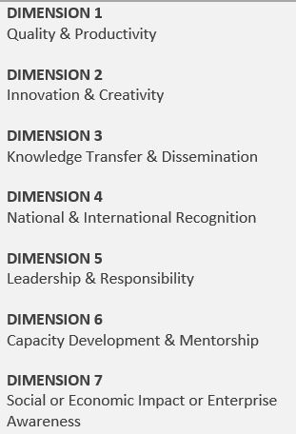
3 x Domains
A set of dimensions per domain

Slide 10
Levels of Achievement
Assistant Professor
Associate
Professor
Professor
Full Professor

Slide 11
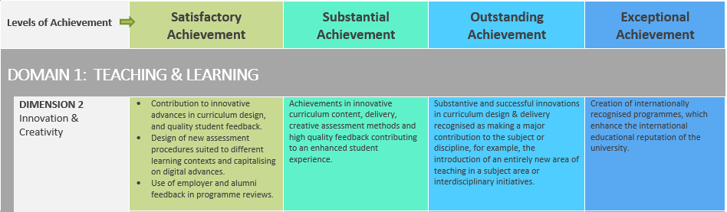
Example: Domain 1 / Dimension 2

Slide 12
Example: Domain 1 / Dimension 2

Slide 13
Example: Domain 1 / Dimension 2

Slide 14
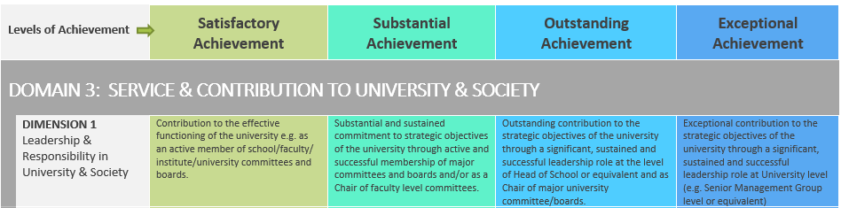
Example: Domain 3 / Dimension 1

Slide 15
Core Academic Activities – 3 Domains
Teaching and Learning
Research and Scholarship
Service and Contribution University and Society

Slide 16
Core Academic Activities – Sub Dimensions
Quality and Productivity
Innovation and Creativity
Knowledge Transfer and Dissemination
National and International Recognition
Leadership and Responsibility
Capacity Development and Mentorship
Social or Economic Impact or Enterprise Awareness

Slide 17
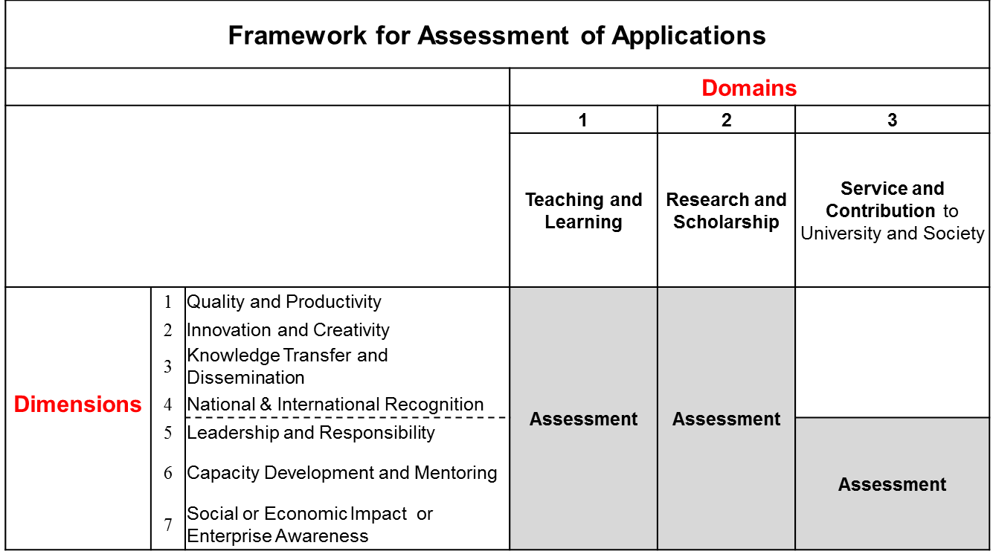
Criteria for Promotion

Slide 18
Scoring of Applications:
T&L or Research Domain
 | Satisfactory (10-24) (25-39) |  | Substantial (40-54) (55-69) Sustained & Substantial |  | Outstanding (70-84) | Exceptional (85-100)
Quality & Productivity |  | X |  | X | X | X
Innovation and Creativity
Knowledge Transfer & Dissemination
National and International Recognition
Leadership and Responsibility
Capacity Development, and Mentorship
Social or Economic Impact or Enterprise Awareness
Recent, or across a limited number of dimensions
AND
at this level across several/ all other dimensions
Also across several/ all other dimensions
AND
at this level across several/ all other dimensions
Evidenced across a limited number of dimensions

Slide 19
Process

Slide 20
Process
Timeline for 2025 is available online https://www.dcu.ie/people/promotion-associate-professor-2025
APC Process covers the period February – October 2025
Closing date for receipt of on-line applications: 4pm Tuesday 22 April 2025

Slide 21
Process
Applicant – Follow procedures
  Present your case
    Teaching & Learning (T&L)
    Research & Scholarship (R&S)
    Service & Contribution (S&C)
    Highlights of Application
University – Call for Applicants
  Assess case
    T&L
    R&S
    S&C
    Supporting documentation
  Rank applicants

Slide 22
To Apply
TAKE ADVICE
Structured application form with guidelines
Provide full information under each heading
Support it with accurate and specific evidence
Nominate one external referee
Adhere to limits and deadlines
– no exceptions

Slide 23
Application Form
Link to the on-line application form is available online under the section ‘How to Submit an Application’
Submit
  One signed on-line application (which includes appendices).
  No Hard Copy Application Accepted
  Please submit books chosen as published work, also by the stated deadline, directly to The Vice President for people, Equality, Diversity & Inclusion, DCU People Department, Dublin City University, marked Confidential, Addressee only, Associate Professor application.

Slide 24
Faculty Review Panel (FRP)
  Composition & Function
  Functions
  Provides APC with a ranked list of applicants
    Using
      Criteria and Guidelines
      External reference & Head of School reference
Academic Promotions Committee (APC)

Slide 25
Assessment
FRP
    Ranked list of applicants to APC
Academic Promotions Committee (APC)
    Composition
    Receives ranked list from each Faculty
    This list will then be divided into 2 groups – one for male applicants and one for female applicants
    Each APC member scores the applications in each group
    Recommends top highest ranked male and female applicants for promotion
    The DCU Executive Committee has given approval for a maximum of 10 promotions through this competition. Should the competition determine that 10 colleagues reach the promotion standard required the breakdown of promotions will be three females, three males and four of either gender. The top seven ranked promotions will take effect from October 2025 and the next three will take effect from February 2026.

Slide 26
Assessment
Scoring
  Domains 1 and 2 (scored out of 100)
  Domain 3 (scored out of 50)
  To be deemed eligible for consideration for promotion to Associate Professor an applicant must achieve:
    a total score equal to or greater than 150
    a score equal to or greater than 50 in both domains 1 and 2, and
    a score equal to or greater than 25 in domain 3
  Please note that at the upper end of Assistant Professor the expectation and minimum score required for promotion to Associate Professor is 150. A minimum, score of 50 in Domains 1 & 2 together with a minimum score of 25 in Domain 3 will not be considered to have met the threshold for promotion to Associate Professor
It is a competition !

Slide 27
Questions
Frequently Asked Questions are available on-line
Any queries in relation to the Promotion to Associate Professor 2025 process should be sent to:
apc.dcupeople@dcu.ie

