Slide 1
DCU EU Horizon europe Budgeting Template
A guide to help you

Slide 2
Form A SUMMARY
All Figures in FORM A SUMMARY will auto populate once the subsequent template sections are completed
The FORM A calculates the Final Budget Figures that are needed for your EU application
Enter Basic Application Details
Additional table to be included with application if purchase costs > 15% of personnel costs
All Figures in FORM A DETAILED BUDGET will also auto populate once the subsequent template sections are completed

Slide 3
Personnel Costs BUDGET
70% OR 80% of PROJECT budget is usually made up of personnel costs
TRY TO GET this as accurate as possible

Slide 4
Personnel – charged direct
Post Graduates (These are Not contracted EMPLOYEES) – you need to know
Stipend amount
Students Start and End Dates
Add Fees to annual stipend cost (fees usually €5,505) https://www.dcu.ie/fees/index.shtml
Research Assistant, Post Doctoral, Research Fellow, Senior Research Fellow – you need to know
Starting lEVEL and starting POINT on IUA Scale
Employee - Start and end dates

Slide 5
Personnel Costs- Salary Scales
DCU online Salary Calculator CLICK TO VIEW
(Based on IUA salary scales and can be used to calculate static or incremental salary rates)
IUA SALARY Scales CLICK TO VIEW (Please ensure you use correct period)

Slide 6
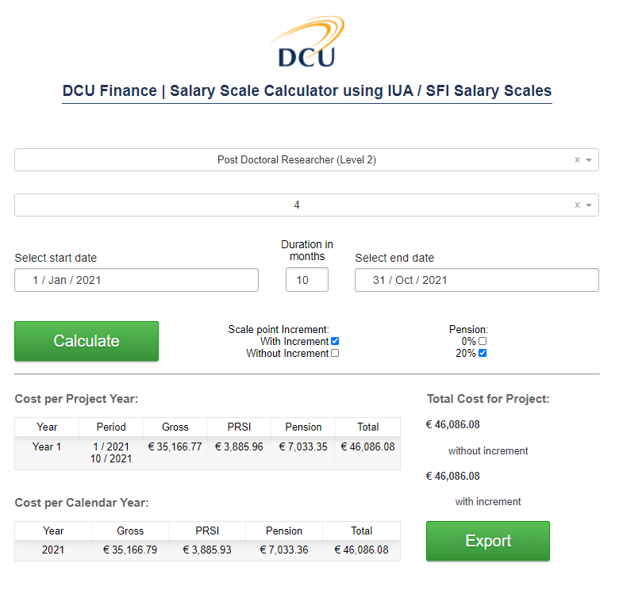
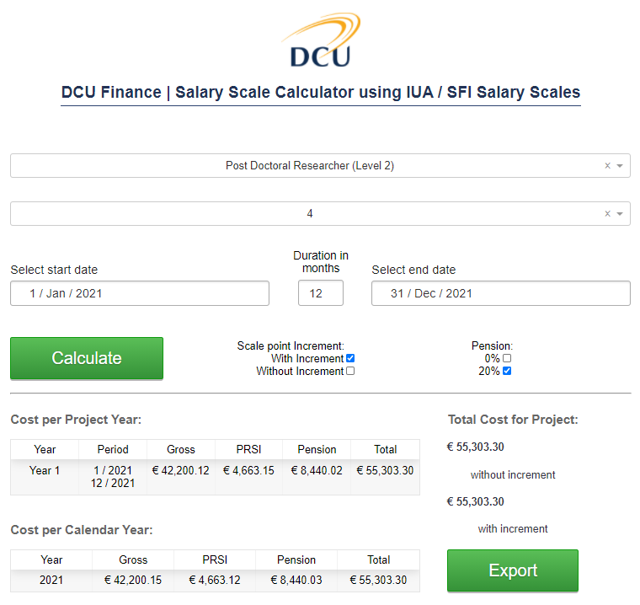
DCU ONLINE SALARY CALCULATOR
To be compatible with EU Budgeting TEMPLATE, ANNUALISED SALARY FIGURES REQUIRED
This date auto populates based on the number of months entered
Correct as multiple of 12
Annualised figure so now can be used with EU Budgeting Template
Enter the staff members start date
Enter the staff members start date
This figure is incorrect as it needs to be multiples of 12 to be able to calculate annual figures needed for EU Budgeting Template
Incorrect as not annualised figure

Slide 7
Personnel – charged direct
Insert corresponding number of months per year for each Employee
Total cost will auto populate based on the figures you entered under annual salary cost and time allocation
Enter the Annual Gross Salary cost for each person including Employer PRSI and Employer pension here

Slide 8
Personnel – PI Input time / Admin
Some of your personnel costs may be charged to the project as PI or Administrator input time. This can occur where salary costs are already charged elsewhere and where only a small proportion of overall hours per month are claimed from this particular grant.
EU hourly costs are based on 1720 productive hours per annum, 215 productive days or 143.33 productive hours per month. For the budget template you will need to know the annualised gross cost of the person including Employer PRSI and Employer pension where appropriate (No pension is included if salary charged to a CORE “D” subcost). Please note productive hours does not equal total hours.
You will also need to know the number of days personnel will be working on the project over it’s lifespan (if calculation is in hours divide by 8 to get into days format).
Admin Support & Technicians: You are advised to consider a costing for Administrative Support and Technicians. Please contact the relevant support person in your Faculty/School/Centre for advice on how to cost Admin support into your budget.

Slide 9
Personnel – PI Input time / Admin
Insert number of Days per year. If you calculated hours divide by 8 for days
Total cost will auto populate based on the figures you entered under annual salary cost and time allocation
Enter PI/Admin name and Annual Gross Salary including Employer PRSI and Employer Pension (If charged to a CORE “D” subcost there should be no Employer pension)

Slide 10
Personnel Costs BUDGET
Include 5% uplift to Salary costs to account for Any Redundancies & Salary Increases during the project where allowed
Congrats ,You have now completed your Budgeted personnel costs . This total will auto populate FORM A
The template has also calculated total Person Months for both direct staff and PI/Admin days converted to Person Months

Slide 11
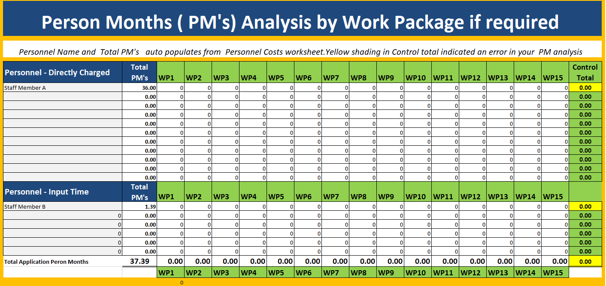
Person months Analysis (If Required)
If Required, please split the Total PM’s into the relevant Work Packages
Should the split not equal the auto populated Total PM’s, the Control total cell will highlight in Yellow to indicate an error

Slide 12
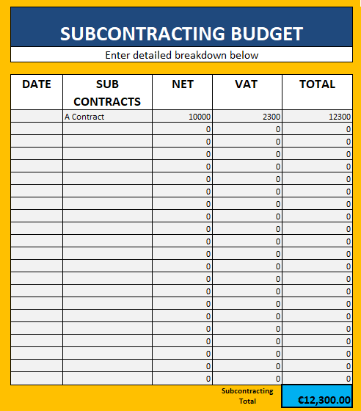
Subcontracting Budget
Enter all details for subcontracting costs to be purchased on project
Remember to include VAT if applicable
Check if Subcontracting is allowable in the call document
In general, the use of subcontractors to deliver part of a research programme should be avoided and programme tasks should be completed by project partners if at all possible. This benefits the strength of the application and confirms that the project team have the skills to deliver the project without relying on third party subcontractors.
If a part of the project must be delivered by a subcontractor it should be a distinct well defined task that is not core to the scientific delivery of the programme.

Slide 13
Travel BUDGET
All costs charged to EU grants including Travel need to be directly connected with the action & necessary for its results in order to be considered as eligible costs.
DCU Travel and subsistence Rates are calculated based on Civil service rates. Different rates apply to different destinations. Please refer to https://www.dcu.ie/finance/accounts-payable/travel.shtml
Under EU regulations staff claiming travel expenses should be employees paid from the grant and must be able to display an active involvement in any conference attended etc. Costs must be eligible and kept to a minimum.
The Budget template for Travel allows for 6 meetings during the course of the grant. Should less detail be required please group costs into 1 or more meetings as needed. The costs can then be analysed by travel, accommodation and subsistence. This section of budget auto populates the claimants names from the list of named personnel. Details of Conferences including estimated dates should be entered if known.
When estimating your travel costs, check if vat is applicable.

Slide 14
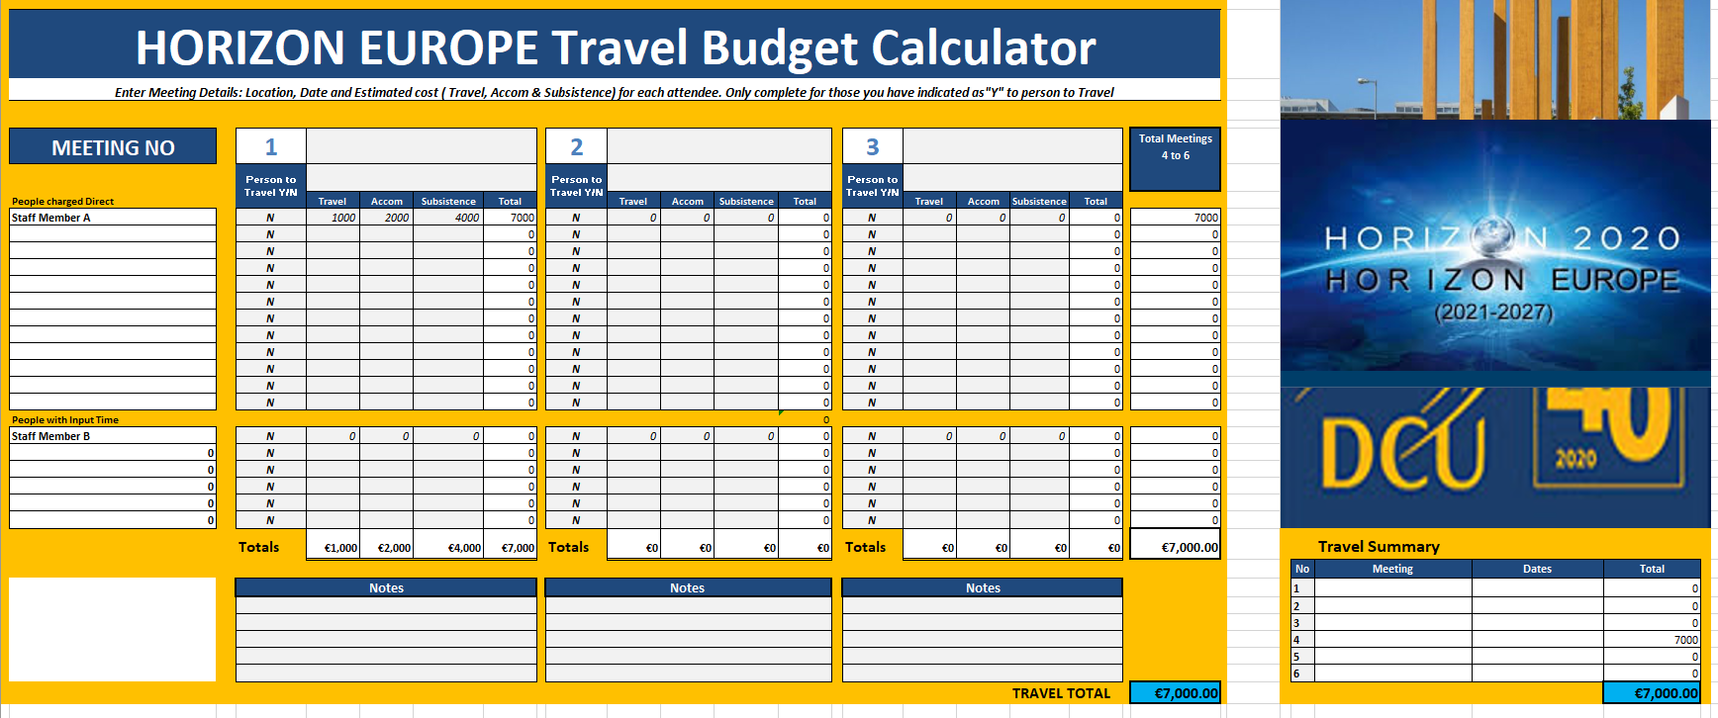
Travel Budget
Should less detail be required please group all costs into 1 or more meetings as needed.
Total cost by trip auto-populates here
Names are auto-populated from Personnel section
Total travel costs auto-populates FORM A
Enter Trip Number, Event and Destination
Analyse budget
by Travel, Accommodation and Subsistence

Slide 15
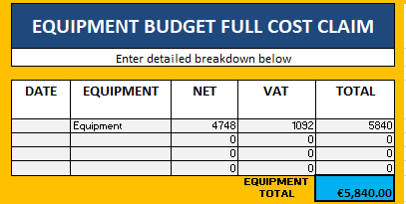
EQUIPMENT BUDGET – Full COST CLAIM
Enter all details for Full Cost Claim equipment to be purchased on project
Remember to include VAT if applicable
As per the fixed asset policy, DCU only capitalise (therefore depreciate) assets over €10,000. If the value of the asset is less than €10,000, the full cost is claimed from EU.
In certain cases the AGA (Annotated Model Grant Agreement) may allow Full Cost Claim of items over €10,000.
Depreciation Treatment: Liaise with project Coordinator as to which Depreciation option applies to your specific project under Article 6.2.D.2 of the AGA. Please check EU Participant Portal to check correct treatment for your project.
Equipment: Laptops are considered as an indirect cost (i.e. payable from overheads) in EU HORIZON EUROPE grants unless stated and approved in the AGA. If purchased but not approved in the AGA the cost of same will be borne out of the PI’s portion of the overhead.
Example Options

Slide 16
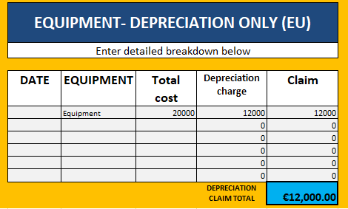
EQUIPMENT BUDGET – Depreciation Only claim
Enter all details for Depreciation Only equipment to be purchased on project
Remember to include VAT if applicable
As per the fixed asset policy, DCU only capitalise (therefore depreciate) assets over €10,000.
The Depreciation costs that can be claimed relate only to the duration of the project and the rate of actual use of the asset.
The amount to be declared in the DCU budget in this case, is therefore not the cost of the asset but instead is the depreciation amount that can be claimed.
All computer assets over €10,000 are depreciated over 3 years and all lab equipment assets over €10,000 are depreciated over 5 years.
There may be a shortfall between the full cost of the equipment and amount claimed. The PI must specify for DCU internal purposes how any shortfall in claiming the cost of Equipment is to be funded at the time of application.

Slide 17
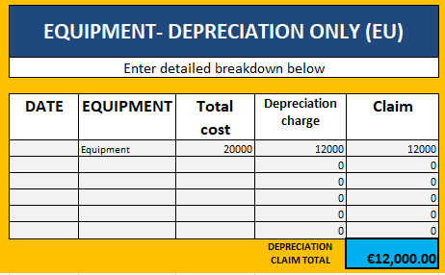
EQUIPMENT BUDGET – Depreciation Only claim
DCU should apply normal accounting policies when preparing budgets for new Horizon Europe proposals.
Therefore, if a PI intends to purchase an asset with a value greater than €10k, she/he should include only the depreciation element for the period of the project in the proposal
(eg Asset cost €20,000, DCU depreciates over 5 years ie €4,000 pa, Project term 3 years , therefore PI can claim 3 yrs * €4,000 = €12,000). If the PI intends to purchase an asset with a value of less than €10k, she/he can include the full cost of the asset in the proposal (eg Asset cost €8,000, DCU does not depreciate as less than €10,000, therefore PI can claim €8,000)

Slide 18
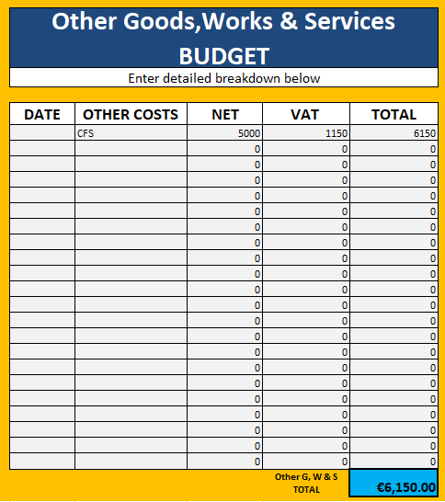
Other Goods, Works & Services
Enter all details for Goods, Works & Services to be purchased on project
Remember to include VAT if applicable
Materials/Consumables costed into a project budget should be items used exclusively in support of the project's objectives and must be separately identifiable.
HORIZON EUROPE Audit Costs: If the total costs of your budget are estimated to exceed €430,000 (Incl Overhead) then include €5,000 (€6,150 Incl VAT) as a minimum for a CFS audit in the final year.
Recruitment costs are generally NOT eligible as direct costs. If a beneficiary needs to recruit additional personnel during the action, the cost of same will be borne out of the PI’s portion of the overhead.

Slide 19
Other Cost CATEGORIES
Remember to include VAT if applicable
Enter budget details if the relevant categories are applicable to your specific project

Slide 20
Final STEPS
FORM A Summary IS now auto populated & complete.
FORM A DETAIL IS NOW AUTO POPULATED & COMPLETE.
In the unlikely event that the summary and detailed budgets do not agree please contact a member of Research Finance and ask them to review.
Congrats, you have now completed your DCU EU HORIZON EUROPE Budgeting Template.

Slide 21
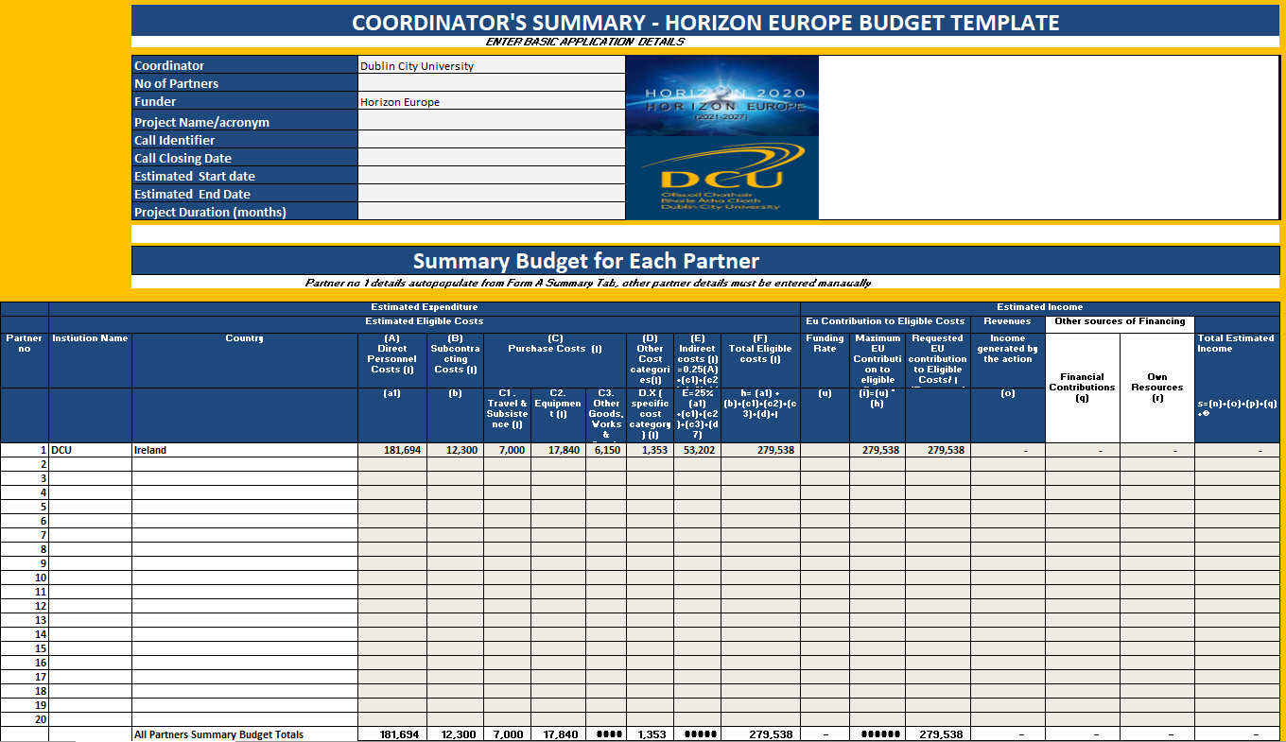
Appendix 1- COORDINATOR’S SUMMARY
All Figures from DCU’s FORM A SUMMARY will auto populate once the subsequent template sections are completed
The Coordinator’s Summary calculates the Final Budget Figures that are needed for your EU application if DCU is Coordinator
Enter Basic Application Details
All Details & Figures from Partner Institution’s FORM A DETAILED BUDGET’s will need to be manually added

Slide 22
Appendix 2 - Consolidated Person months Analysis (If Required)
If Required, please manually add the Partner Institution’s Total PM’s into the relevant Work Packages
Should the split not equal the auto populated Total PM’s, the Control total cell will highlight in Yellow to indicate an error

Slide 23
Appendix 3 - Procurement
PROCUREMENT: MINIMUM requirements
Values (excl. VAT) | Minimum requirements Supplies and / Services
Less than €500 | At least 1 verbal quotation documented
Greater than or equal to €500 and less than €5,000 | At least 2 verbal quotations documented
Greater than or equal to €5,000 and less than €25,000 | At least 3 written quotations in response to brief specification
Greater than or equal to €25,000 and less than EU threshold | National procurement process
Approval by a funding agency of a supplier/consultant does not satisfy the procurement procedures. Engagement of a consultant must be in accordance with DCU policy and DCU Procurement Processes.
National and EU procurement processes are facilitated by the DCU Procurement Office, procurement@dcu.ie.

