Slide 1
QuID Showcase:
Looping in GenAI
Steve Welsh, Learning Technologist
Rob Lowney, Sr. Learning Technologist
Teaching Enhancement Unit

Slide 2


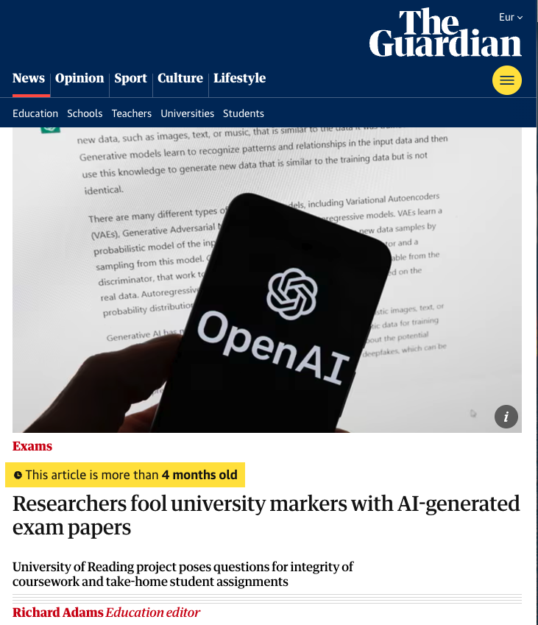
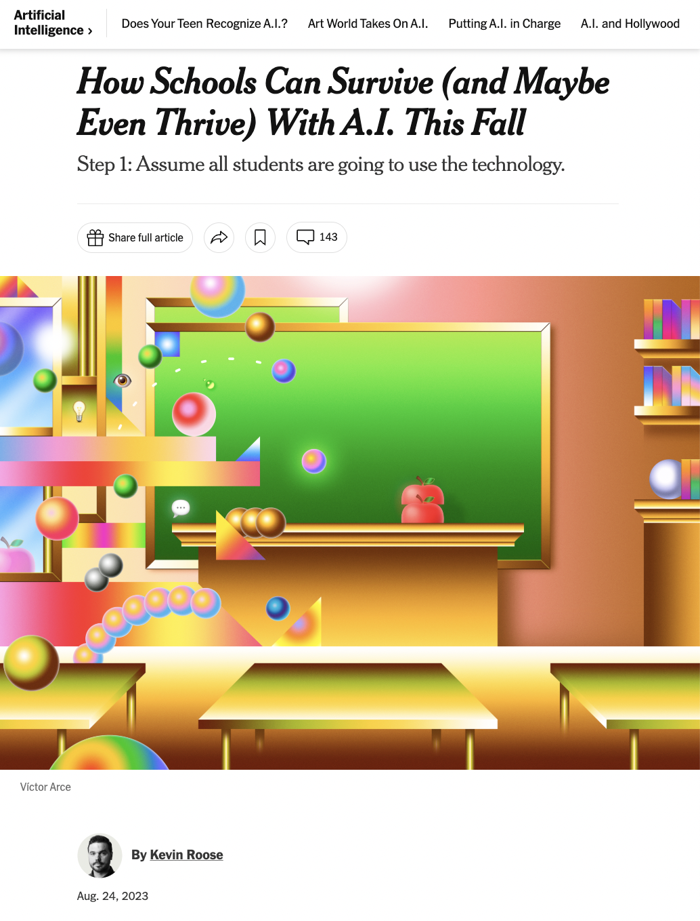
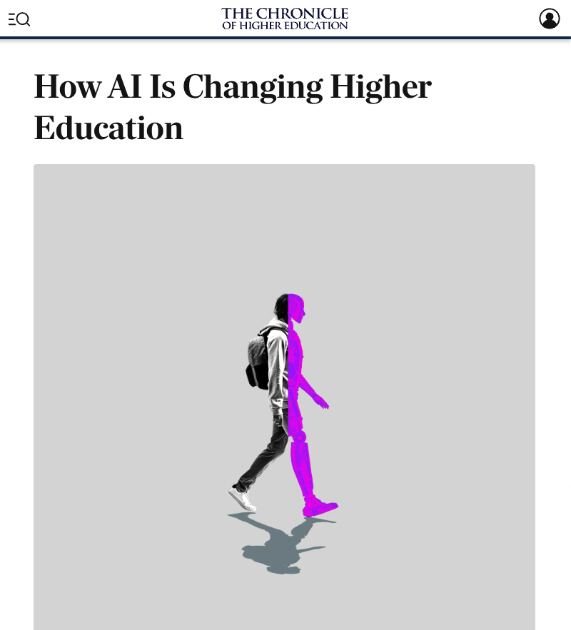
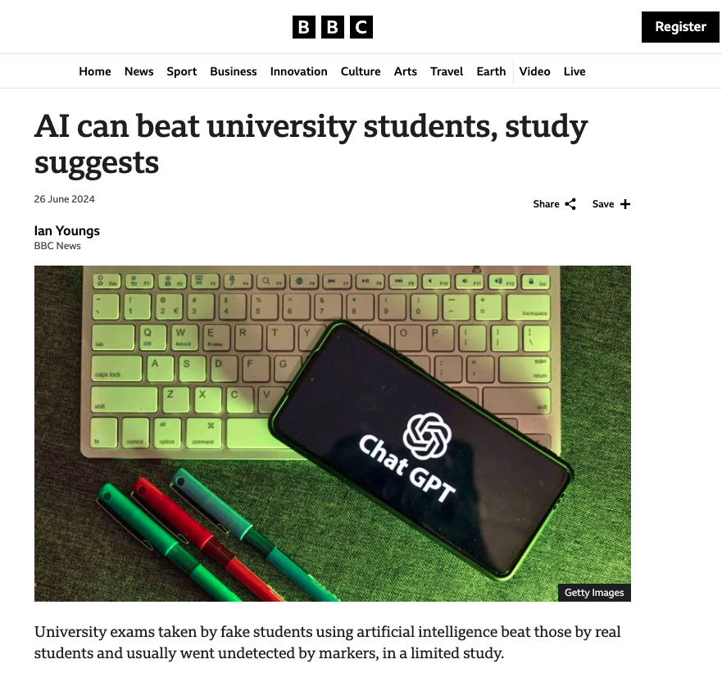
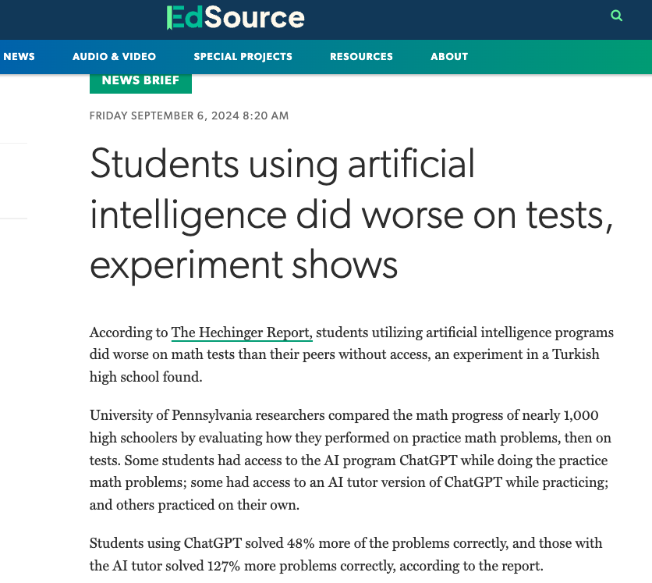
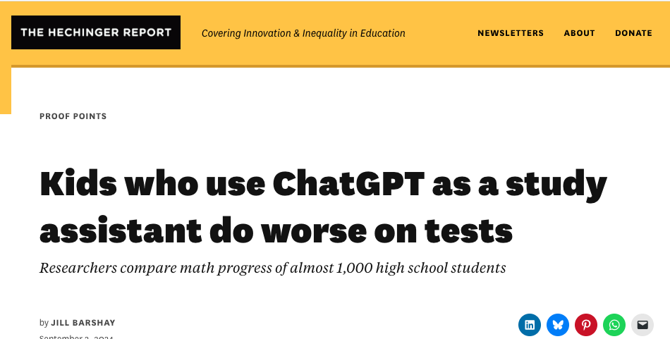
In a climate of heightened anxiety about student use of genAI

Slide 3
How can the ethical adoption of genAI tools benefit lecturers?

Slide 4
Project Aim
Pilot an integration between Loop and OpenAI’s large language model, so lecturers can directly generate content in Loop and understand the benefits and limitations of utilising genAI in practice.

Slide 5
Project Objectives
Install an AI generator plugin on Loop and trial a ChatGPT API subscription.
Recruit some lecturers from each faculty to pilot this plugin to create Loop quiz questions.
Support these lecturers to critique and refine the generated content and deploy quizzes to their students.
Evaluate lecturers’ experience through a REC-approved evaluation and make recommendations for the future potential of genAI and Loop.

Slide 6
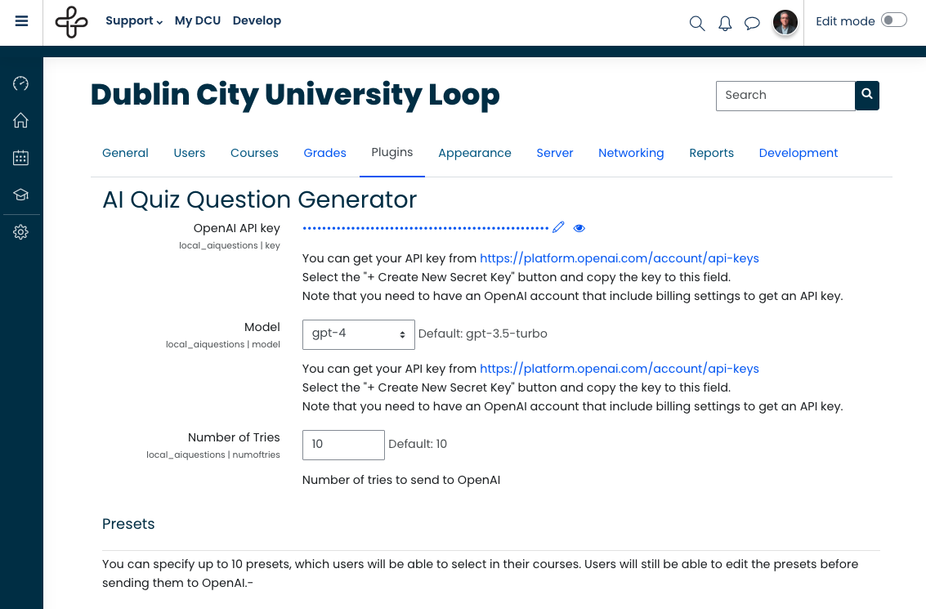
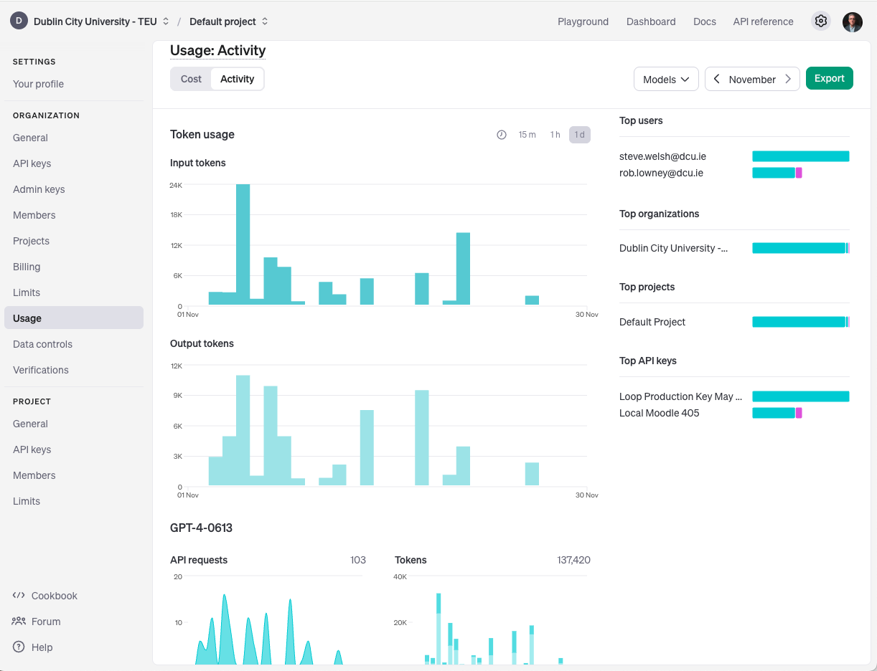
1. Install an AI generator plugin on Loop and trial a ChatGPT API subscription.

Slide 7
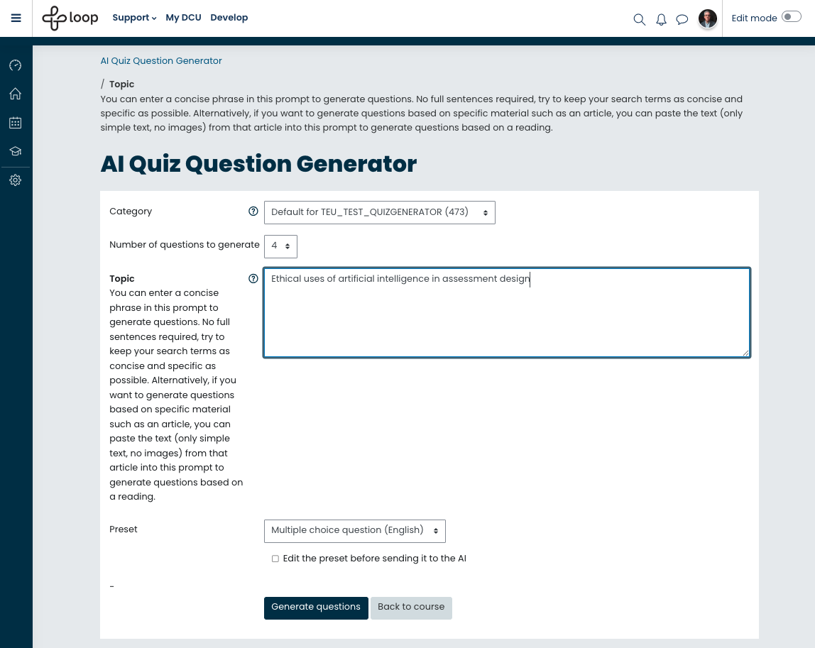

Slide 8
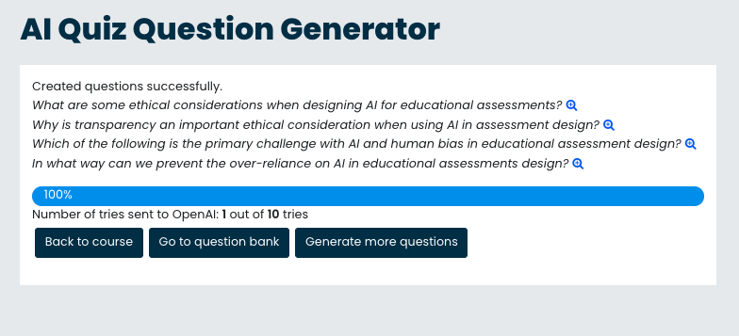

Slide 9
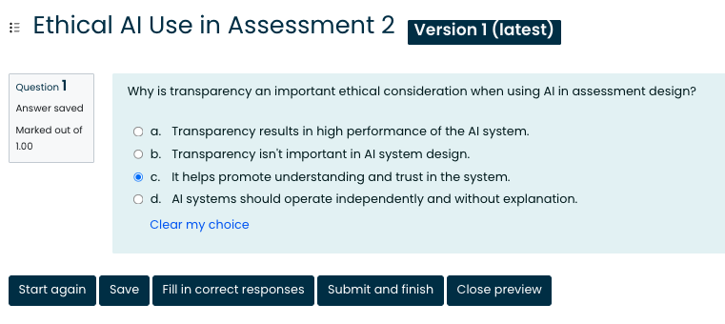
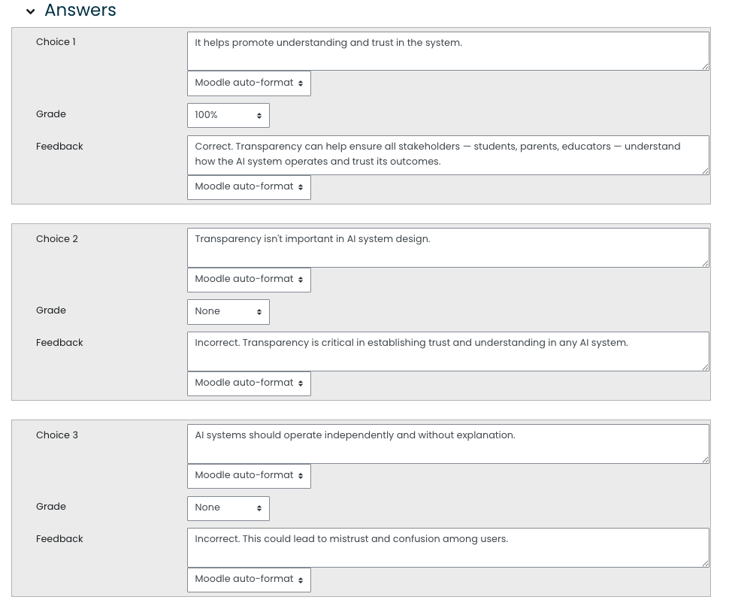

Slide 10
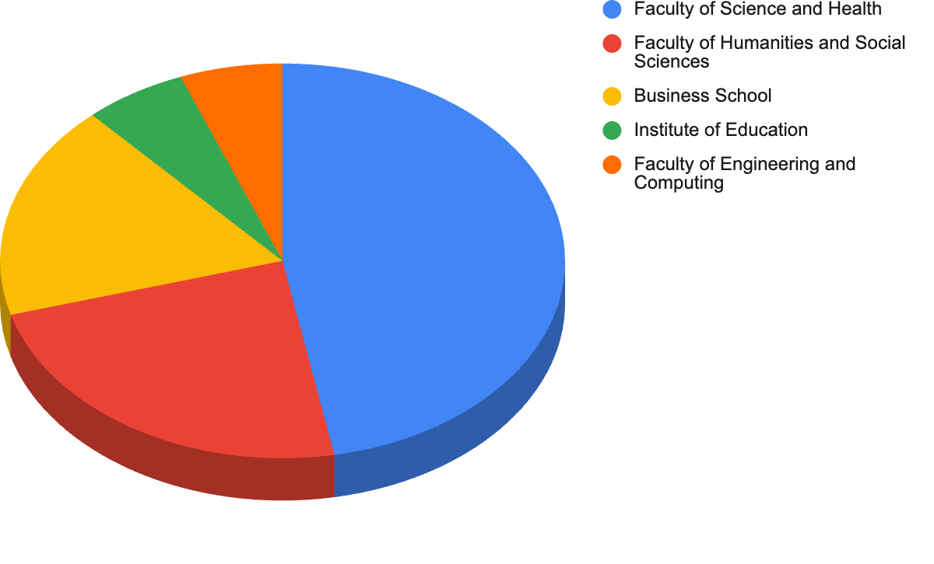
2. Recruit some lecturers from each faculty to pilot this plugin to create Loop quiz questions.

Slide 11
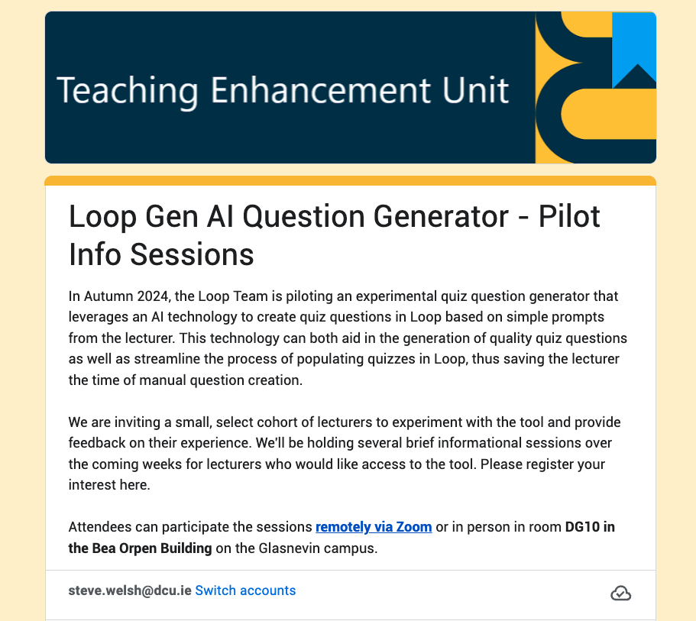
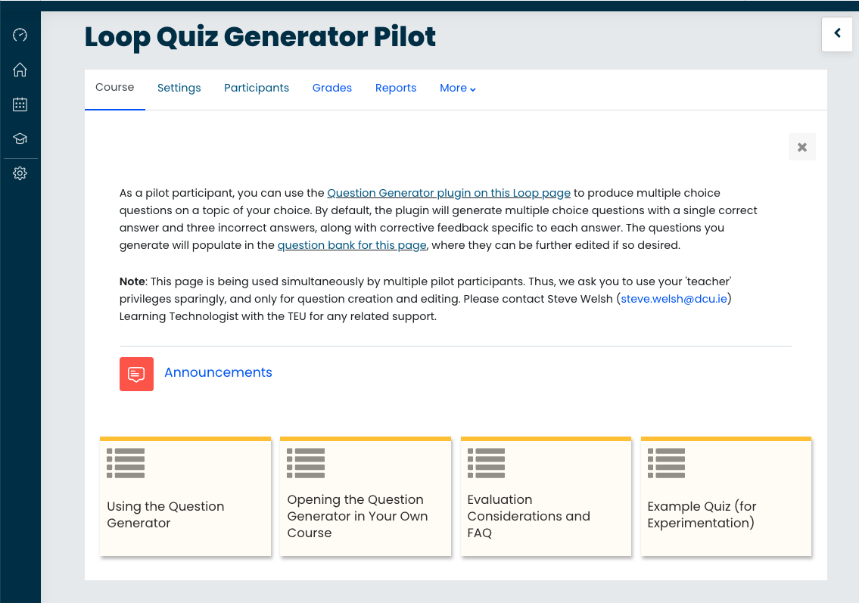
3. Support these lecturers to critique and refine the generated content and deploy quizzes to their students.

Slide 12
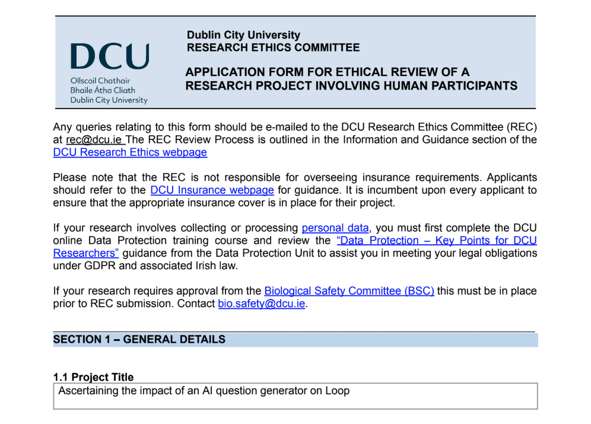
4. Evaluate lecturers’ experience through a REC-approved evaluation and make recommendations for the future potential of genAI and Loop.

Slide 13
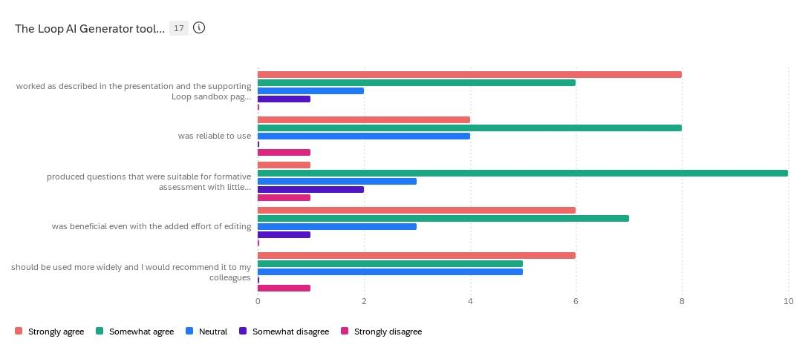
4. Evaluate lecturers’ experience through a REC-approved evaluation and make recommendations for the future potential of genAI and Loop.

Slide 14
Pilot Lecturer Feedback
Initial Findings

Slide 15
Q16. “Why were you interested in using the Loop Question Generator tool?”
"The idea of saving time in providing questions to quiz students and, as a result, being able to provide more robust assessment very much appealed to me.”
“I am interested in the potential of AI to support various teaching and learning tasks. This was a good opportunity to experiment with AI for assessment.
It was also great to see DCU taking the initiative in this space, not feeling like I was 'going it alone'.”

Slide 16
Q16. “Why were you interested in using the Loop Question Generator tool?”
“I routinely use MCQs as part of my 'study' tools for topics I cover in my modules. Putting these together can be very time consuming, and in the past I have used online Google searches and text books to source questions, possible answers, etc. in what has been a huge investment of time and energy. In recent times, I have experimented with AI in an effort to develop more questions, and the opportunity to see a Loop integrated version that performed exactly what I would need was incredibly interesting to me.”
“I like to use pools of questions for my quizzes but I find it very time consuming to prepare multiple similar questions”

Slide 17
Q17. “What do you see as the potential future value of tools like this one?”
“I can see if being a very powerful tool to allow lecturers quickly generate formative quizzes and also as an aid to lecturers designing exams and other questions beyond formative assessment.”
“A great tool for allowing students to assess their knowledge on certain areas covered in a module. The fact the tool provides feedback too was of particular interest because this aspect when done manually more than doubles the work effectively.”

Slide 18
Q17. “What do you see as the potential future value of tools like this one?”
“Based on my experiments, I think it has great potential for creative efficient and effective formative assessments at the end of sections of modules.”
“Time-saving to generate questions. Facilitates providing ‘try it out’ and ‘test yourself’ quizzes (formative/bench marking) without using up the pool of questions for summative quizzes”

Slide 19
Q7. “How did participating in this pilot impact your understanding of the benefits or limitations of AI tools?”
“I was at the infancy of using GenAI when I embarked on this trial so it gave me a good feel for its capabilities and I was excited about the potential.”
“I already saw a lot of value in using AI, and seeing it integrated into Loop in this manner really increased my opinion of how valuable it could be as a tool.”

Slide 20
Some Known Limitations
“It was quite good for text only questions, but it struggled to make well formatted mathematics examples. As a result, the editing for those would take just as long as writing questions from scratch.”
“It worked best for factual questions with closed-ended answers. It was much worse at generating more complex questions.”
“The questions were mostly basic in my case because, since I teach AI, what I teach is novel, not standard content yet, and not available online for GPT to look for.”
“The subject I was using the questions for requires images, and a limitation of the tool was that it is only text-based.”

Slide 21

Further Considerations
“I do worry about the sustainability of GenAI and I think it is a discussion that should be had across the university.”
“I presume the business model will be to make tools cheaply available in the first place, and then hike up the price when these tools are widely used. We might find we become dependent on them, and while nice and time saving tools, they may eat into the University budget in the medium term.”

Slide 22

Next Steps
Continue data collection
Evaluate lecturer feedback
Adopt tool improvements (question types)
Identify opportunities to enhance (targeted) support
Weigh factors (+/-) of potential Loop implementation
Disseminate research and findings, per REC

Slide 23

Thank you.

Slide 24
Thank you.
Go raibh maith agaibh.
Steve Welsh, Learning Technologist
steve.welsh@dcu.ie
Rob Lowney, Sr. Learning Technologist
rob.lowney@dcu.ie

