Slide 1
QUID Project: AI Assistance in Proposal Development
Monica Lechea
Research Development Officer
ADAPT Centre , School of Computing
Notes:
Hello everyone
My name is Monica Lechea and I am a Research Development Officer in the ADAPT Centre, School of Computing in DCU.
Today, I’d like to briefly tell you about my QUID project idea of using AI Assistance in Proposal Development, how I used the funding and what the outputs of my project are.
Just disclaimer that I am not an expert in AI or Generative AI or Large Language Models but probably like many of you, am someone who is interested in understanding how these tools can make our jobs a little easier

Slide 2
AI Assistance in Proposal Development
Total amount of QuID 2024 funding received: €1,500
Attended Online EARMA AI Day & GenAI models for Research Development workshop
Develop Guidelines on Generative AI Models for Research Development
Abstract accepted for International Network of Research Management Societies (INORMS) Congress
Co-hosted workshop on Generative AI in Research Management (Aug 2024)
Notes:
So to start off thank for very much to Rachel and Fiona, and the DCU Quality and Institutional Insights Office (QIO) for giving me the opportunity to investigate how generative AI can be used to support proposal development
We’ve seen that the emergence of models like ChatGPT have the potential to empower us by automating manual and time consuming tasks.
However, there is a lack of clarity on the ethical uses of these tools and guidance on how to use them without unwittingly jeopardising intellectual property, privacy and succumbing to the inherent biases of these models.
So as part of my project I attended the EARMA AI Day to obtain an overview of how the Generative AI models are being used in the RMA community as well as attending a workshop to explore more specifically how GenAI can be used for proposal development
As a result, I was able to develop guidelines based on an analysis and evaluation of some Generative AI models to assess their appropriateness and applicability for Research Development.
The outputs of my learnings have been accepted as an abstract to the INORMS Congress which is (International Network of Research Management Societies) where I will disseminate my findings internationally.
I’ve leveraged the learnings and network as a result of the project organise a Generative AI in Research Management event in August 2024, with over 85 attendees and expert speakers which was co-organised by the ADAPT and AMBER research centres.

Slide 3
Generative AI vs LLMs
Generative AI encompasses a broader category of AI models designed to create new content across various domains, including text, images, audio, video, and more.
These models learn patterns from large datasets and use that knowledge to produce original output
A Large Language Model (LLM) is a specific type of AI model designed to understand, interpret, and generate human language.
LLMs are trained on vast amounts of text data to predict the likelihood of sequences of words.
Notes:
Before I get started I want to briefly explain the difference between Generatative AI and Large Language Models (LLMS)
Generative AI encompasses a broader category of AI models designed to create new content across various domains, including text, images, audio, video, and more.
While a Large Language Model (LLM) is a specific type of AI model designed to understand, interpret, and generate human language.

Slide 4
Concerns associated with the use of Generative AI models like ChatGPT, Mistral etc
There are significant risks associated with using Large Language Models (LLMs) like ChatGPT and Mistral, especially those based outside the EU, including data privacy, ownership, and transparency issues.
GDPR Compliance: It is unclear whether the General Data Protection Regulation (GDPR) apply to LLMs based outside the EU, making them potentially unsafe for intellectual property (IP) issues.
Right to Forget: LLMs do not offer the "right to forget," meaning data cannot be removed once it is inputted.
Data Ownership: Data inputted into LLMs may be used for training, resulting in the loss of ownership of that data.
Closed Source Models: Many private LLMs are closed source models which means they are not recommended due to the lack of transparency in their construction and the data used, posing a high risk.
Biased Data: There is a risk that the data used to train LLMs may be biased, leading to biased outputs.
Inaccuracy of Outputs: The outputs generated by LLMs may not always be accurate, which can affect the reliability of the information provided.
High Energy Consumption: The use of LLMs consumes a significant amount of energy.“A single LLM interaction may consume as much power as leaving a low-brightness LED lightbulb on for one hour.”
Notes:
A key area of focus for me was to understand the risks of using LLMs and how to use them safely in terms of ethical use, IP considerations and personal data
Unfortunately, there are significant risks associated with using these models especially those based outside the EU
Its unclear whether the GDPR apply to models based outside the EU, making them potentially unsafe for (IP) issues.
These models do not offer the "right to forget," meaning data cannot be removed once it is inputted and data inputted may be used for training, resulting in the loss of ownership of that data.
Many private LLMs are closed source models which means they are not recommended due to the lack of transparency in their construction
There is a risk that the data used to train LLMs may be biased, leading to biased outputs.
The outputs generated may not always be accurate, which can affect the reliability of the information provided. LLMs will always try to answer your questions even if they have to make the answers up
There is a high Energy Consumption when using LLMs and “A single LLM interaction may consume as much power as leaving a low-brightness LED light bulb on for one hour
So with this mind, I looked at two different models and assessed how we can use them safely. I chose a closed source model (ChatGPT) based in the US and widely popular and an open source model Mistral based in the EU.

Slide 5
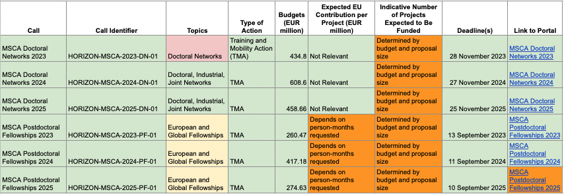
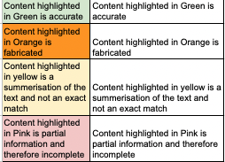
ChatGPT (https://chatgpt.com/)
ChatGPT is a large language model developed by OpenAI (USA)
Closed source so not transparent
Not GDPR compliant since its based in the USA and the data inputted is subject to the Patriot Act
It does sell your data to third parties and uses it for training future models
Therefore ChatGPT’s use must remain limited to publicly available, non-sensitive information to mitigate privacy and security risks.
However the free version has some useful capabilities for publicly available content by enabling users to upload large documents and ask it to summerise/analayse/reformat content
For example, users can upload a Horizon Europe Work Programme and ask it to summerise and reformat content into tables
Using ChatGPT to reformat a document into tables
Notes:
ChatGPT is a large language model developed by OpenAI (USA)
Its closed source so not transparent and we do not know how it was trained or the data used
ChatGPT is not GDPR compliant since its based in the USA and the data inputted is subject to the Patriot Act
It does sell your data to third parties and uses it for training future models
Therefore ChatGPT’s use must remain limited to publicly available, non-sensitive information to mitigate privacy and security risks
However the free version has some useful capabilities for publicly available content by enabling users to upload large documents and ask it to summerise, analayse or reformat content
For example, users can upload a Horizon Europe Work Programme and ask it to summerise and reformat content into tables
The Content highlighted in Green is accurate
The Content highlighted in Orange is fabricated
The Content highlighted in yellow is a summerisation of the text and not an exact match to what was written in the Work Programme
The Content highlighted in Pink is partial information and therefore incomplete
So chatGPT when used with caution can significantly reduce workloads.
This took me about 10 minutes to do and 5 of those minutes were spent checking the outputs for accuracy

Slide 6

Mistral (https://chat.mistral.ai/chat)
Mistral is a Large Language Model (LLM) developed by Mistral AI, a company based in Paris, France.
Open source
GDPR compliant
Does not sell user data to third parties and doesn’t use inputted data for training its LLM.
Can be used to draft proposal text, summarize, sense check against funder guidelines and requirements
Limited functionality in terms of being upload documents in the free version which makes it impractical for some things.
Caution: Privacy terms are subject to change!
Note
Provides very general text and can make erroneous judgments
User needs to provide more detailed information on the technical methods, risk classification, management systems, and specific expertise involved.
Using Mistral to draft text for the Artificial Intelligence section on Horizon Europe proposal using the MSCA Handbook instructions.
— Start User Prompt —
Draft a paragraph on the use of Artificial Intelligence based on the following guidelines
‘
[COPY & PASTE GUIDELINES]
‘
using the following information
'
[add summary of the proposal]
'
— End User Prompt —
Notes:
Mistral is a Large Language Model (LLM) developed by Mistral AI, a company based in Paris, France
Its Open source
GDPR compliant
it does not sell user data to third parties and doesn’t use inputted data for training its LLM.
Can be used to draft text, summarize, sense check text against funder guidelines and requirements but the free version does not allow you to upload documents
It's important to note that if you are not the owner of the data then you need to ask permission before entering any data into an LLM model
As part of my research, I used Mistral to draft text for for the Artificial Intelligence section on MSCA Doctoral Netowrks proposal using the MSCA Handbook instructions.
You’ll see the basic prompt I used on the slide and there are further instructions in the guidelines
The main things I would like to note are
The text it generated was very generic, it misclassified the level of risk for the project
So the user needs provide more detailed information on the technical methods, risk classification, management systems, and specific expertise involved.
It can be very useful as a starting point for the different sections of the proposal although its outputs will be very broad and require refinement
I also used it to analyse the differences between the user generated text and the LLM generated text
So Mistral a bit safer to use to avoid risking IP and data ownership but always with the consent of the data owner (i.e the researcher)
This took me about 10 minutes to do and most of that time was spent reading through the text and seeing how it compared.

Slide 7
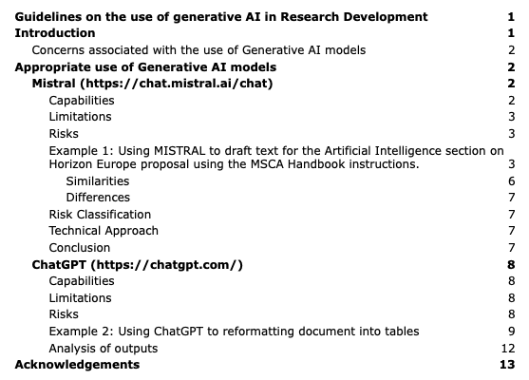
Use of generative AI in Research Development
Generative AI models like Mistral and ChatGPT offer significant potential to enhance research development by automating tasks such as summarizing content, brainstorming ideas, and reformatting documents, their use comes with substantial risks and ethical considerations.
Key concerns include data privacy, ownership, transparency, bias, inaccuracy, and high energy consumption.
To leverage these tools effectively, it is crucial to use them judiciously, ensuring compliance with regulations like GDPR, validating outputs for accuracy, and limiting their application to non-sensitive information.
By doing so, we can harness the benefits of generative AI while mitigating associated risks and upholding ethical standards.
Notes:
So in conclusion
Generative AI models like Mistral and ChatGPT offer significant potential to enhance research development by automating tasks such as summarizing content, brainstorming ideas, and reformatting documents,
But their use comes with substantial risks and ethical considerations around data privacy, data ownership, transparency, bias, inaccuracy, and high energy consumption.
To leverage these tools effectively, we need to monitor them carefully for changes in their privacy policies and they are best used for non-sensitive, publicly available information.
By doing so, we can harness the benefits of generative AI while mitigating associated risks.

Slide 8
Thank you
Monica Lechea
monica.lechea@adaptcentre.ie

