Slide 1


Quality and Institutional Insights Office (QIO)
Quality Improvement & Development (QuID) Funding 2023/24
Transitioning AI from a Threat to a Tool: Project Completion Report 2024
Understanding and comparing the benefits of Google’s Gemini AI and ChatGPT for Python Learning
Dr. Anderson Simiscuka, Performance Engineering Lab, School of Electronic Engineering

Slide 2



Applicant and Involved Members
Applicant/Project PI: Dr. Anderson Simiscuka, Postdoctoral Researcher, Performance Engineering Lab, School of Electronic Engineering
  Design of Assignments, Data Processing, and Publication Leading
Collaborator: Dr. Abid Yaqoob, Performance Engineering Lab, School of Electronic Engineering
    Design of Assignments, Data Processing
Mentor: Prof. Gabriel-Miro Muntean, Performance Engineering Lab, School of Electronic Engineering
    Mentoring, Design of Assignments, Delivery to Students, and Marking

Slide 3








Motivation
With the rise of AI tools like ChatGPT and Google Gemini, there is a growing need to explore their practical applications in education, especially in programming.
Programming is a challenging skill for beginners, and AI tools can help students by simplifying complex concepts, debugging code, and offering solutions in real-time.
AI can reduce the time students spend troubleshooting errors, allowing them to focus on logic, structure, and problem-solving.
By showing how AI can assist, rather than replace, human learning processes, this project can pave the way for transforming AI tools into effective educational aids.

Slide 4
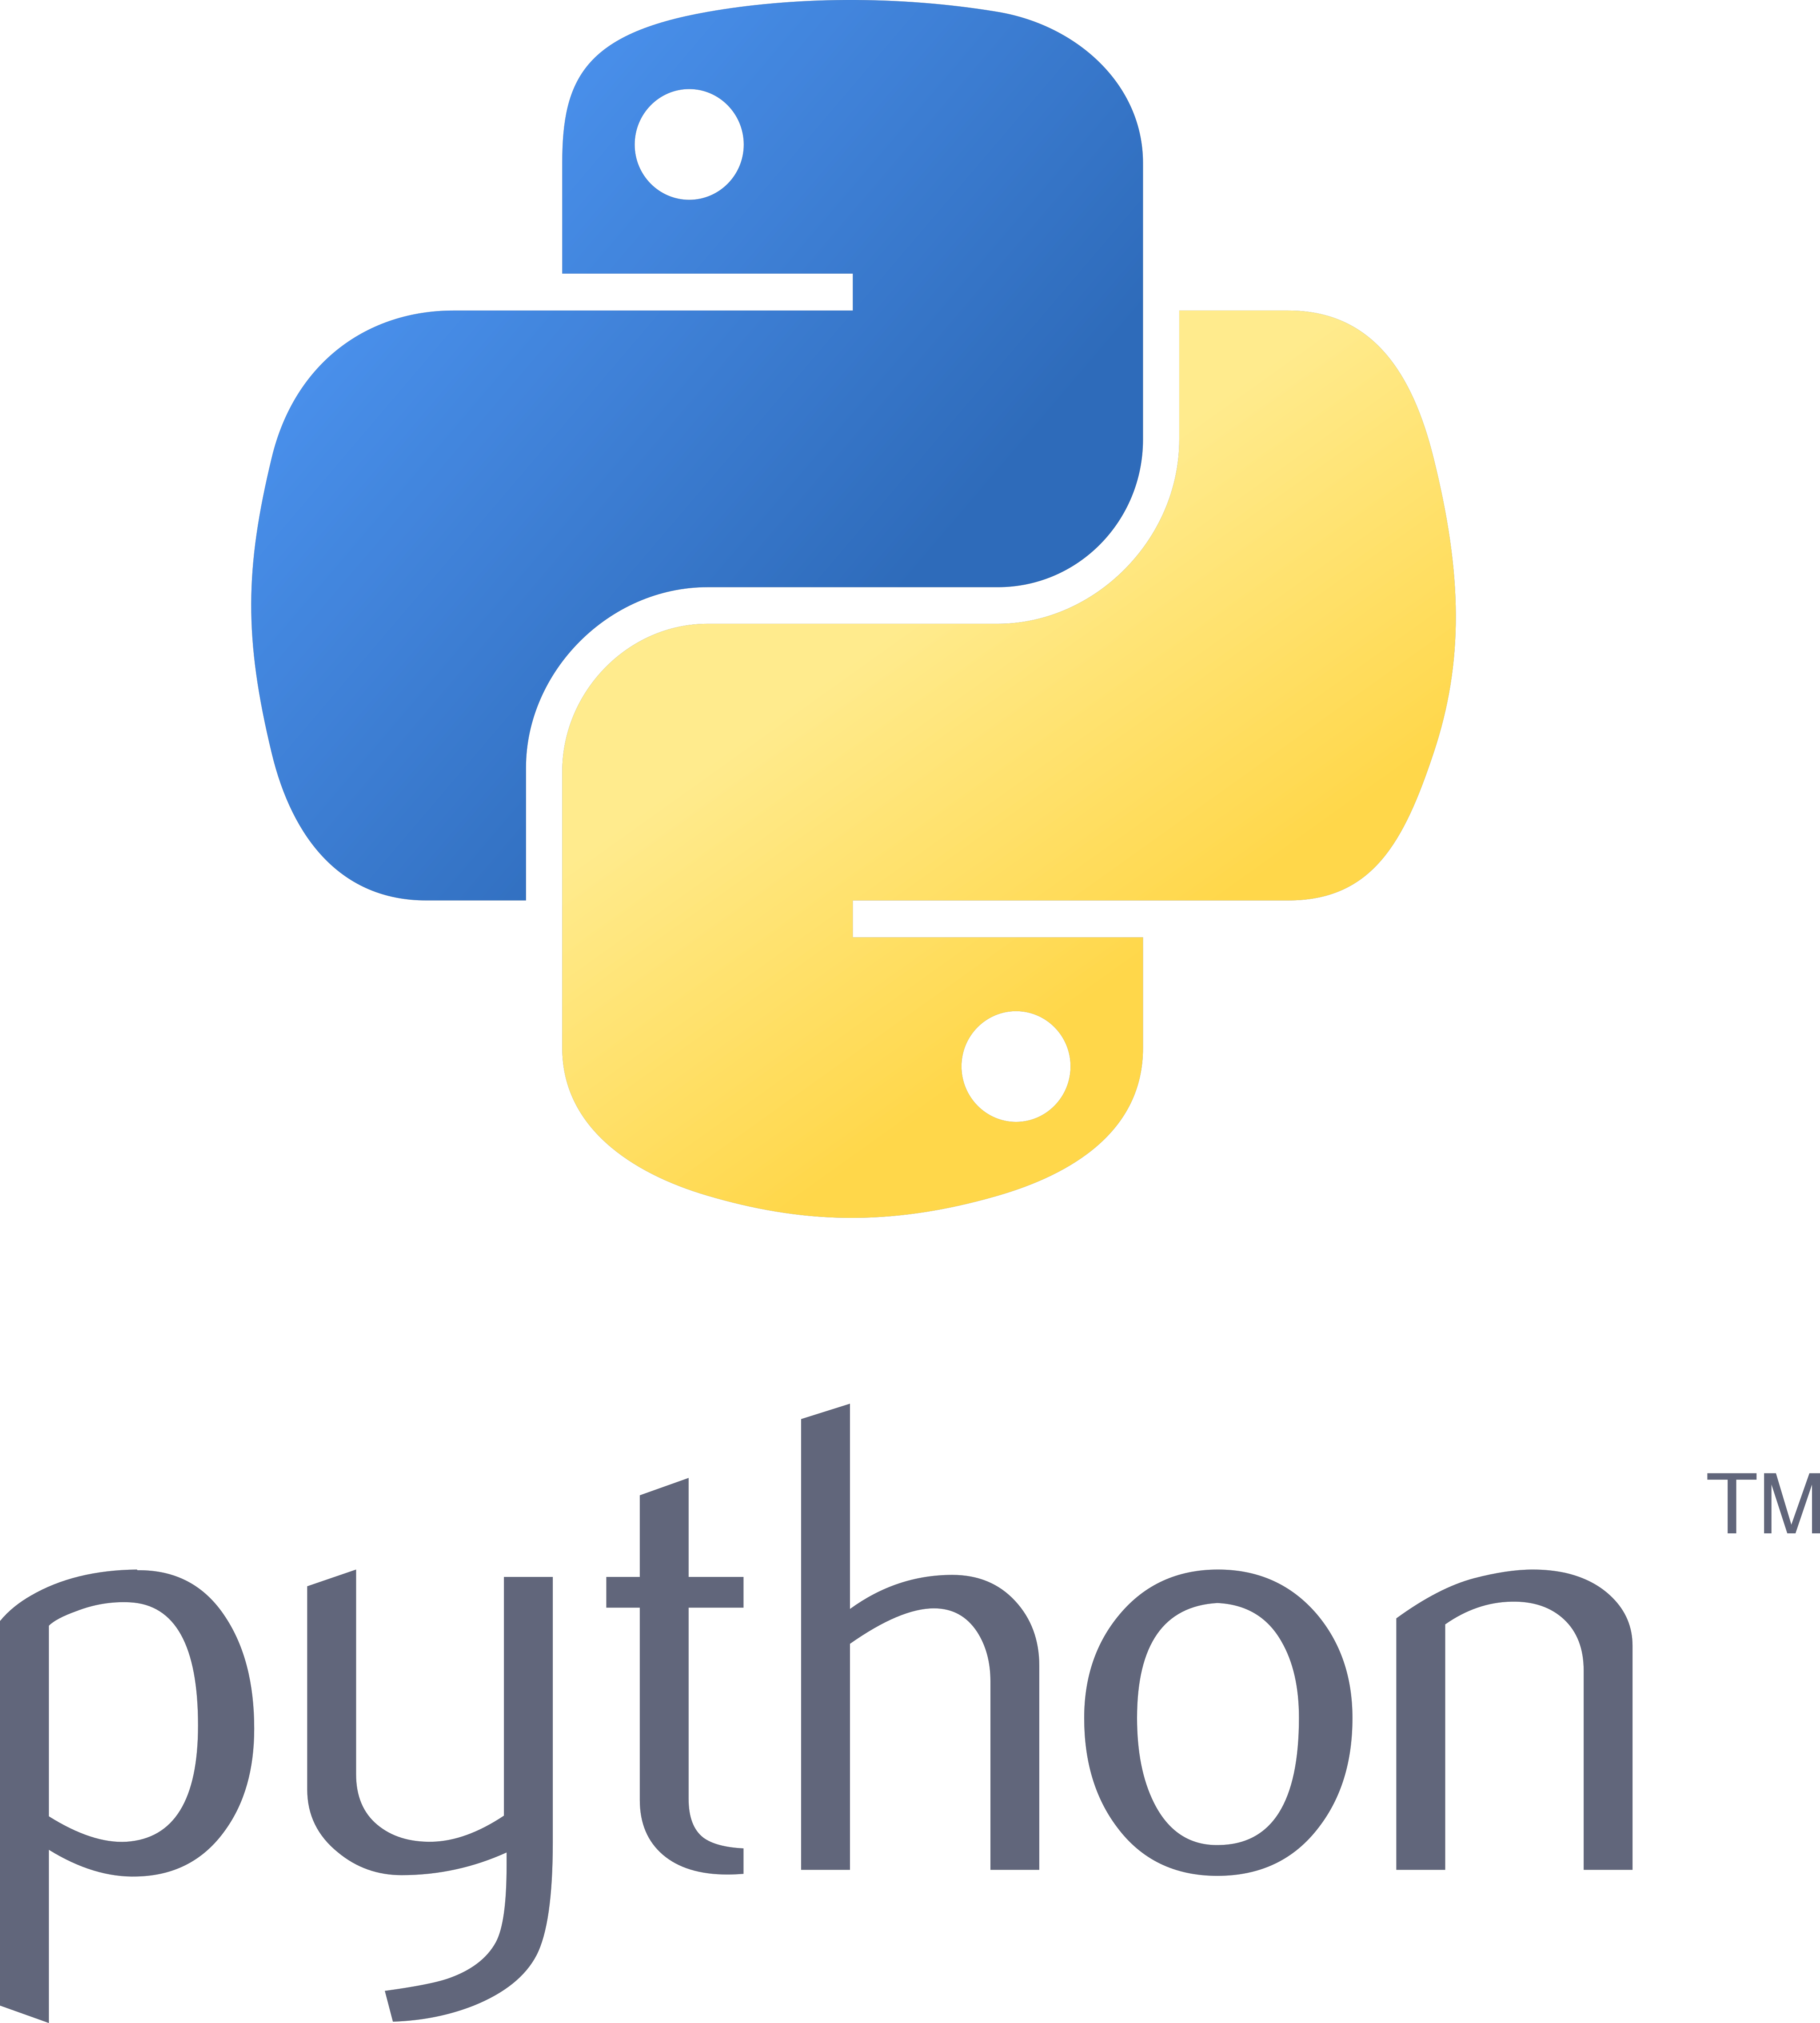
Project Description
Focus: Comparing the benefits of ChatGPT and Google Gemini for Python learning.
Participants: 204 first-year BSc students (EM108 module).
Activities: Coding 'Morra' and 'Quarto' games, with/without LLM assistance.
Questionnaire to capture experiences with assignments.

Slide 5

Assignment 1 - Game: Morra
Morra is a simple two-player game where each player simultaneously shows a number of fingers (0-5).
Rules:
  1. Players also simultaneously guess the total number of fingers shown by both players.
  2. A player wins if their guess matches the actual total number of fingers.
  3. If both players guess correctly, it is a tie.
This game is used to teach basic logic and conditional programming in Python.

Slide 6
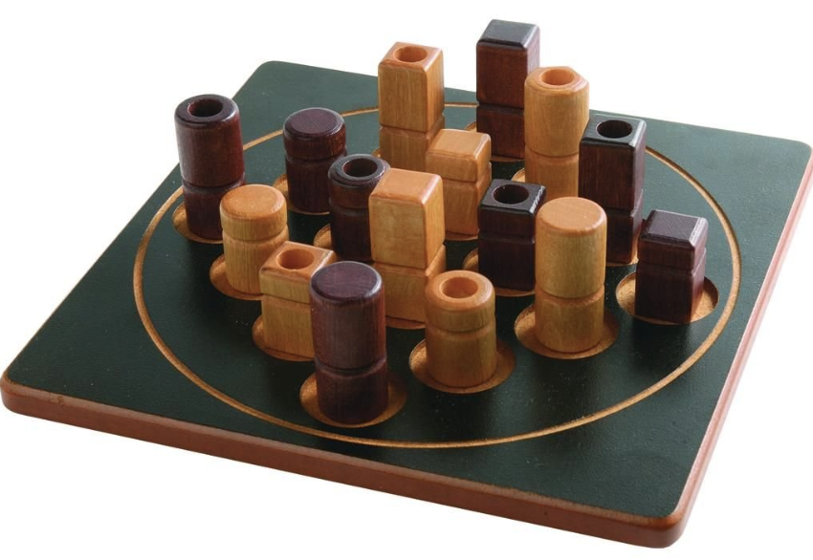
Assignment 2 - Game: Quarto
Quarto is a two-player board game played on a 4x4 grid.
Objective: Players try to create a line (horizontal, vertical, or diagonal) of four pieces sharing at least one common feature.
Features: Pieces differ by height, color, shape, and solid/hollow.
Rules:
  1. Players select a piece for their opponent to play.
  2. The opponent must place the piece on the board.
  3. The game encourages strategic thinking and decision-making.
This game is ideal for teaching advanced programming concepts and AI decision logic.

Slide 7
Assignment 2 - Game: Quarto
Group Allocation: Students worked in pairs. Each pair was assigned into one of four groups (A, B, C, D), each with different requirements:
  Specified LLM to use (ChatCPT or Gemini).
  Input type for generating Python code: diagrams or pseudocode.
  ChatGPT Plus was the only version allowing for diagrams and images to be inserted as inputs for prompts. In total, 20 pairs (40 students) needed these plus accounts.
Step-by-Step Process:
  1. Students created a step-by-step plan for the Quarto game.
  2. The plan was input into the LLM to generate pseudocode or a diagram.
  3. The generated pseudocode or diagram was reinserted into the LLM to produce Python code.
  4. Students asked the LLM to correct errors using prompts.

Slide 8
Project Timeline
Ethical Approval: 08/03/2024 - DCUREC/2024/027
Purchase of ChatGPT Accounts: 25–27/03/2024
Assignment 1 (Morra): 13/03/2024 – 29/03/2024
Assignment 2 (Quarto): 27/03/2024 – 10/04/2024
Conference Attendance: 19–21/06/2024

Slide 9
Project Costs and Funding Usage
ChatGPT Accounts (20): €463.80
Conference Costs: €2,333.00
  Flights to Conference: €502.78
  Conference Fee: €551.82
  Accommodation: €1,278.40
Total Expenses: €2,796.80

Slide 10
Quality Assurance and Enhancement
Benefits: Introduced Python programming with AI tools.
Outputs: Findings submitted to IEEE Transactions on Education.
Methodology applicable to engineering and math education.
The project also aligns with Quality and Qualifications Ireland (QQI) guidelines on identifying beneficial applications of such AI tools.

Slide 11
Project Evaluation
Assignment 1 (Manual):
Average Marks: 71.7
Average Time Fixing Errors: 142 mins
Average Time Completion: 424 mins
Assignment 2 (LLM):
Average Marks: 69.8
Average Time Fixing Errors: 166 mins
Average Time Completion: 326 mins

Slide 12
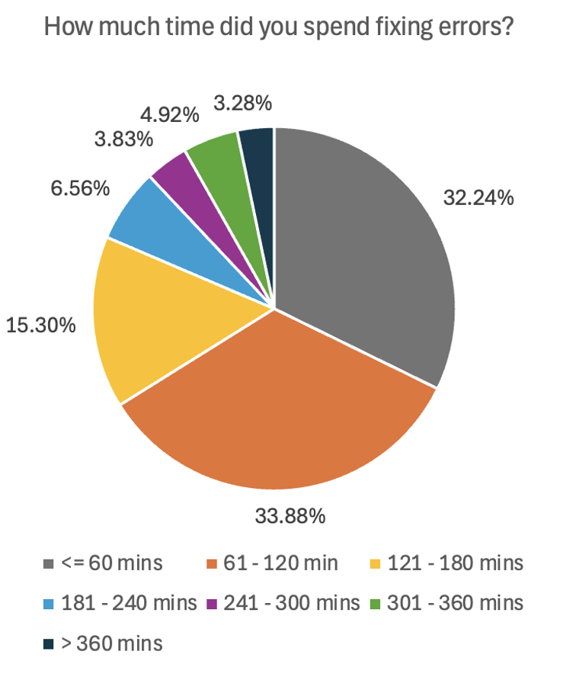
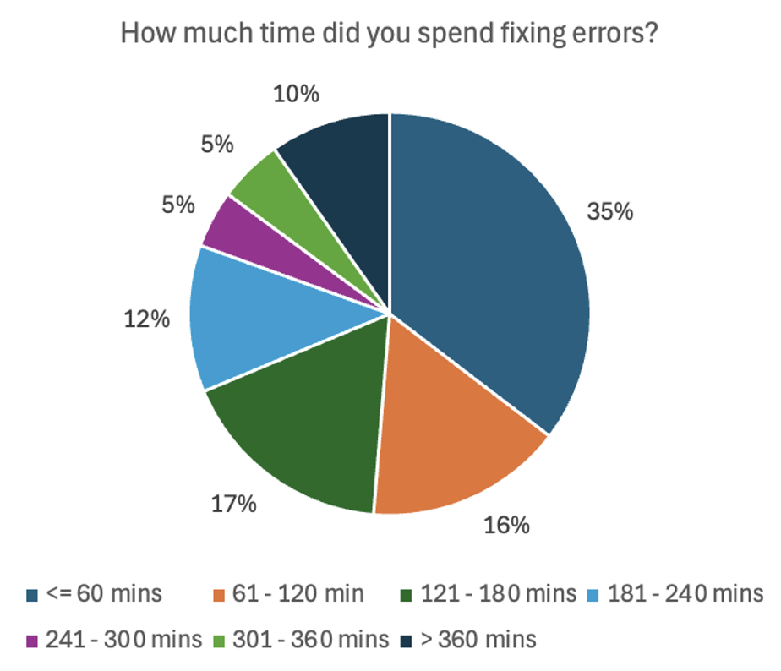
Project Evaluation
How much time did you spend fixing errors?
Assignment 1 Assignment 2
you

Slide 13
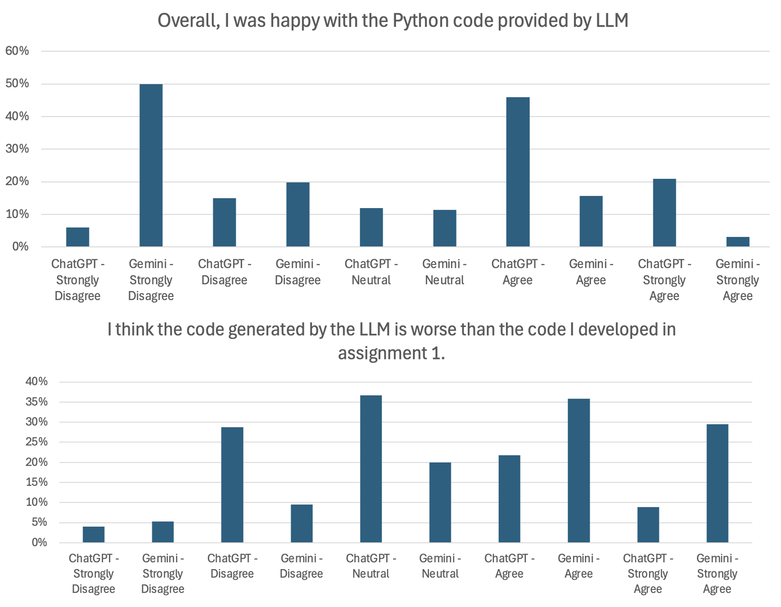
Project Evaluation

Slide 14
Conclusions
Code Compilation:
  ChatGPT: 12 out of 101 students (12%) reported code compilation issues.
  Gemini: 40 out of 98 students (41%) reported code compilation issues.
Students used approximately 23% less time to complete assignment using LLMs, despite slightly lower marks.
Student Satisfaction with LLMs:
    65% of students agreed or strongly agreed that ChatGPT provided satisfactory answers, compared to 15% for Gemini.
    67% of students agreed or strongly agreed that ChatGPT provided satisfactory Python code, compared to 19% for Gemini.
    42% disagreed or strongly disagreed that ChatGPT’s code was worse than their own, while 49% agreed or strongly agreed for Gemini.
Overall Findings:
  ChatGPT consistently outperformed Gemini in terms of code quality, compilation success, and student satisfaction.
  The faster completion times in Assignment 2 suggest that LLMs assist in reducing workload, though Gemini’s higher failure rates required more time spent fixing errors.

Slide 15
This project was funded by the Quality and Institutional Insights Office, Dublin City University.

Slide 16
Thank you!
Any questions?
This project was funded by the Quality and Institutional Insights Office, Dublin City University.

