Slide 1
Pathways
First Year
Unit 1: Hidden skills and talents
Notes:
Attention teachers:
The Pathways units aim to encourage students from diverse backgrounds to think about their career choices, the career decision making process and particularly teaching as a desirable career.
These units are an initiative of the Path Project, which is funded by the Higher Education Authority (HEA), and based in the Institute of Education, Dublin City University (DCU).
There are 3 units for 1st Year students, each approximately 2 hours duration.
Unit 1: Hidden skills and talents
Unit 2: Strategies and styles
Unit 3: Goals and motivations
Some important points about how the Pathways units work:
The slides are classroom ready.
The teacher notes, with step-by-step guidance for the specific activity on each slide, is available in the slide notes or can be accessed in pdf format in the google drive.
It is important to show slides in presentation mode, as some activities depend on animation. Where there is animation on a slide, this is indicated in the slide notes.
When the text in the slide notes is in italics, it is meant it is meant to be paraphrased or used without adaptation by the teacher with students; and when the text is not italicised, it is meant for the teacher only.
There is very little preparation of materials required. Occasionally, and depending on your class, you might decide to photocopy worksheet slides in advance. In activities where this might be useful, you will be promoted in the slide notes.
As a participating teacher, you will be invited to respond to short surveys about the usefulness and effectiveness of these units. In addition, you will be asked to invite students to participate in the research (once parental consent has been provided). This will involve questionnaires and interviews/focus groups.
NB: Before you start Unit 1, please make sure that your students have completed the short baseline survey: https://forms.gle/sPFEvzfTc5ZpfLbt9
Please remember to complete the short teacher survey as soon as possible after finishing Unit 1: https://forms.gle/fgSMbmXMBAk9tjTa7
If you require any further information, please contact: mary.odoherty@dcu.ie
Thank you

Slide 2
Unit 1: Hidden Skills and Talents
Duration: Approx. 2 hours
Suggested learning intentions
We are learning to…
summarise information about young people who have achieved because of their skills and talents
reflect on and share our own skills and talents
identify the skills, talents and supports we need to achieve a goal
    Wellbeing Indicators
    Responsible
    Resilient
    Connected
    Aware
Key Skills
Being literate
Managing myself
Staying well
Managing information and thinking
Being numerate
Being creative
Working with others
Communicating
SLIDES | ACTIVITY | What will we be doing?
3 |  | Introduction to the icons
4 | 1 | Summarising and presenting information about other young people
5-7 | 2 | Reflecting on our skills and talents, sharing these with others and making the link to the 8 key skills of junior cycle
8 | 3 | Discussing the ups and downs of having and getting/building skills and talents
9-10 | 4 | Setting a goal and identifying the skills, talents and supports needed to achieve this goal
11 | 5 | Reflecting on the skills and talents used in this unit
12 | 6 | Checking in with the learning intentions
13 | Extension task | Discussing how to celebrate achieving our goals

Slide 3
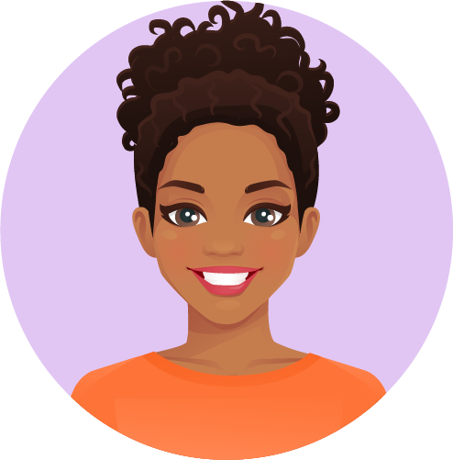








Unit 1, Introduction
Hi, I’m Larissa.
Nice to meet you!
I’m here to tell you that we use icons (the small pictures below) in this unit. These will help you to understand what you will be doing during the different activities.
Have fun (and learn lots)!
Individual work
Make a presentation
Pair work
Go online
Group work
Extension activity

Slide 4

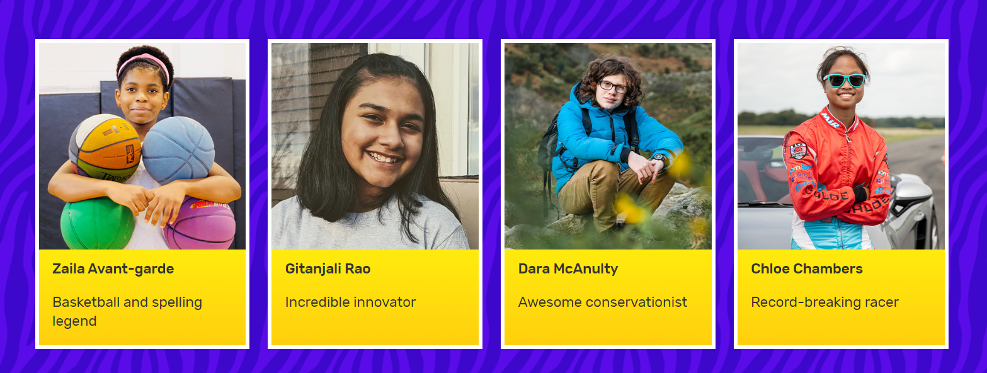
Unit 1, Activity 1
Here’s just a few of the Young Achievers from the 2023 Guinness Book of Records. There are lots more!
Time to go online: https://kids.guinnessworldrecords.com/records/young-achievers/
Notes:
Teacher notes (One animation at *Click)
Has anyone in the class ever gotten The Guinness Book of Records as a present? Can you remember any of the young people in the book?
The four people on the slide were in The Guinness Book of Records in 2023.
Of these four young people, three are from the United States. Dara McAnulty is from Northern Ireland. He is really interested in nature and especially in birds.
Zalia Avant-garde was in The Guinness Book of Records for both basketball and spelling; Gitanjali Rao has invented new technologies; and Chloe Chambers has broken racing records even though she is still a learner driver!
How do you think these young people realised that they had these skills and talents?
*Click to animate the next step in this activity
Take out your devices.
Go to: https://kids.guinnessworldrecords.com/records/young-achievers/
Depending on availability of devices, this activity could be done individually, in pairs or in small groups.
If you do not have online access, you could select and copy information about 2-4 Guinness Book of Records Young Achievers in advance (see website below). Invite students to answer questions 1-4 (below) as you read the information about the Young Achieves aloud in class.
Choose one of the Young Achievers profiled on this page. Pick someone that you feel you have something in common with – maybe you share a skill or a talent, maybe they have a skill or a talent that you think you might also be good at, or maybe you’re just curious to know more about them.
Read about your chosen person and find out:
How this person discovered their skill or talent?
What they do to improve their skill or talent?
Who has helped and supported them in getting to this point?
How they plan on using this skill or talent in the future?
Keep notes on your findings.
When students have finished this step, ask for volunteers to present their findings.
Their presentation should include a brief biography of their chosen person and the answers to the 4 questions above.
Use the following to prompt students during their presentations:
Do you find this person inspiring? Why?
What have you learned by reading about this person?
If you could ask this person one question, what would it be?

Slide 5
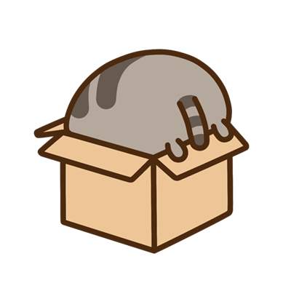

Unit 1, Activity 2
I have lots of hidden talents. The problem is, even I can’t find them!
Notes:
Teacher notes
Read aloud the quote on the slide.
Although some of our skills and talents are obvious, others go unnoticed or are hidden. You can spot your hidden skills and talents by paying attention to the things that energise you.
Take two minutes to think back over the last week.
When did you feel most energised? What were you doing at the time? What skills or talents were you using?
You might find it helps to jot down your answers to these question on a piece of paper.

Slide 6
Unit 1, Activity 2: Worksheet
Favourite hobby
Favourite place
Name
Talent(s) or skill(s)
Favourite colour
Favourite book
Adjectives (describing words) to describe yourself
Favourite music
Favourite food
Favourite movie/video game
Favourite sport to watch/play
Notes:
Teacher notes
Distribute a copy of this slide to each student or invite students to copy the headings on the graphic.
Firstly, write your name, then concentrate on the information about your favourite things.
Then, come up with talents and skills that you have as a result of your favourite things.
Finally, write positive words that describe you – it could be ‘friendly’ or ‘sporty’ or ‘artistic’ or ‘funny’. If possible, pick adjectives (describing words) that make sense in light of the other things that you have written.
Divide the class into small groups.
Now, take turns to share your favourite things, hidden skills and talents in your group.
Remember to listen attentively and show your interest by asking questions when your classmates have finishing speaking about their favourite things and skills/talents.
Consider using an online alarm clock or a bell to signal to students when it is time to hear from someone else.
Allow approx. 10 minutes, then invite students to bring their attention back to you.
Sometimes other people are better at spotting our hidden skills and talents than we are. That is because we sometimes think our skills and talents aren’t that special and we take them for granted.
What, if anything, did you notice or discover about your classmates in this activity?
What, if anything, did you learn about the pool of skill and talent in your group?
Who or what has helped and supported the members of the group to build these skills and talents?
What one positive adjective would you use to describe your group?
Hold onto this worksheet/piece of paper, because you might want to add to it later.

Slide 7

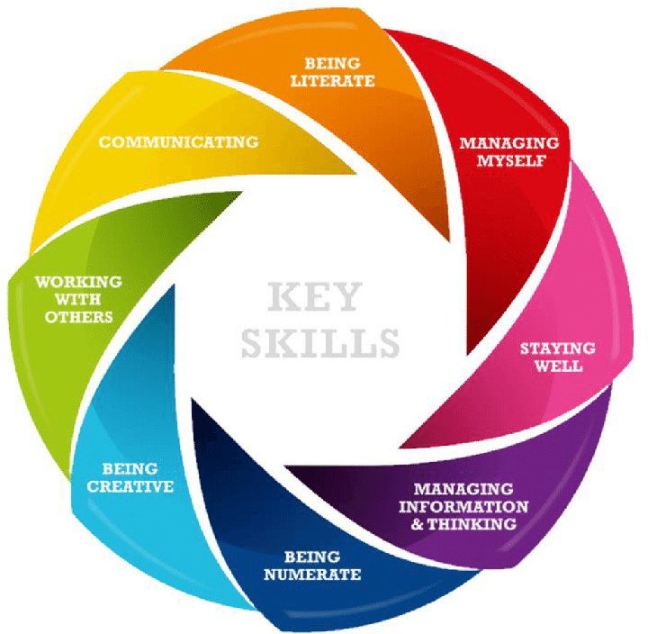
Unit 1, Activity 2
Notes:
Teacher notes
Tell/remind students that there is a focus in junior cycle on building the 8 key skills on the slide.
Read each key skill aloud, ensuring that everyone understands what each key skill means.
Compare the 8 key skills of junior cycle with the skills/talents you have on your worksheet (Slide 6).
Which key skills are you confident that you can demonstrate or show?
Which key skills do you think you might you need to do some work on?

Slide 8
Unit 1, Activity 3
When have you had the most success (been most proud of yourself) in your life? It could be when you were a good friend, gave a good performance, when you learned something well. What about yourself has led to this success?
Imagine a time you felt you were at your best…
Describe what you were doing, and what about that situation made you feel confident.
Compare this to a time when you felt uneasy, or a time you were not confident.
What are the differences?
Think of someone in your life who you admire or respect. What are this person’s greatest skills/talents? How do you know?
Do you have any of these skills/talents? How do you know?
Situations that show us that our skills/talents might need to be stronger can leave us feeling frustrated or tired. What sort of situations cause you to feel this way? What might be the cause of this?
Notes:
Teacher notes
Divide the class into pairs.
Imagine you are on a video call together.
Each person should pick one conversation option from the four on the slide.
Take turns to use your chosen conversation option to ask questions of your partner.
If you want to, now’s the time to add another talent/skill or adjective to your sheet (see Slide 6).

Slide 9

Unit 1, Activity 4
My goal this weekend is to move only enough so that it is obvious that I’m not unconscious!
Notes:
Teacher notes
Read the quote on the slide aloud.
When a person’s goals align with their skills/talents, they tend to put in more effort, and are more likely to be successful. It’s a self-fulfilling prophesy. A self-fulfilling prophecy is a prediction that comes true at least partly because of the belief or expectation that the prediction will come true. For example, if you believe, like the sleeping panda on the slide, that you are going to have a lazy weekend, if you doing nothing is your goal, then you are probably going to be successful in your goal.
Depending on your class, you might like to share an example from your journey to becoming a teacher when your goals aligned with your skills/talents.

Slide 10

Unit 1, Activity 4: Worksheet
My name:
__________________________
My goal:
__________________________
__________________________
The date by which I want to achieve my goal:
__________________________
Notes:
Teacher notes
Distribute one copy of this slide to each student or invite students to copy their own football.
Write your name at the top of the page.
Think about a goal you want to achieve or complete in the short terms (e.g. by the end of today, next week or this year).
Write this goal under the ‘My Goal’ heading.
In the white spaces on the football, write/draw ideas for how you can use your
skills/talents to achieve this goal.
In the space around the football, write/draw things or people who can support you to
achieve this goal.
Write the date by which you want to have achieved your goal on the sheet. Be
realistic!
Display the completed footballs on classroom wall or ask students to keep it safe in
their copy.

Slide 11


Unit 1, Activity 5
Username:
_________________________________
Password:
_________________________________
Notes:
Teacher notes
You might like to show Slide 8, with the 8 key skills of junior cycle after you explain the activity below.
Take a minute to think about one skill/talent you used as you participated in the activities in this unit.
Depending on your class, you might want to remind them of the activities in this unit.
Come up with a username to summarise this one skill/talent (see example below).
Write your username, with a short explanation, in your copy.
Now, come up with a password, with a maximum of 8 characters, to describe how you demonstrated this skill or talent (see example below).
Write your password, with a short explanation, in your copy.
Depending on your class, it might help to share the following as examples:
Username: CreativeCathy; Password: WithIdea (because my name is Cathy and my skill is being creative and I demonstrated this skill/talent by coming up with a good idea about how to present my Young Achiever)
Username: TimTeamWork; Password: HelpPal (because my name is Tim and my skill is working with others. I demonstrated this skill/talent when I helped my friends when we were working together in pairs/groups).

Slide 12

Unit 1, Checking in with the learning intentions
Hello again!
How did you get on with Unit 1?
Did you learn to…?
summarise information about young people who have achieved because of their skills and talents
reflect on and share our own skills and talents
identify the skills, talents and supports we need to achieve a goal
Notes:
Teacher notes
Read each learning intention aloud.
Ask students to give you a thumbs up if they feel they have achieved the learning intention, a thumbs down if they still need some support and a fist if they are unsure.

Slide 13
Unit 1, Extension activity
Here’s an idea for you.
Remember that goal that you said you wanted to achieve?
When you can honestly say that you have achieved your goal, why not celebrate by making a Young Achievers profile of yourself?
Maybe you could all work together to make your own class Guinness Book of Records?
After all, you are all OFFICIALLY AMAZING!!!
Notes:
Teacher notes
The extension activity suggested on this slide is linked to Activity 1 (Slide 4) and Activity 4 (Slide 10).
NB: Please remember to complete the short teacher survey as soon as possible after finishing Unit 1: https://forms.gle/fgSMbmXMBAk9tjTa7

Slide 14
Path Project
Institute of Education
Dublin City University

