Slide 1
Conairí
An Chéad Bhliain
Aonad 1: Scileanna agus Buanna Faoi Cheilt
Notes:
Attention teachers:
The Pathways units aim to encourage students from diverse backgrounds to think about their career choices, the career decision making process and particularly teaching as a desirable career.
These units are an initiative of the Path Project, which is funded by the Higher Education Authority (HEA), and based in the Institute of Education, Dublin City University (DCU).
There are 3 units for 1st Year students, each approximately 2 hours duration.
Unit 1: Hidden skills and talents
Unit 2: Strategies and styles
Unit 3: Goals and motivations
Some important points about how the Pathways units work:
The slides are classroom ready.
The teacher notes, with step-by-step guidance for the specific activity on each slide, is available in the slide notes or can be accessed in pdf format in the google drive.
It is important to show slides in presentation mode, as some activities depend on animation. Where there is animation on a slide, this is indicated in the slide notes.
When the text in the slide notes is in italics, it is meant it is meant to be paraphrased or used without adaptation by the teacher with students; and when the text is not italicised, it is meant for the teacher only.
There is very little preparation of materials required. Occasionally, and depending on your class, you might decide to photocopy worksheet slides in advance. In activities where this might be useful, you will be promoted in the slide notes.
As a participating teacher, you will be invited to respond to short surveys about the usefulness and effectiveness of these units. In addition, you will be asked to invite students to participate in the research (once parental consent has been provided). This will involve questionnaires and interviews/focus groups.
NB: Before you start Unit 1, please make sure that your students have completed the short baseline survey: https://forms.gle/sPFEvzfTc5ZpfLbt9
Please remember to complete the short teacher survey as soon as possible after finishing Unit 1: https://forms.gle/fgSMbmXMBAk9tjTa7
If you require any further information, please contact: mary.odoherty@dcu.ie
Thank you

Slide 2
Aonad 1: Scileanna agus Buanna Faoi Cheilt
Fad: Thart ar 2 uair a chloig
Cuspóirí foghlama molta
Táimid ag foghlaim conas...
faisnéis a achoimriú maidir le daoine óga a bhfuil rudaí gnóthaithe acu mar gheall ar a gcuid scileanna agus buanna
machnamh a dhéanamh ar ár scileanna agus ár mbuanna féin
na scileanna, na buanna agus na tacaíochtaí a shainaithint a theastaíonn uainn chun cuspóir a bhaint amach
    Táscairí Folláine
    Freagrach
    Athléimneach
    Nasctha
    Feasach
Sleamhnáin | Gníomhaíocht | Cad a bheidh ar bun againn?
3 |  | Réamheolas ar na deilbhíní
4 | 1 | Faisnéis a achoimriú agus a chur i láthair maidir le daoine óga eile
5-7 | 2 | Machnamh a dhéanamh ar ár scileanna agus ár mbuanna, iad sin a chomhroinnt le daoine eile agus an ceangal a dhéanamh le 8 n-eochairscil den tsraith shóisearach
8 | 3 | Plé a dhéanamh ar na buntáistí agus na míbhuntáistí a bhaineann le scileanna agus buanna a bheith agat agus le hiad a fháil/a fhorbairt
9-10 | 4 | Cuspóir a shocrú agus na scileanna, buanna agus tacaíochtaí a shainaithint a theastaíonn chun an cuspóir sin a bhaint amach
11 | 5 | Machnamh a dhéanamh ar na scileanna agus buanna a úsáideadh san aonad seo
12 | 6 | Ag seiceáil isteach leis na cuspóirí foghlama
13 | Ceacht le cois | Plé a dhéanamh ar conas baint amach ár gcuspóirí a cheiliúradh
Eochairscileanna
Léamh agus scríobh a bheith agat
Mé féin a bhainistiú
Ag fanacht ar fónamh
Faisnéis agus smaoineamh a bhainistiú
A bheith uimheartha
A bheith cruthaitheach
Ag obair le daoine eile
Cumarsáid

Slide 3









Aonad 1, Réamheolas
Haigh, is mise Larissa.
Deas buaileadh leat!
Tá mé anseo le hinsint duit go mbainimid úsáid as deilbhíní (na pictiúir bheaga thíos) san aonad seo. Cuideoidh siad sin leat an méid a bheidh á dhéanamh agat le linn na ngníomhaíochtaí éagsúla a thuiscint.
Bain sult as (agus bí ag foghlaim)!
Obair aonair
Láithreoireacht a dhéanamh
Obair i mbeirteanna
Téigh ar líne
Obair ghrúpa
Gníomhaíocht le cois

Slide 4

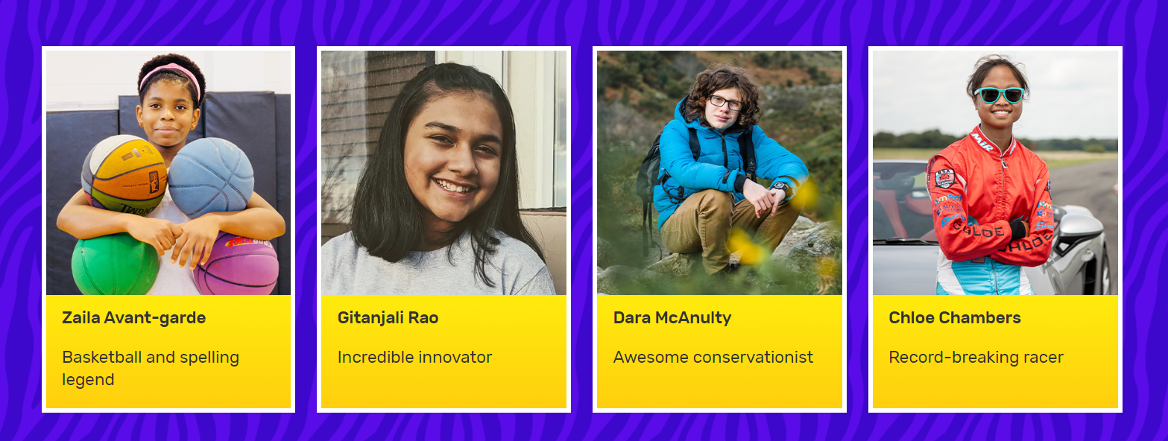
Aonad 1, Gníomhaíocht 1
Seo roinnt de na Gnóthachtálaithe Óga ó ‘Guinness Book of Records’ 2023. Tá go leor eile ann!
Tá sé in am dul ar líne: https://kids.guinnessworldrecords.com/records/young-achievers/
Notes:
Teacher notes (One animation at *Click)
Has anyone in the class ever gotten The Guinness Book of Records as a present? Can you remember any of the young people in the book?
The four people on the slide were in The Guinness Book of Records in 2023.
Of these four young people, three are from the United States. Dara McAnulty is from Northern Ireland. He is really interested in nature and especially in birds.
Zalia Avant-garde was in The Guinness Book of Records for both basketball and spelling; Gitanjali Rao has invented new technologies; and Chloe Chambers has broken racing records even though she is still a learner driver!
How do you think these young people realised that they had these skills and talents?
*Click to animate the next step in this activity
Take out your devices.
Go to: https://kids.guinnessworldrecords.com/records/young-achievers/
Depending on availability of devices, this activity could be done individually, in pairs or in small groups.
If you do not have online access, you could select and copy information about 2-4 Guinness Book of Records Young Achievers in advance (see website below). Invite students to answer questions 1-4 (below) as you read the information about the Young Achieves aloud in class.
Choose one of the Young Achievers profiled on this page. Pick someone that you feel you have something in common with – maybe you share a skill or a talent, maybe they have a skill or a talent that you think you might also be good at, or maybe you’re just curious to know more about them.
Read about your chosen person and find out:
How this person discovered their skill or talent?
What they do to improve their skill or talent?
Who has helped and supported them in getting to this point?
How they plan on using this skill or talent in the future?
Keep notes on your findings.
When students have finished this step, ask for volunteers to present their findings.
Their presentation should include a brief biography of their chosen person and the answers to the 4 questions above.
Use the following to prompt students during their presentations:
Do you find this person inspiring? Why?
What have you learned by reading about this person?
If you could ask this person one question, what would it be?

Slide 5


Aonad 1, Gníomhaíocht 2
Tá a lán buanna faoi cheilt agam. Is í an fhadhb nach bhfuil mise fiú in ann iad a aimsiú!
Notes:
Teacher notes
Read aloud the quote on the slide.
Although some of our skills and talents are obvious, others go unnoticed or are hidden. You can spot your hidden skills and talents by paying attention to the things that energise you.
Take two minutes to think back over the last week.
When did you feel most energised? What were you doing at the time? What skills or talents were you using?
You might find it helps to jot down your answers to these question on a piece of paper.

Slide 6
Aonad 1, Gníomhaíocht 2: Bileog Oibre
An caitheamh aimsire is fearr leat
An áit is fearr leat
Ainm
Bua(nna) nó scil(eanna)
An dath is fearr leat
An leabhar is fearr leat
Aidiachtaí (focail thuairisciúla) chun cur síos ort féin
An ceol is fearr leat
An bia is fearr leat
An scannán/an físchluiche is fearr leat
An spórt is fearr leat bheith ag féachaint air/ag imirt
Notes:
Teacher notes
Distribute a copy of this slide to each student or invite students to copy the headings on the graphic.
Firstly, write your name, then concentrate on the information about your favourite things.
Then, come up with talents and skills that you have as a result of your favourite things.
Finally, write positive words that describe you – it could be ‘friendly’ or ‘sporty’ or ‘artistic’ or ‘funny’. If possible, pick adjectives (describing words) that make sense in light of the other things that you have written.
Divide the class into small groups.
Now, take turns to share your favourite things, hidden skills and talents in your group.
Remember to listen attentively and show your interest by asking questions when your classmates have finishing speaking about their favourite things and skills/talents.
Consider using an online alarm clock or a bell to signal to students when it is time to hear from someone else.
Allow approx. 10 minutes, then invite students to bring their attention back to you.
Sometimes other people are better at spotting our hidden skills and talents than we are. That is because we sometimes think our skills and talents aren’t that special and we take them for granted.
What, if anything, did you notice or discover about your classmates in this activity?
What, if anything, did you learn about the pool of skill and talent in your group?
Who or what has helped and supported the members of the group to build these skills and talents?
What one positive adjective would you use to describe your group?
Hold onto this worksheet/piece of paper, because you might want to add to it later.

Slide 7

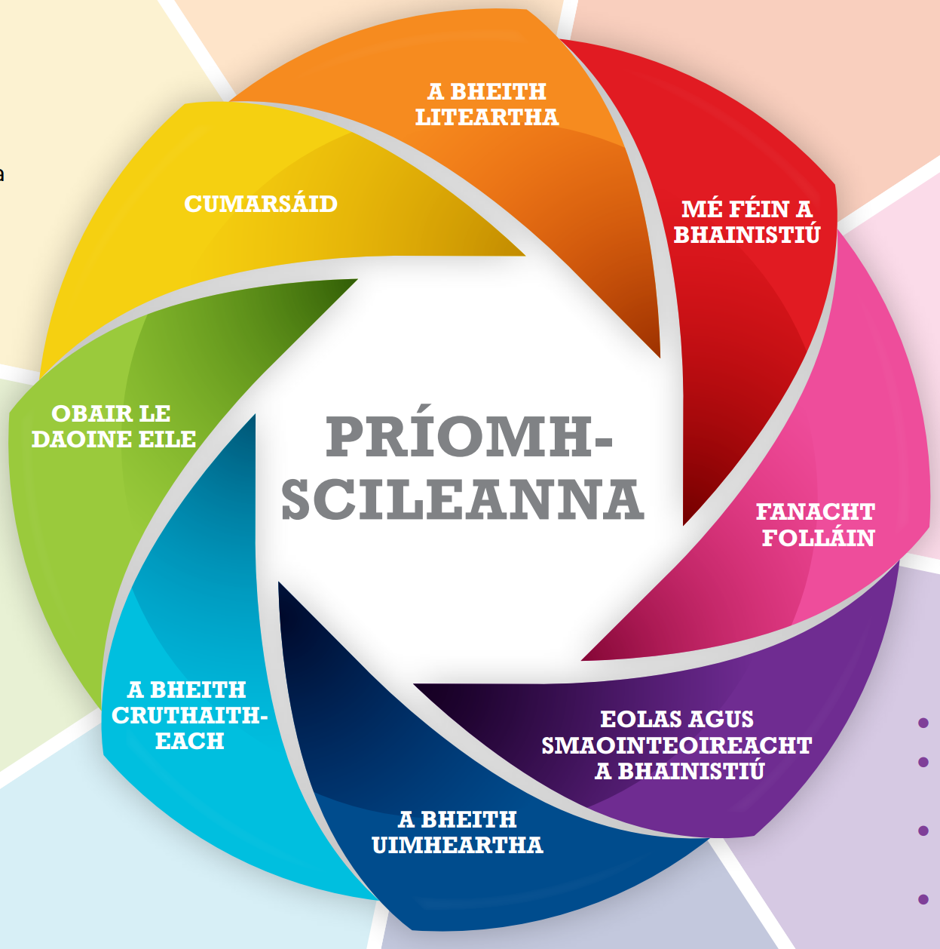
Aonad 1, Gníomhaíocht 2
Notes:
Teacher notes
Tell/remind students that there is a focus in junior cycle on building the 8 key skills on the slide.
Read each key skill aloud, ensuring that everyone understands what each key skill means.
Compare the 8 key skills of junior cycle with the skills/talents you have on your worksheet (Slide 6).
Which key skills are you confident that you can demonstrate or show?
Which key skills do you think you might you need to do some work on?

Slide 8
Aonad 1, Gníomhaíocht 3
Cathain a bhí an rath is mó ort (an bród is mó ort asat féin) i do shaol? B’fhéidir nuair a bhí tú i do chara maith ag duine, nuair a thug tú léiriú maith, nuair a d’fhoghlaim tú rud go maith. Cad atá fút féin is cúis leis an rath sin?
Samhlaigh am nuair a bhraith tú i mbarr do mhaitheasa...
Cuir síos ar an méid a bhí ar bun agat, agus ar an rud sa chás sin a chuir muinín ionat.
Cuir an t-am sin i gcomparáid le ham nuair a mhothaigh tú míshuaimhneach, nó le ham nuair nach raibh muinín ionat.
Cad iad na difríochtaí?
Smaoinigh ar dhuine éigin i do shaol ar a bhfuil meas nó urraim agat. Cad iad scileanna/buanna is mó an duine sin? Conas atá sin ar eolas agat?
An bhfuil cuid ar bith de na scileanna/buanna sin agat? Conas atá sin ar eolas agat?
D’fhéadfaimis a bheith mífhoighneach nó tuirseach mar gheall ar chásanna ina léirítear dúinn go bhféadfadh ár scileanna/buanna a bheith níos láidre b’fhéidir. Cén cineál cásanna is cúis le mothúcháin mar sin a chur ort? Cad a d’fhéadfadh a bheith ina chúis leis sin?
Notes:
Teacher notes
Divide the class into pairs.
Imagine you are on a video call together.
Each person should pick one conversation option from the four on the slide.
Take turns to use your chosen conversation option to ask questions of your partner.
If you want to, now’s the time to add another talent/skill or adjective to your sheet (see Slide 6).

Slide 9
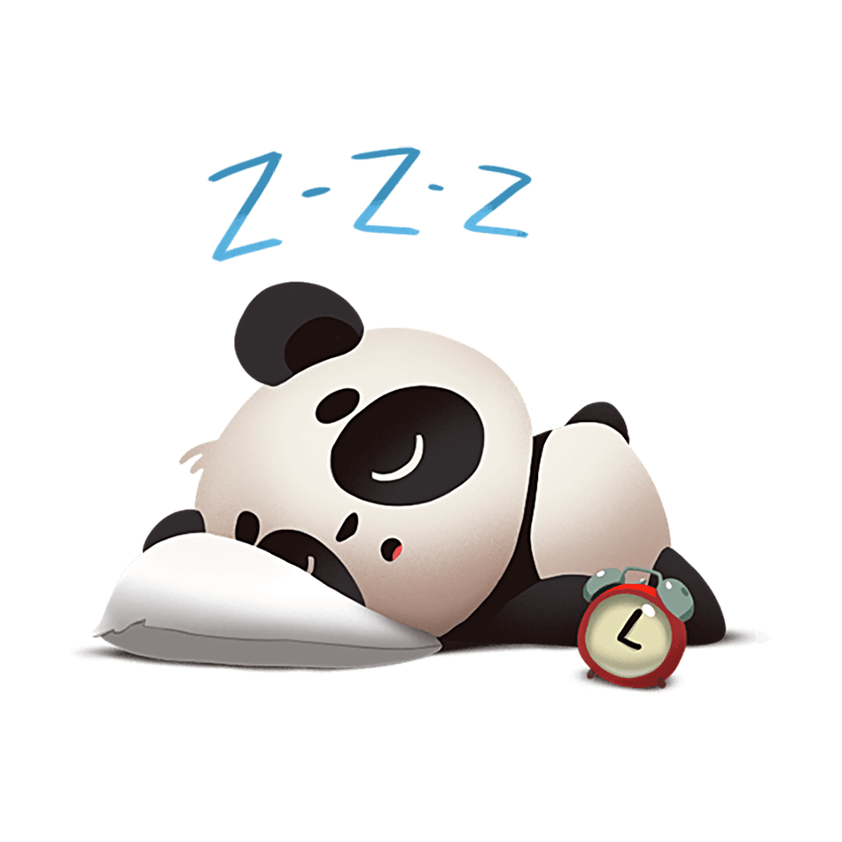
Aonad 1, Gníomhaíocht 4
Is é mo chuspóir an tseachtain seo gan bogadh ach an oiread sin agus gur léir nach bhfuil mé gan aithne!
Notes:
Teacher notes
Read the quote on the slide aloud.
When a person’s goals align with their skills/talents, they tend to put in more effort, and are more likely to be successful. It’s a self-fulfilling prophesy. A self-fulfilling prophecy is a prediction that comes true at least partly because of the belief or expectation that the prediction will come true. For example, if you believe, like the sleeping panda on the slide, that you are going to have a lazy weekend, if you doing nothing is your goal, then you are probably going to be successful in your goal.
Depending on your class, you might like to share an example from your journey to becoming a teacher when your goals aligned with your skills/talents.

Slide 10

Aonad 1, Gníomhaíocht 4: Bileog Oibre
M’ainm:
__________________________
Mo chuspóir:
__________________________
__________________________
An dáta faoina bhfuil sé de dhíth orm mo chuspóir a bhaint amach:
__________________________
Notes:
Teacher notes
Distribute one copy of this slide to each student or invite students to copy their own football.
Write your name at the top of the page.
Think about a goal you want to achieve or complete in the short terms (e.g. by the end of today, next week or this year).
Write this goal under the ‘My Goal’ heading.
In the white spaces on the football, write/draw ideas for how you can use your
skills/talents to achieve this goal.
In the space around the football, write/draw things or people who can support you to
achieve this goal.
Write the date by which you want to have achieved your goal on the sheet. Be
realistic!
Display the completed footballs on classroom wall or ask students to keep it safe in
their copy.

Slide 11


Aonad 1, Gníomhaíocht 5
Ainm úsáideora:
_________________________________
Pasfhocal:
_________________________________
Notes:
Teacher notes
You might like to show Slide 8, with the 8 key skills of junior cycle after you explain the activity below.
Take a minute to think about one skill/talent you used as you participated in the activities in this unit.
Depending on your class, you might want to remind them of the activities in this unit.
Come up with a username to summarise this one skill/talent (see example below).
Write your username, with a short explanation, in your copy.
Now, come up with a password, with a maximum of 8 characters, to describe how you demonstrated this skill or talent (see example below).
Write your password, with a short explanation, in your copy.
Depending on your class, it might help to share the following as examples:
Username: CreativeCathy; Password: WithIdea (because my name is Cathy and my skill is being creative and I demonstrated this skill/talent by coming up with a good idea about how to present my Young Achiever)
Username: TimTeamWork; Password: HelpPal (because my name is Tim and my skill is working with others. I demonstrated this skill/talent when I helped my friends when we were working together in pairs/groups).

Slide 12

Aonad 1, Ag seiceáil isteach leis na cuspóirí foghlama
Haigh arís!
Conas mar a d’éirigh leat le hAonad 1?
Ar fhoghlaim tú conas...?
faisnéis a achoimriú maidir le daoine óga a bhfuil rudaí gnóthaithe acu mar gheall ar a gcuid scileanna agus buanna
machnamh a dhéanamh ar ár scileanna agus ár mbuanna féin
na scileanna, na buanna agus na tacaíochtaí a shainaithint a theastaíonn uainn chun cuspóir a bhaint amach
Notes:
Teacher notes
Read each learning intention aloud.
Ask students to give you a thumbs up if they feel they have achieved the learning intention, a thumbs down if they still need some support and a fist if they are unsure.

Slide 13
Aonad 1, Gníomhaíocht le cois
Seo smaoineamh duit.
An gcuimhin leat an cuspóir sin go ndúirt tú gur mhaith leat é a bhaint amach?
Nuair is féidir leat a rá i ndáiríre gur bhain tú do chuspóir amach, cad chuige nach ndéanfá sin a cheiliúradh trí phróifíl Gnóthachtálaithe Óga a dhéanamh díot féin?
B’fhéidir gur féidir libh uile oibriú le chéile chun ‘Guinness Book of Records’ a dhéanamh do do rang féin?
Chun an fhírinne a dhéanamh, tá sibh uile GO hIONTACH GO hOIFIGIÚIL!!!
Notes:
Teacher notes
The extension activity suggested on this slide is linked to Activity 1 (Slide 4) and Activity 4 (Slide 10).
NB: Please remember to complete the short teacher survey as soon as possible after finishing Unit 1: https://forms.gle/fgSMbmXMBAk9tjTa7

Slide 14
Tionscadal Conaire
Institiúid Oideachais
Ollscoil Chathair Bhaile Átha Cliath

