Slide 1
Pathways
First Year
Unit 2: Strategies and styles
Notes:
Attention teachers:
The Pathways units aim to encourage students from diverse backgrounds to think about their career choices, the career decision making process and particularly teaching as a desirable career.
These units are an initiative of the Path Project, which is funded by the Higher Education Authority (HEA), and based in the Institute of Education, Dublin City University (DCU).
There are 3 units for 1st Year students, each approximately 2 hours duration.
Unit 1: Hidden skills and talents
Unit 2: Strategies and styles
Unit 3: Goals and motivations
Some important points about how the Pathways units work:
The slides are classroom ready.
The teacher notes, with step-by-step guidance for the specific activity on each slide, is available in the slide notes or can be accessed in pdf format in the google drive.
It is important to show slides in presentation mode, as some activities depend on animation. Where there is animation on a slide, this is indicated in the teacher notes.
When the text in the slide notes is in italics, it is meant it is meant to be paraphrased or used without adaptation by the teacher with students; and when the text is not italicised, it is meant to for the teacher only.
There is very little preparation of materials required. Occasionally, and depending on your class, you might decide to photocopy worksheet slides in advance. In activities where this might be useful, you will be prompted in the teacher notes.
As a participating teacher, you will be invited to respond to short surveys about your experience of the units. In addition, you will be asked to invite students to participate in the research (once parental consent has been provided). This will involve questionnaires and interviews/focus groups.
NB: If your students have not engaged with Unit 1 materials and are starting with Unit 2, please ensure that they first complete a short baseline survey: https://forms.gle/sPFEvzfTc5ZpfLbt9
Please remember to complete the short teacher survey as soon as possible after finishing Unit 2: https://forms.gle/jqGLBJGs2PoTRWHS8
If you require any further information, please contact: mary.odoherty@dcu.ie
Thank you

Slide 2
Unit 2: Strategies and styles
Duration: Approx. 2 hours
Suggested learning intentions
We are learning to…
rank learning and teaching strategies according to how enjoyable and effective they are
identify our current strongest learning style and what this means for our learning
make the link between learning and teaching strategies and our learning styles
reflect on what we did well and what we could improve
    Wellbeing Indicators
    Resilient
    Connected
    Aware
Key Skills
Being literate
Managing myself
Staying well
Managing information and thinking
Being numerate
Being creative
Working with others
Communicating
SLIDES | ACTIVITY | What will we be doing?
3 |  | Introduction to the icons
4-6 | 1 | Discussing a range of learning and teaching strategies – the ones we enjoy and the ones that really help us learn
7-12 | 2 | Finding out about our learning styles or strengths by doing a Quiz and calculating our results. NB: Print copies of the Quiz in advance Reflecting on the experience of doing and discussing the Quiz
13 | 3 | Discussing the learning and teaching strategies that suit different learning styles
14 | 4 | Checking in with the learning intentions
15 | Extension task | Surveying our teachers

Slide 3









Unit 2, Introduction
Hi, I’m Dave.
Nice to meet you!
I’m here to tell you that we use icons (the small pictures below) in this unit. These will help you to understand what you will be doing during the different activities.
Have fun (and learn lots)!
Individual work
Reading
Group work
Go online
Class discussion
Extension activity

Slide 4
Unit 2, Activity 1
Art (drawing, designing logos, making posters etc.) | Case studies (about people, places or events)
Creative writing (diary entries, imaginative essays etc.) | Cloze test (complete the sentence, fill in the blanks)
Debate/Walking debate | Drama (role play, freeze frame etc.)
Film (documentaries, TED Talks, YouTube etc.) | Giant steps
Interviews | K-W-L chart (Know, Want to know, Learned)
Mind maps/spider diagrams (and other graphic organisers) | Mentimeter/Padlet (and other apps)
Newspaper/online articles | Photographs/images (interpreting images, writing captions for photos)
Questionnaire/survey/vox pop | Quiz
Structured discussion (pair, small group, whole class) | Teacher input
Think-Pair-Share (think on your own, pair with someone else and discuss, then share in a group) | Worksheets
Notes:
Teacher notes
Ask for volunteers to read the text in the rows on the slide aloud.
Does anyone know what these are? What do they all have in common?
These are all learning and teaching strategies (sometimes called approaches or methodologies).
Which of these strategies have you experienced at some point in primary or secondary school? Can you explain this strategy to the rest of the class?
Are there any strategies on the slide that you have never heard of before? Can anyone explain what happens with these strategies?
Are there other strategies that belong on this slide?
Use the two spaces at the bottom of the table to insert any additional strategies that students suggest. [NB: To do this you will need to be in ‘normal’ not ‘presentation’ view.]
We are going to do an activity in small groups, where you will rank the learning and teaching strategies on the slide.
Firstly, you will rank the strategies under the heading of ‘Enjoyable’, with the most enjoyable first.
Then, you will rank the strategies under the heading of ‘Effective’ (meaning that the strategy engaged you and helped you to learn), with the most effective first.
For both rankings, take note of the top two scoring strategies and be prepared to give the reasons why you ranked these two at the top.
Depending on your class, you might also like to do the ranking activity as well. You can use this activity as an opportunity to talk to your class about the strategies you most enjoy using in your teaching and the ones where you learn the most from or about your students.
Divide the class into small groups.
Prompt students to take out a piece of paper and pen so that they can write their ranking lists.
Allow sufficient time for discussion and give students a 2-minute warning when they need to change from the first to the second ranking task.
Facilitate feedback from each group, focusing on the reasons why particular strategies are favoured.
Highlight the different choices made by groups and ask students to discuss these differences.
Did any group have the same one/two strategies ranked at the top for both ‘enjoyable’ and ‘effective’?
What, if anything, does this tell us?

Slide 5

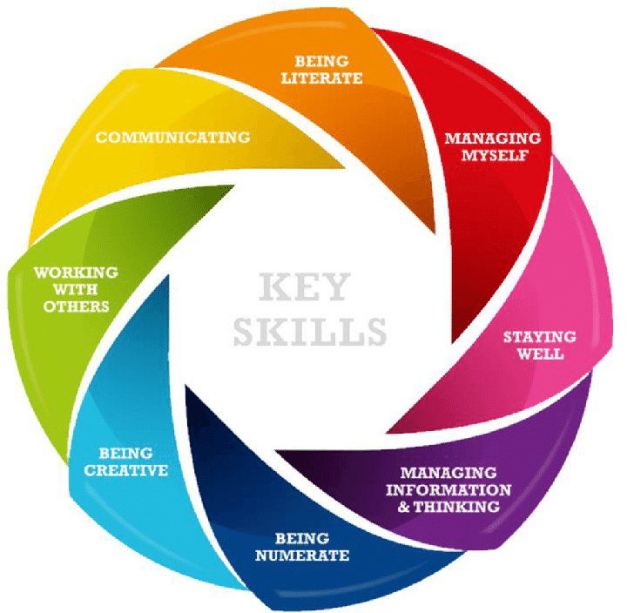
Unit 2, Activity 1
Notes:
Teacher notes
Tell/remind students that there is a focus in junior cycle on building the 8 key skills on the slide.
Read each key skill aloud, ensuring that everyone understands what each key skill means.
Think about your two most enjoyable learning and teaching strategies. Which key skills do you think these strategies help to build?
Now, think about your two most effective strategies. Which key skills do you think these strategies help to strengthen?

Slide 6
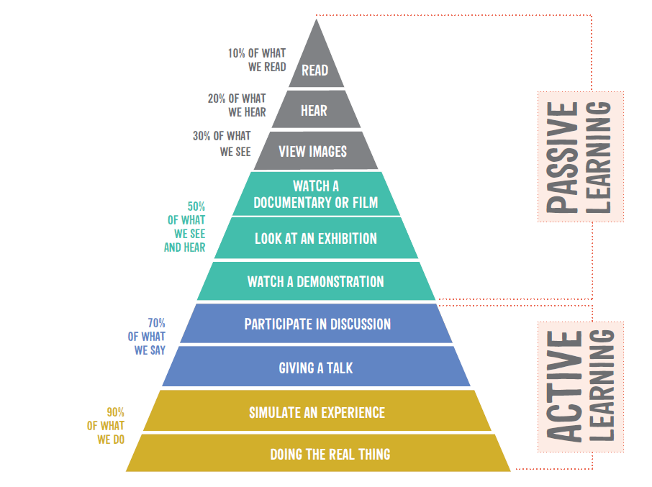
Unit 2, Activity 1
Notes:
Teacher notes
The learning pyramid on the slide is based on research that shows that people tend to remember more of their learning when they are actively engaged. This means that learning and teaching strategies, like the ones that we have been talking about, are most effective when students are learning actively.
It is part of a teachers’ job to try to keep all students engaged, and hopefully also to make sure that learning is as enjoyable as possible.
The reality is that one strategy may work for one person and a different one for another person. One method may work for certain topics or subjects and a different method for different topics or subjects.
The challenge for you (and your teachers) is:
find the best strategies that work for you/the class.
be able to change from one strategy to another as the topic or subject changes.

Slide 7
Pathways: Learning and teaching strategies log
Name and short description | What went well? | Even better if
Notes:
Teacher notes
Throughout the rest of the Pathways module, we’re going to keep a log of the different learning and teaching strategies that we use.
Invite students to copy the table into their journal/copy.
For every strategy we do, you need to write down the name and a short description, a reflection on what went well and how things could be improved (even better if).
The ‘what went well?’ and ‘even better if’ columns might be something that your classmates or teacher did well or could do better, but you should try to focus on yourself – that is, identify what you did well and what you can do to improve your own enjoyment or engagement with your learning?
Teachers often do this type of thinking or reflection after a lesson, especially if it’s the first time that they have tried a strategy or the first time with a particular class.
Do you think this is a useful exercise for teachers to do? Why/not?
Depending on your class, you might want to share an example of a time that you used a strategy for the first time, how it went, your reflections afterwards and if/how this changed how you used this strategy thereafter?
After the next learning and teaching strategy, I’ll remind you to fill in the first row in your log.

Slide 8



Unit 2, Activity 2
Visual
Auditory
Kinaesthetic
Notes:
Teacher notes
Some experts say that the people understand information and solve problems in three
different ways.
Visual (seeing) people like to learn through written language such as reading and
writing. They remember what they have written down. They use bullet points, charts,
graphs, mind maps, pictures, write stories, or use flash cards.
Auditory (hearing) people like to learn by making speeches or doing presentations,
using recordings, reading aloud, creating musical jingles to aid memory or telling
stories.
Kinaesthetic (doing) people like to learn by moving, touching or making. They often
move about while studying.
Your strongest learning style might, for example, be through seeing things (visual),
but that doesn’t mean that you aren’t also able to learn by hearing (auditory) or
making (kinaesthetic). It just means at that point in your life, your visual processing of
information and problem solving is the strongest of the three learning styles. In fact,
most people use a combination of learning styles, and it is possible to strengthen a
learning style over time.
Would you like to know about your learning style(s)? Why/not?
We’re going to do a short Learning Styles Quiz with 20 multi-choice questions, to find
out which of the three learning styles is your strongest right now.
To access the Learning Styles Quiz, share this link with your students
(https://forms.gle/a6jNH9HZrpiHYmmv5) or distribute pre-printed copies of the pdf of
the Quiz, available in the Pathways Unit 2 google drive folder.
[NB: in the online version, students are asked to provide an email address only so
that they automatically receive a copy of their completed quiz.]
Answer each questions as honestly as possible to get an accurate result.
Try not to leave any question blank. If you are unsure how to answer a question,
choose the option that is closest to what you would do in this situation.
NB: Make a note of the number of the option you pick for each Quiz question.

Slide 9
Unit 2, Activity 2
Visual
Auditory
Kinaesthetic
1st option in every question
2nd option in every question
3rd option in every question
Notes:
Teacher notes
Each question in the Learning Styles Quiz had three options.
The first option in every case was the option that a Visual learner would have selected, the second option was Auditory, and the third option was Kinaesthetic.
Count how many times you selected a Visual option, how many times you selected an Auditory option, and how many times you selected a Kinaesthetic option.
Imagine we had someone in the class called X.
X got 12 as their total under Visual, 5 as their total under Auditory and 3 as their total under Kinaesthetic.
How can X work out the percentage for each of these?
X needs to divide each total by 20 (the number of questions in the quiz), then multiple that answer by 100.
The result is that X is 60% Visual, 25% Auditory and 15% Kinaesthetic.
Now, work out what percentage you got for each of the learning styles.
What have you learned about the three learning styles by doing the Quiz?
As we go through the information on the next few slides, see if you recognise yourself in the description of the three learning styles.
Keep a note if you come across any tips or hints that might help you to learn more effectively.

Slide 10
Unit 2, Activity 2
People with a visual learning style or strength…
learn best using methods that are primarily visual, for example, by reading or seeing pictures.
understand and remember things by sight.
can picture what they are learning in their head
often close their eyes to visualise or remember something
are usually (but not always) neat and clean.
will find something to watch if they are bored.
may have difficulty with spoken directions and may be easily distracted by sounds.
are attracted to colour and to spoken language (like stories) that are rich in imagery.
Notes:
Teacher notes
Ask for volunteers to read the points on the slide aloud.
Remember, regardless of the percentage you got for being a Visual learner, you can work on strengthening your visual information processing and problem solving.

Slide 11
Unit 2, Activity 2
People with an auditory learning style or strength…
learn best using methods that are primarily auditory, that is, by hearing and listening.
store information by the way it sounds.
have an easier time understanding spoken instructions than written ones.
often learn by reading aloud because they have to hear it or speak it to know it.
probably hum or talk to themselves or others if they are bored.
Notes:
Teacher notes
Ask for volunteers to read the points on the slide aloud.
Remember, regardless of the percentage you got for being an Auditory learner, you can work on strengthening your auditory information processing and problem solving.

Slide 12
Unit 2, Activity 2
People with a kinaesthetic learning style or strength…
learn best using methods that are primarily kinaesthetic, that is, by touching and doing.
understand and remember things through physical movement.
are a "hands-on" learners who prefer to touch, move, build, or draw to support their learning.
like to take things apart and put things together.
may need to take frequent breaks.
often speak with their hands and with gestures.
may have difficulty sitting still.
tend to find reasons to tinker or move around they are bored.
may be very well coordinated and have good athletic ability.
Notes:
Teacher notes
Ask for volunteers to read the points on the slide aloud.
Remember, regardless of the percentage you got for being a Kinaesthetic learner, you can work on strengthening your kinaesthetic information processing and problem solving.
Now’s the time to fill in that first row in your Learning and Teaching Strategies Log (Slide 7).
The name of the first strategy is the Learning Styles Quiz and Discussion.
Take a minute to write a short description of this quiz, then jot down your reflections in the ‘what went well’ and ‘even better if’ columns.

Slide 13
Unit 2, Activity 3
Art (drawing, designing logos, making posters etc.) | Case studies (about people, places or events)
Creative writing (diary entries, imaginative essays etc.) | Cloze test (complete the sentence, fill in the blanks)
Debate/Walking debate | Drama (role play, freeze frame etc.)
Film (documentaries, TED Talks, YouTube etc.) | Giant steps
Interviews | K-W-L chart (Know, Want to know, Learned)
Mind maps/spider diagrams (and other graphic organisers) | Mentimeter/Padlet (and other apps)
Newspaper/online articles | Photographs/images (interpreting images, writing captions for photos)
Questionnaire/survey/vox pop | Quiz
Structured discussion (pair, small group, whole class) | Teacher input
Think-Pair-Share (think on your own, pair with someone else and discuss, then share in a group) | Worksheets
Notes:
Teacher notes
We’ve come full circle, back to our learning and teaching methodologies.
Now that we know a bit more about the way we learn and the diversity of strengths in this class, let’s take a few minutes to discuss which learning and teaching strategies suits the different learning styles.
Read each strategy aloud and ask students to indicate which learning style is helped when this strategy is used in class.
What have you noticed from matching learning styles to learning and teaching strategies?
Just like every person has different learning strengths or styles, every classroom has
a diverse group of personalities and learning strengths or styles.
When teachers are choosing and planning the learning and teaching approaches that
they will use with a particular class, they try to suit all these learning styles over
the course of time.
Why do you think teachers do this?
Depending on your class, you might like to share an example from your own teaching
where you planned teaching strategies because you knew they would suit the
Learning styles and needs of students.

Slide 14

Unit 2, Checking in with the learning intentions
Hello again!
How did you get on with Unit 2?
Did you learn to…?
rank learning and teaching strategies according to how enjoyable and effective they are
identify our strongest learning style(s) and what this means for our learning
make the link between learning and teaching strategies and our learning styles
Notes:
Teacher notes
Read each learning intention aloud.
Ask students to give you a thumbs up if they feel they have achieved the learning intention, a thumbs down if they still need some support and a fist if they are unsure.

Slide 15
Unit 2, Extension activity
Here’s an idea for you.
Why not carry out a survey of your teachers?
Ask them to identify the learning and teaching strategy they think is most enjoyable and/or effective. They should give you a reason for their choice.
Discuss the survey findings in class. You could even consider going back to your teachers with a comparison of their enjoyable/effective strategies and those picked by your class.
Notes:
Teacher notes
The extension activity suggested on this slide is linked to Activity 1 (Slide 4) and Activity 3 (Slide 13).
NB: Please remember to complete the short teacher survey as soon as possible after finishing Unit 2: https://forms.gle/jqGLBJGs2PoTRWHS8

Slide 16
Path Project
Institute of Education
Dublin City University

