Slide 1
Conairí
An Chéad Bhliain
Aonad 2: Straitéisí agus stíleanna
Notes:
Attention teachers:
The Pathways units aim to encourage students from diverse backgrounds to think about their career choices, the career decision making process and particularly teaching as a desirable career.
These units are an initiative of the Path Project, which is funded by the Higher Education Authority (HEA), and based in the Institute of Education, Dublin City University (DCU).
There are 3 units for 1st Year students, each approximately 2 hours duration.
Unit 1: Hidden skills and talents
Unit 2: Strategies and styles
Unit 3: Goals and motivations
Some important points about how the Pathways units work:
The slides are classroom ready.
The teacher notes, with step-by-step guidance for the specific activity on each slide, is available in the slide notes or can be accessed in pdf format in the google drive.
It is important to show slides in presentation mode, as some activities depend on animation. Where there is animation on a slide, this is indicated in the teacher notes.
When the text in the slide notes is in italics, it is meant it is meant to be paraphrased or used without adaptation by the teacher with students; and when the text is not italicised, it is meant to for the teacher only.
There is very little preparation of materials required. Occasionally, and depending on your class, you might decide to photocopy worksheet slides in advance. In activities where this might be useful, you will be prompted in the teacher notes.
As a participating teacher, you will be invited to respond to short surveys about your experience of the units. In addition, you will be asked to invite students to participate in the research (once parental consent has been provided). This will involve questionnaires and interviews/focus groups.
NB: If your students have not engaged with Unit 1 materials and are starting with Unit 2, please ensure that they first complete a short baseline survey: https://forms.gle/sPFEvzfTc5ZpfLbt9
Please remember to complete the short teacher survey as soon as possible after finishing Unit 2: https://forms.gle/jqGLBJGs2PoTRWHS8
If you require any further information, please contact: mary.odoherty@dcu.ie
Thank you

Slide 2
Aonad 2: Straitéisí agus stíleanna
Fad: Thart ar 2 uair a chloig
Cuspóirí foghlama molta
Táimid ag foghlaim conas...
straitéisí foghlama agus teagaisc a rangú de réir mhéid an suntais a bhaintear astu agus cé chomh héifeachtach agus atá siad
ár stíl foghlama is láidre a shainaithint agus cad is brí leis sin dar gcuid foghlama
an ceangal a dhéanamh idir straitéisí foghlama agus teagaisc agus ár stíleanna foghlama
machnamh a dhéanamh ar rudaí a rinneamar go maith agus ar rudaí ar féidir linn iad a fheabhsú
    Táscairí Folláine
    Athléimneach
    Nasctha
    Feasach
Eochairscileanna
Léamh agus scríobh a bheith agat
Mé féin a bhainistiú
Ag fanacht ar fónamh
Ag bainistiú eolais agus ag smaoineamh
A bheith uimheartha
A bheith cruthaitheach
Ag obair le daoine eile
Cumarsáid
Sleamhnáin | Gníomhaíocht | Cad a bheidh ar bun againn?
3 |  | Réamheolas ar na deilbhíní
4-6 | 1 | Plé a dhéanamh ar raon straitéisí foghlama agus teagaisc - na cinn as a mbainimid sult agus na cinn a chuidíonn linn foghlaim i ndáiríre
7-12 | 2 | Ag fáil amach faoinár stíleanna nó láidreachtaí foghlama trí Thráth na gCeist a dhéanamh agus ár dtorthaí a ríomh Machnamh a dhéanamh ar an eispéireas de Thráth na gCeist a dhéanamh agus a phlé
13 | 3 | Na straitéisí foghlama agus teagaisc a phlé a oireann do stíleanna éagsúla foghlama
14 | 4 | Ag seiceáil isteach leis na cuspóirí foghlama
15 | Ceacht le cois | Ag fáil amach faoi shuirbhé ar féidir linn é a dhéanamh lenár múinteoirí

Slide 3









Aonad 2, Réamheolas
Haigh, is mise Dave.
Deas buaileadh leat!
Tá mé anseo le hinsint duit go mbainimid úsáid as deilbhíní (na pictiúir bheaga thíos) san aonad seo. Cuideoidh siad sin leat an méid a bheidh á dhéanamh agat le linn na ngníomhaíochtaí éagsúla a thuiscint.
Bain sult as (agus bí ag foghlaim)!
Obair aonair
Léamh
Obair ghrúpa
Téigh ar líne
Plé ranga
Gníomhaíocht le cois

Slide 4
Aonad 2, Gníomhaíocht 1
Ealaín (líníocht, lógónna a dhearadh, póstaeir a dhéanamh) | Cás-staidéir (maidir le daoine, áiteanna nó imeachtaí)
Scríbhneoireacht chruthaitheach (iontrálacha dialainne, aistí samhlaíocha, etc.) | Tástáil Cloze (críochnaigh an abairt, líon isteach na bearnaí)
Díospóireacht/Díospóireacht siúil | Drámaíocht (rólghlacadh, fráma reoite etc.)
Scannán (cláir faisnéise, Cainteanna TED, YouTube) | Céimeanna ollmhóra
Agallaimh | Cairt K-W-L chart (Know, Want to know, Learned)
Meabhairmhapaí/damhánléaráidí (agus eagraithe grafacha eile) | Mentimeter/Padlet (agus aipeanna eile)
Ailt nuachtáin/ar líne | Grianghraif/íomhánna (íomhánna a léirmhíniú, fotheidil a scríobh do ghrianghraif)
Ceistneoir/suirbhé/vox pop | Tráth na gCeist
Plé struchtúrtha (beirt, grúpa beag, rang iomlán) | Ionchur ón múinteoir
Smaoinigh-Téigh i mBeirteanna-Comhroinn (smaoinigh leat féin, téigh i mbeirt le duine eile agus pléigh, agus ansin comhroinn leis an ngrúpa) | Bileoga oibre
Notes:
Teacher notes
Ask for volunteers to read the text in the rows on the slide aloud.
Does anyone know what these are? What do they all have in common?
These are all learning and teaching strategies (sometimes called approaches or methodologies).
Which of these strategies have you experienced at some point in primary or secondary school? Can you explain this strategy to the rest of the class?
Are there any strategies on the slide that you have never heard of before? Can anyone explain what happens with these strategies?
Are there other strategies that belong on this slide?
Use the two spaces at the bottom of the table to insert any additional strategies that students suggest. [NB: To do this you will need to be in ‘normal’ not ‘presentation’ view.]
We are going to do an activity in small groups, where you will rank the learning and teaching strategies on the slide.
Firstly, you will rank the strategies under the heading of ‘Enjoyable’, with the most enjoyable first.
Then, you will rank the strategies under the heading of ‘Effective’ (meaning that the strategy engaged you and helped you to learn), with the most effective first.
For both rankings, take note of the top two scoring strategies and be prepared to give the reasons why you ranked these two at the top.
Depending on your class, you might also like to do the ranking activity as well. You can use this activity as an opportunity to talk to your class about the strategies you most enjoy using in your teaching and the ones where you learn the most from or about your students.
Divide the class into small groups.
Prompt students to take out a piece of paper and pen so that they can write their ranking lists.
Allow sufficient time for discussion and give students a 2-minute warning when they need to change from the first to the second ranking task.
Facilitate feedback from each group, focusing on the reasons why particular strategies are favoured.
Highlight the different choices made by groups and ask students to discuss these differences.
Did any group have the same one/two strategies ranked at the top for both ‘enjoyable’ and ‘effective’?
What, if anything, does this tell us?

Slide 5

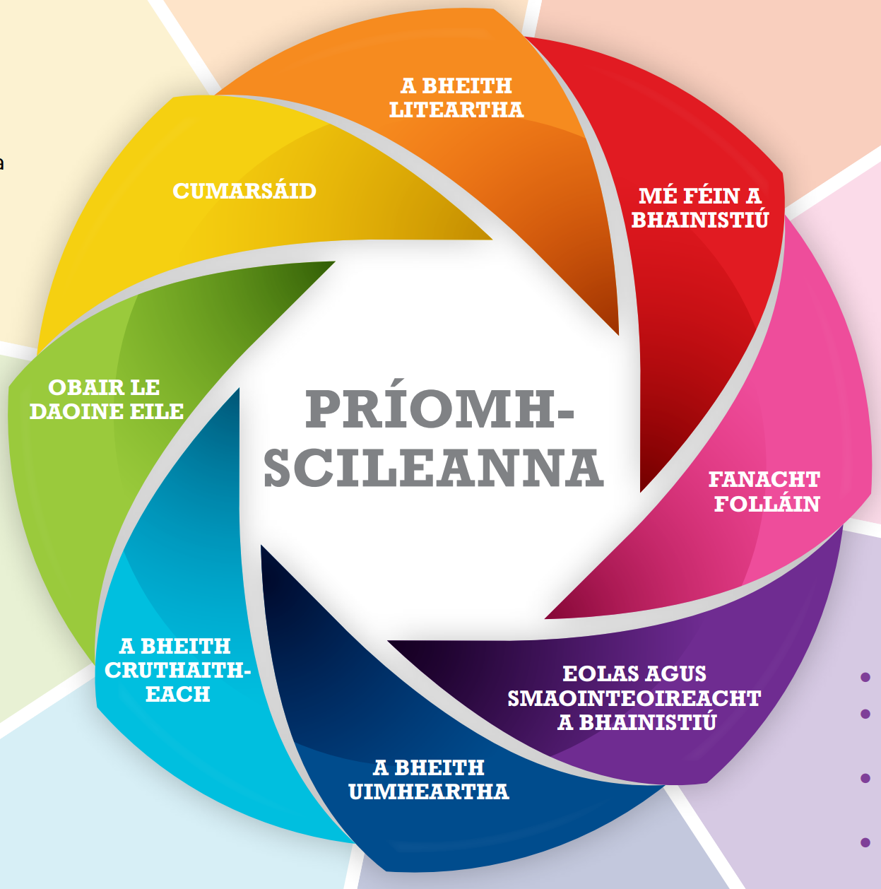
Aonad 2, Gníomhaíocht 1
Notes:
Teacher notes
Tell/remind students that there is a focus in junior cycle on building the 8 key skills on the slide.
Read each key skill aloud, ensuring that everyone understands what each key skill means.
Think about your two most enjoyable learning and teaching strategies. Which key skills do you think these strategies help to build?
Now, think about your two most effective strategies. Which key skills do you think these strategies help to strengthen?

Slide 6
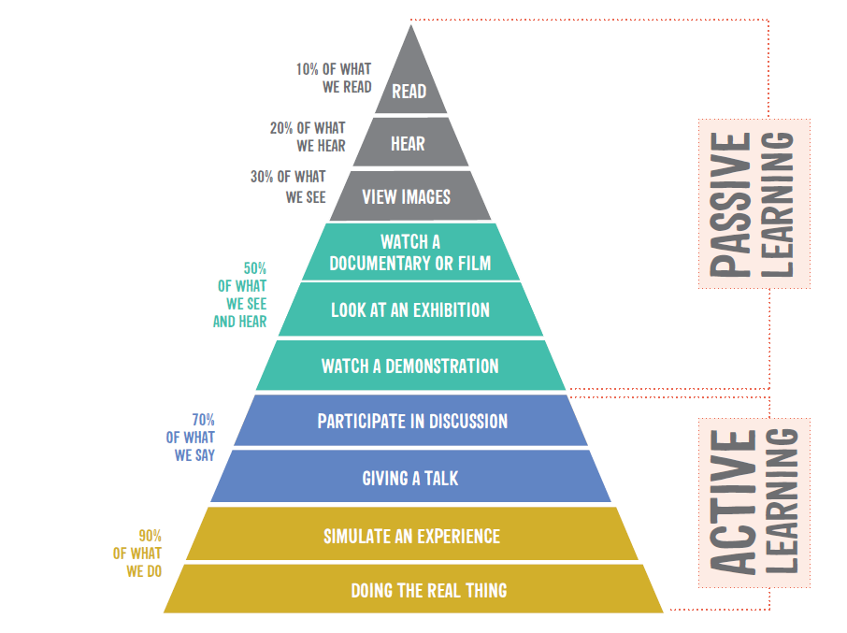
Aonad 2, Gníomhaíocht 1
Notes:
Teacher notes
The learning pyramid on the slide is based on research that shows that people tend to remember more of their learning when they are actively engaged. This means that learning and teaching strategies, like the ones that we have been talking about, are most effective when students are learning actively.
It is part of a teachers’ job to try to keep all students engaged, and hopefully also to make sure that learning is as enjoyable as possible.
The reality is that one strategy may work for one person and a different one for another person. One method may work for certain topics or subjects and a different method for different topics or subjects.
The challenge for you (and your teachers) is:
find the best strategies that work for you/the class.
be able to change from one strategy to another as the topic or subject changes.

Slide 7
Conairí: Loga straitéisí foghlama agus teagaisc
Ainm agus cur síos gairid | Cad a d’éirigh go maith leis? | Bheadh sé fiú níos fearr má
Notes:
Teacher notes
Throughout the rest of the Pathways module, we’re going to keep a log of the different learning and teaching strategies that we use.
Invite students to copy the table into their journal/copy.
For every strategy we do, you need to write down the name and a short description, a reflection on what went well and how things could be improved (even better if).
The ‘what went well?’ and ‘even better if’ columns might be something that your classmates or teacher did well or could do better, but you should try to focus on yourself – that is, identify what you did well and what you can do to improve your own enjoyment or engagement with your learning?
Teachers often do this type of thinking or reflection after a lesson, especially if it’s the first time that they have tried a strategy or the first time with a particular class.
Do you think this is a useful exercise for teachers to do? Why/not?
Depending on your class, you might want to share an example of a time that you used a strategy for the first time, how it went, your reflections afterwards and if/how this changed how you used this strategy thereafter?
After the next learning and teaching strategy, I’ll remind you to fill in the first row in your log.

Slide 8



Aonad 2, Gníomhaíocht 2
Gné Amhairc
Éistitheach
Cinéistéiseach
Notes:
Teacher notes
Some experts say that the people understand information and solve problems in three
different ways.
Visual (seeing) people like to learn through written language such as reading and
writing. They remember what they have written down. hey use bullet points, charts,
graphs, mind maps, pictures, write stories, or use flash cards.
Auditory (hearing) people like to learn by making speeches or doing presentations,
using recordings, reading aloud, creating musical jingles to aid memory or telling
stories.
Kinaesthetic (doing) people like to learn by moving, touching or making. They often
move about while studying.
Your strongest learning style might, for example, be through seeing things (visual),
but that doesn’t mean that you aren’t also able to learn by hearing (auditory) or
making (kinaesthetic). It just means at that point in your life, your visual processing of
information and problem solving is the strongest of the three learning styles. In fact,
most people use a combination of learning styles, and it is possible to strengthen a
learning style over time.
Would you like to know about your learning style(s)? Why/not?
We’re going to do a short Learning Styles Quiz with 20 multi-choice questions, to find
out which of the three learning styles is your strongest right now.
To access the Learning Styles Quiz, share this link with your students
(https://forms.gle/a6jNH9HZrpiHYmmv5) or distribute pre-printed copies of the pdf of
the Quiz, available in the Pathways Unit 2 google drive folder.
[NB: in the online version, students are asked to provide an email address only so
that they automatically receive a copy of their completed quiz.]
Answer each questions as honestly as possible to get an accurate result.
Try not to leave any question blank. If you are unsure how to answer a question,
choose the option that is closest to what you would do in this situation.
NB: Make a note of the number of the option you pick for each Quiz question.

Slide 9
Aonad 2, Gníomhaíocht 2
Gné Amhairc
Éistitheach
Cinéistéiseach
1^{ú} rogha i ngach ceist
2^{ú} rogha i ngach ceist
3^{ú} rogha i ngach ceist
Notes:
Teacher notes
Each question in the Learning Styles Quiz had three options.
The first option in every case was the option that a Visual learner would have selected, the second option was Auditory, and the third option was Kinaesthetic.
Count how many times you selected a Visual option, how many times you selected an Auditory option, and how many times you selected a Kinaesthetic option.
Imagine we had someone in the class called X.
X got 12 as their total under Visual, 5 as their total under Auditory and 3 as their total under Kinaesthetic.
How can X work out the percentage for each of these?
X needs to divide each total by 20 (the number of questions in the quiz), then multiple that answer by 100.
The result is that X is 60% Visual, 25% Auditory and 15% Kinaesthetic.
Now, work out what percentage you got for each of the learning styles.
What have you learned about the three learning styles by doing the Quiz?
As we go through the information on the next few slides, see if you recognise yourself in the description of the three learning styles.
Keep a note if you come across any tips or hints that might help you to learn more effectively.

Slide 10
Aonad 2, Gníomhaíocht 2
Maidir le daoine ag a bhfuil stíl nó láidreacht foghlama amhairc...
foghlaimíonn siad ar an mbealach is fearr agus modhanna á n-úsáid lena mbaineann gné amhairc go príomha, mar shampla, trí léamh nó trí féachaint ar phictiúir.
tuigeann siad rudaí agus cuimhníonn siad iad trí aithne shúl.
is féidir leo an méid atá á fhoghlaim acu a shamhlú ina n-intinn
druideann siad a súile go minic chun rud a shamhlú nó a chuimhneamh
de ghnáth (ach ní i gcónaí) bíonn siad néata agus glan.
aimseoidh siad rud le féachaint air má tá siad dubh dóite.
d’fhéadfadh deacracht a bheith acu le treoracha labhartha agus d’fheadfadh fuaimeanna cur isteach orthu go furasta.
bíonn spéis acu i ndathanna agus i dteanga labhartha (amhail scéalta) ina bhfuil a lán íomháineachais.
Notes:
Teacher notes
Ask for volunteers to read the points on the slide aloud.
Remember, regardless of the percentage you got for being a Visual learner, you can work on strengthening your visual information processing and problem solving.

Slide 11
Aonad 2, Gníomhaíocht 2
Maidir le daoine ag a bhfuil stíl nó láidreacht foghlama éistitheach...
foghlaimíonn siad ar an mbealach is fearr agus modhanna á n-úsáid lena mbaineann gné éistitheach go príomha, is é sin, trí chluinstin agus trí éisteacht.
déanann siad faisnéis a stóráil de réir a fuaime.
bíonn sé níos fusa dóibh treoracha labhartha a thuiscint i gcomparáid le treoracha scríofa.
foghlaimíonn siad go minic trí léamh os ard mar bíonn orthu é a chluinstin nó a labhairt sula mbeidh sé ar eolas acu.
is dócha go mbíonn siad ag dordán nó ag labhairt leo féin nó le daoine eile má bhíonn siad dubh dóite.
Notes:
Teacher notes
Ask for volunteers to read the points on the slide aloud.
Remember, regardless of the percentage you got for being an Auditory learner, you can work on strengthening your auditory information processing and problem solving.

Slide 12
Aonad 2, Gníomhaíocht 2
Maidir le daoine ag a bhfuil stíl nó láidreacht foghlama atá cinéistéiseach...
foghlaimíonn siad ar an mbealach is fearr agus modhanna á n-úsáid lena mbaineann gné chinéistéiseach go príomha, is é sin, trí thadhall agus trí rudaí a dhéanamh.
tuigeann siad rudaí agus cuimhníonn siad rudaí trí ghluaiseacht fhisiceach.
is foghlaimeoirí “teagmhálacha” iad ar fearr leo an méid a fhoghlaimíonn siad a theagmháil, a bhogadh, a thógáil, nó a tharraingt
is maith leo rudaí a bhaint as a cheile agus a chur le cheile arís
d’fhéadfadh sé a bheith riachtanach dóibh sosanna rialta a ghlacadh
labhraíonn siad go minic agus a lámha agus comharthaí láimhe á n-úsáid
d’fhéadfadh deacracht a bheith acu suí go socair.
bíonn nós acu bheith ag útamáil le rudaí nó ag bogadh thart má bhíonn siad dubh dóite.
d’fheadfadh comhordú sármhaith a bheith acu mar aon le cumas lúthchleasach maith.
Notes:
Teacher notes
Ask for volunteers to read the points on the slide aloud.
Remember, regardless of the percentage you got for being a Kinaesthetic learner, you can work on strengthening your kinaesthetic information processing and problem solving.
Now’s the time to fill in that first row in your Learning and Teaching Strategies Log (Slide 7).
The name of the first strategy is the Learning Styles Quiz and Discussion.
Take a minute to write a short description of this quiz, then jot down your reflections in the ‘what went well’ and ‘even better if’ columns.

Slide 13
Aonad 2, Gníomhaíocht 3
Ealaín (líníocht, lógónna a dhearadh, póstaeir a dhéanamh) | Cás-staidéir (maidir le daoine, áiteanna nó imeachtaí)
Scríbhneoireacht chruthaitheach (iontrálacha dialainne, aistí samhlaíocha, etc.) | Tástáil Cloze (críochnaigh an abairt, líon isteach na bearnaí)
Díospóireacht/Díospóireacht siúil | Drámaíocht (rólghlacadh, fráma reoite etc.)
Scannán (cláir faisnéise, Cainteanna TED, YouTube) | Céimeanna ollmhóra
Agallaimh | Cairt K-W-L chart (Know, Want to know, Learned)
Meabhairmhapaí/damhánléaráidí (agus eagraithe grafacha eile) | Mentimeter/Padlet (agus aipeanna eile)
Ailt nuachtáin/ar líne | Grianghraif/íomhánna (íomhánna a léirmhíniú, fotheidil a scríobh do ghrianghraif)
Ceistneoir/suirbhé/vox pop | Tráth na gCeist
Plé struchtúrtha (beirt, grúpa beag, rang iomlán) | Ionchur ón múinteoir
Smaoinigh-Téigh i mBeirteanna-Comhroinn (smaoinigh leat féin, téigh i mbeirt le duine eile agus pléigh, agus ansin comhroinn leis an ngrúpa) | Bileoga oibre
Notes:
Teacher notes
We’ve come full circle, back to our learning and teaching methodologies.
Now that we know a bit more about the way we learn and the diversity of strengths in this class, let’s take a few minutes to discuss which learning and teaching strategies suits the different learning styles.
Read each strategy aloud and ask students to indicate which learning style is helped when this strategy is used in class.
What have you noticed from matching learning styles to learning and teaching strategies?
Just like every person has different learning strengths or styles, every classroom has
a diverse group of personalities and learning strengths or styles.
When teachers are choosing and planning the learning and teaching approaches that
they will use with a particular class, they try to suit all these learning styles over
the course of time.
Why do you think teachers do this?
Depending on your class, you might like to share an example from your own teaching
where you planned teaching strategies because you knew they would suit the
Learning styles and needs of students.

Slide 14

Aonad 2, Ag seiceáil isteach leis na cuspóirí foghlama
Haigh arís!
Conas mar a d’éirigh leat le hAonad 2?
Ar fhoghlaim tú conas...?
straitéisí foghlama agus teagaisc a rangú de réir mhéid an suntais a bhaintear astu agus cé chomh héifeachtach agus atá siad
ár stíl(eanna) foghlama is láidre a shainaithint agus cad is brí leis sin dar gcuid foghlama
an ceangal a dhéanamh idir straitéisí foghlama agus teagaisc agus ár stíleanna foghlama
Notes:
Teacher notes
Read each learning intention aloud.
Ask students to give you a thumbs up if they feel they have achieved the learning intention, a thumbs down if they still need some support and a fist if they are unsure.

Slide 15
Aonad 2, Gníomhaíocht le cois
Seo smaoineamh duit.
Cad chuige nach ndéanfá suirbhé ar do mhúinteoirí?
Iarr orthu an straitéis foghlama agus teagaisc is taitneamhaí nó is éifeachtaí dar leo a aithint. Ba cheart dóibh cúis a thabhairt duit lena rogha.
Pléigh torthaí an tsuirbhé sa rang. Ba cheart duit smaoineamh fiú ar dhul ar ais chuig do mhúinteoirí le comparáid idir na straitéisí is taitneamhaí/is éifeachtaí dá gcuid agus na cinn a roghnaigh do rang.
Notes:
Teacher notes
The extension activity suggested on this slide is linked to Activity 1 (Slide 4) and Activity 3 (Slide 13).
NB: Please remember to complete the short teacher survey as soon as possible after finishing Unit 2: https://forms.gle/jqGLBJGs2PoTRWHS8

Slide 16
Tionscadal Conaire
Institiúid Oideachais
Ollscoil Chathair Bhaile Átha Cliath

