Slide 1
Conairí
Bliain a hAon
Aonad 3: Spriocanna agus spreagadh
Notes:
Attention teachers:
The Pathways units aim to encourage students from diverse backgrounds to think about their career choices, the career decision making process and particularly teaching as a desirable career.
These units are an initiative of the Path Project, which is funded by the Higher Education Authority (HEA), and based in the Institute of Education, Dublin City University (DCU).
There are 3 units for 1st Year students, each approximately 2 hours duration.
Unit 1: Hidden skills and talents
Unit 2: Strategies and styles
Unit 3: Goals and motivations
Some important points about how the units work:
The slides are classroom ready.
It is important to show slides in presentation mode, as some activities depend on animation. Where there is animation on a slide, this is indicated in the slide notes.
When the text in the slide notes is in italics, it is meant it is meant to be paraphrased or used without adaptation by the teacher with students; and when the text is not italicised, it is meant to for the teacher only.
There is very little preparation of materials required. Occasionally, and depending on your class, you might decide to photocopy worksheet slides in advance. In activities where this might be useful, you will be promoted in the slide notes.
As a participating teacher , you will be invited to respond to short surveys about the usefulness of the activities in these units. In addition, you will be asked to invite students to participate in the research (once parental consent has been provided). This will involve questionnaires and interviews/focus groups.
NB: Please remember to complete the short teacher survey as soon as possible after finishing Unit 3: https://forms.gle/2Q3AfG3WLc1XHBh8A
If you require any further information, please feel welcome to contact mary.odoherty@dcu.ie
Thank you

Slide 2
Aonad 3: Spriocanna agus spreagadh
Fad: Thart ar 2 uair a chloig
Cuspóirí foghlama molta
Táimid ag foghlaim conas...
ár spriocanna gairme don todhchaí a aithint
ár spreagadh intreach agus eistreach a mheas, mar aon leis na tacaíochtaí atá ar fáil
naisc a dhéanamh lenár scileanna/buanna, stíleanna foghlama agus spriocanna gairme don todhchaí
machnamh a dhéanamh maidir leis an méid a d'fhoghlaimíomar inár 3 n-aonad Conairí
    Táscairí Folláine
    Nasctha
    Freagrach
    Athléimneach
    Ardmheas
    Feasach
Sleamhnáin | Gníomhaíocht | Cad a bheidh ar bun againn?
3 |  | Réamheolas ar na deilbhíní
4-5 | 1 | An post nó gairm a bhfuilimid ag iarraidh a dhéanamh sa todhchaí a aithint. Ag cruthú siombail dhraíochta chun ár mianta don phost nó gairm atá uainn sa todhchaí
6-7 | 2 | Ag breathnú ar an spreagadh atá ag múinteoirí chun a bpost a dhéanamh Na spreagthaí intreacha agus eistreacha a bhaineann lenár bpost nó lenár ngairm a theastaíonn uainn sa thodhchaí a aithint
8 | 3 | Ag plé naisc lenár scileanna/buanna, stíleanna foghlama agus gairmeacha/spreagthaí don todhchaí
9 | 4 | Imlíne ceachta a phleanáil bunaithe ar rud éigin a d’fhoghlaimíomar sna haonaid seo
10 | 5 | Ag seiceáil isteach leis an cuspóirí foghlama
11 | Ceacht le cois | Ag fáil amach faoi agallaimh is féidir linn a dhéanamh le daoine fásta faoina gcuid post
Príomh-Scileanna
Léamh agus scríobh
Mé féin a bhainistiú
Ag fanacht ar fónamh
Ag bainistiú eolais agus ag smaoineamh
A bheith cruthaitheach
Ag obair le daoine eile
Cumarsáid

Slide 3









Aonad 3, Réamheolas
Haigh, is mise Clár.
Deas buaileadh leat!
Tá mé anseo le hinsint duit go mbainimid úsáid as deilbhíní (na pictiúir bheaga thíos) san aonad seo. Cuideoidh siad sin leat an méid a bheidh á dhéanamh agat le linn na ngníomhaíochtaí éagsúla a thuiscint.
Bain sult as (agus bí ag foghlaim)!
Obair aonair
Plé ranga
Obair ghrúpa
Léamh
Obair i bpéirí
Gníomhaíocht le cois

Slide 4


Aonad 3, Gníomhaíocht 1
Bhí múinteoirí ina ndaltaí óga scoile tráth, cosúil leat féin. Deacair a chreidiúint, tá a fhios agam!
Ag pointe éigin, bhreathnaigh siad i dtreo a dtodhchaí agus smaoinigh siad “Is mian liom a bheith i mo mhúinteoir.”.
Nuair a bhreathnaíonn tú i dtreo do thodhchaí, cad atá ar bun agat?
Is mian liom …………………………………………………………...….
…………………………………………………………...………….………………………………………………………………………………………………………………………………………………………………………………………………………………………………………………………………………………………………
Notes:
Teacher notes (Two animations at *Click)
Read the text on the slide.
*Click to animate the ‘I want’ stem.
In Unit 1, we identified immediate goals (Unit 1, Activity 4). Now, we are going to focus on our dreams or goals for our future job or profession.
The word ‘profession’ is used when you have to go to university and get a formal qualification to do this job. Teaching in an example of a profession. These days the qualification that young people in Ireland must get to become a teacher is either (1) a Post Graduate Masters in Education (PME), which takes two years and is done after an undergraduate degree (which may take 3-4 years depending on what is being studied), or (2) a Bachelors in Education (BEd) which usually takes 4 years and is the qualification for primary teachers or for secondary teachers with specific subjects, like Home Economics.
Depending on your class, you might wish to share details about your teaching qualification, where you went to university and something that you found particularly interesting or enjoyable in your studies.
In your copy, write the words ‘I want’.
*Click to animate the magic dust gif.
Imagine you had a magic wand. When you wave the magic wand, any obstacles, real or imagined, to you getting this job or entering this profession just disappear.
Complete the ‘I want’ stem sentence.

Slide 5
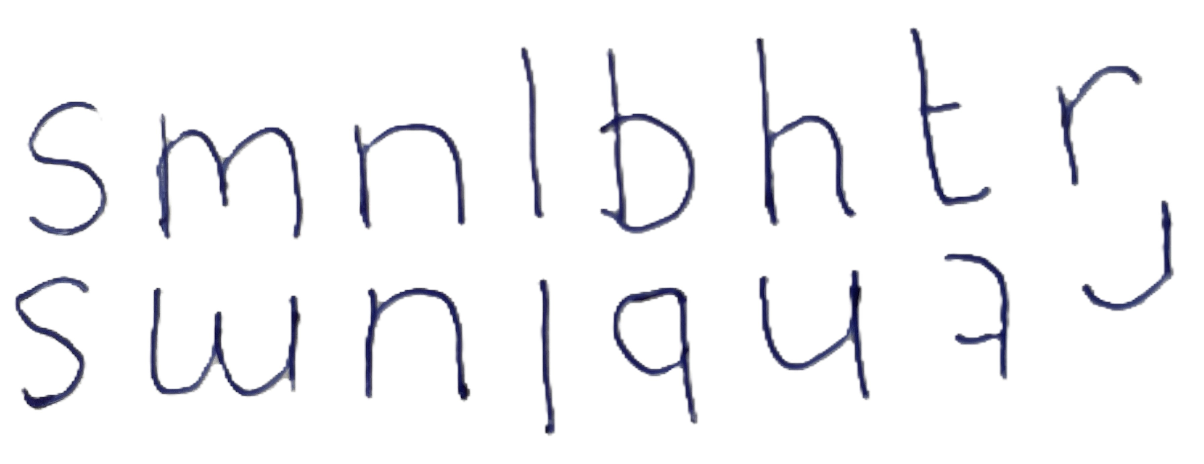
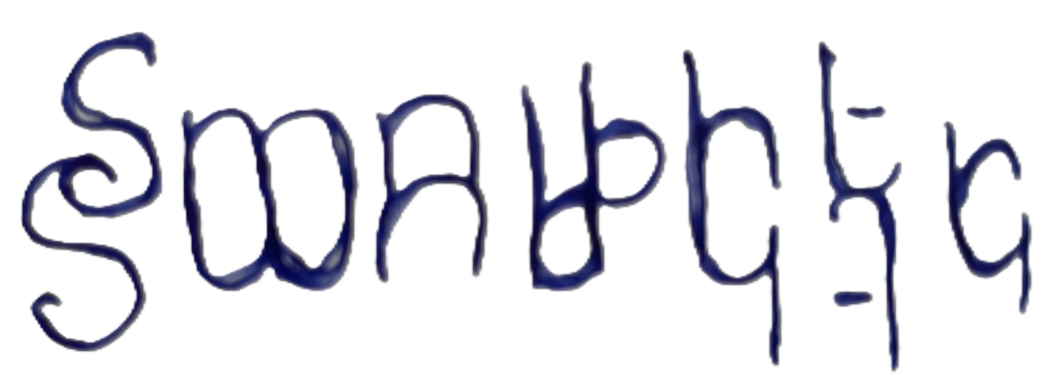
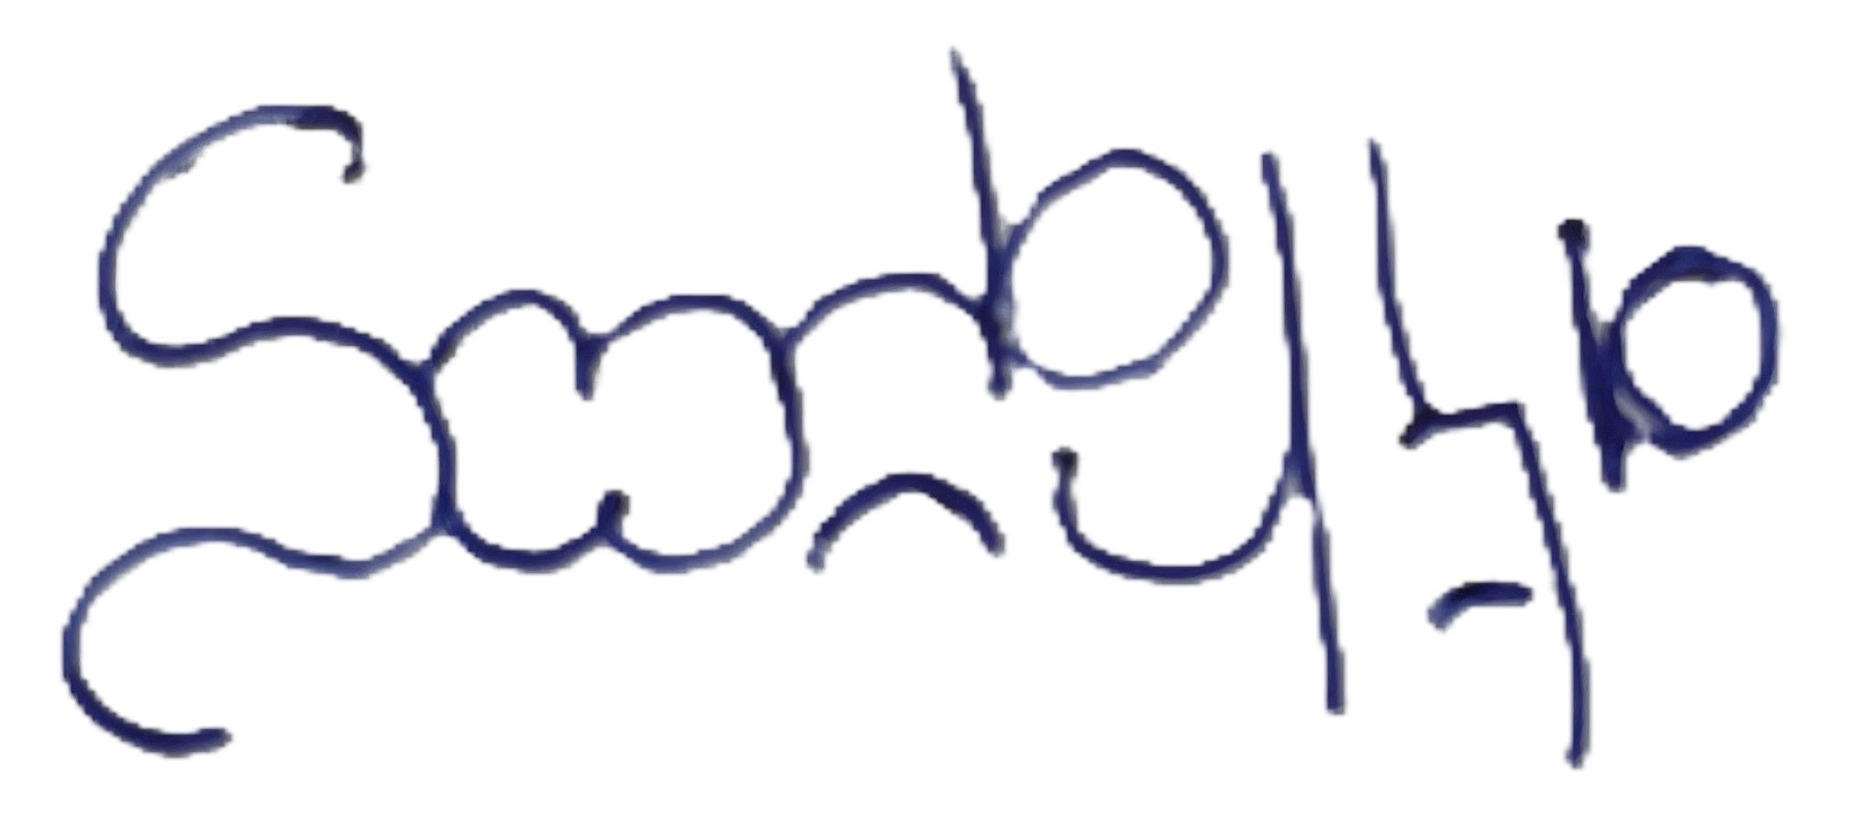
Aonad 3, Gníomhaíocht 1
Céim a hAon:
Is mian liom a bheith i mo mhúinteoir
Is mian liom a bheith i mo mhúinteoir
s m n l m bh th m
mh nt r
Céim a Dó:
s m n l m bh th m
mh nt r
s m n l bh t
r
Céim an Trí:
s m n l b h t r
bí ag útamáil leis na litreacha seo, mar shampla:
Notes:
Teacher notes
Keeping with the theme of magic, we are going to create a Sigil or a magic picture that will stand for our desired future job or profession. This Sigil will be your personal future desired job or profession.
Let’s look at an example of how to create a Sigil.
Step one is to identify all the vowels in your ‘I want’ stem sentence (vowels = a, e, i, o and u).
You can see that the vowels in the example on the slide are in purple.
You then re-write your sentence without vowels.
Step two is to identify where there is more than one of each consonant (non-vowel letters) in your ‘I want’ stem sentence.
In the example on the slide there are 3 letter t’s. We are only keeping one ‘t’ and will remove the other two in purple.
You then re-write your sentence without the duplicate consonants.
Step three is to take the remaining letters and play with them.
In the example on the slide, the letters were repeated below and in reverse, then the shapes that the letters coming together made helped to form the finished Sigil.
The key is to keep playing with your design until you feel that it looks magic.
Sometimes it helps to turn your page around and create your different versions.
You might end up with something like the example of the slide, made up of lines and curves, or you might end up with a picture of a butterfly or an animal. It depends on what your letters suggest to you.
Invite students to display their completed Sigils.
If students are willing, they might share their original stem sentence.
Cut/tear your Sigil out so that it is on a smaller piece of paper. We will need this again shortly.
Don’t forget to complete your Learning and Teaching Strategies Log for the Activity 2 (see Unit 2 for Learning and Teaching Strategies Log).

Slide 6



Aonad 3, Gníomhaíocht 2
Cad a spreag thú chun a bheith i do mhúinteoir?
Is as ceantar mé nach dtagann mórán múinteoirí as. Theastaigh uaim a thaispeáint do dhaltaí gur féidir leo mianta a gcroí a bhaint amach agus barr a gcumais a bhaint amach, beag beann ar a gceantar dúchais.
Bí bródúil as an áit as a dtagann tú!
Is breá liom a bheith ag obair le daoine óga agus tá a fhios agam go bhfuil sé de chumas agam cuidiú leo agus difear a dhéanamh ina saol.
Mo ghrá don Ghaeilge.
Notes:
Teacher notes (3 animations at *Click)
Motivation is what causes people to start and continuing acting or behaving towards achieving or reaching a goal. Motivation is that reason why you want something in the first place and the thing that keeps you going even when things get tough or difficult.
People have different motivations for working to get a specific job or enter a specific profession.
Let’s look at some of the things that teachers said when they were asked what motivated them to become teachers.
After each quote, stop and jot down anything that you think is worth noticing – it could be that you feel the same way or not, or it could be an idea or opinion that the teacher quote sparked in you.
*Click to animate in 3 consecutive teacher quotes.
Discuss these quotes and anything you noticed with a partner.

Slide 7
Aonad 3, Gníomhaíocht 2
Spreagadh intreach
Spreagadh eistreach
fonn cuidiú le daltaí
an sampla a thug a gcuid múinteoirí spreagúla féin
paisean nó suim in ábhar
dúil in obair le páistí agus daoine óga
Notes:
Teacher notes
The quotes on the previous slide show that people are motivated to teach for different reasons:
their passion or interest in a subject
love of working with children and young people
the example given by their own inspiring teachers
wanting to help students
These are all intrinsic motivations, meaning they come from inside. The teachers get pleasure, enjoyment, personal development or growth from their job.
Can you think of any other intrinsic motivations for becoming a teacher?
Some motivation is extrinsic, meaning that you do something because of a reward (money, prize, praise, fame, power) or because you want to avoid a punishment.
Can you think of any extrinsic motivations for becoming a teacher?
Depending on your class, you might want to share your motivations for becoming a teacher, whether this was something that you always wanted to do or something that you came to after another career or line of work. Prompt your students to identify whether your motivations were intrinsic or extrinsic or a mixture of both.
When teachers are asked what motivated them to become a teacher, they often mention intrinsic motivations only. Does this surprise you? Why/not?
Let’s think about our own intrinsic/extrinsic motivations for our own future career goal now.
Take out your ‘I want’ magic Sigil again.
Orient a page in landscape.
Place your ‘Sigil in the centre of the paper.
Divide the page in two – one side is for intrinsic motivations and the other is for extrinsic motivations.
Write or draw about your motivations, placing them on the intrinsic or extrinsic side of the page.
Talk to the person next to you if this will help you to complete this task.
Depending on your class, you might like to take feedback from a selection of students.
Which is more important – intrinsic or extrinsic motivation? Why?
Both types of motivation are important. But intrinsic motivation is especially important to get you started and keep you going when you meet challenges or when times get tough.
For example, anyone who wants to become a primary teacher or an Irish teacher in secondary school or a teacher of any subject in a Gaelcholaiste, needs to do higher level Gaeilge for their Leaving Certificate. Some people might find this challenging, but if they are sufficiently motivated then they will put in the effort to reach their goal, including, if needed, becoming informed about and accessing the help and support that is available.
Examples of support that are available for young people who are motivated to get a university qualification are the HEAR and DARE schemes.
Has anyone heard of these schemes?
HEAR is a support for school leavers under the age of 23 who come from lower income families, went to a school or come from a place that is considered disadvantaged.
Depending on your class, you might want to tell students whether their school/locality is considered disadvantaged.
Further information, including short videos, on the HEAR scheme are available here: HEAR - Access College
DARE is a support for school leavers under the age of 23 who have one or more conditions or disabilities from a list that includes ADD or ADHD, Dyslexia, Dyspraxia and others, and can prove that this has had a negative impact on their secondary education.
Further information, including short videos, on the DARE scheme are available here: DARE - Access College
Share any knowledge or experience you have had of students accessing either the HEAR or DARE schemes. Prompt anyone who wants to know more about HEAR or DARE schemes to talk to the school guidance counsellor.
Don’t forget to complete your Learning and Teaching Strategies Log for the Activity 2 (see Unit 2 for Learning and Teaching Strategies Log).

Slide 8

Aonad 3, Gníomhaíocht 3
Ár stíleanna foghlama
Ár scileanna agus buanna
An bhfuil aon nasc idir ár scileanna/buanna, stíleanna foghlama agus ár gcuid spriocanna agus spreagthaí gairme?
An ndéanann siad comhlánú ar a chéile? Más é sin an cás, cén dóigh? Mura ndéanann, cad a léiríonn sé sin dúinn, má léiríonn sé aon rud?
I bhfianaise ár spriocanna gairme, cén scileanna agus stíleanna foghlama is gá dúinn a fháil nó a neartú?
Cé/cad is féidir cuidiú linn leis sin?
Ár spriocanna agus
spreagadh gairme
Notes:
Teacher notes (1 animation at *Click)
In Pathways Unit 1, we looked at our skills and talents and thought about how we could use these skills and talents to achieve a short-term goal.
In Pathways Unit 2, we looked at our learning styles.
Today we’ve been focusing on our career goals and our motivations where these goals are concerned.
Divide the class into small groups.
*Click to animate in group work discussion questions.
Read through the questions on the slide.
Invite students to discuss these questions in their group.
Take feedback from a selection of groups.
Don’t forget to complete your Learning and Teaching Strategies Log for the Activity 3 (see Unit 2 for Learning and Teaching Strategies Log).

Slide 9
Aonad 3, Gníomhaíocht 4
Rollchóstóirí
Dathanna, cruthanna, agus aon rud glas.
Gan eagla a bheith ort roimh an bhfiaclóir
Conas iPad a úsáid.
Barráin píotsa.
D’fhéadfainn léamh do dhaoine nach féidir léamh.
Rudaí a bhíonn ar snámh
Sram agus pasta.
Litriú.
Seo mar a d’fhreagair grúpa páistí 6 bliana d’aois an cheist:
“Cén ábhar a bhféadfá ceacht a mhúineadh air?”
Ag baint leas as an méid a d’fhoghlaim tú ó ghníomhaíochtaí Chonairí, cén ábhar a bhféadfá ceacht gairid a mhúineadh air?
Notes:
Teacher notes (1 animation at *Click)
Ask for volunteers to read the text on the slide aloud.
Everyone has something that is worth sharing or educating someone else about.
Divide the class into pairs.
What were the standout activities for you in the 3 Pathways units?
Depending on your class, you might have to prompt student’s memories, for example:
In Unit 1, we looked at the skills and talents of young people who made it into the Guinness Book of Records and we identified our own skills and talents, shared these in small groups and linked them to the key skills of junior cycle.
In Unit 2, we ranked different learning and teaching strategies, looked at the learning pyramid, and did a quiz to identify whether we were visual, auditory or kinaesthetic learners.
In Unit 3, we have created a Sigil based on the future careers we want, and looked at the motivations and supports that will help us to achieve these careers.
*Click to animate a pair work question.
Invite students to consider not just what they would teach (content, skills), but also how they would teach this, keeping the range of learning styles in the classroom in mind.
Ask a selection of pairs to present their lesson outline.
Don’t forget to complete your Learning and Teaching Strategies Log for the Activity 3 (see Unit 2 for Learning and Teaching Strategies Log).

Slide 10

Aonad 3, Ag seiceáil isteach leis an cuspóirí foghlama
Haigh arís!
Conas mar a d’éirigh leat le hAonad 3?
Ar fhoghlaim tú conas...?
ár spriocanna gairme don todhchaí a aithint
ár spreagadh intreach agus eistreach a mheas, mar aon leis na tacaíochtaí atá ar fáil
naisc a dhéanamh lenár scileanna/buanna, stíleanna foghlama agus spriocanna gairme don todhchaí
machnamh a dhéanamh maidir leis an méid a d'fhoghlaimíomar inár 3 n-aonad Conairí
Notes:
Teacher notes
Read each learning intention aloud.
Ask students to give you a thumbs up if they feel they have achieved the learning intention, a thumbs down if they still need some support and a fist if they are unsure.

Slide 11
Aonad 3, Gníomhaíocht le cois
Seo smaoineamh duit.
Cuir agallamh ar 1+ duine fásta faoina bpost...ball teaghlaigh, cara teaghlaigh nó duine a bhfuil post acu a bhfuil spéis agat ann.
D’fhéadfá na ceisteanna seo a chur:
Cad a spreag thú chun dul isteach sa phost seo?
Cad a bhí le déanamh agat (staidéar, oiliúint, srl.) chun an post seo a fháil?
Cad, nó cé, a thug tacaíocht duit chun an post seo a fháil?
Cén scileanna atá ag teastáil chun an post seo a dhéanamh?
Déan cur síos ar ghnáthlá oibre duit.
Dá mbeifeá in ann tosú arís, cén post a mbeifeá á dhéanamh? Cén fáth?
Cén comhairle a thabharfá do dhuine óg atá ag smaoineamh ar do phost a dhéanamh mar rogha gairme?
Roinn an méid a d’fhoghlaim tú
leis an rang.
Notes:
Teacher notes
The extension activity suggested on this slide is linked to Activity 3 (Slides 6 & 7).
NB: Please remember to complete the short teacher survey as soon as possible after finishing Unit 3: https://forms.gle/2Q3AfG3WLc1XHBh8A

Slide 12
Tionscadal Conaire
Institiúid Oideachais
Ollscoil Chathair Bhaile Átha Cliath

