Slide 1
Pathways
Third Year
Unit 3: Virtual reality
Notes:
Attention teachers:
The Pathways units aim to encourage students from diverse backgrounds to think about their career choices, the career decision making process and particularly to consider teaching as a desirable career.
These units are an initiative of the Path Project, which is funded by the Higher Education Authority (HEA), and based in the Institute of Education, Dublin City University (DCU).
There are 3 units for 3rd Year students, each approximately 2 hours duration.
Unit 1: My whole life
Unit 2: Requirements and routes
Unit 3: Virtual reality
Some important points about how the Pathways units work:
The slides are classroom ready.
The teacher notes, with step-by-step guidance for the specific activity on each slide, is available in the slide notes or can be accessed in pdf format.
It is important to show slides in presentation mode (unless prompted to do otherwise in the slide notes), as some activities depend on animation. Where there is animation on a slide, this is indicated in the slide notes.
When the text in the slide notes is in italics, it is meant to be paraphrased or used without adaptation by the teacher in speaking with students; when the text is not italicised, it is meant for the teacher only.
There is very little preparation of materials required. Occasionally, and depending on your class, you might decide to photocopy worksheet slides in advance. In activities where preparation is required, you will be prompted on Slide 2 and in the relevant place in the slide notes.
If you require any further information, please contact: mary.odoherty@dcu.ie
Thank you

Slide 2
Unit 3: Virtual reality
Duration: Approx. 2 hours
Suggested learning intentions
We are learning to…
discuss the value of good relationships between teachers/lecturers and students
recognise the importance of Leaving Certificate subject choices
profile a Leaving Certificate subject, LCVP or LCA module
use our learning from the Pathways units to motivate others to engage with these activities
    Wellbeing Indicators
    Aware
    Connected
    Resilient
    Responsible
SLIDES | ACTIVITY | What will we be doing?
3 |  | Introduction to the icons
4-6 | 1 | Getting to know our teacher better | considering the role of both students and teachers in building good relationships NB: check the questions on Slide 6 to make sure you are happy to answer these.
7-8 | 2 | Learning about Transition Year (TY), Leaving Certificate (Established), Leaving Certificate Vocational Programme (LCVP) and Leaving Certificate Applied (LCA)
9-10 | 3 | Profiling a Leaving Certificate subject, LCVP or LCA module with a view to informing our senior cycle choices NB: internet useful for this activity
11-12 | 4 | Identifying supports for students in university courses NB: internet required for this activity
13 | 5 | Reflecting on our Pathways learning by creating a motivational poster
14 |  | Checking in with the learning intentions
15 | Extension task | Creating a virtual tour of our school, with information focused on senior cycle
Key Skills
Being literate
Managing myself
Staying well
Managing information and thinking
Being creative
Working with others
Communicating

Slide 3









Unit 3, Introduction
Hi, I’m Alex.
Nice to meet you!
I’m here to tell you that we use icons (the small pictures below) in this unit. These will help you to understand what you will be doing during the different activities.
Have fun (and learn lots)!
Individual work
Class discussion
Reading
Pair work
Group work
Extension activity

Slide 4


Unit 3, Activity 1
What do teachers do all summer?
A. Lots of exercise.
B. Find other teachers to play with.
C. Tidy up the classroom.
D. Go on a big trip.
E. Stay up really late and eat fries and burgers.
F. Wait until it’s over.
Notes:
Teacher notes
When a group of six-year-olds were asked what they thought teachers do all summer, these were the answers they gave.
Divide the class into pairs.
With your partner:
discuss what you think teachers do all summer.
come up with one (appropriate) question that you would like teachers to answer.
Take feedback from a selection of pairs.
Note any questions for teachers that you would be happy to answer. Add these to the questions on Slide 6 (in normal mode).
NB: Students should stay in the same pairs for the next slide.

Slide 5


Unit 3, Activity 1
If you weren’t a teacher, what job would you have?
If you could teach all teachers one thing, what would that be?
What do teachers talk about in the staff room?
What do teachers do for fun?
Who do you sit beside in the staff room?
What do teachers do after school?
What’s the best thing a student ever said to you?
Do you think teachers should get an end of year report?
What’s the one thing that you need to be a good teacher?
Finish this sentence: I’m in it for…
Notes:
Teacher notes
Ask each pair to join with another.
Sit in a chair in a central position in the classroom.
We’re going to do a type of hot seat activity, where you get to ask me some questions, like those on the slide.
First, there are a few rules:
only one question is allowed from each group (if you can’t think of anything, use one of the questions on the slide).
questions must be focused on my role as a teacher or my journey to becoming a teacher.
Very importantly - questions must be appropriate/respectful (this doesn’t mean that they can’t be funny). I reserve the right to refuse to answer any question if it doesn’t fit these criteria. The activity will end if too many questions are inappropriate/disrespectful.
NB: Students should stay in the same groups for the next slide.

Slide 6
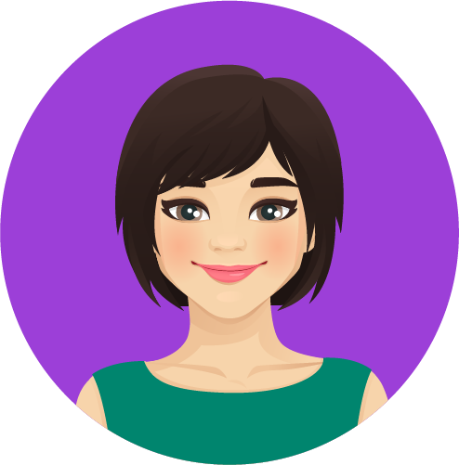
Unit 3, Activity 1
Aideen
I do think teachers are important for students. Students spend a lot of their week with their teachers.
I can remember teachers I had. My Maths teacher – I remember she told us she was dyslexic and asked us to tell her if we saw she had made a mistake. It made me think ‘oh, she’s human’.
Notes:
Teacher notes
Ask for a volunteer to read Aideen’s story (on the slide).
In your group, discuss the following:
How can you tell if there is a good relationships between students and teachers?
Who has a role in making sure that there are good relationships between teachers and students? What can teachers do? What can students do? What about school management, or parents/guardians?
Why are good relationships between teachers and students important?
Take feedback from a selection of groups.

Slide 7
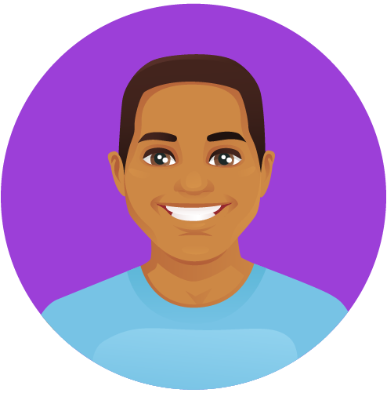
Unit 3, Activity 2
Nasir
[In Transition Year] I really became fully engaged in class activities. I found that I started to change for the better. I went on loads of school trips, made loads of more friends in my year, got to know teachers better. Teachers who would not have really known me…I made a connection with some of them.
Teachers were always very positive. They were a shoulder to cry on. They helped me in so many different ways, like you know you'd have teachers you could go to if you're feeling quite upset, if things weren't going right in your life and they would be more than happy to listen to you and try to give you some encouraging words to help you.
Notes:
Teacher notes
Ask for a volunteer to read Nasir’s story (on the slide).
Facilitate a whole class discussion, based on the following prompt questions:
What, if anything, do you know about Transition Year?
Why do you think it is called ‘Transition Year’?
What are the pros and cons of doing Transition Year?
Transition Year (TY) is a one-year stand-alone (usually optional) programme that forms the first year of a three-year senior cycle in many schools. It is designed to act as a bridge between the junior and senior cycle. Each school designs its own TY programme, within set guidelines, to suit the needs and interests of its students and the local context. TY offers students an opportunity to mature and develop. It gives you time to think about what you would like to concentrate on in 5th and 6th year. It also provides an opportunity to think about the value of learning in preparing you for the adult world of work, apprenticeships, further and/or higher education. TY is a great opportunity to further build your relationships with peers and with teachers. These relationships can then help to keep you going through 5th and 6th years.

Slide 8

Unit 3, Activity 2
Leaving Certificate (Established)
Languages | Irish, English, French, German, Italian, Latin, Greek, Spanish, Arabic, Japanese, Russian, Classical Studies, Hebrew Studies, Lithuanian, Mandarin Chinese, Polish, Portuguese In addition, Leaving Certificate examinations in any of the recognised languages of the European Union and Ukrainian are possible, if you meet certain criteria.
Sciences | Applied Mathematics, Biology, Chemistry, Mathematics, Physics
Business studies | Accounting, Business, Economics
Applied sciences | Agricultural Science, Construction Studies, Engineering, Home Economics, Design and Communication Graphics, Technology, Computer Science, Physical Education
Social sciences | Art, Geography, History, Home Economics, Music, Politics and Society, Religious Education
FYI: Senior cycle (made up of Transition Year, 5th and 6th Years) is currently in the process of change. Some of these changes may affect you. For example, 2 additional new Leaving Certificate subjects will be in some schools from September 2026:
Climate Action and Sustainable Development
Drama, Film and Theatre Studies
Notes:
Teacher notes
There are three Leaving Certificate programmes: Leaving Certificate (Established) (on the slide), Leaving Certificate Vocational Programme (LCVP) and Leaving Certificate Applied (LCA).
Has anyone ever heard of these programmes before? What do you know about them?
The Leaving Certificate Established is the programme that most post-primary students follow. For this reason, I’m going to spend some time explaining this programme, but I’ll also give an overview of the other programmes.
Take notes while I explain the different programmes and don’t be afraid to ask questions.
Leaving Certificate Established
Students usually study Leaving Certificate 7 subjects: 3 core subjects of Irish (unless you are exempt), English and Maths, and 4 other subjects. At present, when calculating CAO points for entry to different courses, it is your best 6 from one set of Leaving Certificate results that can be counted. You should always try to study subjects at the highest level you are able for because this allows the possibility of getting the most CAO points.
Leaving Certificate Vocational Programme
The Leaving Certificate Vocational Programme (LCVP) is a 2-year programme where students study at least 5 subjects - English, Irish, plus two subjects from specified vocational subject groupings, and a Modern European language (other than Irish or English). Students also take three Link Modules on Enterprise Education, Preparation for Work and Work Experience. For assessment, students complete a portfolio that accounts for 60% of their overall grade. The terminal exam, which takes place in May of the 6th year, makes up the remaining 40%. The LCVP certificate is awarded at three levels: Pass; Merit; and Distinction. CAO points are awarded for these grades.
Leaving Certificate Applied
Leaving Certificate Applied (LCA) is a 2-year Leaving Certificate programme aimed at preparing students for adult and working life. LCA consists of four half-year blocks, or sessions. Achievement is credited in each session. Modules are offered in three main areas: Vocational Preparation; General Education; and Vocational Education. LCA has a 'vocational’ focus, which means that it's more job and employment orientated than the other two programmes. Students who study the LCA programme may not wish to proceed directly to university, many go the Further Education & Training (FET) route and others go straight into a job. The LCA certificate is awarded at three levels: Pass; Merit; and Distinction.

Slide 9
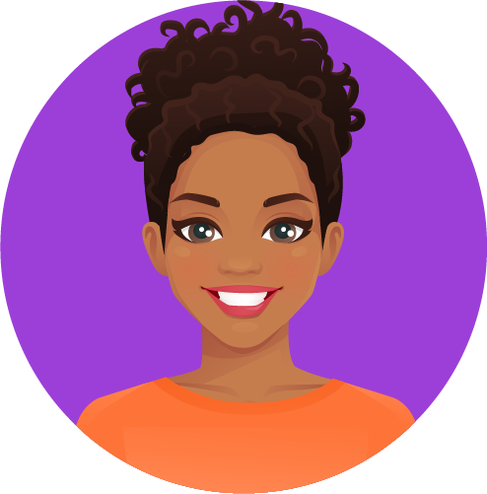
Unit 1, Activity 3
Larissa
I went back [to train as a primary teacher] after 20 years – there was a 20- year gap between doing my honours Irish and studying to be a teacher – there was a BIT of a vacuum there that needed to be filled...
I can’t emphasis enough what a big part of the training that Gaeilge is. There is just no getting around it. You must have the standard. Sin é. It’s a big part of the daily life of a primary teacher. As it should be…
Notes:
Teacher notes
Ask for a volunteer to read Larissa’s story (on the slide).
When Larissa decided to leave her law career and become a primary teacher, she had to work hard to refresh her Irish language abilities. However, she was lucky she had honours Leaving Certificate Irish. As you might remember (Unit 2), honours Irish is a minimum entry requirement for the university course that qualifies you to become a primary teacher. Unless you want to teach Irish, this isn’t the case for post-primary teaching.
Larissa’s story gives some idea of the importance of senior cycle subject choices. Senior cycle subjects can form the foundation for courses you might like to do.
Divide the class into small groups.
In your group, share what you know about senior cycle subject choices. For example:
Do you have a sense which subjects might interest you?
Do you know what jobs/careers the different subject choices you have can lead to?
How can you prepare yourself to make good senior cycle subject choices? Where can you go for information or who can you ask for help?
Take feedback from a selection of groups.
NB: Where possible, answer questions and address any misconceptions that arose in the group discussion. Remind students about the career guidance support that is available in the school.
The best general advice in terms of making Leaving Certificate subject choices is to:
pick the subjects that you find interesting and are good at (these two things usually go together)
think about subjects that complement each other (e.g. Business and Home Economics, or Maths, Physics and Applied Maths).
if you know what you want to do when you leave school, make sure to research the subjects that will be support you (e.g. entry requirements for further or higher education courses)
don’t worry if you don’t know what you want to do when you leave school, this is common. Choosing a 3rd language and a science subject is good strategy for keeping your options open.

Slide 10



Unit 3, Activity 3
Leaving Certificate Subject Profile
Subject title…
Advantage to have studied at junior cycle…
What kind of student it would suit (include abilities/skills)…
Subject overview…
Assessment…
Job/career possibilities…
What subject teachers say…[Why would they recommend it?; What do they like about this subject?]
What students studying this subject say…
Notes:
Teacher notes (NB: internet would be useful for this activity)
NB: The template on the slide is for profiling a Leaving Certificate subject. Depending on your class, you might like to encourage them to adapt the template, e.g. LCA module profile. Students will need to be given time after class to populate the last two headings and you may need to support them to talk to relevant subject teachers and senior cycle students.
Divide the class into small groups.
To help inform our decision-making when it comes time to select our Leaving Certificate subjects, we’re going to create subject profiles.
Depending on your class, either allow groups to choose the subject they want to profile or allocate one subject to each group (see Slide 7)
You must use the template headings on the slide. If you want, you can add another 1-2 headings.
Depending on your class, you may wish to share some of the following useful links:
Senior Cycle Subjects | Curriculum Online ; Leaving Cert Subjects | CareersPortal.ie ; some schools have produced and published subject guides, e.g. Guide to Leaving Cert Subject Options | Stepaside ETSS
Leaving Certificate Vocational Programme (LCVP) | Curriculum Online
LCA | CareersPortal.ie ; Leaving Certificate Applied | NCCA

Slide 11
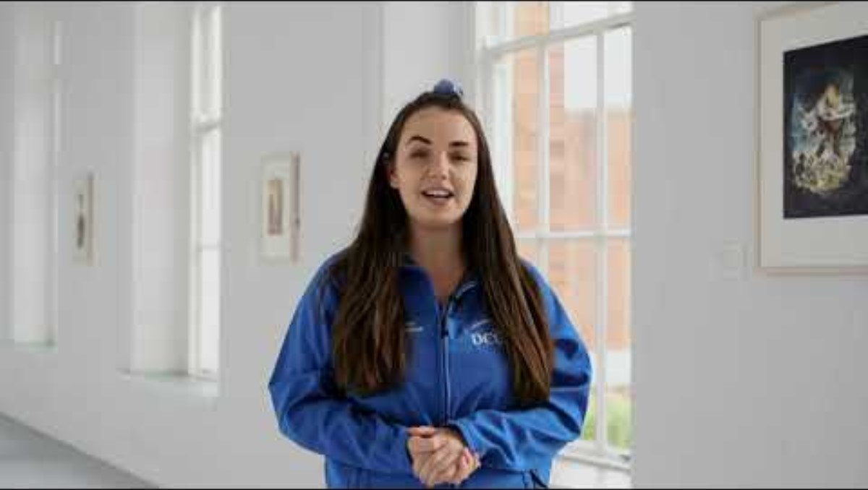
Unit 3, Activity 4
DCU Institute of Education St Patricks Campus – Virtual Tour (3.53 mins)
Notes:
Teacher notes (NB: internet required for this activity)
We’re going to watch a short video where young people who are doing teacher education courses give a tour of DCU’s Institute of Education (St Patrick’s Campus, Drumcondra, Dublin).
As you watch, jot down anything that interests you or that would motivate you to attend DCU’s Institute of Education.
Play the video on the slide (3.53 mins) (see: DCU Institute of Education St Patricks Campus – Virtual Tour)
Depending on your class, you might like to play the video a second time.
Take feedback from a selection of students.
Now, take a minute to jot down anything that you would find challenging or difficult about going to university or to a college of further education. [Possible answers: no one in my family has ever gone to university/college before (this could lead to a limit on family capacity to support the academic demands of the course), financial challenges mean that I would have to work part-time or full-time while studying (which could lead to difficulties meeting the academic demands of the course), lack of digital skills, lack of self-confidence about my academic abilities etc].
Take feedback from a selection of students.
Let’s watch the video again. This time, jot down any student supports that are mentioned in the video. [Answer: student advice centre, access office, careers office, disability and learning support, counselling and personal development, financial assistance service]
Divide the class into pairs/small groups depending on access to devices.
Allocate one of the student supports mentioned in the video to each pair/group (see hyperlinks above).
As you read/watch/listen to the information available about your allocated student support, identify which challenge or difficulty this specific student support can help overcome.
Take feedback from a selection of pairs/groups.

Slide 12
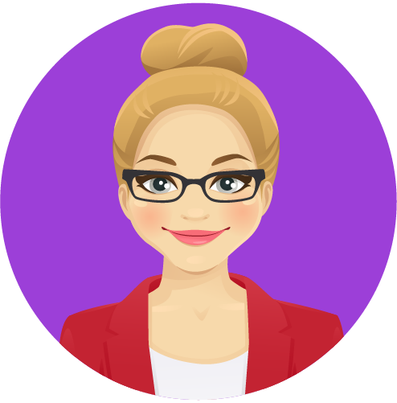
Unit 3, Activity 4
Lena
I had primary teaching as my first choice. … Then when the [Leaving Certificate] points came around, I didn’t get the choice that I wanted. I accepted an Arts [undergraduate degree] place instead.
I never thought of secondary school teaching as something for me. At the time you could pick 3 subjects [in first year Arts]. I picked Religion to drop it later. I found it was something I really enjoyed. The lecturers were nice and supportive, and I liked the small class groups. I just changed my mind then and decided to become a secondary school Religion teacher.
Notes:
Teacher notes
Ask for a volunteer to read Lena’s story (on the slide).
Together with the student supports we have already looked at Lena mentions other supports which helped her to get her Arts degree. What are these? [Answer: lecturers and small class groups].
University or college is the same as school in that the relationships that you have with people are so important in terms of supporting you to achieve.

Slide 13

Unit 3, Activity 5
Think about the various Pathways activities we have done.
Create a Pathways poster for students who are just about to start these activities.
The aim of your poster is to motivate other young people to participate in the various activities, to learn to the best of their abilities and get the most they can from the experience.
Feel free to either use digital technology or hand draw your poster.
Notes:
Teacher notes
Read the text on the slide aloud.
Depending on your class, you might wish to remind students of the various Pathways units/activities they have engaged with. The table on Slide 2 in each unit may be useful in this regard.
With the permission of students, their completed posters may be useful to show to the next class that you take through the Pathways units.

Slide 14

Unit 3, Checking in with the learning intentions
Hello again!
How did you get on with Unit 3?
Did you learn to…?
discuss the value of good relationships between teachers/lecturers and students
recognise the importance of Leaving Certificate subject choices
profile a Leaving Certificate subject, LCVP or LCA module
use our learning from the Pathways units to motivate others to engage with these activities
Notes:
Teacher notes
Read each learning intention aloud.
Ask students to give you a thumbs up if they feel they have achieved the learning intention, a thumbs down if they still need some support and a fist if they are unsure.

Slide 15
Unit 3, Extension activity
Here’s an idea for you.
Watch a few different virtual tours of universities and further education colleges. Try to find videos of institutions that offer courses that you are interested in doing.
Be inspired by the best virtual tours to create of a virtual tour of your own school focused on giving information about senior cycle (TY and/or 5th & 6th year).
Publish your virtual tour on the school website and/or show it at a relevant parent’s evening.
Notes:
Teacher notes
The extension activity suggested on this slide is linked to Activity 2 (Slides 7-8), Activity 3 (Slides 9-10) and Activity 4 (Slide 11).

Slide 16
Path Project
Institute of Education
Dublin City University

