Slide 2
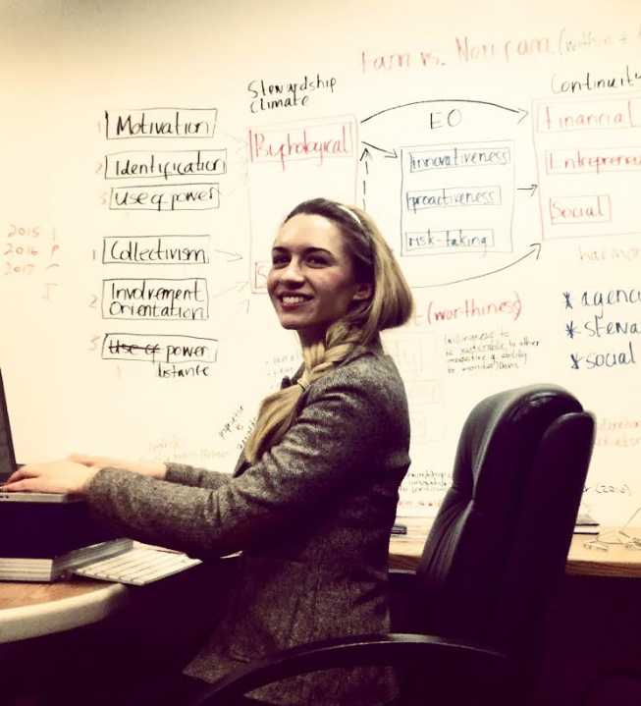
Success for Scholar Catherine Faherty, February 2017
Catherine has launched the First National Business Survey on Workplace Culture & Trust
Catherine has also secured a postdoctoral research position in the prestigious Kellogg School of Management at Northwestern University, Chicago

Slide 3
CFB Webinar delivered by Dr Eric Clinton, March 2017:
Talent in the Family Business –
The Role of Non-Family Members

Slide 4
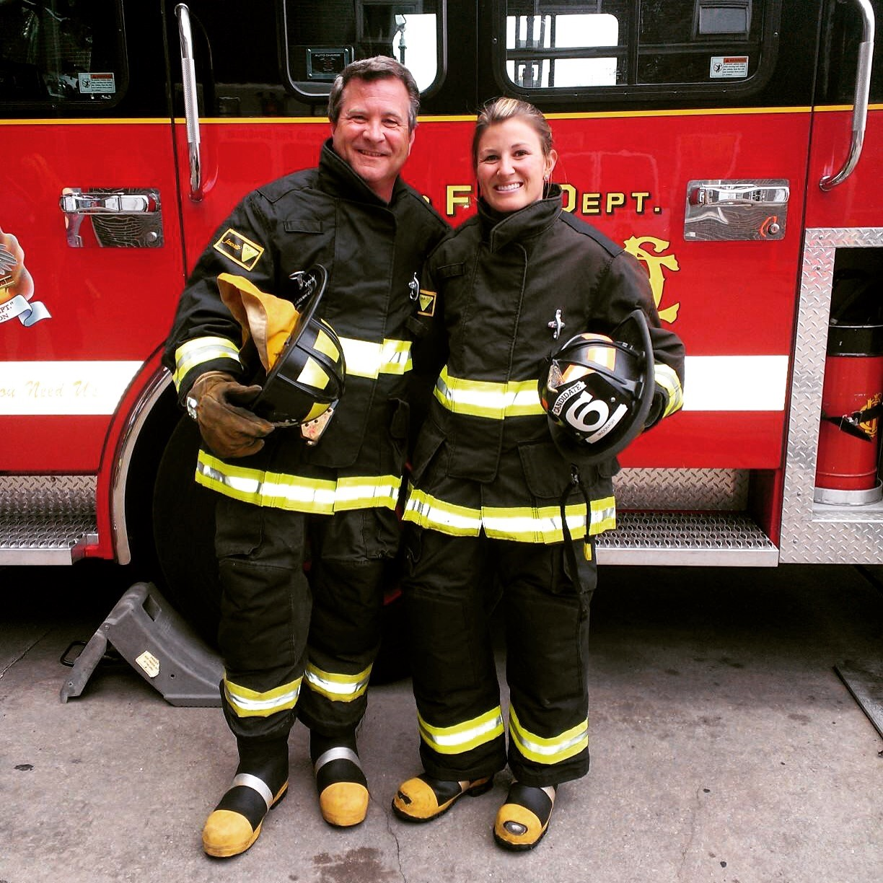
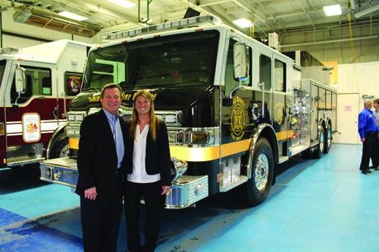
CFB Conference, March 2017:
The Darley Family
Paul Darley & Audrey Darley of W.S. Darley & Co

Slide 5
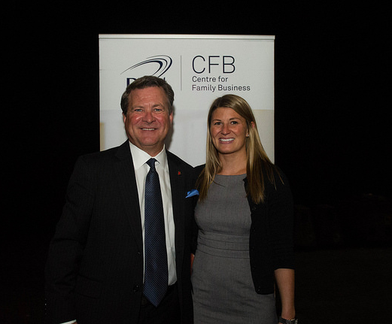
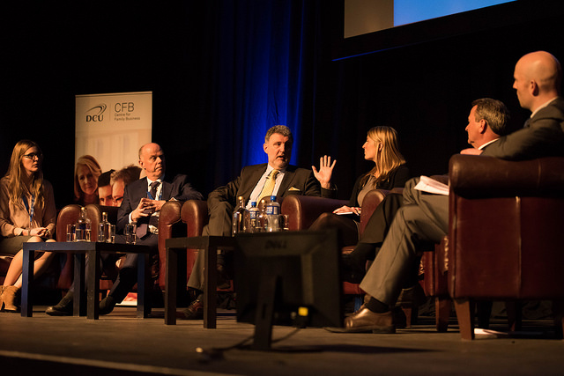
Kevin & Rachel O’Connor, Colourtrend; Paul Hennessey, PwC; and Audrey & Paul Darley, W.S. Darley & Co, in conversation with Brian O’Connor

Slide 6
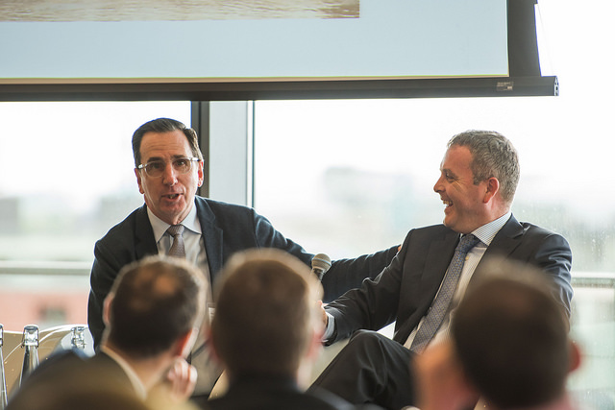
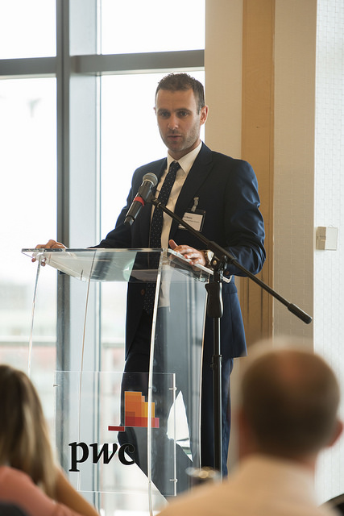
CFB Roadshow, Dublin, May 2017

Slide 7
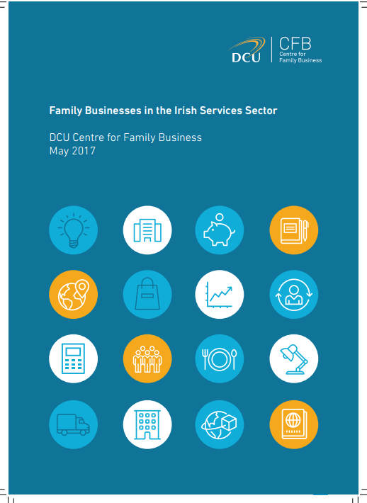
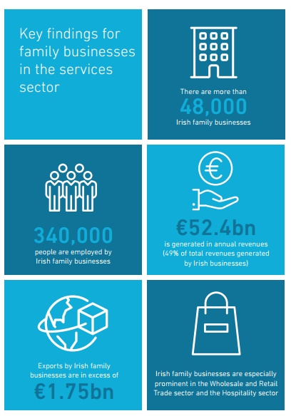
CSO Research Report Published, May 2017:
Family Businesses in
the Irish Services Sector

Slide 8
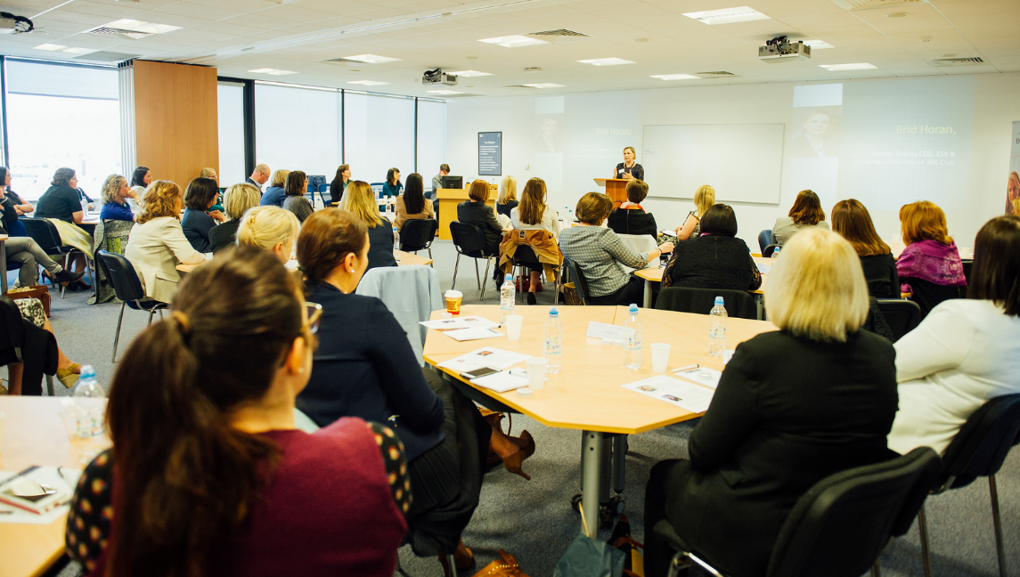
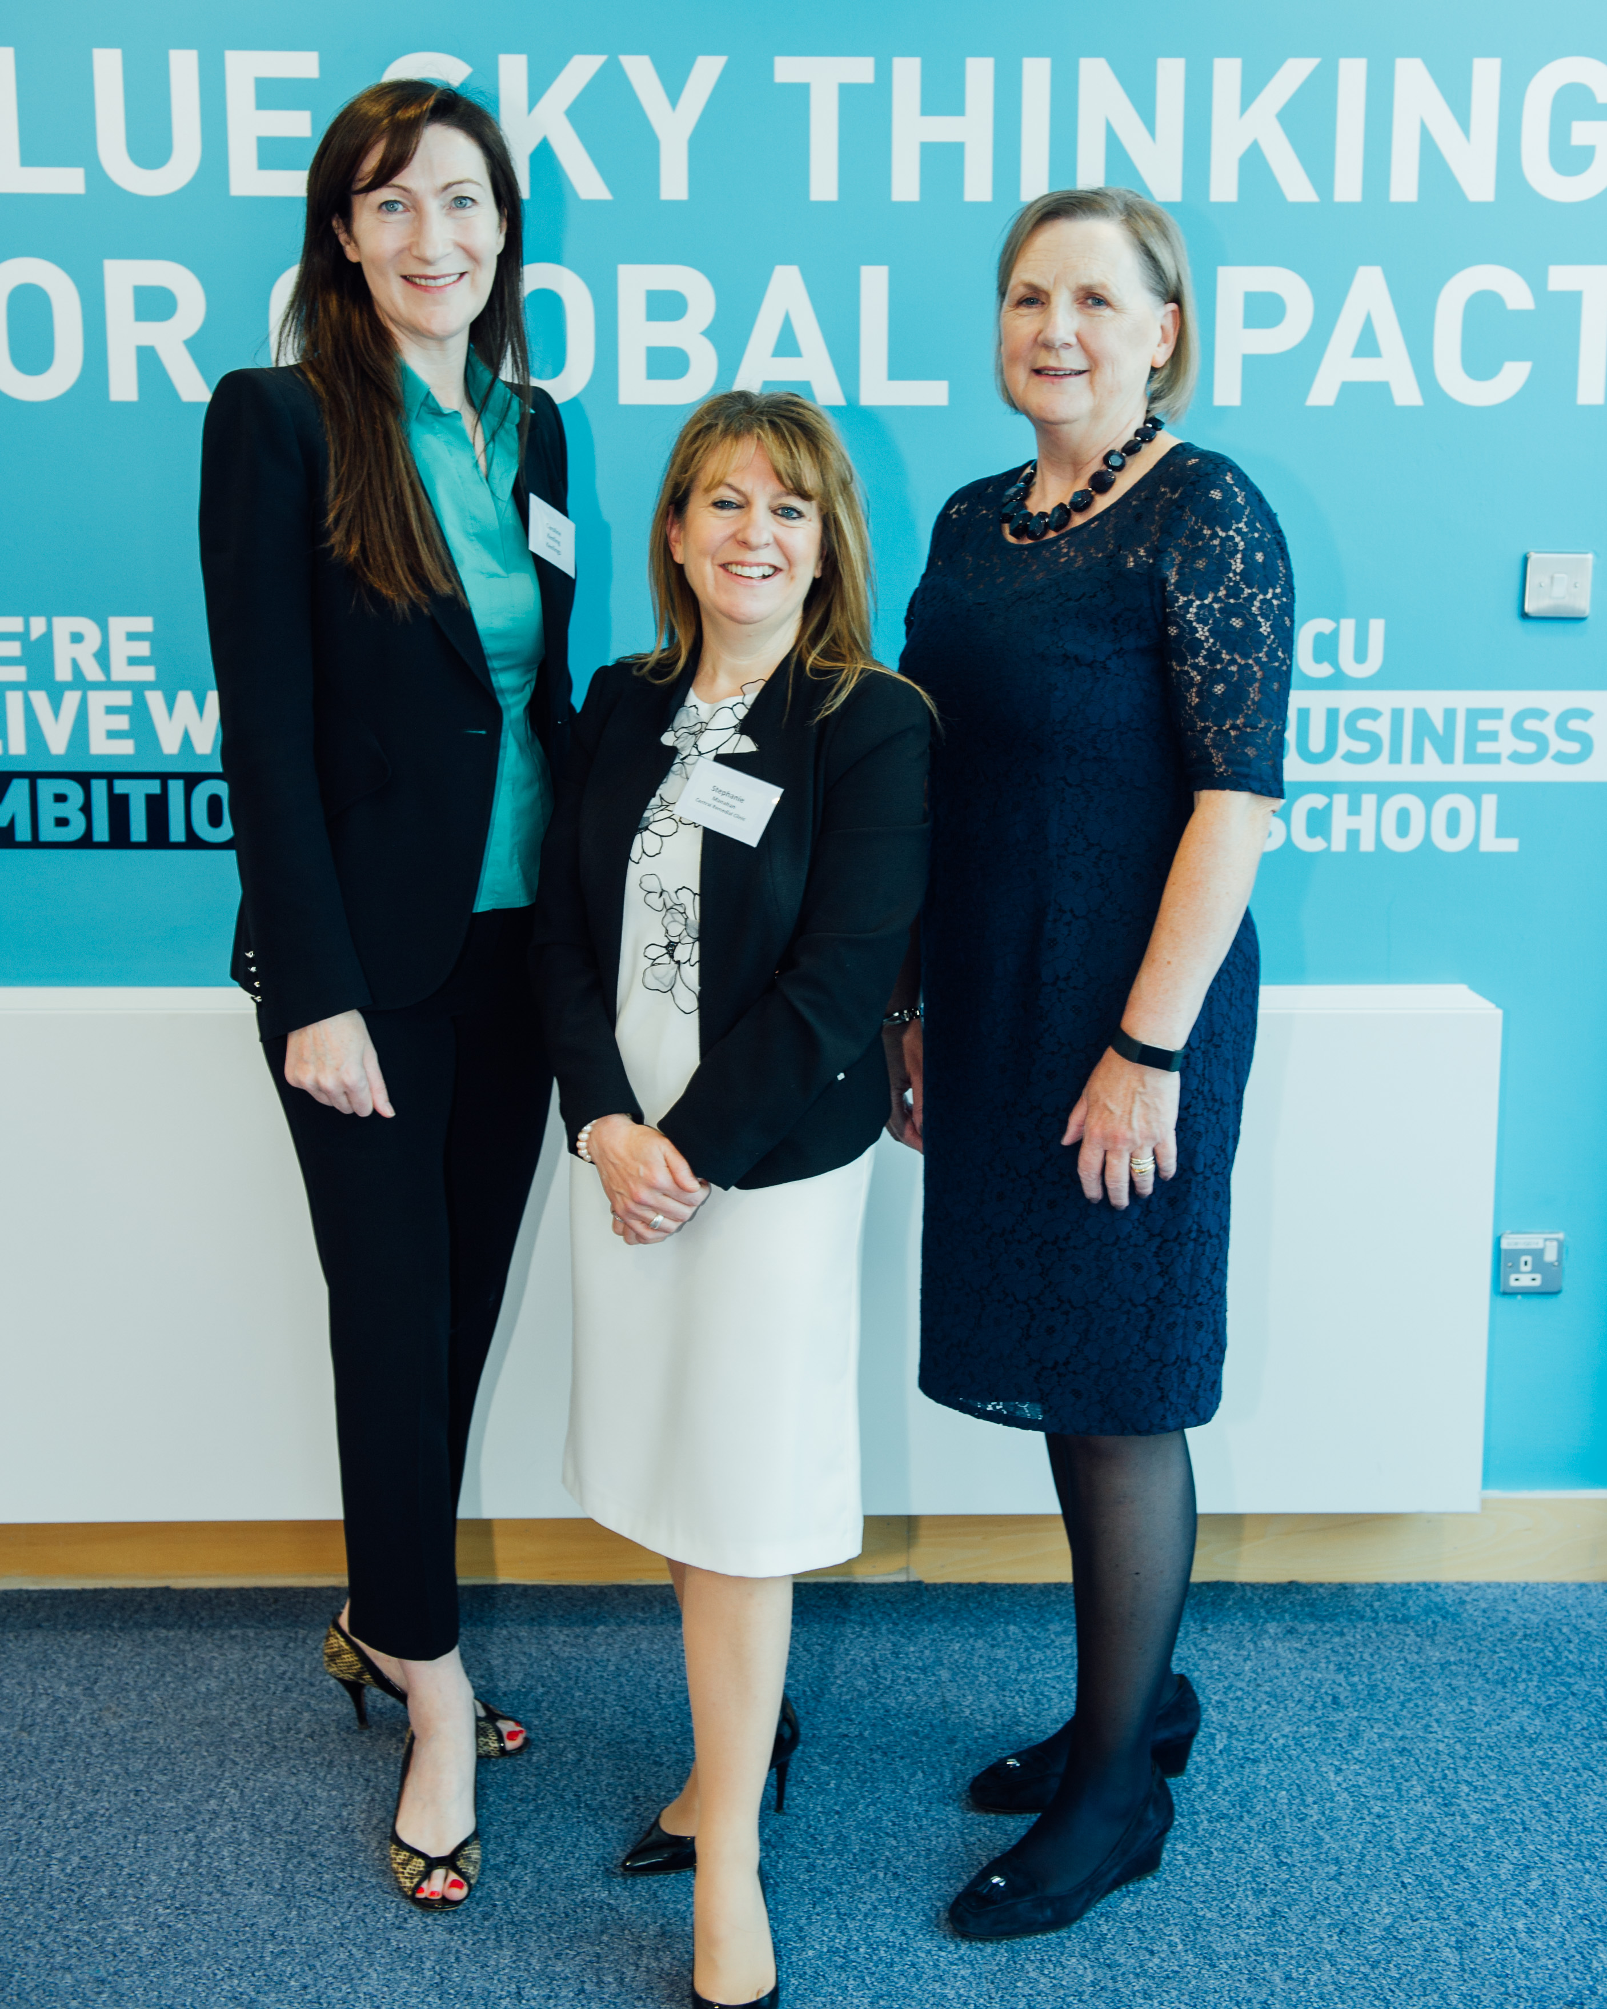
Women in Family Business & Leadership Event, May 2017

Slide 9
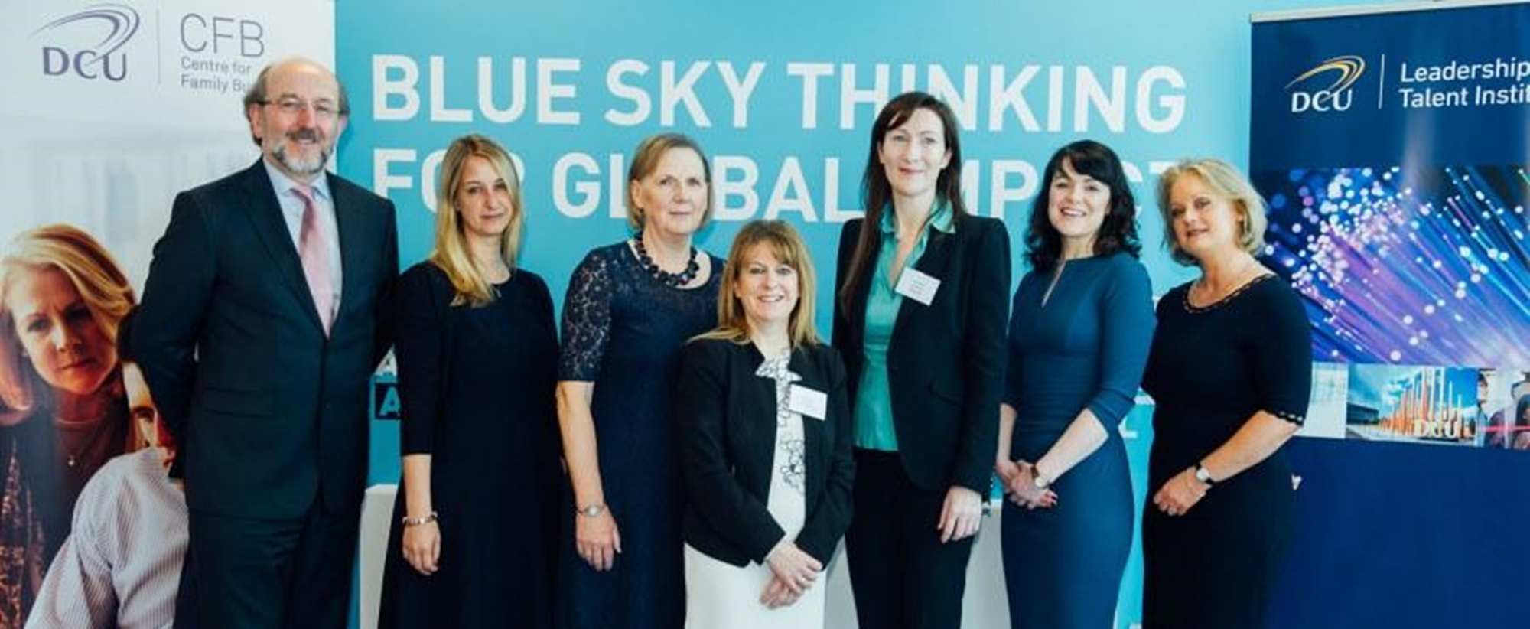
Women in Leadership & Family Business Event
Guest Speakers Brid Horan, Caroline Keeling & Stephanie Manahan

Slide 10
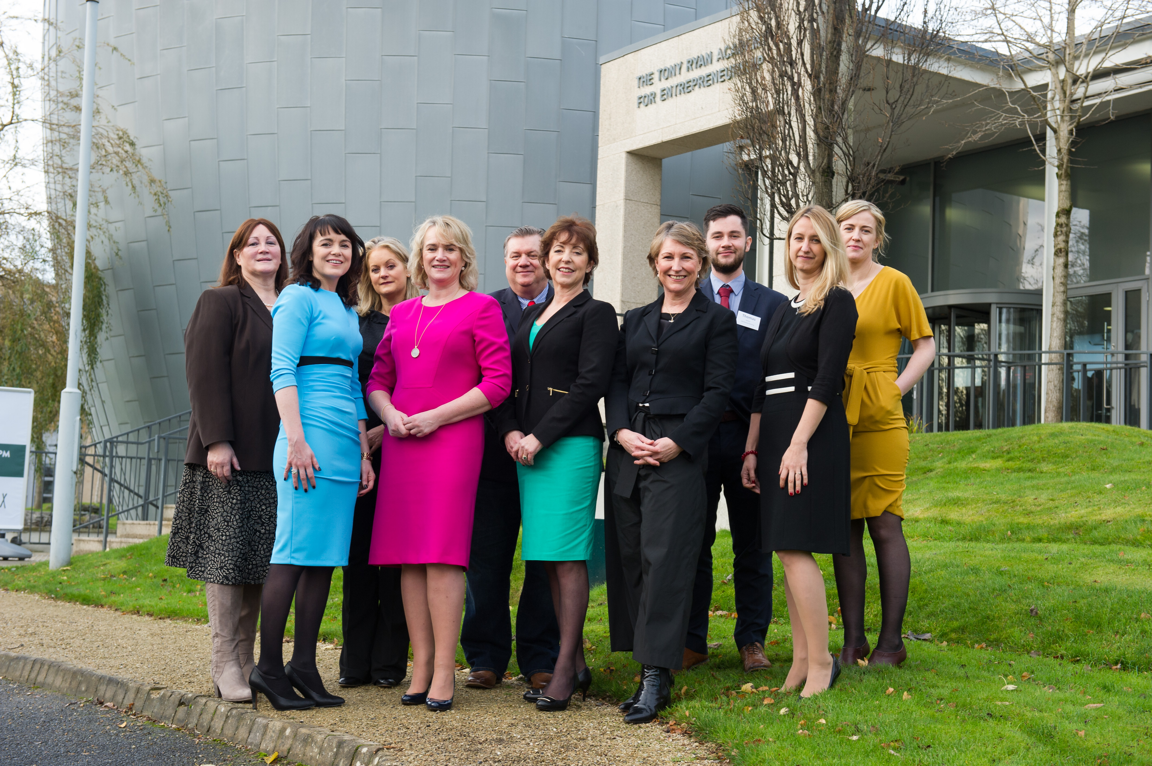
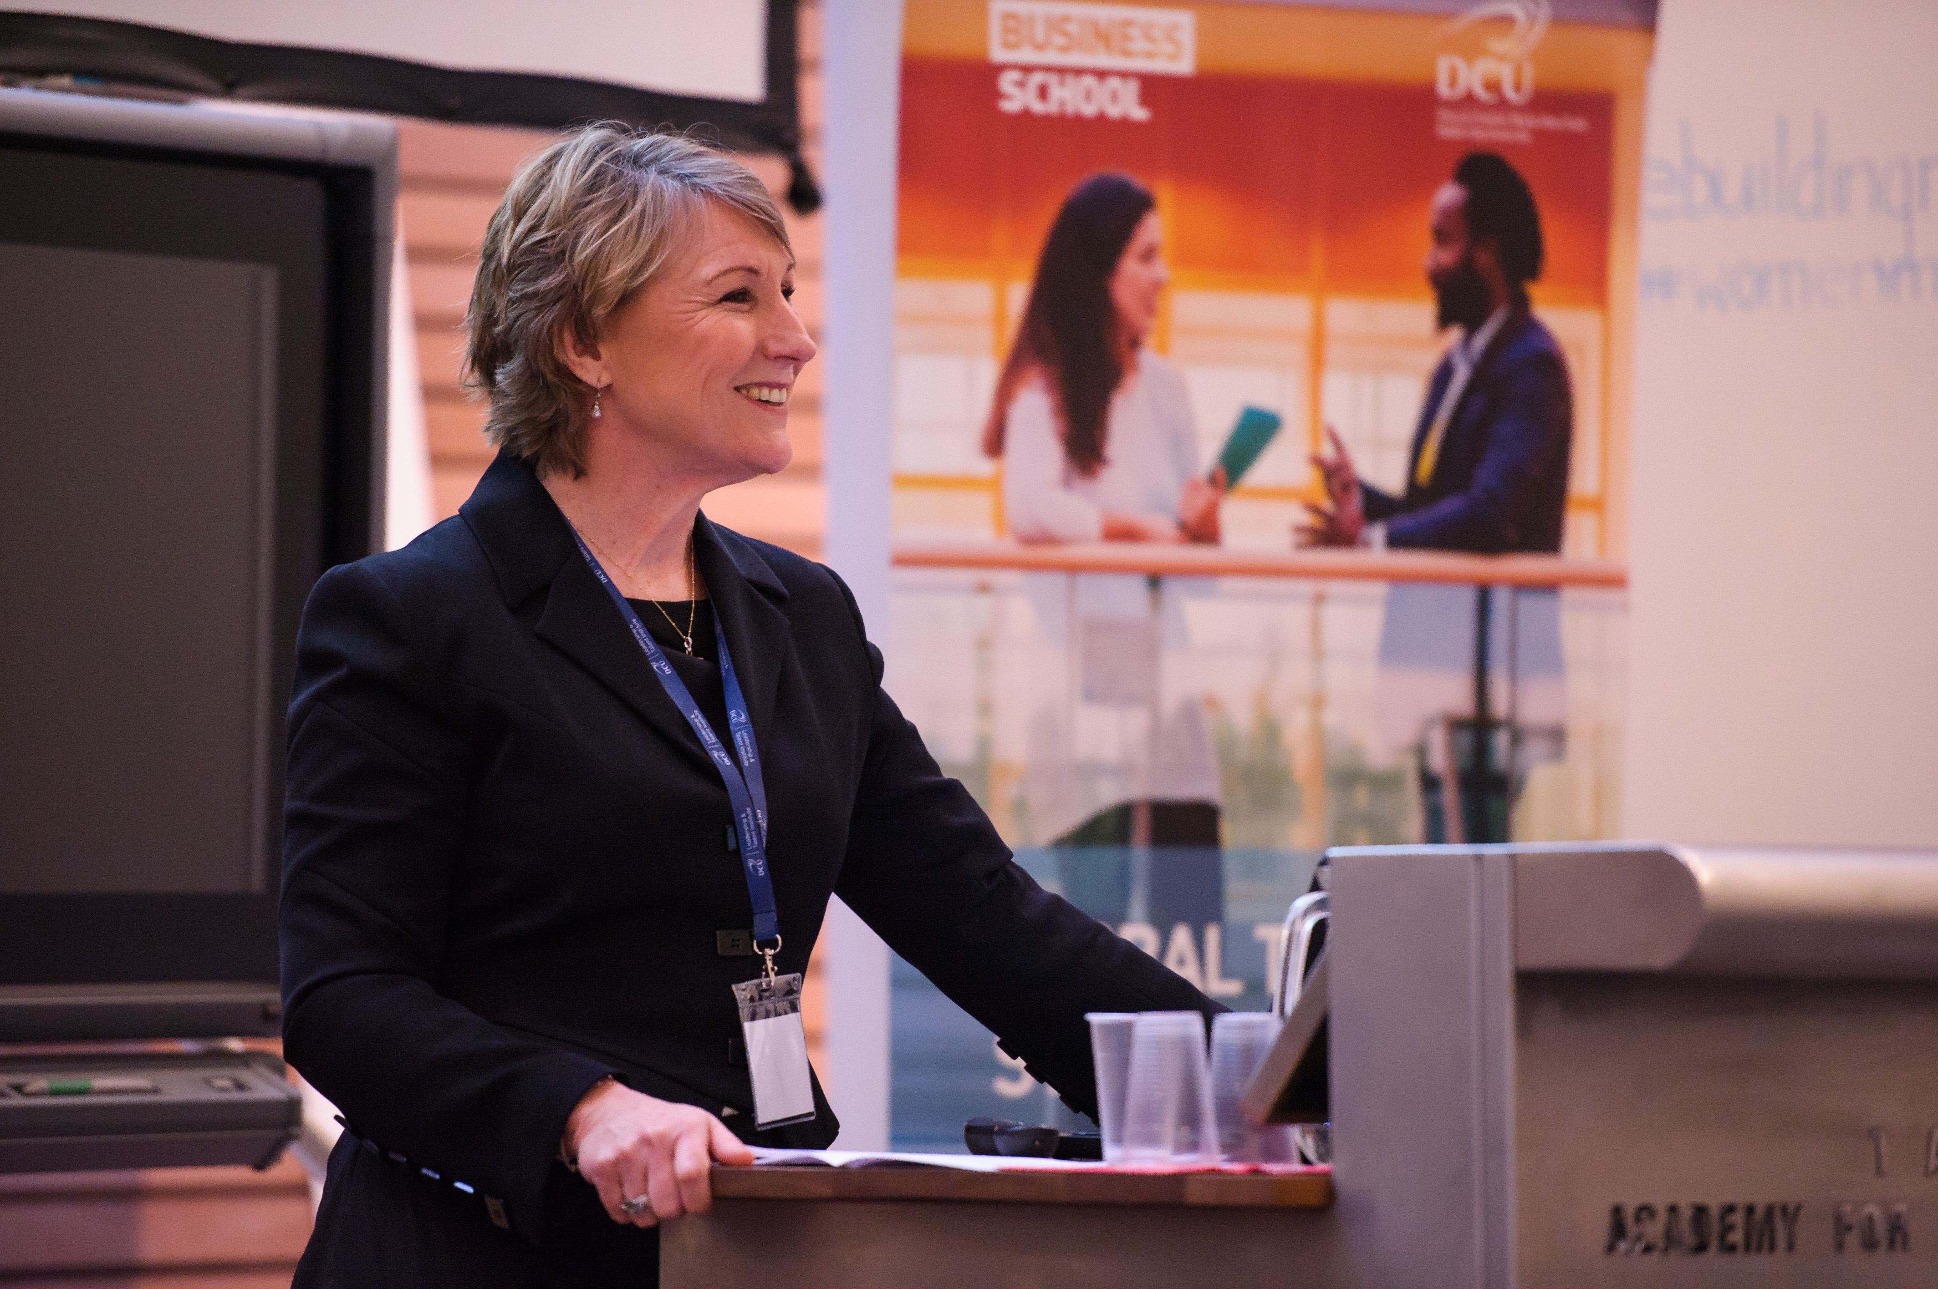
Women in Leadership and Family Business, November

Slide 11
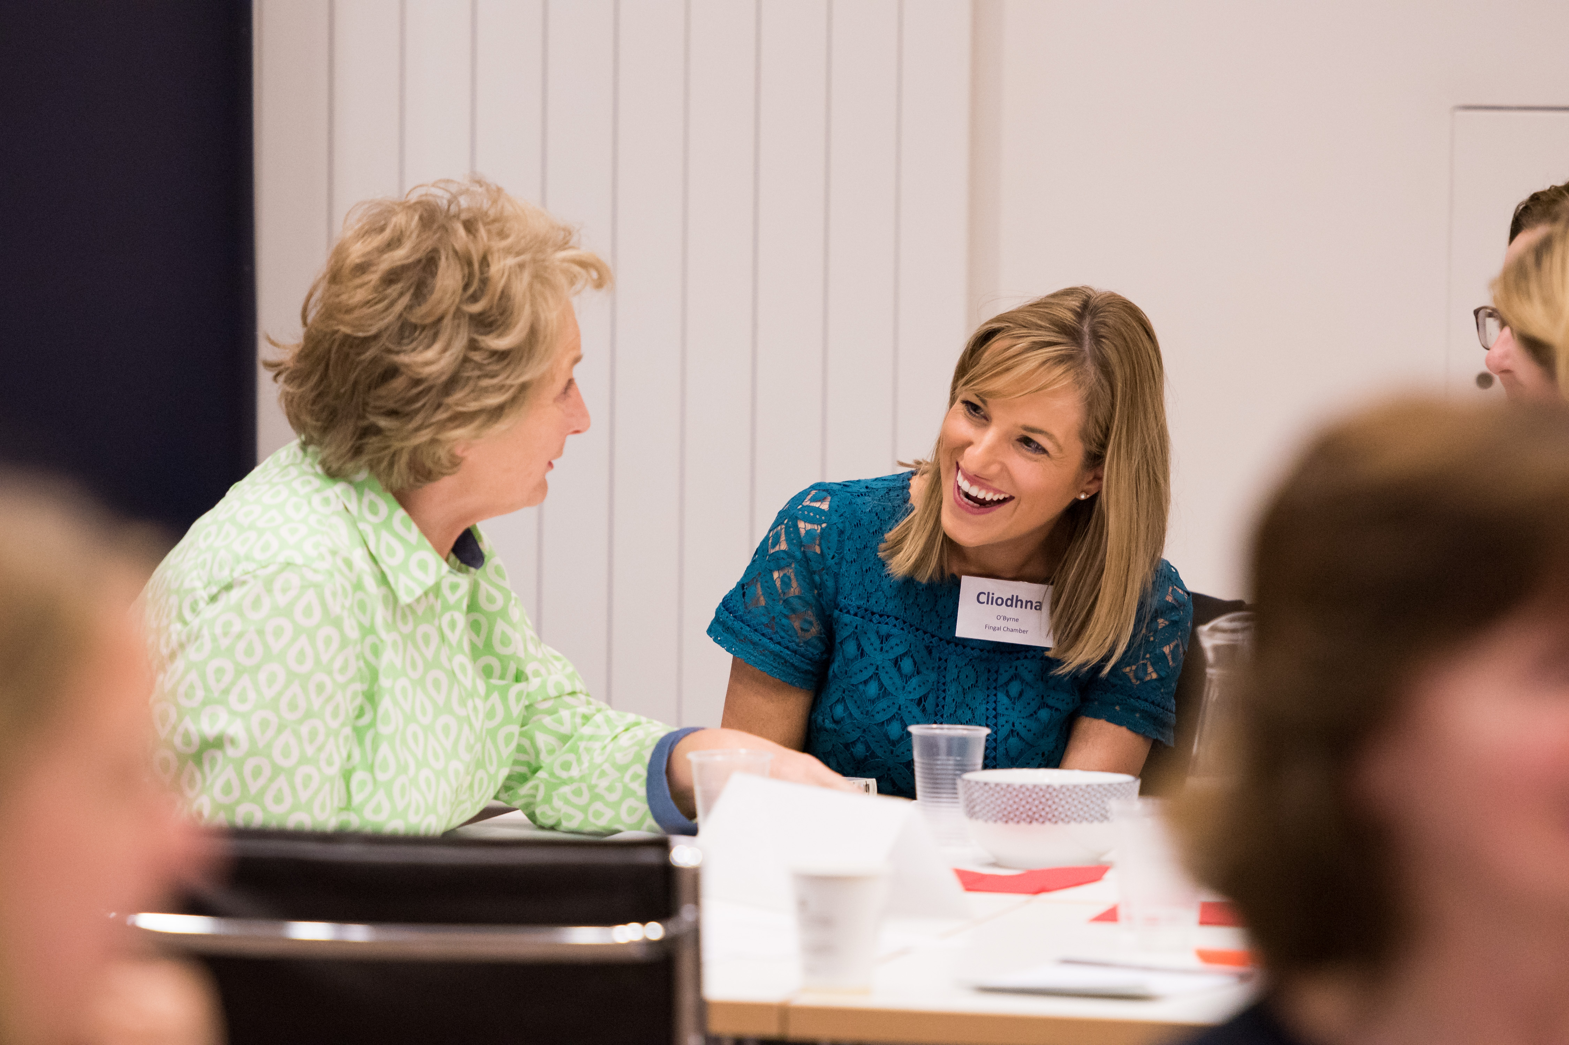
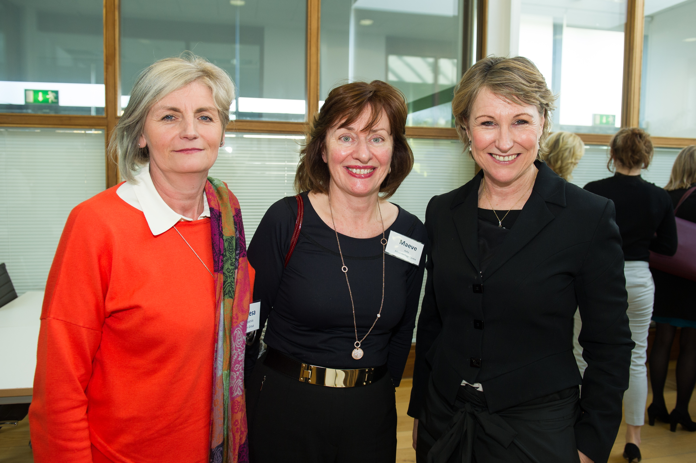
Women in Leadership & Family Business Series, November

