Slide 1

It’s good to talk??
Chatbot meet-cute
With www.dcu.ie YYY
Ger Cannon - gerald.cannon@dcu.ie - ISS

Slide 2

Special thanks to…
Communications,
Marketing & Events
Placements
People
QUID

Slide 3



Real issues can be addressed
Users get access to 24/7 support
Outside office hours help
No waiting in queues
Departments can refocus resources e.g.
Provide better 2nd/3rd level support
Develop improved documentation
Hands dirty learning
- Why?
Notes:
Data already there
Already demand from departments after seeing chatbots go live

Slide 4
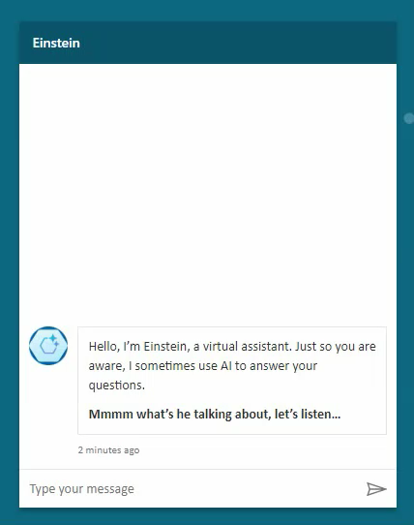
Issues
It’s a new technology so…
In a state of flux
Little documentation/ guides/best practice
No definite idea of future direction
Plus one infamous flaw:
It sometimes gets things wrong!
Notes:
But of course there are issues…
Like any new technology its in a state of flux >>>
We’re not sure what things might stick and what might not so there’s no definite idea of future direction >>>>
And of course there is the now infamous flaw..
It sometimes gets things wrong! >>>>>
But there are ways to manage this –You need to set user expectations properly, keep it subject area focused and above all make sure you have good training data

Slide 5
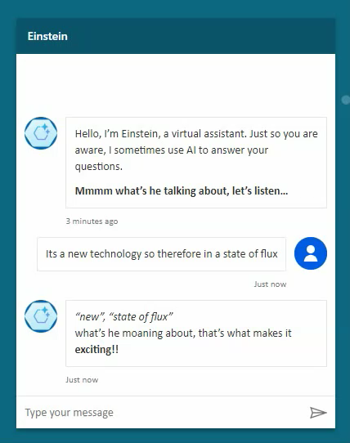
Issues
It’s a new technology so…
In a state of flux
Little documentation/ guides/best practice
No definite idea of future direction
Plus one infamous flaw:
It sometimes gets things wrong!
Notes:
But of course there are issues…
Like any new technology its in a state of flux >>>
We’re not sure what things might stick and what might not so there’s no definite idea of future direction >>>>
And of course there is the now infamous flaw..
It sometimes gets things wrong! >>>>>
But there are ways to manage this –You need to set user expectations properly, keep it subject area focused and above all make sure you have good training data

Slide 6
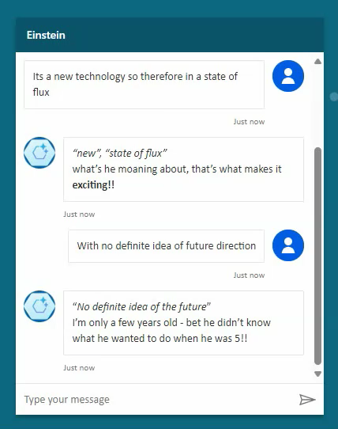
Issues
It’s a new technology so…
In a state of flux
Little documentation/ guides/best practice
No definite idea of future direction
Plus one infamous flaw:
It sometimes gets things wrong!
Notes:
But of course there are issues…
Like any new technology its in a state of flux >>>
We’re not sure what things might stick and what might not so there’s no definite idea of future direction >>>>
And of course there is the now infamous flaw..
It sometimes gets things wrong! >>>>>
But there are ways to manage this –You need to set user expectations properly, keep it subject area focused and above all make sure you have good training data

Slide 7
Overview
Built on the Microsoft Studio Copilot platform
Answer
Knowledge
Training data normally a website and/or documents
User query
Follow up query
Topics
Custom answers or pathways to specific queries (intents)
Fallback to manual support

Slide 8

Query types (ISS)
Common queries… Passwords, MFA and Cybersecurity

Slide 9

Query types (ISS)
Registration issues

Slide 10

Query types (ISS)
Edge cases, unusual questions and just plain wrong usage!

Slide 11

Thoughts
The technology is surprisingly predictable in its outcomes

Slide 12

Thoughts
Microsoft very strong on data management, security and governance

Slide 13

Thoughts
A major advantage of the platform is providing a link to the original source

Slide 14

Thoughts
data
It is all about the …

Slide 15

Next steps
Continue monitoring and updating existing deployments

Slide 16

Next steps
Roll out chatbots currently in the pipeline

Slide 17

Next steps
Use Power BI to produce user friendly reporting

Slide 18

Next steps
Move from providing information to carrying out actions on behalf of users

Slide 19

Thanks for your attention!
- gerald.cannon@dcu.ie

