Slide 1
HORIZON 2020 : what will ‘integrating the gender dimension’ mean in Science and Engineering if it’s not all about role models and recruitment ?
Elizabeth Pollitzer, genSET
ep@portiaweb.org.uk

Slide 2
PREVIEW

Slide 3
1. Recognising sex and gender as key variables

Slide 4
2. Addressing research quality issues
Exclusion of women from studies (e.g. heart, pollution, smoking, voice recognition, crash dummies, radiation doses)
Attachment to the ‘science is gender neutral’ paradigm (e.g. efficacy of vaccinations, safety of drugs)
Unrecognised ‘gender blindness’ (e.g. stem cells, innovation)
Conformity with ‘male as the norm’ models (e.g. toxicokinetics, cars, pain, radiation dosimetry)
Lack of awareness of the relevance of sex/gender factors
Gaps in researcher training, women and men (e.g. analysing medical risk by sex)
Gaps in science knowledge (e.g. less evidence for women)
Fuzzy concept of ‘excellence’ (e.g. women less successful in getting ERC grants, across all ERC themes)
Underreporting/misreporting of results (e.g. Reboxetine)

Slide 5
3. Improving research outcomes
Breast cancer and colon cancer screening and diagnosis (men and women, healthcare interventions)
Diversifying ideas, and building higher collective intelligence of teams (www.innocentive.com, FoldIT, Discover Markets)
Role of sexual dimorphism – from biomarkers to control of wildlife disease
Efficacy of vaccination strategies (e.g. men/women cervical cancer, flu) and drugs (e.g. 8 out of 10 prescription drugs withdrawn from market in the US during 1997- 2001 were more dangerous to women than to men
Effective/sustainable energy use in developing countries (e.g. failure of the improved design of wood burning cooking stoves)
Rehabilitation and assistive technologies responsive to demographic changes (e.g. aging, wellbeing, longer work life)
Evaluation of risk (e.g. women and men’s attitudes to risk taking)

Slide 6
Evidence → Dialogue → Consensus → Action

Slide 7
Sex and gender as key variables
Biomarkers (e.g. in metabolic profiles)
Stem cells (e.g. in regenerative properties of cells)
Pain (e.g. experiencing and dealing with pain)
Diagnostics (e.g. colon and breast cancer)
Toxicokinetics (e.g. efficacy of vaccinations, drugs)
Environmental toxicology (e.g. impact of pollution)
Radiology (e.g. dosimetry, medical use)
Crash dummy design (e.g. size/anatomy, pregnancy)
Car safety (e.g. impact of accidents)
Communication (e.g. voice recognition, collective intelligence)
Energy use (e.g. household behaviour)
Health (e.g. gender medicine), Agriculture (e.g. hybrid seeds), etc

Slide 8
Quality issues
Outdated/inadequate models (e.g. Reference Man in radiation dosimetry, pain, toxicology, epidemiology)
Gender neutrality/gender blindness (e.g. not recording sex of cells used in experiments)
Women excluded from studies/not grouping women by age and hormonal state
Risks not analysed by sex (e.g. harm done by drug, exposure to pollutants
Not reporting/misreporting (e.g. Reboxetine, efficacy of vaccinations)
Flaws in study/intervention design (e.g. energy use, vaccination programmes)
Gaps in knowledge (e.g. generally less evidence for women, but also for men as in breast cancer and osteoporosis)

Slide 9
Relevance, efficacy, safety
Healthcare interventions (e.g. cervical cancer vaccination strategies, screening programmes, gender medicine)
Innovation strategies (e.g. engaging consumers in product idea creation – Discover Markets, crowd sourcing – www.innocentive.com)
Societal challenges (e.g. energy and cooking stoves, demographics shifts and maintenance of cognitive and physical performance)
Drug development (e.g. personalised medicine)

Slide 10
Evidence → Dialogue → Consensus → Action

Slide 11
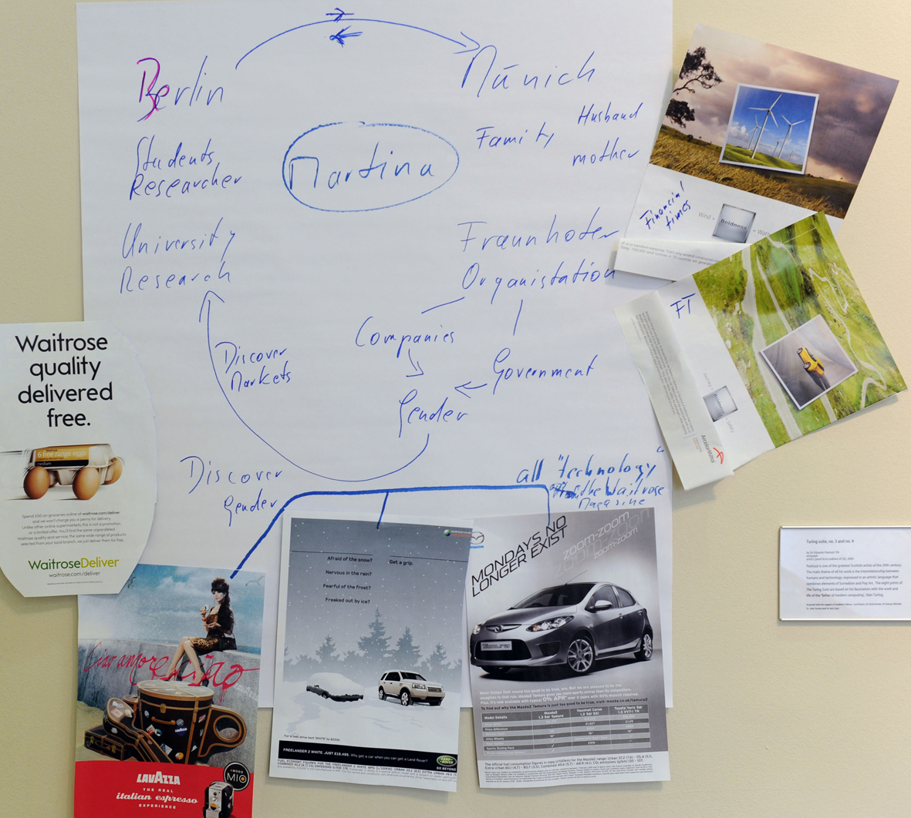
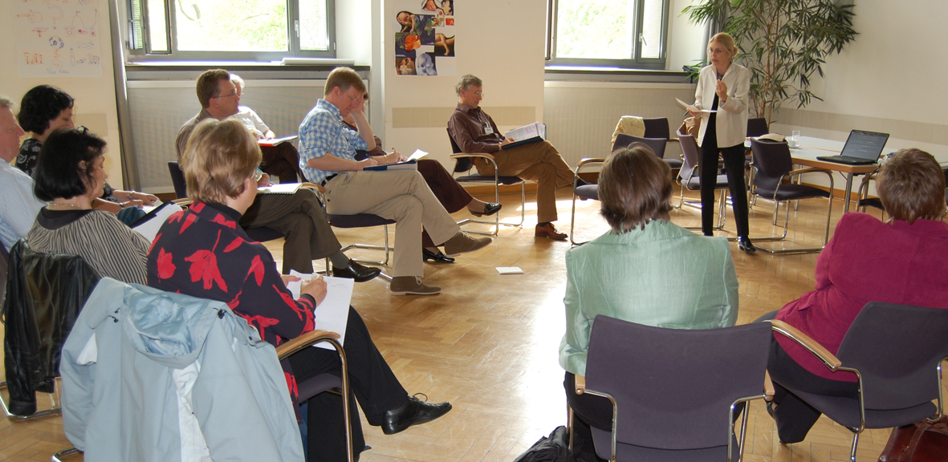
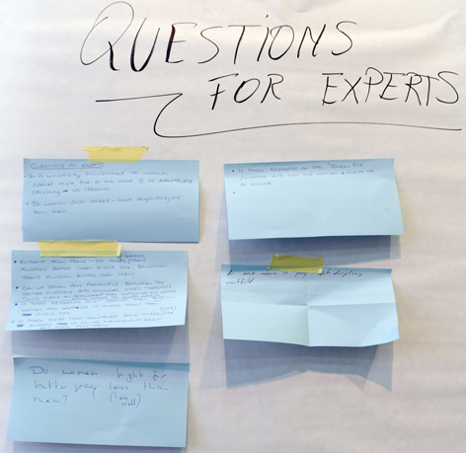
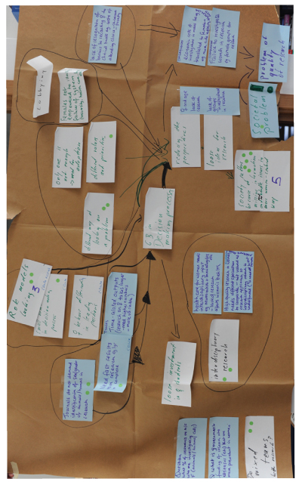
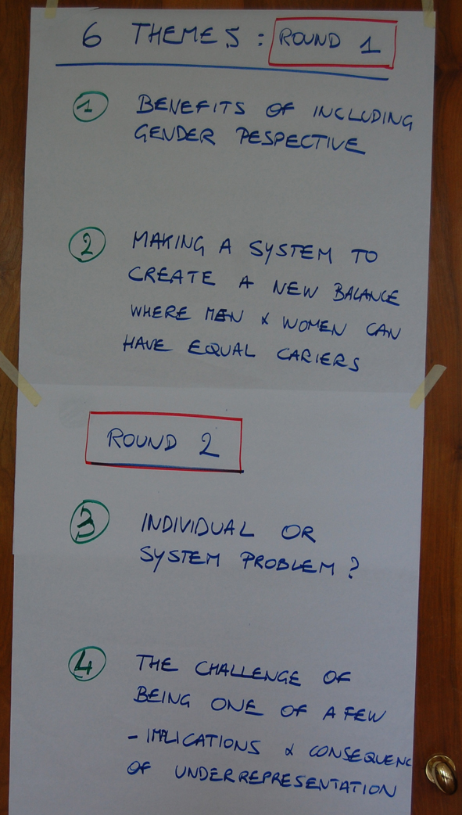
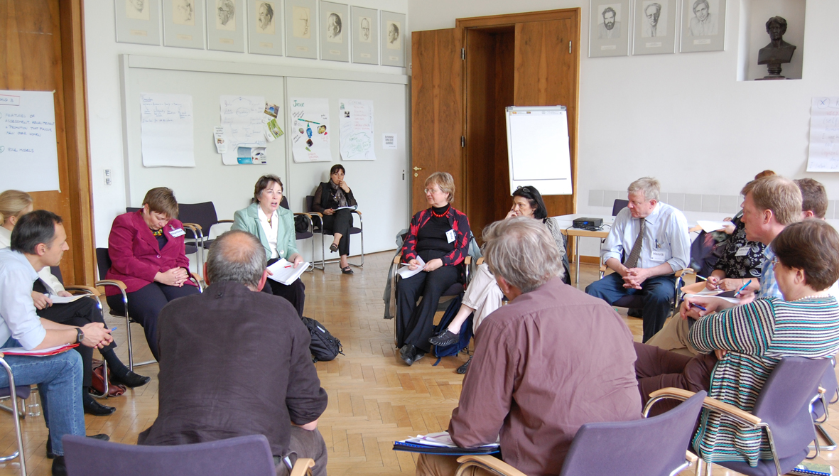
Dialogue between scientists and gender scholars

Slide 12
Evidence → Dialogue → Consensus → Action

Slide 13
Science leaders’ consensus recommendations (report and Briefing Notes @ www.genderinscience.org)

Slide 14
Science community’s and policy makers’ response to the new focus on sex/gender issues
Important to ensure quality in science knowledge making
Important to engage in the dialogue the scientists, gender scholars and policy makers
Gender Summit as high-level platform - 2011 and 2012 attracted 100 top-level speakers (research, policy), and over 800 attendees
The Manifesto was signed by 4500 people working in science in the 1st year of going on-line
International interest: Summit participants from 40 countries; next Gender Summit in the USA - NSF as the lead partner
ERA – gender equality as one of core pillars
RRI (responsible research and innovation) – new EC policy measure includes gender equality as one of its six principles

Slide 15
Evidence → Dialogue → Consensus → Action

Slide 16
‘Best practices’ and standards needed for integrating gender dimension
In particular for:
HORIZON 2020 – not repeating the mistakes of past FPs
ERA – challenges of meeting the diversity of national, regional, European priorities and contexts
RRI – combining engagement of key actors, ethics, gender equality, governance, public engagement, open access
Guardians of excellence – research funders, research performers, research publishers, research communicators, bioethics
Researcher training – addressing sex/gender related risk/efficacy/impact variations between different populations in studies & models
Science curriculum – correcting and not propagating gaps and flaws in knowledge
Policy development – using research evidence; meeting demographic shifts, e.g. challenges of aging society (working longer, chronic diseases, what counts as a ‘normal’ cognitive and physical performance)

Slide 17
Emerging tools and methods
Gendered Innovation: “methods for sex/gender analysis to create new knowledge”, http://genderedinnovations.stanford.edu
Discover Markets project, http://www.fraunhofer.de/de/leistungsangebot/forschung/discover-markets.html
Case studies, e.g. http://www.yellowwindow.be/genderinresearch/
Evidence: “From ideas to market: the gender factor”, “ The A-Z of why gender matters in research and innovation”
Cross discipline/cross sector collaborative networks, e.g. Photonics4Life, http://www.photonics4life.eu
Consensus seminars to resolve controversial issues
Gender Summit for sharing knowledge between key actors

Slide 18
Conclusions
Strong research evidence of different flaws in science practice and knowledge, which make outcomes less evidence based and less safe for women
New support from science leaders and EU policy concerned about impact on excellence
Gender dimension as a strategic driver in developing markets for science knowledge
Europe’s advantage: implementation through HORIZON 2020, Innovation Union, ERA
Systematic methods are emerging for integrating the gender dimension in research process

Slide 19
Thank you
For further details please send an email to ep@portiaweb.org.uk
For background information please consult www.genderinscience.org and www.gender-summit.eu

