Slide 1
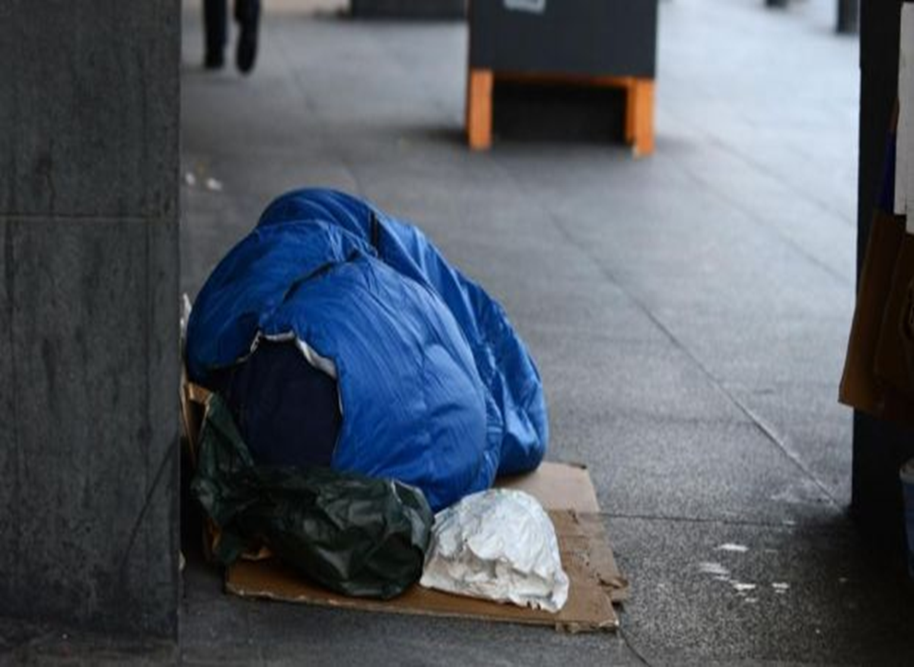
Health Care needs of the Homelessness
Liz Pigott-Glynn
Team Coordinator Health-Link Team

Slide 2
Homelessness
https://www.youtube.com/watch?v=MYGakxLz_7Q

Slide 3
Causes of Homelessness
Poverty
Structural
Leaving institutional care
Relationship breakdown
Personal reasons

Slide 4
Homelessness
An unhealthy state
Die younger
Disproportionate level of illness and addiction
Co existing morbidities
Disease experience
Mental Health
Risk taking behaviours
Use of health care services

Slide 5
Hierarchy of Needs
Maslow, A. (1943). A theory of human motivation

Slide 6
Homelessness: an unhealthy state

Slide 7
Homelessness: an unhealthy state
“
Sometimes I get a place in a hostel. Then I get angry and get into fights

Slide 8
Homelessness: an unhealthy state
I’m a nobody,
I feel invisible, people often look the other way

Slide 9
Homelessness: an unhealthy state
I don’t like night shelters. I have to share a room. My stuff gets stolen”

Slide 10
Homelessness: an unhealthy state
I often feel ashamed

Slide 11
Health care services
Safety Net
Simon Community Detox
Access Team
Ushers Island Mental Health Team
Health –Link Team

Slide 12
Homelessness: An Unhealthy State
Health of the homeless in Dublin: has anything changed in the context of Ireland's economic boom? O'Carroll A, O'Reilly F. Eur J Public Health. 2008;18(5):448–53
Access to primary care services for homeless mentally ill people. Woollcott M. Nurs Stand (Royal College of Nursing (Great Britain): 1987). 2008;22(35):40–4.
The Health and Dental Needs of Homeless People in Dublin Condon M, et al. Northern Area Health Board. 2001 Smith M, McGee H, Shannon W. Holohan T
One Hundred Homeless Women. Health Status and health service use of homeless women and their children in Dublin. RCSI/ERHA 2001 Smith M, McGee H, Shannon W. Holohan T

Slide 13
And addiction
My bandages no longer cover the wounds. My care will not prevent disease and addiction from taking another life.
Duct tape to fix a cardboard shelter, or a sleeping bag to keep out the cold, will not ensure a peaceful night of safety and sleep
Only a roof will do that, and I am not a carpenter.

