Slide 1
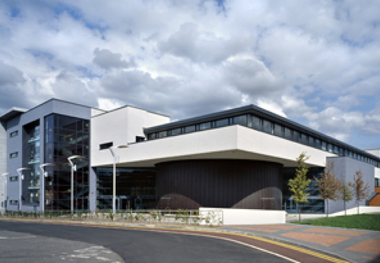
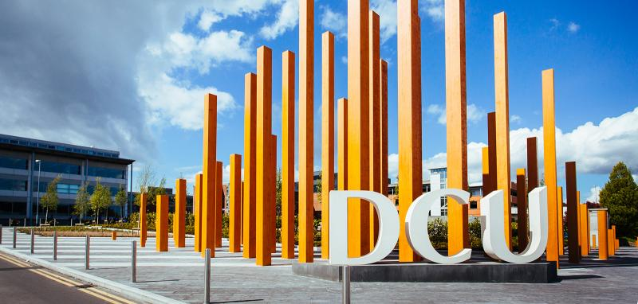
School of Nursing & Human Sciences, DCU
Anne Matthews

Slide 2
Programmes at SNHS: to meet health & societal challenges
Nursing programmes
Other programmes
Certificate in Homelessness prevention and intervention
BSc Psychology
BSc Health & Society
MA Sexuality Studies
MSc Psychotherapy
Doctorate Psychotherapy
Research: MSc PhD
BSc Nursing
General
Mental health
Intellectual disability
Children’s/ General integrated
Higher Diploma in Children’s nursing
Bachelor Nursing Studies/ Theory (online)
Professional development framework
MSc Chronic Disease Management
MSc Nursing/ Healthcare Practice framework
Beaumont Hospital
Bon Secours Hospital, Glasnevin
Connolly Hospital
Daughters of Charity Intellectual Disability Services
Dublin North City Mental Health Services HSE
Mater Misericordiae University Hospital
North Dublin Mental Health Services, HSE
St Joseph’s Intellectual Disability Service, Portrane
Temple Street Children’s University Hospital

Slide 3
What are health inequalities?
“Health inequalities are preventable and unjust differences in health status experienced by certain population groups. People in lower socio-economic groups are more likely to experience chronic ill-health and die earlier than those who are more advantaged”.
Institute of Public Health in Ireland
http://www.publichealth.ie/healthinequalities/healthinequalities

Slide 4
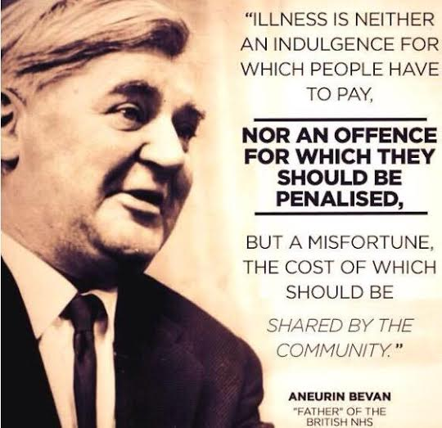

Slide 5
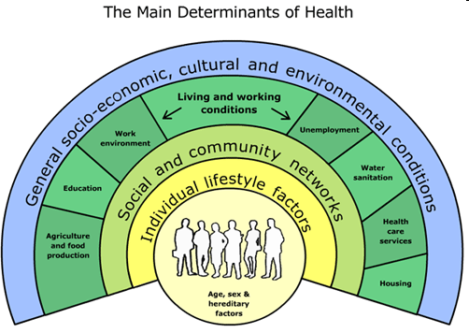
Not misfortune?
G Dahlgren and M Whitehead Policies and Strategies to Promote Social Equity in Health
(Institute of Futures Studies Stockholm 1991)

Slide 6
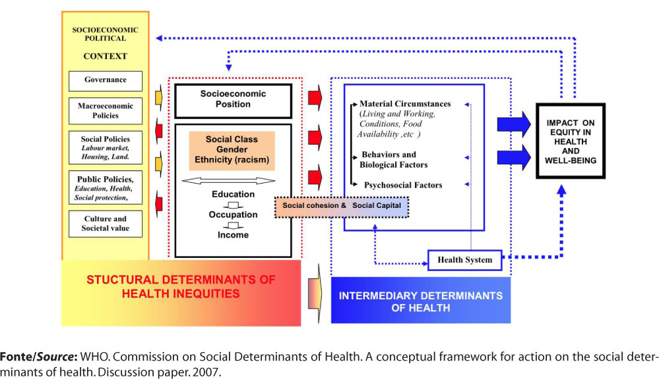

Slide 7
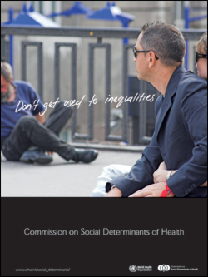
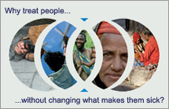
Thank you for your participation in and commitment to today’s gathering and to future collaborative practice and action.

