Slide 1

Interview Preparation Aids
Participant Manual

Slide 2
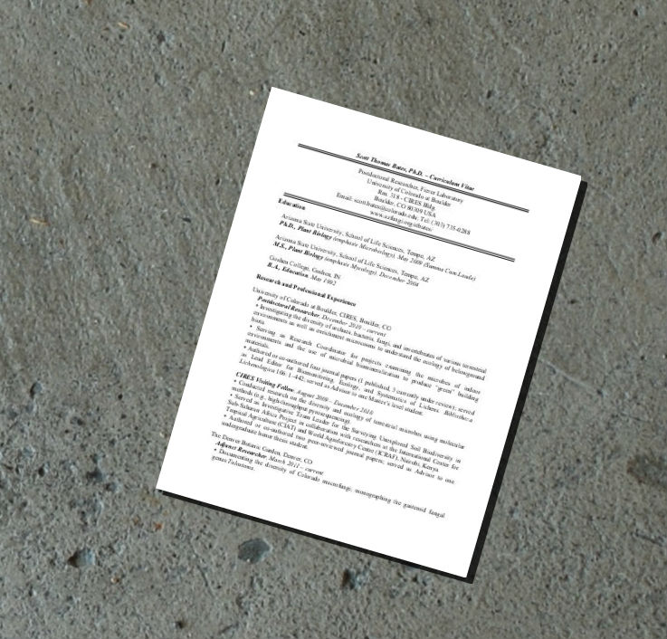
Jot down, in your own words……
Role Title: __________________________
A BRIEF SUMMARY OF THE ROLE
WHY I WOULD LIKE THE ROLE

Slide 3
Your Career to Date
Tips
A BRIEF SUMMARY OF YOUR CAREER TO DATE.
Avoid ‘the day I went to the zoo’ storytelling version of your career!
Focus on the highlights
Talk mainly in relation to the parts that are most relevant for this role
Usually only a warm up question so keep it concise
Practice it out loud
One of the few questions that you can more or less count on being asked in some guise

Slide 4
Your Career to Date
A BRIEF SUMMARY OF YOUR CAREER TO DATE.
<Insert summary>

Slide 5
Identifying the Selection Criteria
Use the Job Description/Vacancy Bulletin
Qualifications | Length of Experience | Specific Skills | Personal Traits/ Competencies
1. | 1. | 1. | 1.
2. | 2. | 2. | 2.
3. | 3. | 3. | 3.
4. | 4. | 4. | 4.
5. | 5. | 5. | 5.

Slide 6
Building the Evidence
This evidence provides you with the information you need to answer the behavioural questions i.e. “can you give me an example of a time when….”
Criteria | Example of when I demonstrated this? | What did I do? | What was the outcome? | What did I learn?
1.
2.
3.

Slide 7
Building the Evidence
This evidence provides you with the information you need to answer the behavioural questions i.e. “can you give me an example of a time when….”
Criteria | Example of when I demonstrated this? | What did I do? | What was the outcome? | What did I learn?
4.
5.
6.

Slide 8
My top 3 strengths are….
(In relation to this role)
01
<Insert strength 1>
03
<Insert strength 3>
02
<Insert strength 2>

Slide 9
My top 3 achievements are….
(relevant to this role, if possible)
01
<Insert achievement>
03
<Insert achievement>
02
<Insert achievement>

Slide 10
My short and medium term career goals are:
I am the best candidate for this role because:
<Insert text>
<Insert text>
During the first 6 months in this role I would:
I would need the following supports in taking on the role…
<Insert text>
<Insert text>

Slide 11
Other sample (biographical) questions
Your CV
Tell me about your career to date?
What role did you enjoy the most & why?
What role was the most challenging?
What aspects of your current role give you the most satisfaction?
You weren’t working for 8 months in 2014, did you take time out?
Your Career
What are your future career aspirations?
Where does this role fit into your future career plans?
Do you intend to take on any further formal education?
You
Why did you apply for this role?
What are your key strengths?
What is your proudest achievement to date?
How would your colleagues describe you?
What are your development needs?
The role/Institution
What do you know about the school/faculty/institution/company?
What challenges do you see for this school/dept?
What opportunities do you envisage?

Slide 12

Information in relation to the department/school/company/institution….
<Insert text>
Google
Contacts

Slide 13
Interview Checklist
√
I can list five things about myself that make me a good candidate for this job
I can discuss in detail each item on my CV and/or job application
I can list the skills & experience (including ample examples) that qualify me for this job.
I have the minimum educational requirements for this role.
I have done detailed research on the role, the department, and the company/institution.
If I am asked for references, I have the names and contact details for three individuals who have agreed to be my referees.
I have any relevant documentation that is required e.g. identification such as social security card, driver’s license, passport etc.
I am dressed appropriately for the job for which I am applying.
I have detailed directions and have made transportation arrangements so that I can get to the interview location about 10/15 minutes in advance.
I have prepared some questions to asked the interviewers.

Slide 14
Further Information/Notes/Questions I would like to ask
<Insert text>

