Slide 1
Healthcare Interoperability :Lessons Learned
This research has received funding from the European Union's Horizon 2020 research and innovation programme under the Marie Skłodowska-Curie grant agreement No. 801522, by Science Foundation Ireland and co-funded by the European Regional Development Fund through the ADAPT Centre for Digital Content Technology grant number 13/RC/2106_P2 and Davra Network.
Subhashis Das, MSCA ELITE-S Fellow, ADAPT, CeIC, DCU
Supervisor: Dr Pamela Hussey, ADAPT, CeIC, DCU

Slide 2
Interface of Information Model

Slide 3
Information Model+Ontology Schema
Ontology Schema

Slide 4
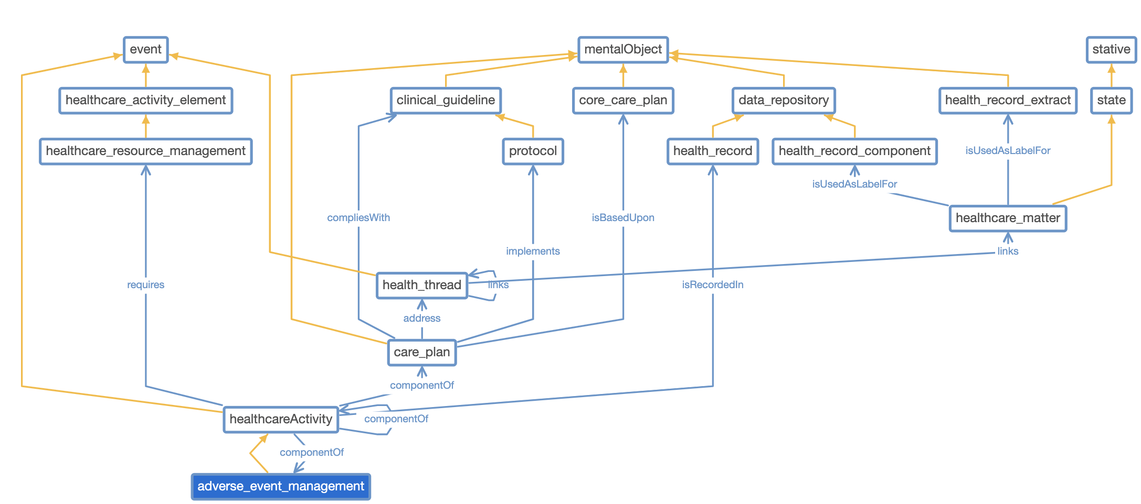
ContSys Revision Work
https://www.iso.org/standard/83432.html

Slide 5
Alignment of Standards

