Slide 1
Critical Writing
DCU Student Learning

Slide 2
Discussion
What questions do you have about critical writing?

Slide 5
Today’s session
Definition – critical wheel
Critical reading
Critical writing

Slide 6
1. Define - What is critical writing?
University of Surrey (2016):
A refusal to accept the conclusions of other writers without evaluating the arguments and evidence provided;
A balanced presentation of reasons why the conclusions of other writers may be accepted or treated with caution;
A clear presentation of your own evidence and argument, leading to your conclusion;
A recognition of the limitations in your own evidence, argument, and conclusion.

Slide 7
Critical Process
Description
Where?
When?
Who?
How?
What?
Analysis
Topic
Why?
What if?
What next?
So what?
Evaluation
Source: Hilsdon (2010)

Slide 8
Description
what
where
who
when
What is this about?
What is the situation/context?
What is the problem/topic to be explored?
Where does it take place?
Who is involved?
Who might be interested?
When does this occur?
Source: Hilsdon (2010)

Slide 9
Analysis
why
how
what if
Why this argument/theory/solution?
Why not something else?
Why did this occur?
Why was that done?
How does one factor affect the other?
How do the parts fit into the whole?
How does it work in theory/practice/context?
What if there are alternatives?
What if there was a problem?
What if this factor was added/altered/removed?
Source: Hilsdon (2010)

Slide 10
Evaluation
so what
what next
So what does this mean?
So what is the implication of this? In what way is it significant?
So what can be learnt from this?
What next in this research field?
Source: Hilsdon (2010)

Slide 11
2. Critical reading
What is the author’s position?
What is the author’s line of reasoning?
What evidence is used and is it strong evidence?
Does the evidence support the conclusions?
Are the writer’s conclusions meaningful?
Description
Analysis
Evaluation
Adapted from Cottrell (2016)

Slide 12
Example 1
Source: University of Cumbria (2017)
Read this critically: does it move from description to analysis to evaluation?
Leadership is an essential quality in nursing, as posited by Brown (2005) . This is confirmed by the recent requirements of the NHS Plan (DOH, 2002). This Plan has emphasized the importance of introducing the transformational model of leadership. Smith (2001) explains that this is a leadership which involves the use of charisma and interpersonal skills to enable achievement. Jones (2004) argues that the key characteristic of transformational leadership is empowering others to achieve. In my own experience, a leader with transformational qualities can make any team member feel that they have a useful part to play in the organization. This is confirmed by Fea (2001) who argues that transformational leadership increases feelings of self-worth and capability in their team members. Transformational leadership is therefore really important.
Follow steps 1-5 in
hand out provided
Notes:
Presents lots of references (evidence) but lacks analysis of these references – lets take a look at how to analyse evidence

Slide 13
Example 2
Source: University of Cumbria (2017)
Read this critically: does it better analyse the sources referenced?
A review of the available literature provides a wealth of examples of authors advocating leadership as an essential quality in nursing. For example, Shackleton (1950) emphasises that nursing needs strong leadership and recommends a strong transactional approach of reward and punishment to get results and promote teamwork. However, more recently, authors have moved towards the concept of charismatic and transformational leadership (Smith, 2001; Jones, 2004). These qualities are also an integral part of the new recommendations in the NHS Plan (DOH 2002).
Charisma appears to be a complex phenomenon to define. Davidzhar (1991) suggests that it is an aspect of personality which makes the individual irresistible to others, in terms of their ability to persuade and empower others. However, other authors, such as Romano (1996) and Harvey (2000) highlight the intangible nature of charisma and emphasise the frustrating point that individuals know charisma if they see it, but find it difficult to define.
It appears problematic, therefore, to identify exactly how charisma can become an integral part of developing transformational leadership in nursing, if it is a quality which, in itself, is difficult to define. For example, Smith (2001) maintains that transformational leadership uses a combination of charisma and interpersonal skills to enable achievement. However, identifying potential transformational leaders may be a difficulty if the pre-requisite for identifying charismatic individuals is an integral part of this selection process.

Slide 14
Analysing evidence
Why is the author choosing to use the evidence they’ve presented?
Is it all presented, or is some missing…
Is there a hidden agenda?
Do they use reliable, disinterested sources
Is there BIAS present?
E.g. a drug trial – were all results (positive and negative) reported? Who benefits financially from these results? Does the sponsor of the study benefit? Was there pressure on the researcher to achieve statistical significance for an expensive research project? Has the researcher maybe unintentionally displayed BIAS

Slide 15
Valid criteria
Evidence must be evaluated according to valid criteria – previous research in the field or an appropriate theoretical model
e.g. a doctor makes a diagnosis of the symptoms (evidence) based on training and knowledge based on medical research (Cottrell, 2016)

Slide 16
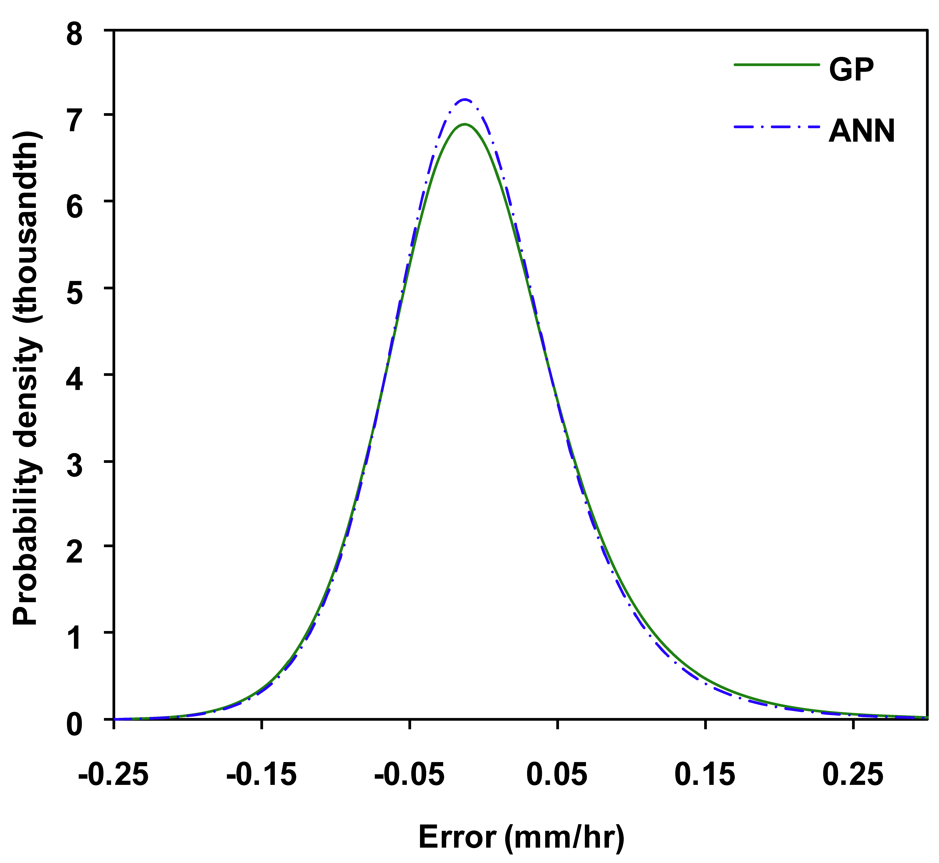
Beware statistics
What is wrong with this statement?
“60% of people prefer cats to dogs”
Sample size and generalisability?
What method of statistical analysis
was chosen and why?
T-test
Anova
Regression etc

Slide 17
Valid conclusions
Are the conclusions justified by the evidence presented?
e.g. (Cottrell 2016)
Proposition 1: The karate champion is a woman. (Verifiable fact.)
Proposition 2: My mother is a woman. (Verifiable fact.)
Conclusion: My mother is a woman, therefore she is a karate champion. (False conclusion.)
Notes:
Sound evidence does not equal sound conclusions

Slide 18
Exercises
Critique the examples on the worksheet provided

Slide 19
3. Critical writing
What is an argument?
Position
Line of reasoning
Conclusion
Evidence presented in a sequential logical format to strengthen position
Evidence is valid, uses the best available sources and is critiqued
Recognise limitations in own arguments and conclusions

Slide 20
Progression
Your position
Strengthened by point 1
Leads to point 2
Connects to point 3
Forms a conclusion that reinforces your position
Notes:
Optional worksheet on progression can be completed here

Slide 21
Critical Writing: Structure
Introduction: | Present your argument or outline what you aim to achieve in the essay Where we’re going / why we’re going there
Main body: | Description of theory/study/background info Analysis of evidence Evaluation of what it all means
Conclusion: | Show how evidence leads to your argument Identify weaknesses in your argument Identify further research questions

Slide 22
Critical Writing: Content
Description
Analysis
Evaluation
Avoid stringing quotes together
Be ‘fair’: assess strengths/weaknesses of other people’s ideas and writing … without prejudice
Check unsubstantiated statements. Have I included sufficient evidence?

Slide 23
Final Example: Meditation essay
Research shows that mindfulness may not only be applicable for the prevention of relapse in depression, but also for the treatment of acute depressive symptoms. Hofmann et al. (2010) conducted a meta-analytic review of effect sizes in 39 studies evaluating the efficacy of mindfulness based approaches in treating symptoms of depression. They found that overall mindfulness based therapies for people with depression had a large effect size (0.95). The study’s authors note that theirs was the first large-scale and scientifically rigorous meta-analysis in this field. Furthermore, the large effect size revealed here was identical to that revealed previously for the efficacy of cognitive behavioural therapy (Butler et al. 2006). This indicates that mindfulness is potentially as effective as the commonly used and broadly scientifically validated cognitive behavioural therapy approach, and that more research is needed to compare the two methods for long-term efficacy, cost benefits and appeal to patients.
Source: Murphy (2017)

Slide 24
Discussion
Is this piece a good example of academic writing?
Can you identify if and where it follows the critical process?
Description
Analysis
Evaluation

Slide 25
Summary
Description
Where?
When?
Who?
How?
What?
Analysis
Topic
Why?
What if?
What next?
So what?
Evaluation
Source: Hilsdon (2010)
Notes:
Examples of reflective questions which may be adapted to suit your subject area
Generic CT questions (used by ES for MSc social work students)
What is the issue? Why?
What kind of place does this occur in? Why?
Who are the stakeholders? How?
When does this occur? What is the significance of the timing of this?
How does this issue manifest (e.g.)?
Why does it occur in this way?
How is it usually addressed? Why?
What if it weren’t addressed at all?
What if resources weren’t an issue?
So what is the real/deeper issue to be tackled?
How might this be tackled?
Generic reflection questions (used by ES with year 2 Dietetics students)
What was a challenge for me? (What is the issue?) Why?
What kind of place does this occur in? Why?
Who else is affected? How?
When does this occur? What is the significance of the timing of this?
How does this issue manifest (e.g.)? For me? For others around me?
Why does it occur in this way?
How have I addressed this in the past? Why? How would I address it now after studying this? Why?
What if I didn’t addressed it?
So what is the real/deeper issue that needs addressing?
How might this be tackled? Why?

Slide 26
References
Cottrell, S. 2016. Critical thinking skills. Available at: http://www.skills4studycampus.com/StudentHome.aspx (Accessed 18 February 2016).
Hilsdon, J. 2010. Critical thinking. Available at: https://www.plymouth.ac.uk/uploads/production/document/path/1/1710/Critical_Thinking.pdf (Accessed 2 November 2016).
Murphy, C. (2013). ‘Mindfulness in educational psychology’, EDUC 41970: Child Assessment and Intervention. University College Dublin. Unpublished essay.
University of Cumbria (2017). Critical writing. Available at: https://my.cumbria.ac.uk/Student-Life/Learning/Skills-Cumbria/FAQs/What-is-critical-writing/#d.en.59802 (Accessed: 10 October 2017).
University of Surrey 2015. What is critical writing. Available at: http://libweb.surrey.ac.uk/library/skills/writing%20Skills%20Leicester/page_42.htm (Accessed 2 November 2016).

