Slide 1
Moodle reports to inform practice
Dr Mark Glynn
mark.glynn@dcu.ie
@glynnmark

Slide 2
Measure what you value - not the other way around

Slide 3
Overview
Admin
Teacher
Plug-ins

Slide 4
Google Analytics
Comparison
Devices & Browsers
Timings

Slide 5
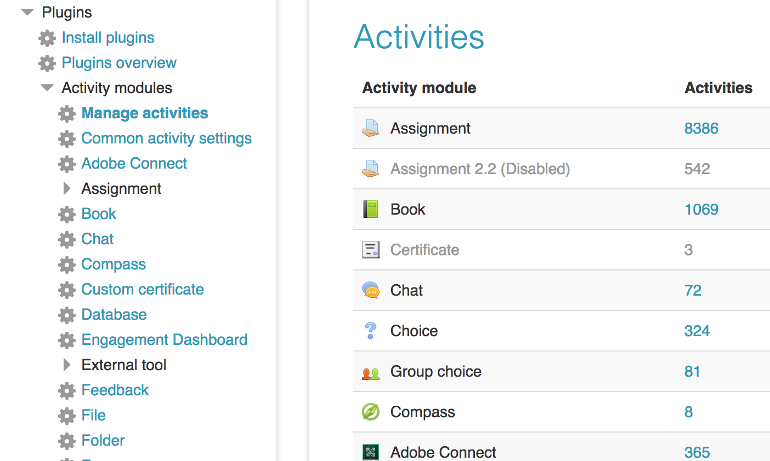
Activity Analytics

Slide 6
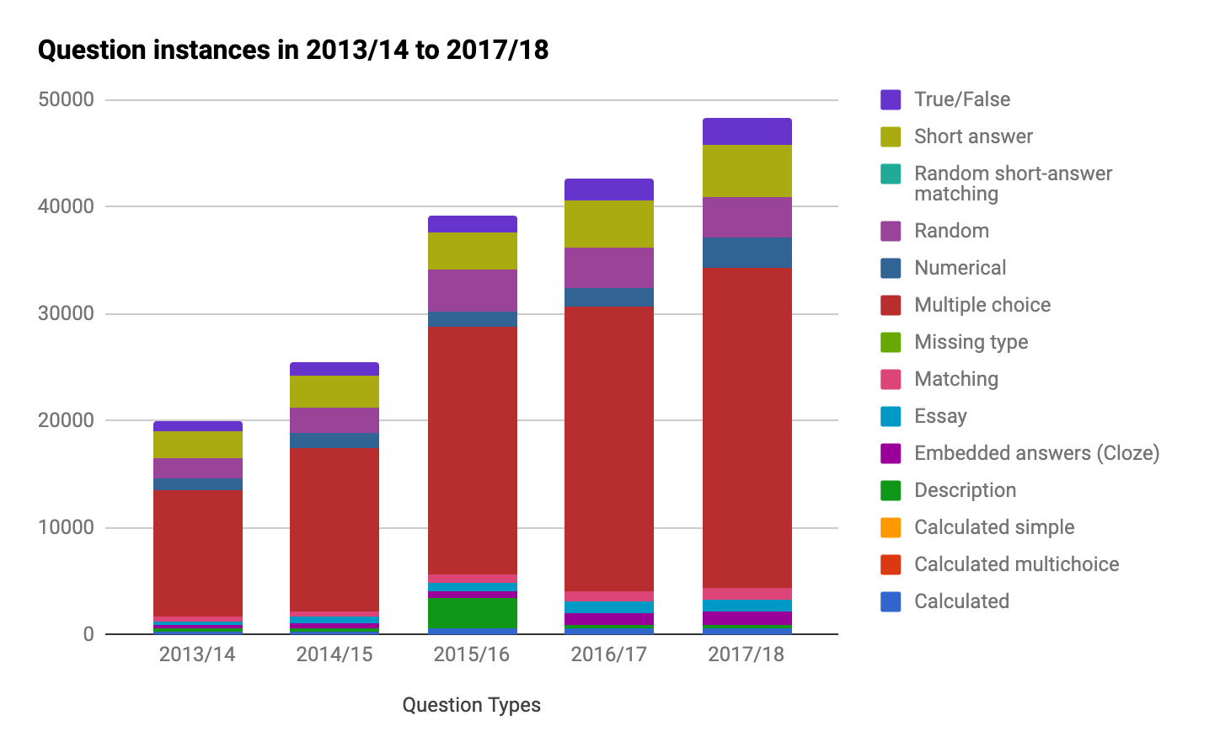
What makes up a quiz?

Slide 7
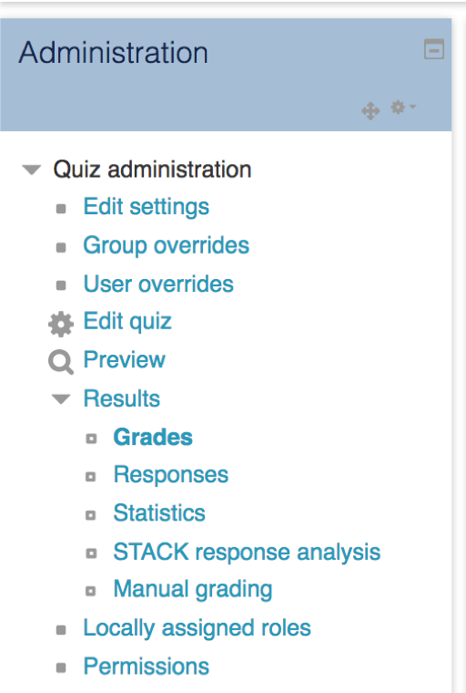
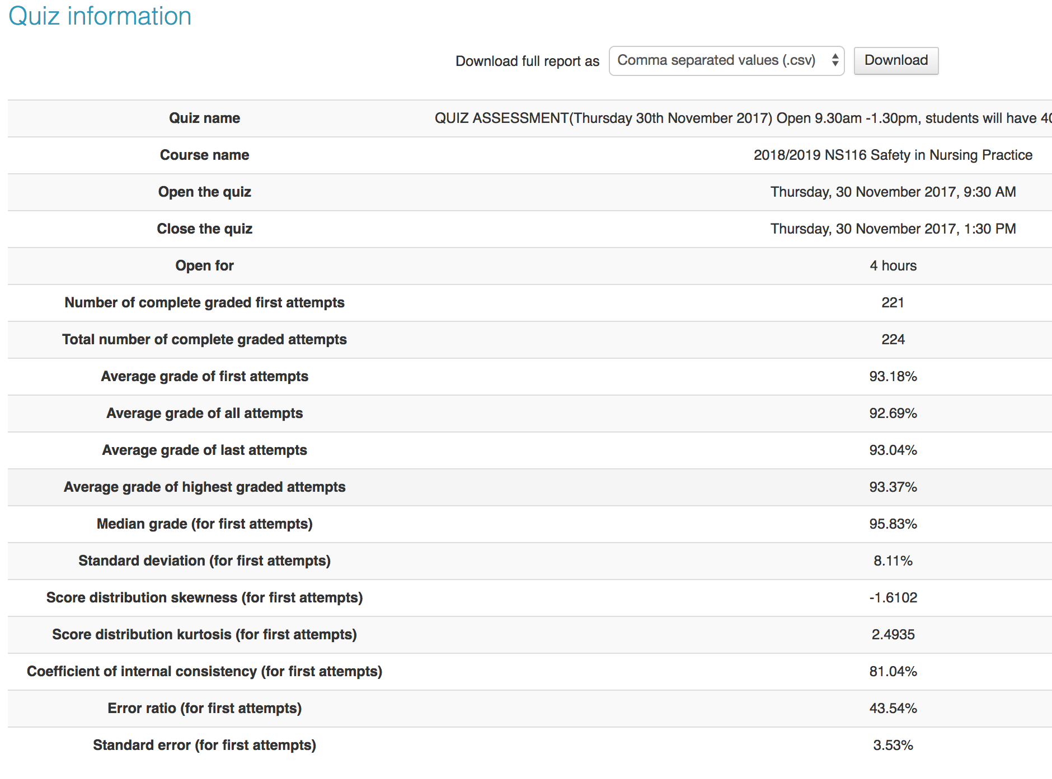
Digging into the data behind the quiz
Notes:
Started this is 2013 / 2014 academic year. 15 quizzes and over 200 questions in module 1, 9 quizzes and over 100 questions in module 2. Now have large bank of data to analyse
Discrimination index is an indicator of the performance of a question to separate high and low scorers on the quiz. This measure uses the top third of the scores and the bottom third of the scores for the calculation.
Discrimination efficiency is also a measure of the power of the question to distinguish between high and low scorers. This measure is a correlation coefficient between scores for the question and the whole quiz.
For both Discrimination index and Discrimination efficiency, the score can be between –1 and +1. Positive values indicate questions that do discriminate proficient learners, indicating that higher scorers tended to select the correct option. Negative values indicate questions that are answered best by those with lowest grades, not really what we intend!

Slide 8
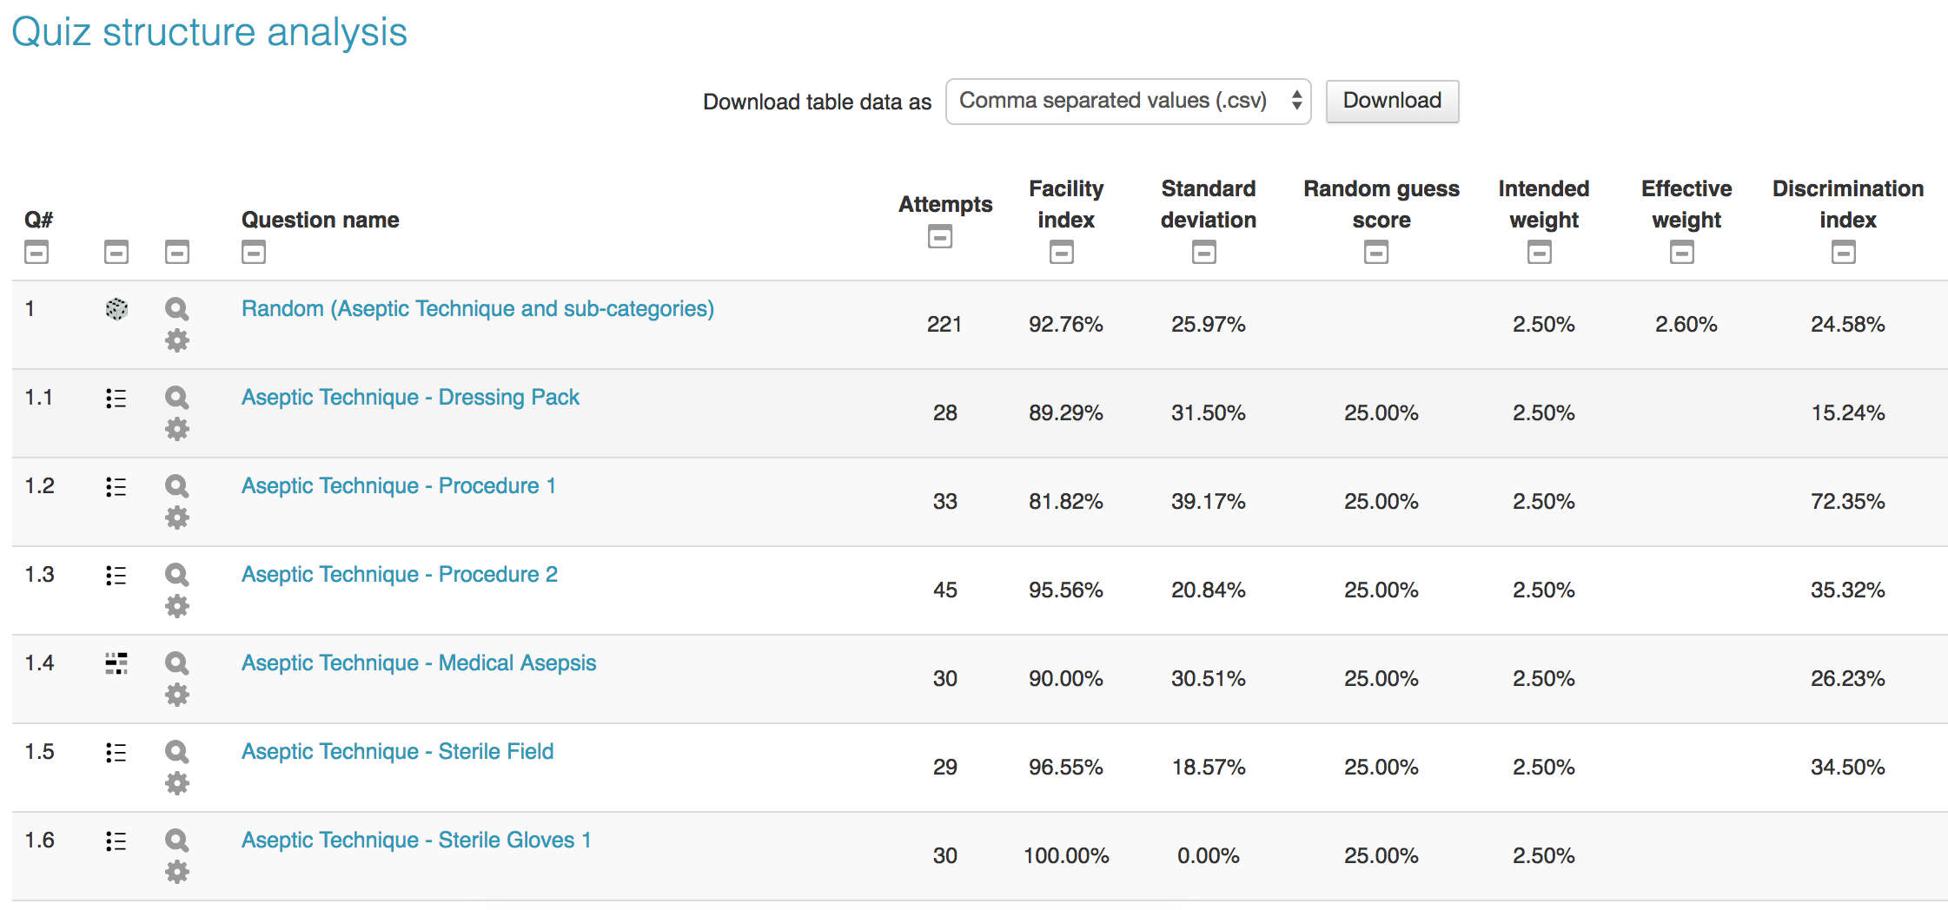
Digging into the data behind the quiz

Slide 9
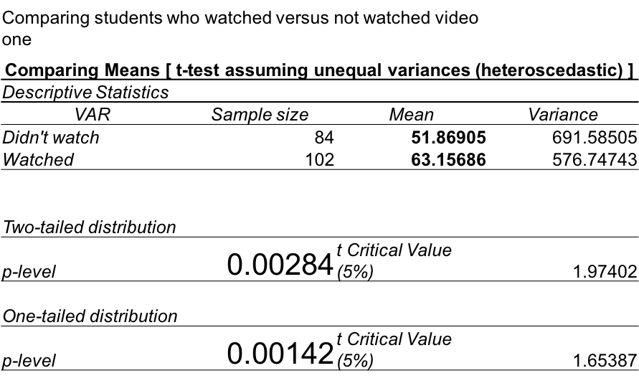
Resource Analysis - logs

Slide 10
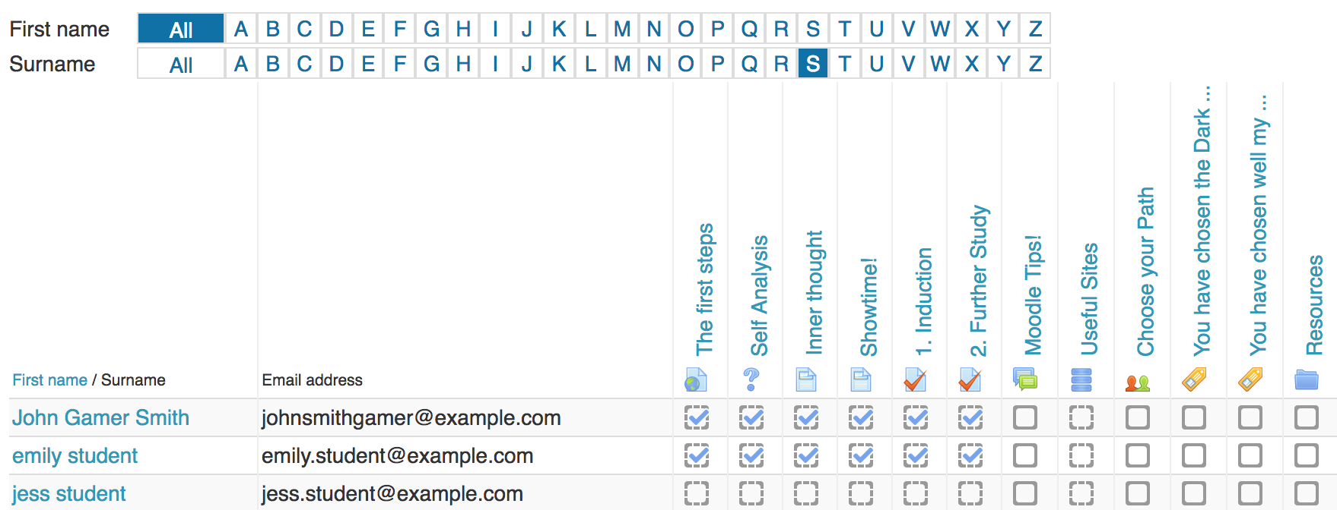
Activity Completion

Slide 11
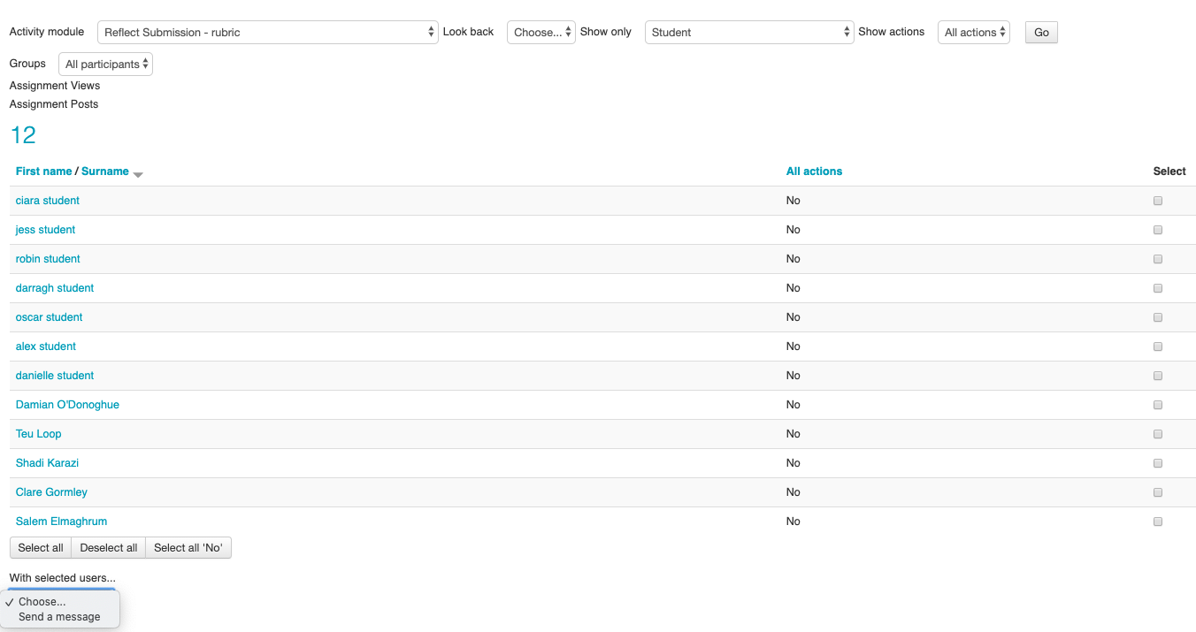
Course participation

Slide 12
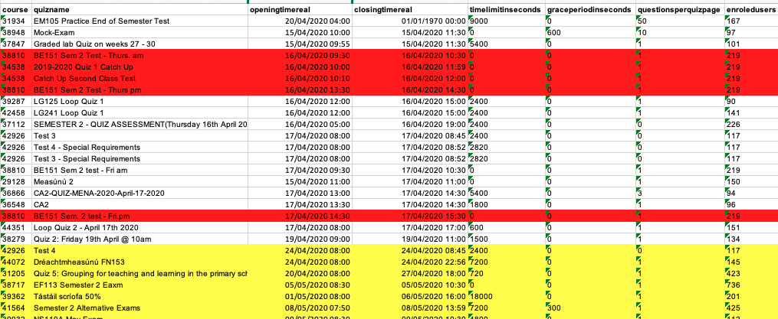
AD Hoc reports

Slide 13
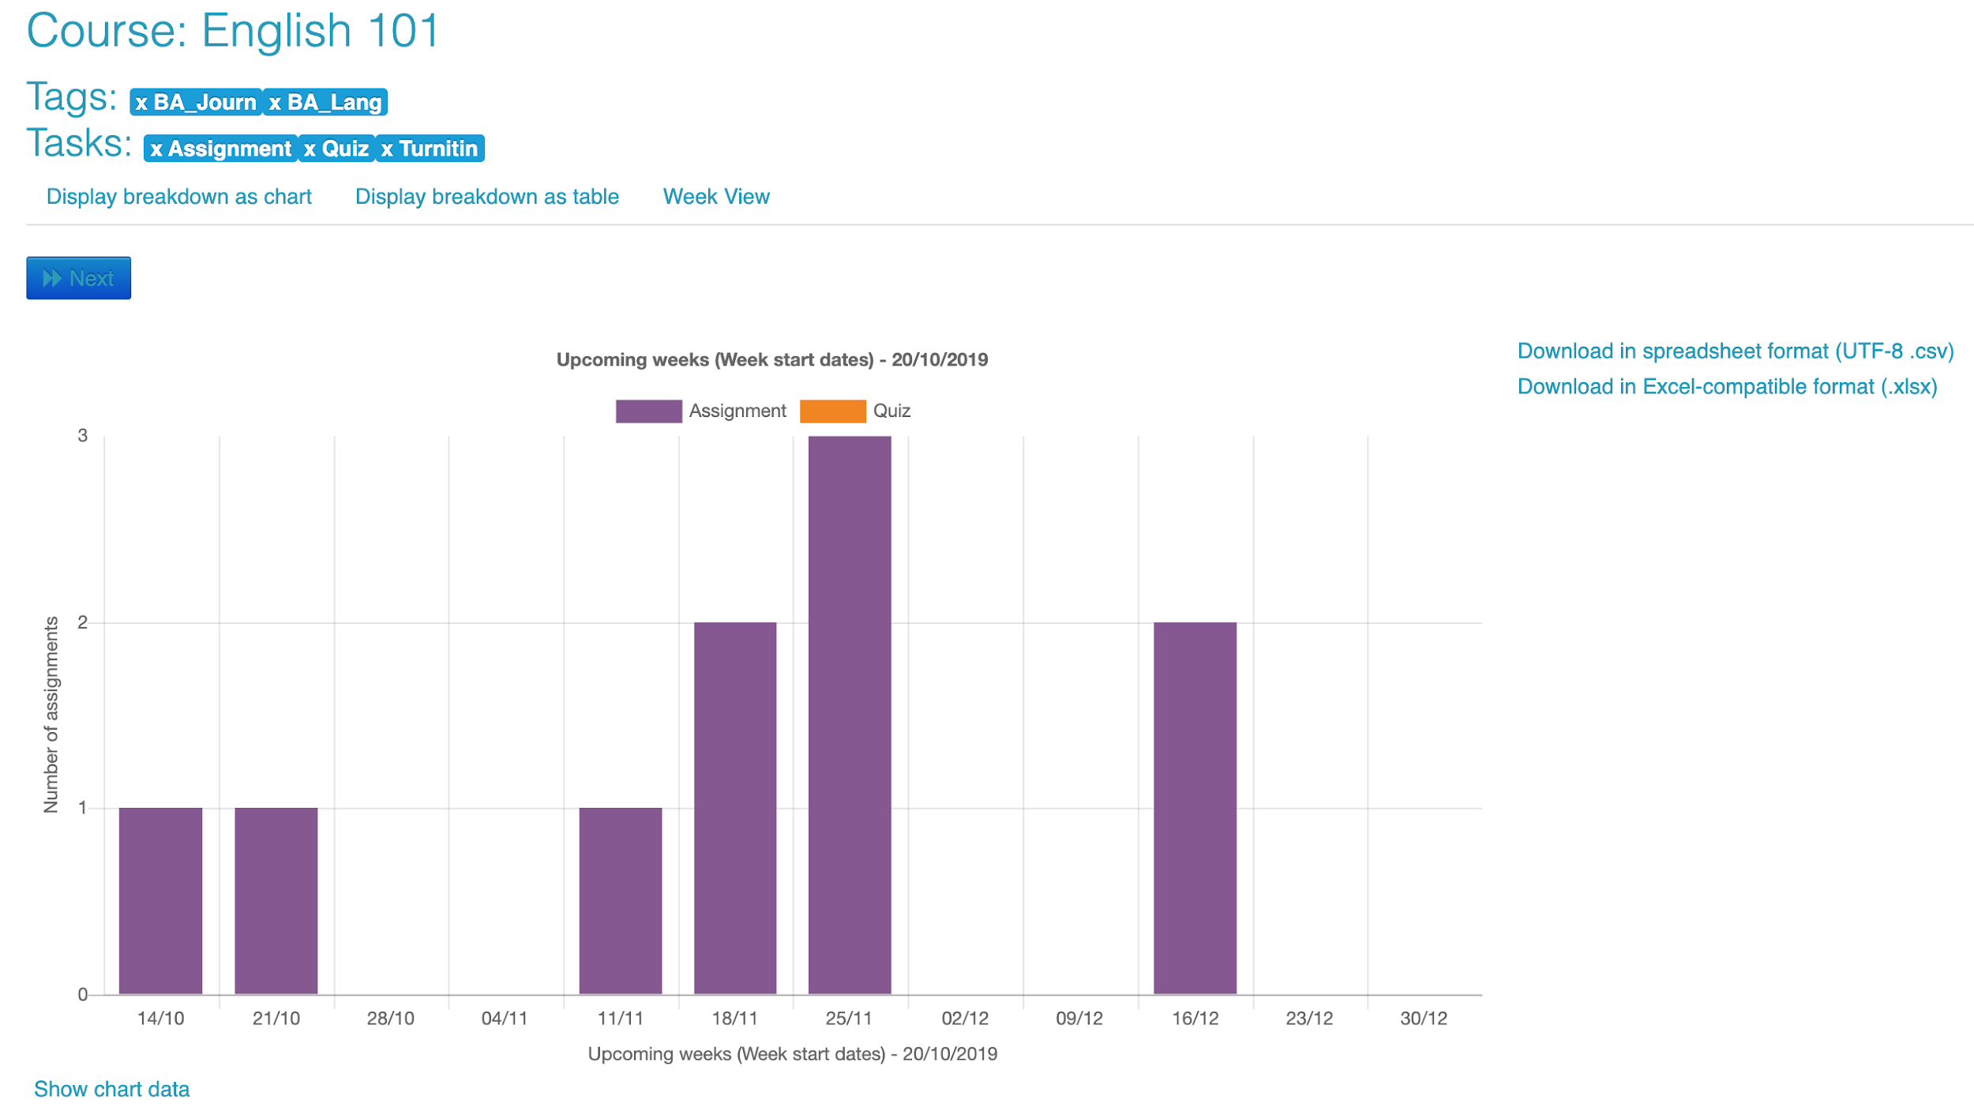
“Multi-tag timeline” Report
Live example
Multi tag timeline plugin built by LTS
Notes:
(need to add more assignments in here for this mock up)

Slide 14
Improving accessibility
Accessibility Checker plugin built by Brickfield labs

Slide 15
Improving accessibility
Accessibility Checker plugin built by Brickfield labs

Slide 16
Assessment Breakdown
My Feedback plugin built by UCL
Notes:
It is also possible to get the data displayed in a different way, showing all the assignments from one particular module, in this case the module “Test Assign”. Here you will see the breakdown of how many students submitted on time, how many were late, how many non-submissions, how many were graded and how many of those scored below 50%. This report is available for every assignment within a course page

Slide 17
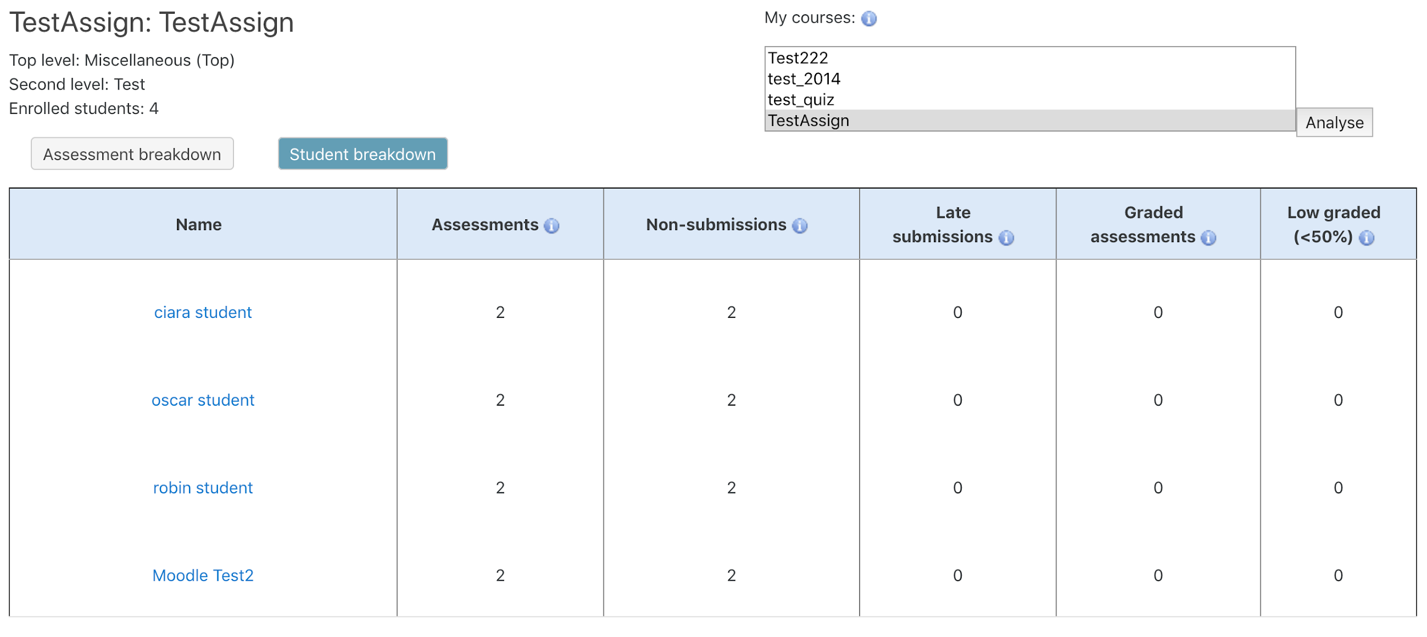
Student Breakdown
My Feedback plugin built by UCL
Notes:
The final report that we wish to show is from a module tutor or programme coordinator point of view. It provides a breakdown on a student by student basis within a module rather than a breakdown by each assignment. from a data protection point of view, each tutor will only see the data on students that they have permissions to access.

Slide 18
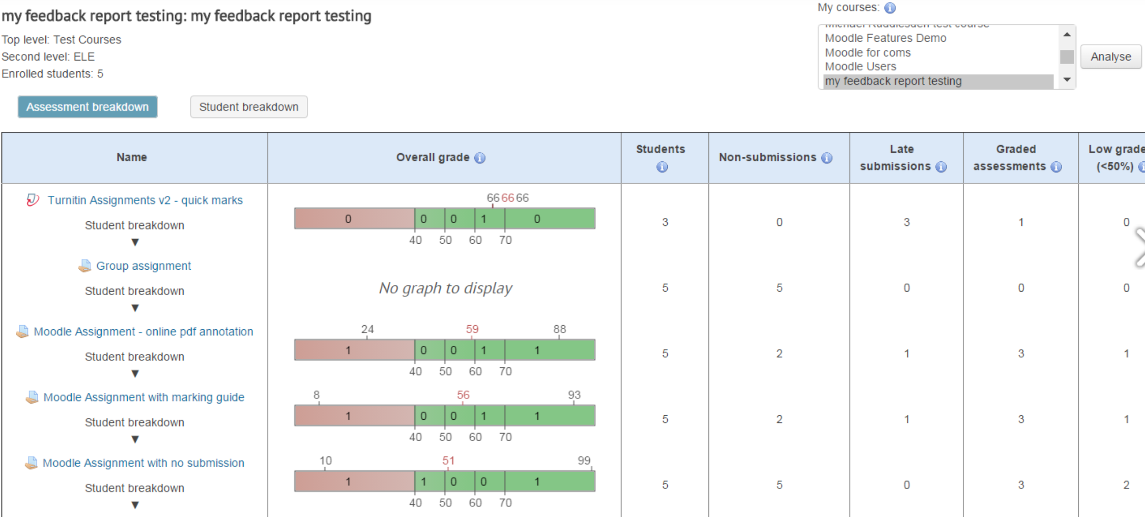
My Feedback plugin built by UCL

Slide 19
Measure what you value - not the other way around

Slide 20
Contact us
mark.glynn@dcu.ie

Slide 21
Acknowledgements
Images from presentermedia.com
The work presented is an amalgamation of all of the efforts of the members of the Teaching Enhancement Unit in DCU

Slide 22
Additional Slides

Slide 23
Digging into the data behind the quiz
Discrimination index is an indicator of the performance of a question to separate high and low scorers on the quiz.
Facility Index - This is the percentage of students that answered the question correctly
Notes:
Discrimination index is an indicator of the performance of a question to separate high and low scorers on the quiz. This measure uses the top third of the scores and the bottom third of the scores for the calculation.
Discrimination efficiency is also a measure of the power of the question to distinguish between high and low scorers. This measure is a correlation coefficient between scores for the question and the whole quiz.
For both Discrimination index and Discrimination efficiency, the score can be between –1 and +1. Positive values indicate questions that do discriminate proficient learners, indicating that higher scorers tended to select the correct option. Negative values indicate questions that are answered best by those with lowest grades, not really what we intend!

Slide 24
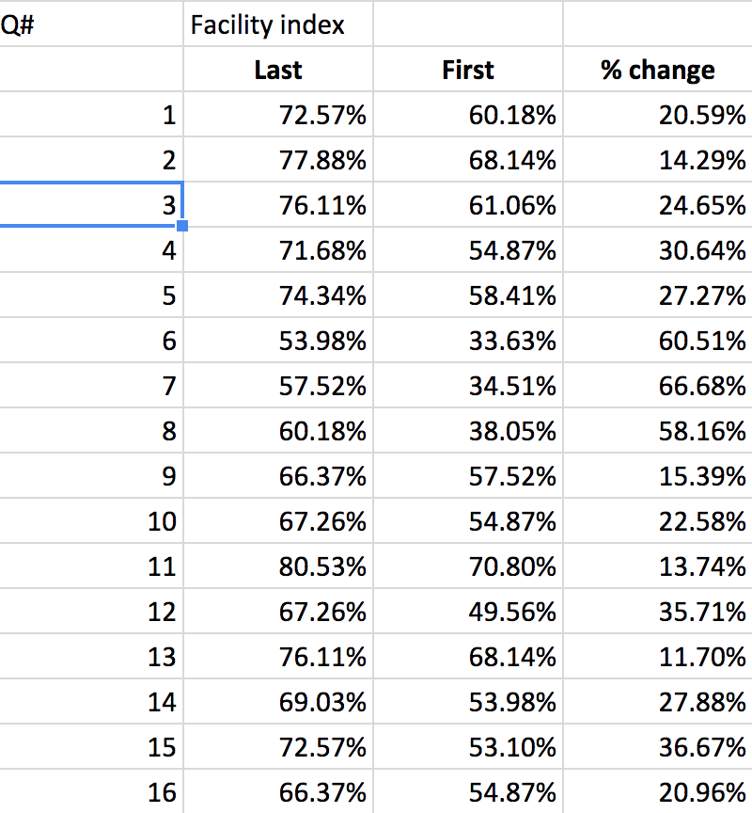
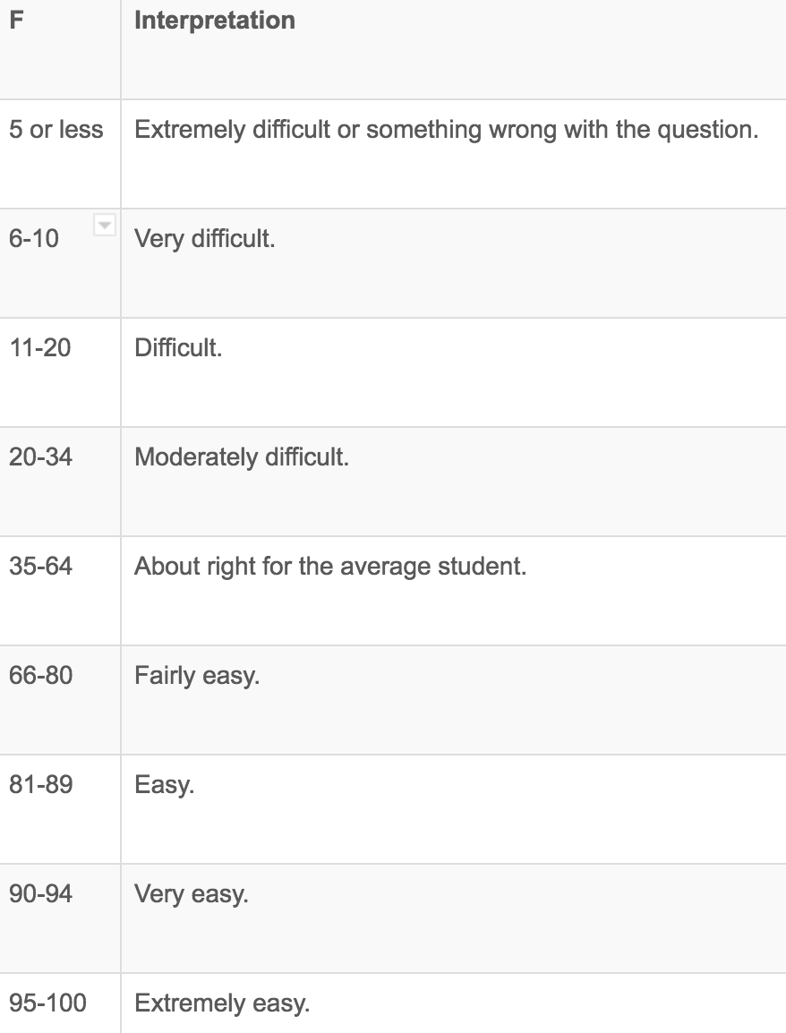
Facility index - interpretation

Slide 25
slide on comparison of attempts to final score (drug calculations)
Group / Category of Students | n | Average mark out of 5 | Equivalent %
All students | 215 | 4.6605 | 93.21%
Students who never attempted or accessed quiz | 71 | 4.4225 | 88.45%
Students who never attempted the quiz but did access it | 35 | 4.5714 | 91.43%
Students who attempted the quiz at least once | 109 | 4.8440 | 96.88%
Notes:
The total number of students who did the summative quiz was 215. The average score for all 215 students was 93.21% - this is desirable because the information in these quizzes is “must know” information. Analyzing and comparing scores suggests that the more that students interacted with the quizzes the better they did in the summative exam. Students who never attempted or accessed the quiz scored 88.45% on average. Those who accessed quizzes but never attempted them scored 91.43% on average. Those who attempted the quizzes at least once scored 96.88% on average (i.e. 8.43% higher than those who never accessed or attempted the quizzes and 5.45% better than those who just accessed them).
Furthermore analysis of the scores in relation to the numbers of times that students did the formative quizzes shows that results in the summative exam got progressively higher (with one exception) the more attempts that students made at the formative quizzes. Students who made just one attempt at the formative exam scored 95.09%, those who made 2 attempts jumped by 4.2% to 99.29 whilst those who made 3, 5 or 7 attempts scored 100%. The exception was the students who made 4 attempts at the quiz and scored 95.56% on average. (I need to drill more into this when/if I get a chance to see what their approach was to the formative quizzes).

Slide 26
slide on comparison of attempts to final score (Infection control)
Group / Category of Students | n | Average mark out of 4 | Equivalent %
All students | 215 | 3.6442 | 91.1%
Students who never attempted or accessed quiz | 67 | 3.4164 | 85.41%
Students who never attempted the quiz but did access it | 20 | 3.6065 | 90.15%
Students who attempted the quiz at least once | 128 | 3.7693 | 94.23%
Notes:
As with drug calculations the students’ scores in the summative quizzes tend to improve the more they interact with the formative quizzes.

