Slide 1
Improving accessible and inclusive
teaching and learning practices in
online, undergraduate modules.
Chloé Beatty, James Brunton, & Sophia Pallaro
Dublin City University

Slide 2
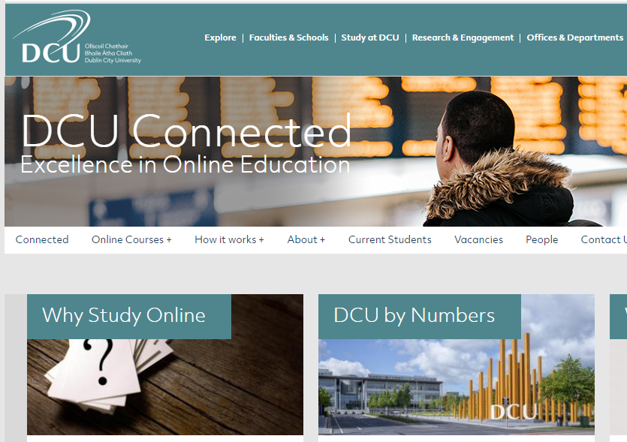
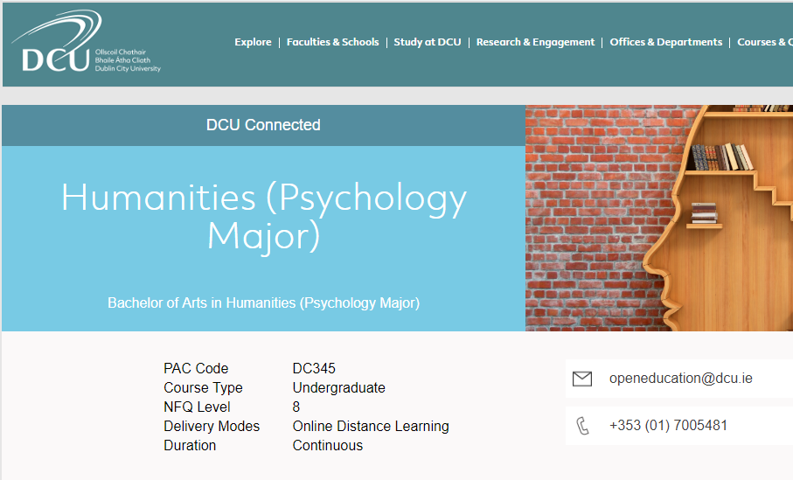

Slide 4
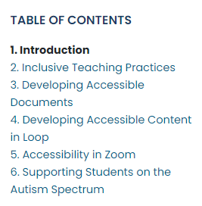

Slide 6
How can levels of accessibility and inclusion, following UDL principles, be improved in online, undergraduate modules?
Photo by Jamie Templeton on Unsplash

Slide 7
Go raibh míle maith agaibh!

