Slide 1
Managing our
Online Content
At Dublin Business School

Slide 2
DigCompEdu Framework Context
Creating and Modifying Digital Resources
Managing, Protecting and Sharing Digital Resources
Notes:
This talk is in the context of the digcopmedu competencies of:
Digital Resources: Creating and Modifying
Digital Resources : Managing, Protecting and Sharing Digital Resources

Slide 3
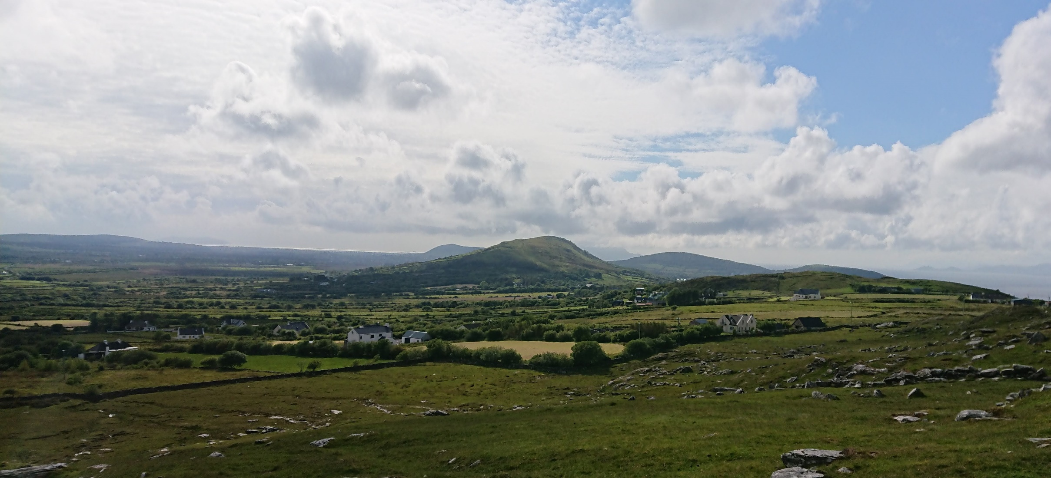
Notes:
I first talked on this subject at the Irish EdTech conference last summer, where I presented a short talk about our Zoom, Panopto and Moodle integration at Dublin Business School. We had been running online diploma courses for a couple of semesters, and were recording the live online classes in Zoom.
At the beginning of that College year, September 2018 we started a pilot year with Panopto and I saw the opportunity for this to help us with one of our technical challenges – to make these recordings quickly, easily and securely available to the students.
We had the Panopto Moodle integration, which enabled us to host videos on Panopto and publish in Moodle using the Moodle access rights. We then integrated Panopto with Zoom to allow us to automatically upload the recordings from the Zoom cloud to the Panopto one. This was pretty big for me at the time – though admittedly didn’t affect a huge number of people in DBS.
Our Panopto account manager asked if I would talk about this at EdTech 2019, so off I went.

Slide 4
A tale of two projects
Notes:
Moving forward to September 2019, we started to become what we eventually called an Online Learning Team – consisting of myself, Anna our new ID – my first hire at DBS – and Ber Higgins as our Academic Online Lead.
We started work on two new projects which would involve this integration is new ways. The first was to assist in the delivery of a number of blended modules which the College was introducing into ‘normal’ face to face delivered programmes.
The team worked with the teachers to record lessons (using Panopto) and use these to create weekly on demand lessons. These were delivered prior to a class which was either online class (using Zoom) or onsite (ratio of 4:1 online to onsite). The lessons were created using Articulate Storyline, but the videos themselves were hosted on Panopto and embedded into the packages. The Zoom classes were all recorded and made available in Moodle.
The second project was to try and increase the usage of Panopto for lecture capture of onsite classes. This was an ‘Opt-in’ feature and we were, to be honest, struggling with sign up for this.
The integration was updated by Panopto at the end of the year, which added a few features. In summary we were now using this integration in a wide range of ways, but at this point not in huge quantities. The experience that we were all gaining would prove to be invaluable. In February we added to our team an audio visual technician, Dave Mackey. This was about a month prior to the lockdown – good timing Dave!

Slide 5
Notes:
Then all this happened, and of course, everything changed.
This picture has been in our possession since around 1996, when my husband found it at a gig he was working on in London – it was in a skip. It’s been on our wall for most of the last 24 years, and is currently on the wall facing my desk, so NOT visible on my Zoom calls, I’m thinking maybe it should be. Amazingly enough, I never really read and took in the text!
It was literally about 3 weeks into the lockdown that I looked at it and actually took in the meaning – Wow!!

Slide 6
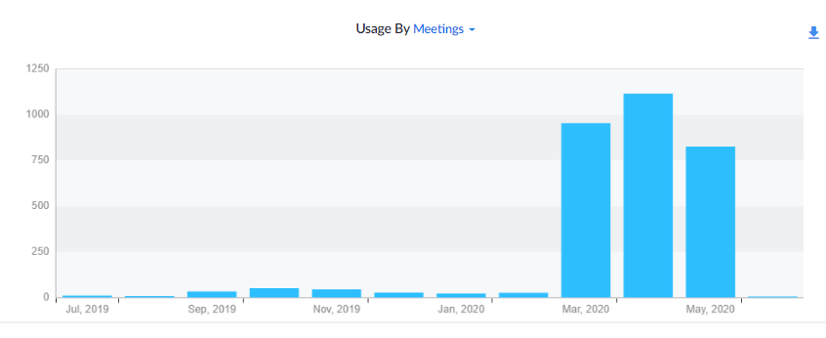
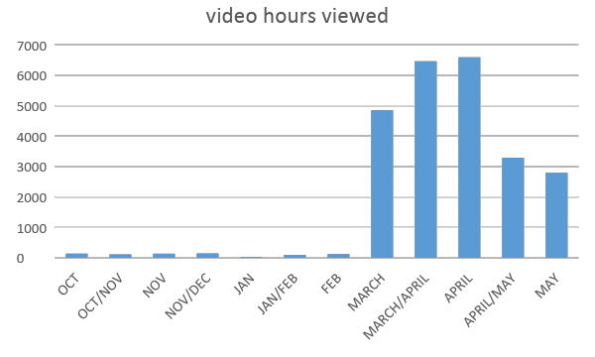
How have we used it all?
Zoom
Panopto
Notes:
Massively, hugely, incredibly, sometimes really badly. But a LOT
My colleague Tony put it most succinctly in a recent meeting when he said “we had our T&L Strategy document, SLATE, approved by Academic Board at the end of last year. This stated an intention to put up to 50% of our teaching as blended or fully online within three years. A few months later we put 100% of our teaching AND assessment and examinations online in a matter of days and weeks. It. Was. Nuts.
In addition to the teaching and learning we have also been using Zoom-Panopto-Moodle in various combinations for staff training, open evenings, student support, Library Desk.

Slide 7
What does the integration look like
Notes:
So how does it work?
Panopto is our cloud-based video streaming service with recording and authoring tools and the ability to live stream presentations.
Zoom is our online virtual classroom.
Moodle is our everything else.
Panopto integrates with Zoom and with Moodle, and so provides the bridge that makes the Zoom class recordings easily and securely available to the students who attended it.
Zoom classes are recorded to the Zoom cloud and are automatically transferred to a specified folder in Panopto (deleted once transfer is complete)
Lecturer moves these to the folder that is associated with their Moodle course page – this action makes the recording accessible to the students enrolled on that page.
Moodle access rights control most of the access in Panopto, which in DBS is itself linked to the student information and timetabling systems.

Slide 8
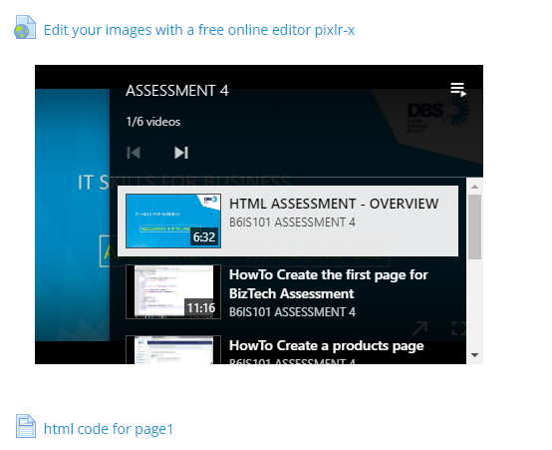
A Panopto Playlist embedded on a Moodle page
Notes:
Lecturers use Panopto at home to record class materials in a collection of short videos. These are usually voice over powerpoints, voice over screencasts and sometimes person to camera.
They can publish these in a variety of ways on the Moodle page – either via a link, and embedded video or an embedded playlist.

Slide 9
Assessments
Group presentations
Individual presentations
Notes:
Individual and group presentations:
Groups – scheduled slots in a Zoom session, each group presenting as the only ones in the room (plus tutor and optional moderator or Zoom technical host)
Recorded to tutor’s personal folder for moderators and externs to view.

Slide 10
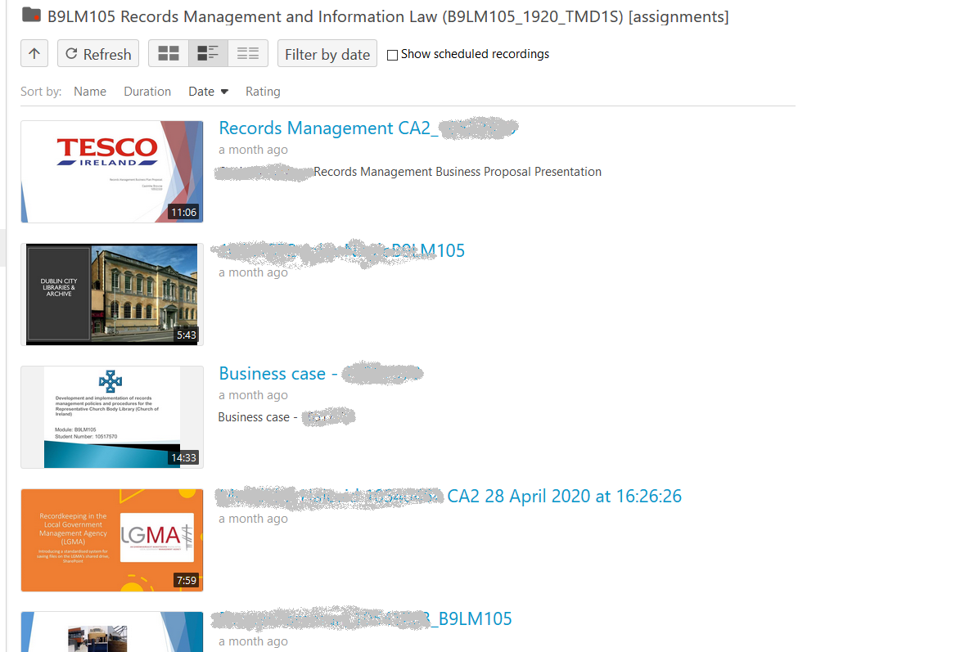
Notes:
Individual presentations: the Panopto Assignment function was used on multiple modules where each student was being assessed on an individual presentation. By uploading this to the Panopto Assignment folder (via their Moodle authentication) they could submit a video of their presentation that was only viewable by the tutor, not the other students.

Slide 11
How has this setup helped us so much?
Secure & compliant
Video management
Accessible
Usage
statistics
User experience
Notes:
Security – inherited from Moodle so seamless and SSO enabled. Downloads disabled from Panopto. Link forwarding doesn’t work etc.
Accessibility – consistent and very functional player, closed captions option, flexible delivery if required.
Consistency of experience and functionality for students: they can view all their on demand content and class recordings in a good quality phone app, the browser viewer and app are highly function with the ability to slow down and speed up, focus in on either the video or screen capture, view PowerPoint slide titles, create bookmarks and notes in the recordings, share those notes with your peers.
Usage record & stats – it is possible to get very detailed usage statistics, and broad ones too.
Ease of training – we had a head start when it came to the move to online as the infrastructure and contracts were already in place. We’ve had to make a few software upgrades and purchases but the main contracts were in place.
Panopto/Moodle makes copying/moving videos and their access rights very simple – move the video to the right folder and the rights are acquired by the Moodle page

Slide 12
Future plans
Notes:
More integration between Zoom and Moodle – a combination or one or other of SSO integration and the LTI Pro tool will enable this
The main aims are improved security of access and operational efficiencies. This includes easier and more automated links to classes, easier relocation of live class recordings (less centrally managed), pre-registration to enable setup of breakout rooms in advance (and have these saved for a series of classes), better licence management and so on.

Slide 13
Image references
Slide 3: authors own
Slide 4: www.presentationmedia.com
Slides 7 & 12: logos of companies that we pay good money to, so I’m going to provide them with some free advertising
Slide 5: Authors own
Slide 9: Articulate360

