Slide 1
UDL principles in practice:
Reflections on a UDL Moodle toolkit approach
Teaching Enhancement Unit (TEU)

Slide 2
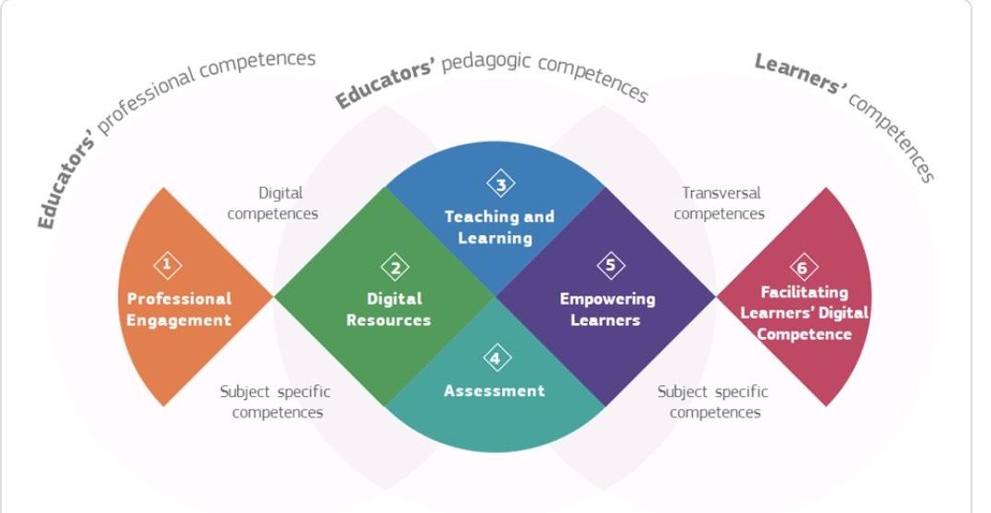
DigCompEdu Framework #5 Empowering learners
Teaching Enhancement Unit (TEU)
Notes:
Empowering learners - offering choice

Slide 3
Overview
Development of a UDL toolkit for Moodle - concept and process
Reflections on the application of the toolkit and the UDL principles in practice - in Moodle and beyond.
Notes:
Reminder of toolkit
More in slides and recording

Slide 4
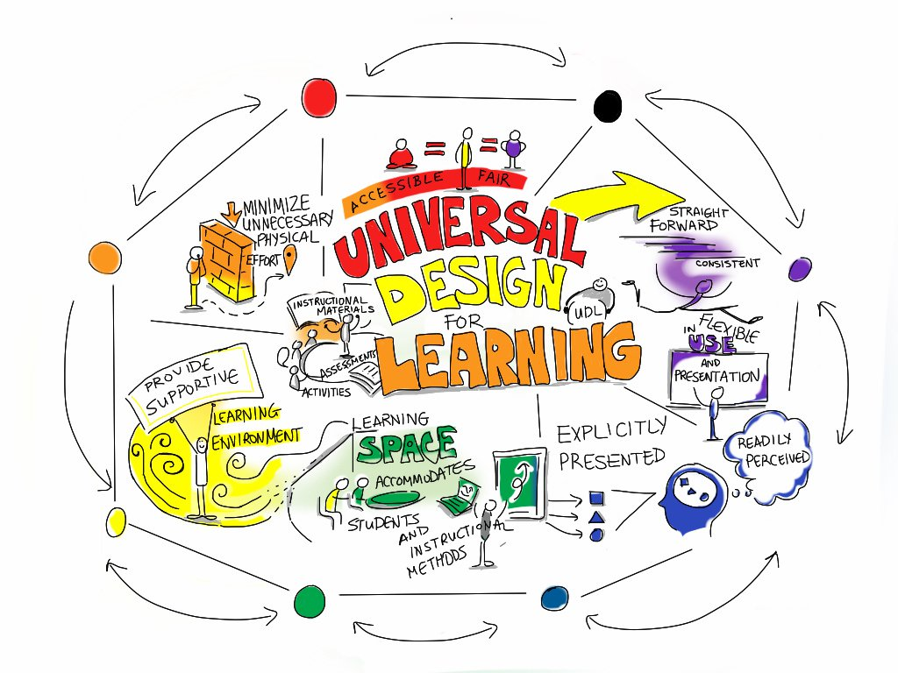
Universal Design for Learning
A Framework for Inclusive Practice
Notes:
Inclusive for all, not just those with particular needs in terms of teaching and learning. Benefits for all learners.
Designing learning for all.

Slide 5
Flexible ways of learning
Flexible study resources & facilities
Flexible assessments
http://udloncampus.cast.org/home#.Vo_kv2fnnIU
Teaching Enhancement Unit (TEU)
Notes:
Key = multiple means; flexibility for learners
http://udloncampus.cast.org/home

Slide 6
Why a toolkit?
Notes:
Policy to practice

Slide 7
Why a toolkit?
UDL principles to practice
Notes:
Policy to practice

Slide 8
UDL Toolkit Development
REFLECT
Moving from policy to practice
*PLAN
Sketch outline of Toolkit
Embedding UDL Principles into VLE Practice
OBSERVE
Pilot Toolkit and Gather Feedback
ACT
Engage with those who teach
Teaching Enhancement Unit (TEU)
Notes:
Draft toolkit - introduction; check lists; template for Moodle
Focus groups
Revised toolkit
Piloted with groups in scaffolded sessions

Slide 9
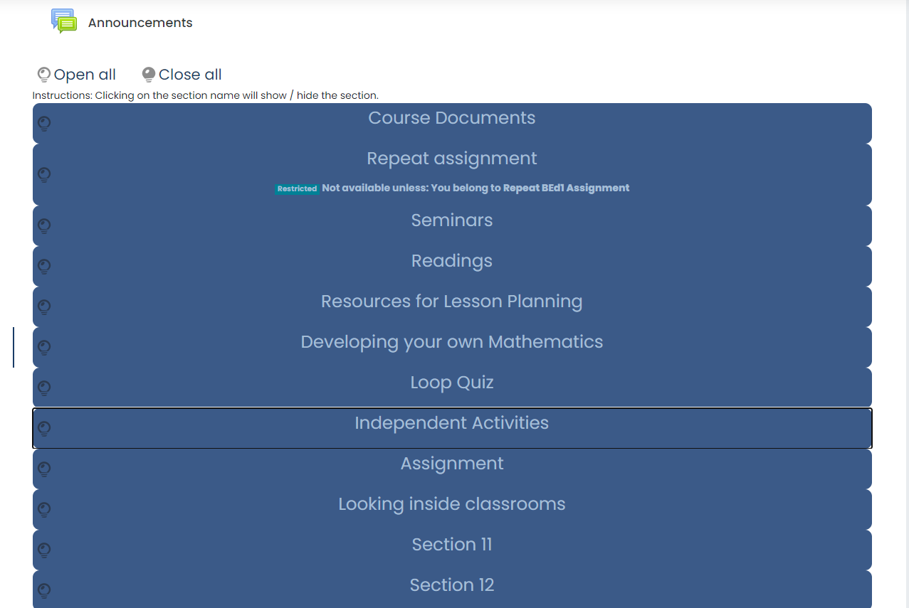
Lorraine’s reflections
Moodle as a filing cabinet

Slide 10
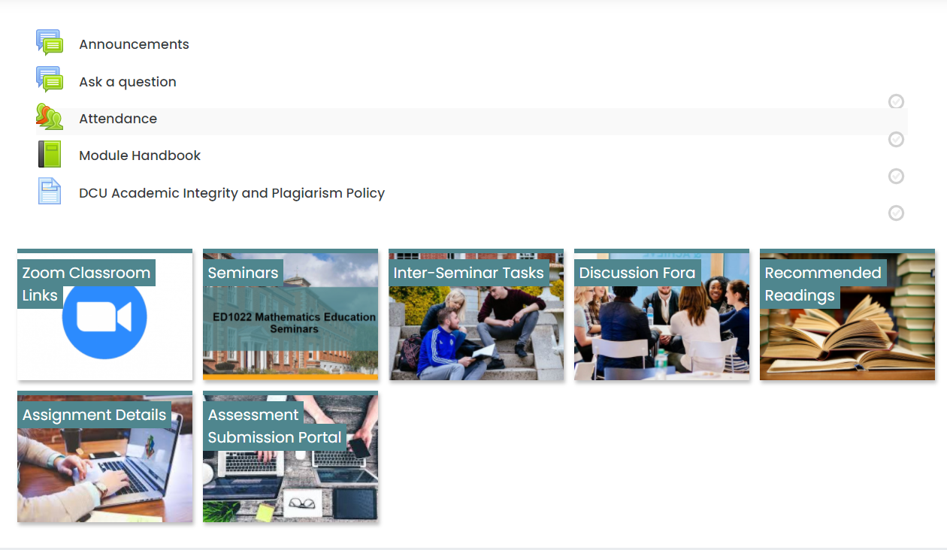
Moodle as a virtual learning environment
Notes:
Learning design unit

Slide 11
A universally designed virtual learning environment

Slide 12
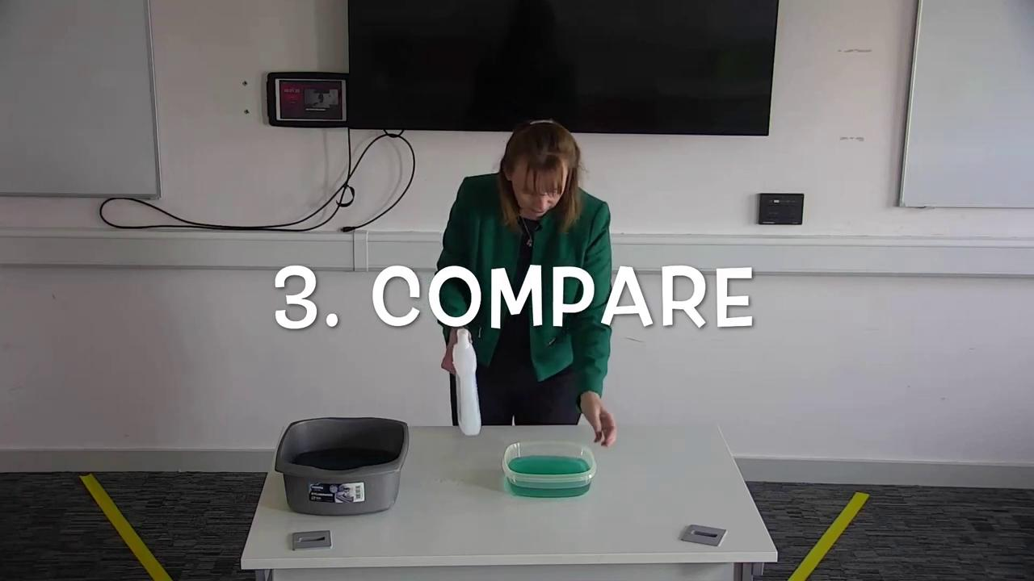
Representing content to maximise engagement
Notes:
Used iMovie and then manually entered the subtitles on YouTube. Mary typed the subtitles but YouTube tagged them to my speech.Youtube seem to have a default setting of putting two lines together. The onscreen text can only be at the bottom right or in the centre of the screen. Better Microsoft software that would have allowed more control over certain things such as the positioning of the text. What I hadn't thought about was the table being so close to the bottom of the screen. In retrospect what we should have done is to video either on the left or the right in front of the whiteboards as the black was too dark as a backdrop so we had to move the table forward.

Slide 13
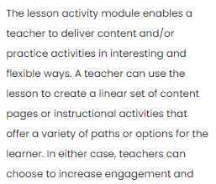
Action & expression to maximise learning
On completion of the lesson, students can review their answers immediately after completing the lesson but when they go back in, they can't see their answers. Teachers can see them in Reports.
Cannot view Lessons by seminar group, only alphabetically so it is impossible to see who in each of the 12 groups out of the circa 450 students have not attempted or not completed the lesson.
Can only give feedback on each question in turn rather than an overall comment at the end of the lesson.
When you 'email graded assignments', no idea where those emails go
“Attempts will be added to the final grade”
Notes:
Write/type up your responses. When you are ready, put your answers into the self-paced lesson 2 in the inter-seminar tasks. There is no way to save your responses or indeed see your previous responses in the lesson activity, hence that is why I would encourage you to do the task in your own time first. Henry Langton explored options with us.

Slide 14
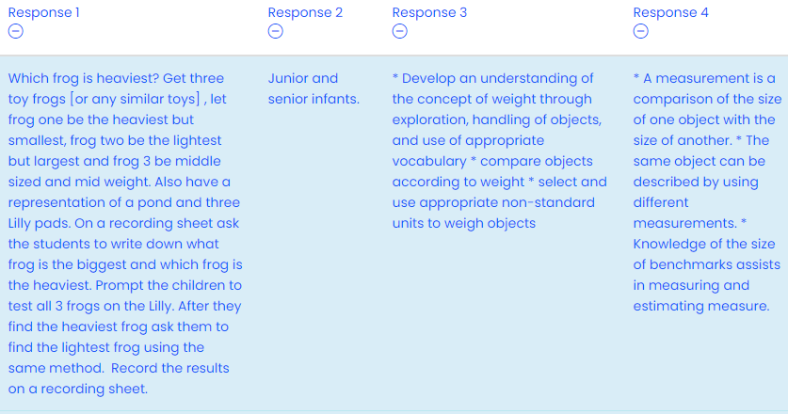
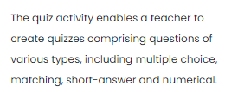
UDL to empower learners

Slide 15
Ann Marie’s reflections
Pedagogy = teaching, learning, assessment, curriculum (Nind et al, 2016)
Organisation of Loop Page
Signposts
Moodle ‘books’
Welcome videos and Guide videos
Covid-19 … Moodle became the classroom
Teaching
MMR = range of guest speakers & panels … chunked teaching videos … selected resources
Learning
MME = short pre-recorded videos by guests followed by panel … reading materials … formative tasks ‘live’ and asynchronous supported by feedback … blend of synchronous and asynchronous engagement …
Assessment
MMAE = synch and asynch formative tasks …. Choices re tasks - what / who / how many … input into assessment design
Going forward
Blend of online / F2F
Interaction of the elements of pedagogy … implication for managing learning environment
Photo - Aaron Burden, Unsplash

Slide 16
Thank you!
Teaching Enhancement Unit (TEU)

Slide 17
Resources:
UDL Toolkit available through creative commons
Recording of detailed presentation on UDL toolkit
References:
CAST Universal Design for Learning General Information
UDL Toland, Melissa (2018) UDL Implementation Rubric - used as starting point for UDL toolkit checklist
Teaching Enhancement Unit (TEU)

