Slide 1
DCU’s Discover Programme: A Hybrid Approach to Transition Leveraging Moodle
Alicia Menendez Tarrazo, Student Learning Manager
Annabella Stover, Acting Director, Student Support & Development
Notes:
Rob

Slide 2
Overview
Context
Design
Stages
USPs and concluding thoughts
Notes:
Rob

Slide 3
Context
Foster a culture that is ‘student-focussed’
SP Goal 1: Provide a transformative student experience
Development of multi-dimensional skills
Extra-curricular engagement
Particular focus on enhanced transitions and continuing support for development
Move from orientation as an ‘event’ to transitions as a ‘process’
“until a student goes through at least one academic cycle (e.g. studying for a module and submitting coursework and sitting exams), they have not been inducted into the process of study.” (Morgan, 2012, p. 22).
Digital affordances accelerated by pandemic (Guidance Digi Comp 3)
Notes:
Annabella

Slide 4
Early access
My DCU online orientation
Loop programme pages and programme orientation
Module pages and learning supports
Multi
dimensional development
Notes:
Annabella - leveraging moodle to support transition

Slide 5
Our Design Approach:
Asynchronous
Self-paced Moodle interactive activities
Self-directed campus and outdoors activities
Digital
Physical
Live Zoom webinars
Scheduled on-campus events
Adapted from Brown, 2015
Synchronous

Slide 6
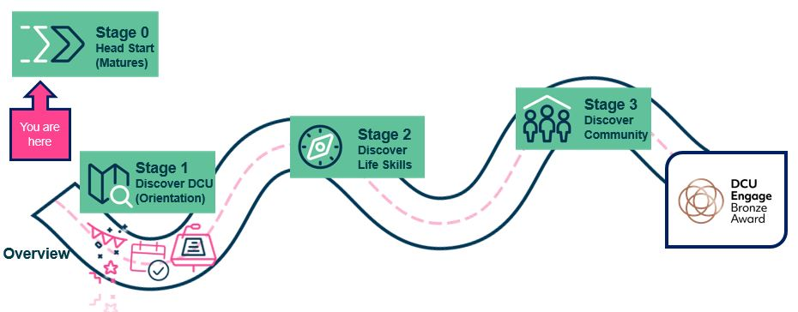
Phased Transitions Programming using Moodle
(DigCompEdu competence 3.2 ‘Guidance’)

Slide 7
Early access - Stage 0
Targeted groups provided with pre-access supports
Mature students ‘Head Start’
Focus on
Academic writing
Digital confidence
Maths
Moodle course with interactive H5P content
Welcome videos and interactive short courses
Notes:
Annabella

Slide 8
Stage 1:
Access upon offer acceptance, pre-registration
UG and PG curated version
General information and community welcome
‘Discover DCU’ short courses
Interactive, gamified activities dispersed
Companion live events on campus orientation
Just in time and revisiting opportunities
Digital Badge on completion
Notes:
Annabella

Slide 9
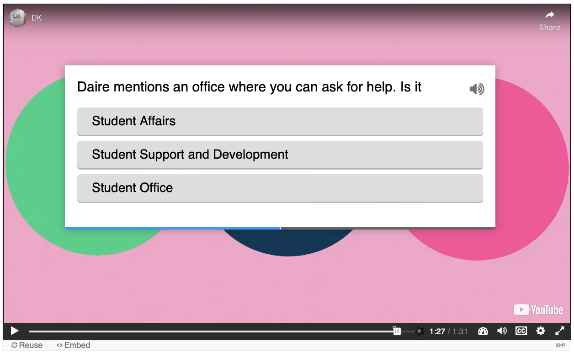
Interactive videos
High quality videos with interactive questions and assets to facilitate active learning

Slide 10
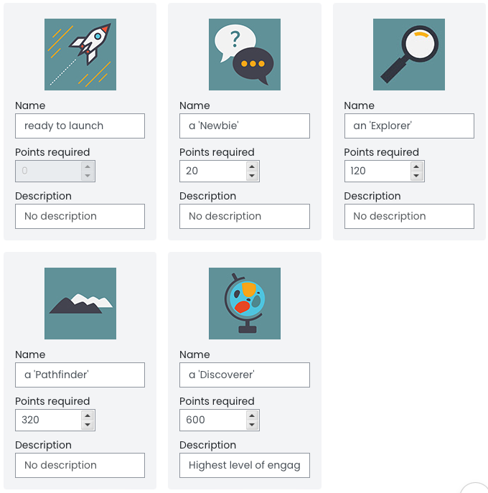
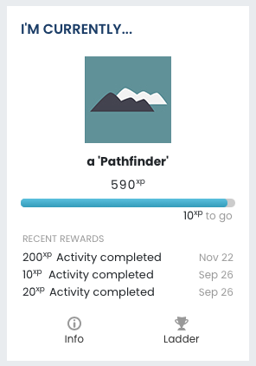
‘Level Up’
Gamification tool where students earn XP points and rise through levels as they complete activities - motivation and reward!

Slide 11
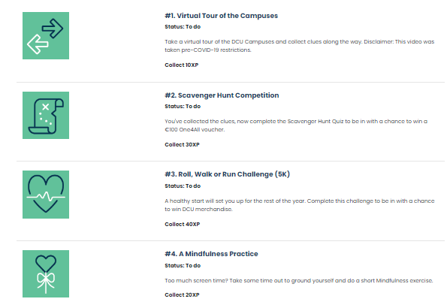
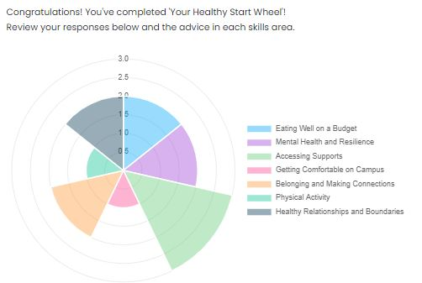
Healthy Start Interactive Activities
Fun and practical activities designed to help students learn more about DCU and learn how to use the Moodle VLE. Developed through to 22/23 with self-assessment tools informed by positive psychology to help build resilience.
Sample Activities in 22/23 with self-assessment wheel tool - “Compass Plus” developed by Brickfield Labs

Slide 12
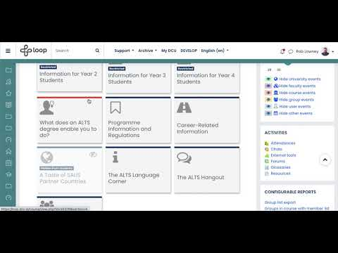
Programme pages
Shared page for all students on a programme
Discipline identity and sense of belonging
Dissemination of specific information and wisdom
Programme orientation information
Central hub for revisiting
Notes:
Rob

Slide 13
Stage 2:
Week 1
Self Assessment
Six Core Skills
Self Management
Digital Skills
Active Learning
Critical Self Reflection
Mindset
Self Efficacy
Live companion workshops Life Skills Centre
Digital Badge
Short courses beginning with a self assessment tool
Notes:
Annabella

Slide 14
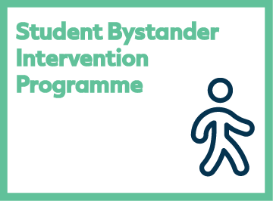
Stage 3:
End of Sem 1/Sem 2 start
Active*Consent module
Bystander Intervention
Tilt Role Play
Pick 2 out of 3
“Subcourses” of main My DCU course
Digital Badge
Notes:
Annabella

Slide 15
USPs and Concluding Thoughts
1
2
3
Inspired by an ethos of welcome, belonging and wellbeing
Personalisation and self-assessment features which serve to empower students through the use of digital tools, to reflect, take action and be mindful of their health and wellbeing
A pre- and post-orientation extended transitions programme, suited to students’ own needs and pace, which can be revisited
Broader window to build affinity with DCU, from pre-entry onwards
A transformed transitions programme - move away from physical only campus welcome events, to a rich transitions ‘ecology’ for students to immerse themselves in
Greater potential to measure the impact due to technology
Technology-enhanced model applied to other activities
Continued refinement based on student feedback

Slide 16
Concluding thoughts
Enhanced transitions underway, with Moodle playing key role
Flexibility and revisiting affordances for students
Reaching more learners, especially ‘non-traditional’ cohorts
Ability to track engagement
More opportunities ahead
Notes:
Annabella

Slide 17
Contact us
alicia.menendeztarrazo@dcu.ie
annabella.stover@dcu.ie

