Slide 1
Maria Loftus & Rob Lowney
Increasing student agency: a case study in giving students access to a lecturer authoring tool

Slide 2
Why do this?
Harness students’ familiarity with video
Previous smartphone cinema project lacked language focus
Teachers love setting reflective tasks, students less enthusiastic
Unique affordances offered by H5P - both temporal and spatial
Loop Reflect (Mahara) - one-stop shop + technical support
Students’ digital skills - aligned to competence 6.3 Digital content creation on DigCompEdu framework

Slide 3
Backdrop to project
First year core-language module, 115 students from 5 different programmes
Year long: 3 contact hours per week, one of which is in a lab.
Transitioning from summative assessment driven Leaving Certificate to a more formative assessment style
Task-based module - an interview with a French native speaker about university life, a photo novel depicting their worst day so far as a third-level student, written piece documenting their best day thus far as a student and a critical analysis of a visit to an informal learning space.
H5P enhanced video: add reflective hotspots to the video
H5P embedding recently enabled on the Mahara-supported Loop Reflect e-portfolio

Slide 4
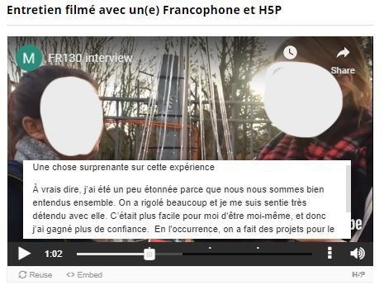
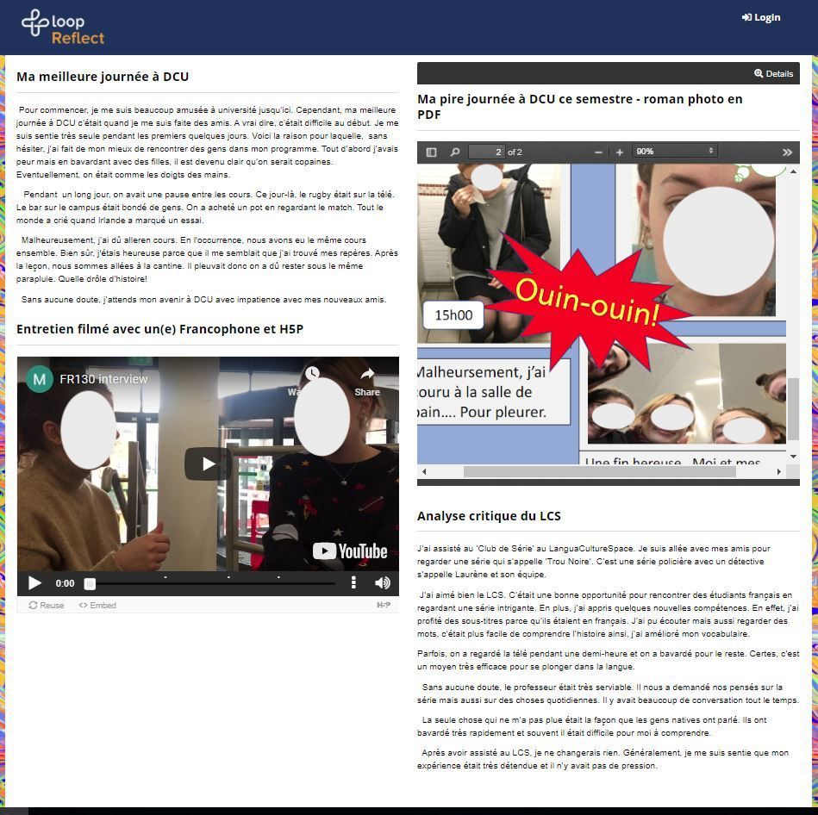
Moodle & Mahara facilitated homing of H5P

Slide 5
Scaffolded introduction
Students answer H5P questions embedded in video cloned by lecturer
Students create H5P interactions embedded in video created by students
Students create H5P interactions embedded in video cloned by students

Slide 6
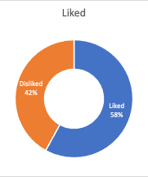
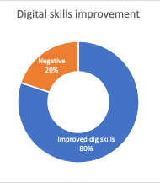
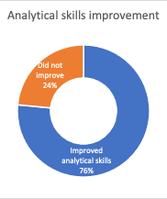
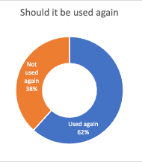
Findings
Post-project focus group
Themes: 1) Instructions and guidance; 2) H5P technical interface; 3) Tech-savviness; 5) Attitude to digital skills development; 6) Impact on language learning; 7) Impact on reflective skills

Slide 7
Excerpts
Even though it wasn't my favourite activity, it did put us out of our comfort zone and challenge our technical and communication skills.
[It helped improve my French]... because you have to create questions and answer them based on our understanding of the French in the video which means you must research words you are not familiar with
If the medium is in English I think the instructions should be in English as well because otherwise you're just trying to figure out which one is which
I had to concentrate to spot any mistakes in my grammar and pronunciation and it helped to hear myself speaking from a different point of view
H5P really helped my technical skills, more so than my French. As someone who struggles technology the software was easy to use. Inserting the interactions into videos and things like that gave me practice working with computers and editing. It was very helpful and fun to use French through a computer rather than pen and paper.
I think it was too soon to use H5P as it took a while to get used to it which took time away from studying french

Slide 8
The spine - Moodle
Students answered H5P questions embedded in video cloned by lecturer
Moodle H5P plugin
Student created video with H5P interactions
Mahara via MNET; submission to Moodle assignment
Students create H5P interactions embedded in video created by students
Students create H5P interactions embedded in video cloned by students
H5P community site; Moodle Database activity

Slide 9
Modifications for future implementation
More clarity around rationale, instructions, guidance
Provide opportunities to access technical support/FAQs
Introduce focus on creativity
With Moodle 3.9, explore possibility of giving student role access to H5P content bank and editor to remove need to use H5P.org community site (suggestion from Lance Roe, Idaho State University)

Slide 10
Thank you
maria.loftus@dcu.ie
rob.lowney@dcu.ie

Slide 11
Bibiliography
Liao, Yu-Hsiu & Chen, Yi-Ling & Chen, Hsueh-Chih & Chang, Yulin. (2018). Infusing Creative Pedagogy into an English as a Foreign Language Classroom: Academic Achievement, Creativity, and Motivation. Thinking Skills and Creativity. 29. 10.1016/j.tsc.2018.07.007.
Loftus, M., Tiernan, P. & Cherian, S. Educ Inf Technol (2014) 19: 569. https://doi.org/10.1007/s10639-013-9286-4
Russ, S. W., & Fiorelli, J. A. (2010). Developmental approaches to creativity. In J. C. Kaufman, & R. J. Sternberg (Eds.). The Cambridge handbook of creativity (pp. 233–249). Cambridge: Cambridge University Press.

