Slide 1
Student Engagement
and Gamification
Dr Mark Glynn
@glynnmark

Slide 2
Engaging students through gamification
Gamification is the use of game thinking and game mechanics in non-game contexts to engage user

Slide 3
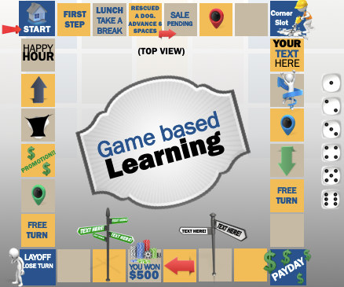
Game Continuum
Gamification
Game based learning
Serious games
Uses game principles and elements to motivate learning rather than actual games
Uses games or video games as a means for learning
Computer based immersive games with educational and informative purposes

Slide 4
Approaches to Gamification
Progress levels
Freedom to Fail
Learning pathways
Conditional access
Reward
Activity
Module
Programme
Image from https://presentermedia.com

Slide 5
Quiz - case study
Activity
The Challenge:
Do online quizzes enable student engagement and learning or Are we just fooling ourselves?
The solution:
Mixture of formative & summative assignments and quantitative analysis of student performance

Slide 6
Logistics
Activity
x 8 - 1 for each topic
25 questions
unlimited attempts
Open once the topic is complete
Freedom to fail
4 per topic each topic
32 questions
one attempt
Controlled opening time
images from presentermedia.com

Slide 7
comparison of attempts to final score (drug calculations)
Activity
Group / Category of Students | n | Average mark out of 5 | Equivalent %
All students | 215 | 4.6605 | 93.21%
Students who never attempted or accessed quiz | 71 | 4.4225 | 88.45%
Students who never attempted the quiz but did access it | 35 | 4.5714 | 91.43%
Students who attempted the quiz at least once | 109 | 4.8440 | 96.88%
Notes:
The total number of students who did the summative quiz was 215. The average score for all 215 students was 93.21% - this is desirable because the information in these quizzes is “must know” information. Analyzing and comparing scores suggests that the more that students interacted with the quizzes the better they did in the summative exam. Students who never attempted or accessed the quiz scored 88.45% on average. Those who accessed quizzes but never attempted them scored 91.43% on average. Those who attempted the quizzes at least once scored 96.88% on average (i.e. 8.43% higher than those who never accessed or attempted the quizzes and 5.45% better than those who just accessed them).
Furthermore analysis of the scores in relation to the numbers of times that students did the formative quizzes shows that results in the summative exam got progressively higher (with one exception) the more attempts that students made at the formative quizzes. Students who made just one attempt at the formative exam scored 95.09%, those who made 2 attempts jumped by 4.2% to 99.29 whilst those who made 3, 5 or 7 attempts scored 100%. The exception was the students who made 4 attempts at the quiz and scored 95.56% on average. (I need to drill more into this when/if I get a chance to see what their approach was to the formative quizzes).

Slide 8
comparison of attempts to final score (infection control)
Activity
Group / Category of Students | n | Average mark out of 4 | Equivalent %
All students | 215 | 3.6442 | 91.1%
Students who never attempted or accessed quiz | 67 | 3.4164 | 85.41%
Students who never attempted the quiz but did access it | 20 | 3.6065 | 90.15%
Students who attempted the quiz at least once | 128 | 3.7693 | 94.23%
Notes:
As with drug calculations the students’ scores in the summative quizzes tend to improve the more they interact with the formative quizzes.

Slide 9
Module - case study
Module
The Challenge:
High failure rate of “research methods” module in first year
The solution:
Introduce elements of gamification into the module

Slide 10
Key Insights - Positive outcomes
Module
Students responded positively to gamified features such as Knowledge Check Quizzes, self monitoring progress tools
Students preferred to learn remotely using E-Learning activities.
Gamified activities that provided real world applications of the topic were useful in increasing students perceptions of course value and are linked to exam performance.
Key Learning
More tools such as these could be incorporated into future interventions

Slide 11
Key Insight - Control
Module
Students felt in control of their learning when they had the freedom to conjecture, hypothesis, explore and fail without negative consequence.
Course instructors feel that too much student control over learning may have negative outcomes if they are not appropriately monitored and assisted by a teaching professional.
Key Learning
A balance is required between student and instructor led control of learning that takes account of different learning styles across students.

Slide 12
Gamification - Transition
Programme
The Challenge:
Engage and monitor students in online orientation
The solution:
Gamify the entire orientation process

Slide 13
“My DCU”
Programme
Digital badges
Quizzes
Scavenger Hunts
Discussion Forums
Giveaways
‘ready to launch’
0 Points
a 'Newbie'
20 Points
an 'Explorer’
120 Points
a 'Pathfinder’
320 Points
a 'Discoverer’
600 Points
Notes:
I loved the "assignments" we needed to do, it not only helped us learn the system of loop and loop reflect better but it was also fun and knowledgeable.
I enjoyed the virtual 5K challenge.
I think it's a great idea to have competitions for completing activities as people are more likely to participate.
I like to know more about the campus of DCU, and I hope to get the hoodie based on 5K run :-)
I like that the Digital Edge online learning programme was provided for us & that an incentive to get moving was also provided (5K walk/ run)
more interactive games/videos
I would ditch the experience system. I've asked a few other students what they thought of it and we all seem to agree it's a little childish. Other than that the course seems reasonably good.
The little exercises like the scavenger hunt and mindfulness were really fun. I also like the lunchtime event, particularly the ones featuring the SU officers everyday because it gave me a taste of what DCU is like.
no need for improvement
I found the course to be useful due to the interactive features

Slide 14
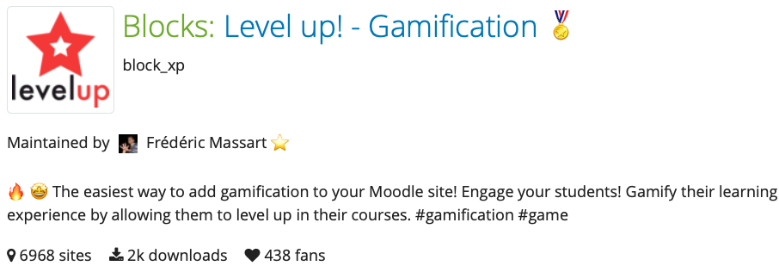
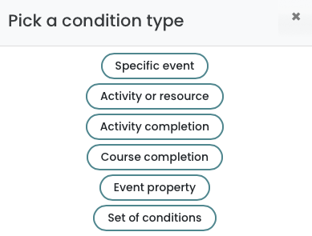
Level Up Plus - Moodle Plugin
Programme
Points awarded according to rules: Moodle events or Grades
Notes:
https://moodle.org/plugins/block_xp - level up plugin
https://moodle.org/plugins/mod_choicegroup - group choice plugin

Slide 15
Conclusions
Programme

