Slide 1
Playful approaches to CPD with Moodle
Lisa Donaldson
Rob Lowney
Dublin City University

Slide 2
Hello!
Lisa Donaldson
(and Rob Lowney!)
You can find me at @dubdonaldson

Slide 3
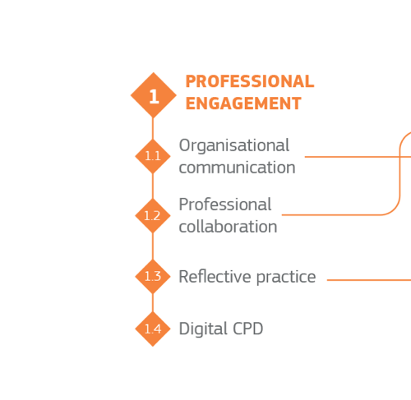

Slide 4
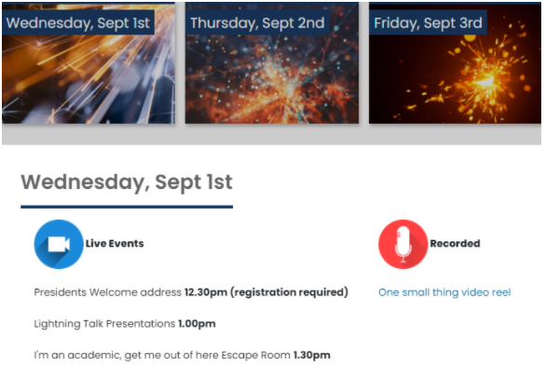
The Event
The Teaching & Learning Week event sought to offer an opportunity to pause, reflect, and consider the impact of the pandemic on future teaching approaches but utilise a playful approach to ward off Zoom fatigue and create an engaging learning environment.

Slide 5
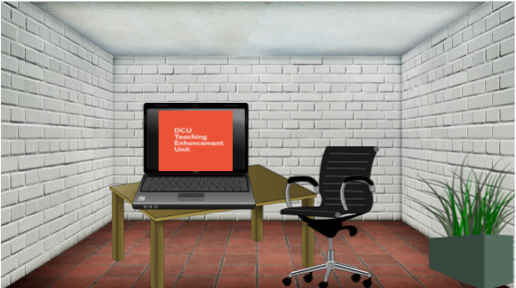

Slide 6
I'm really competitive so I was determined to escape

Slide 7
What three things from the online week were most useful to you?
42% of respondents specifically mentioned the Escape Room

Slide 8
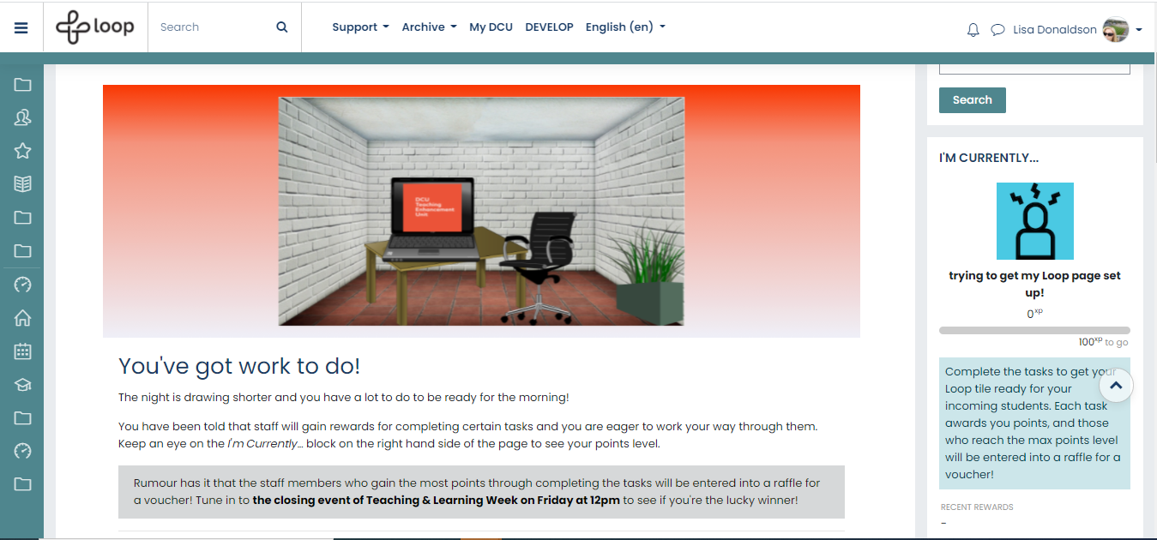

Slide 9
Task 1

Slide 10
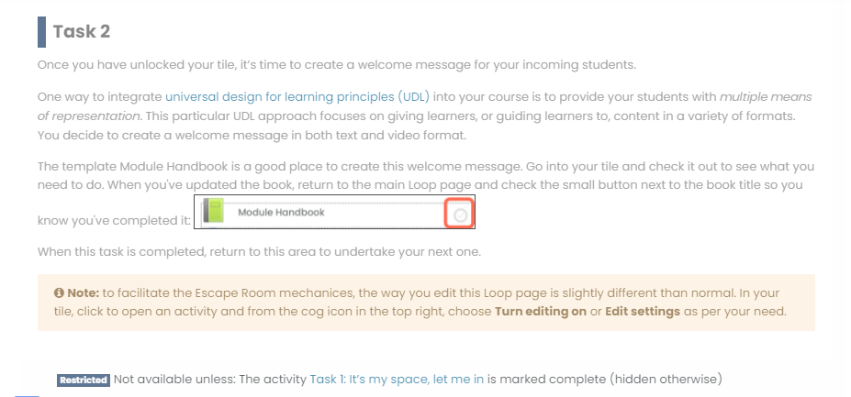

Slide 11
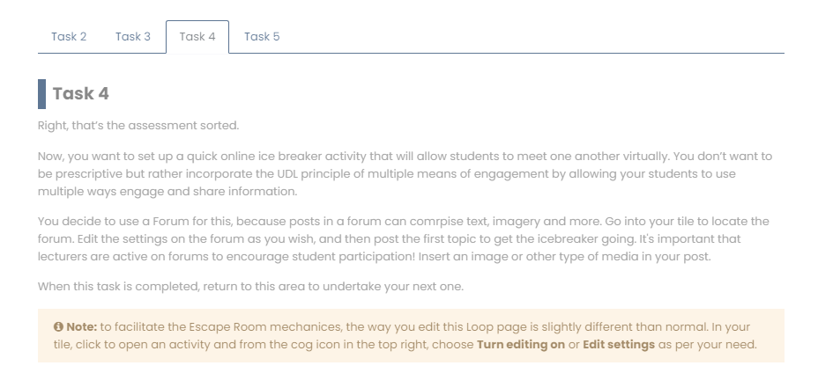

Slide 12
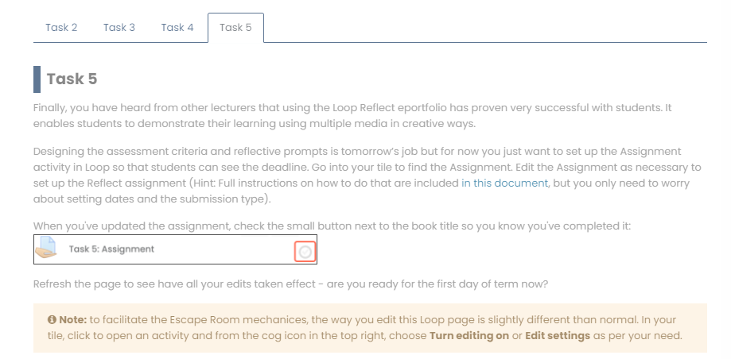

Slide 13
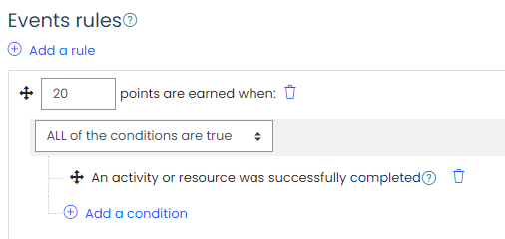
Points mean prizes!

Slide 14
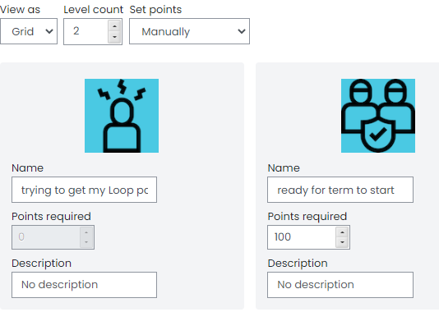
Points mean prizes!

Slide 15
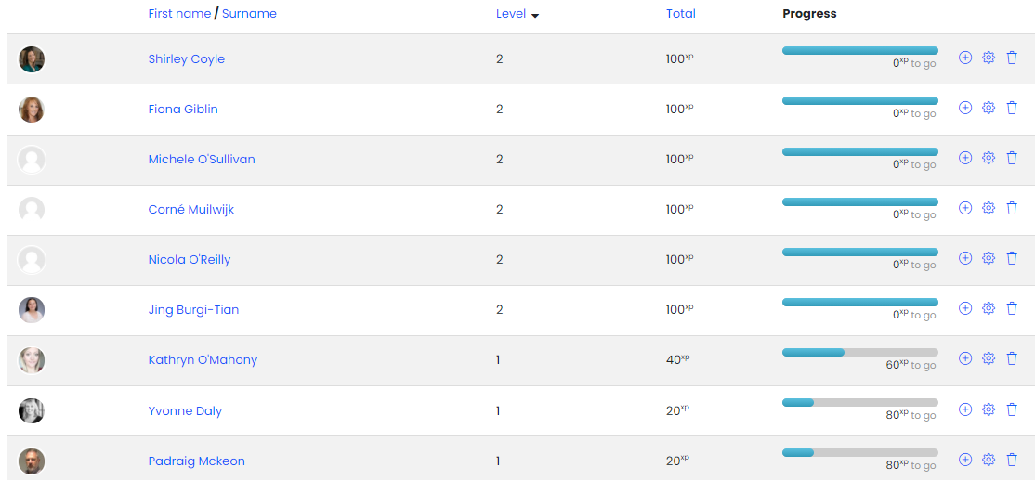
Points mean prizes

Slide 16
Happy to take questions
(but direct the technical ones to Rob!)

