Slide 1
Options for Gamification in Moodle
Dr Mark Glynn
@glynnmark

Slide 2
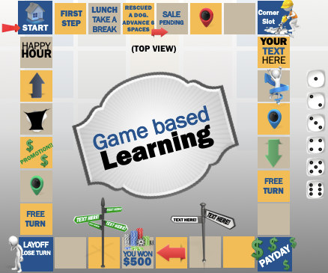
Game Continuum
Gamification
Game based learning
Serious games
Uses game principles and elements to motivate learning rather than actual games
Uses games or video games as a means for learning
Computer based immersive games with educational and informative purposes

Slide 3
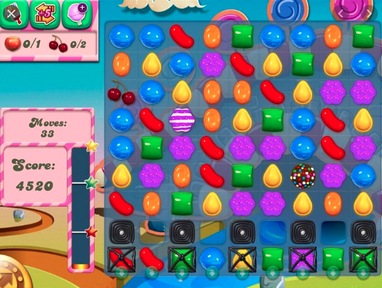
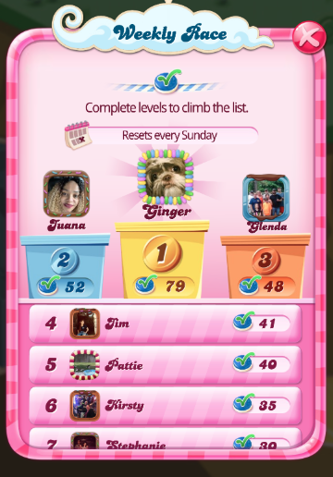
Candy Crush

Slide 4
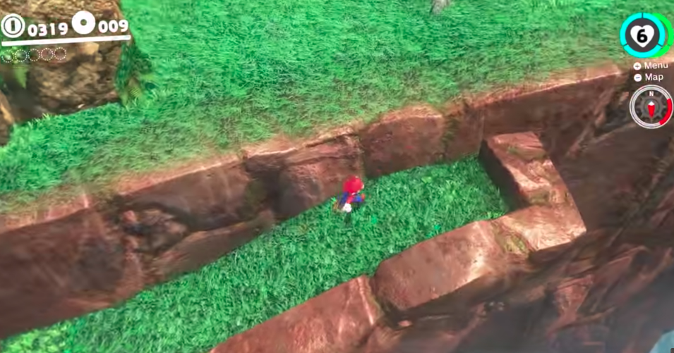
Mario Brothers

Slide 5
Approaches to Gamification in Moodle
Progress levels
Freedom to Fail
Learning pathways
Conditional access
Reward
Activity
Module
Programme
Image from https://presentermedia.com

Slide 6
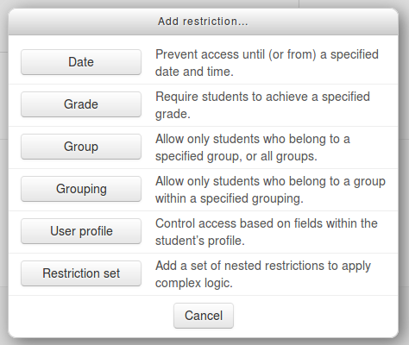
Conditional Access
Restrict to role or attainment
Individual, And, Or

Slide 7
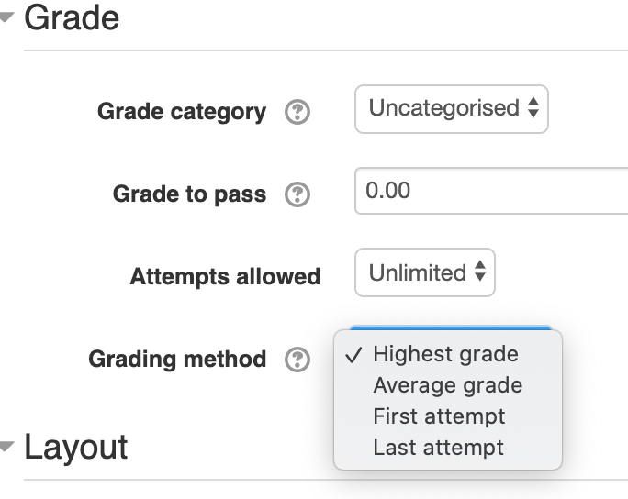
Freedom to fail
Activity
Quiz
Assignment
Workshop
or Gradebook

Slide 8
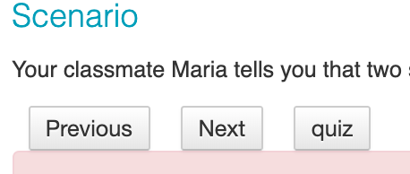
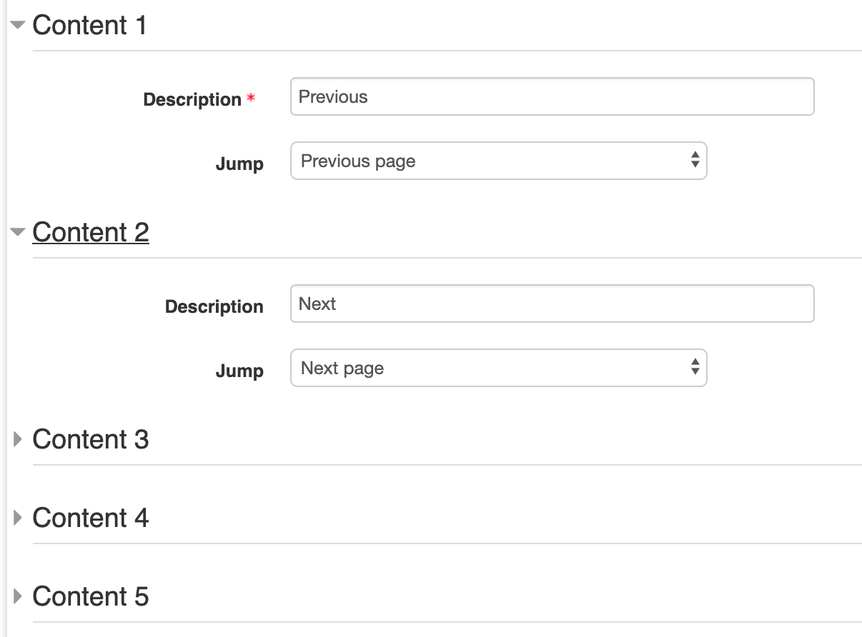
Different pathways
Choice
Lessons
H5P
Learning plans
Groups

Slide 9
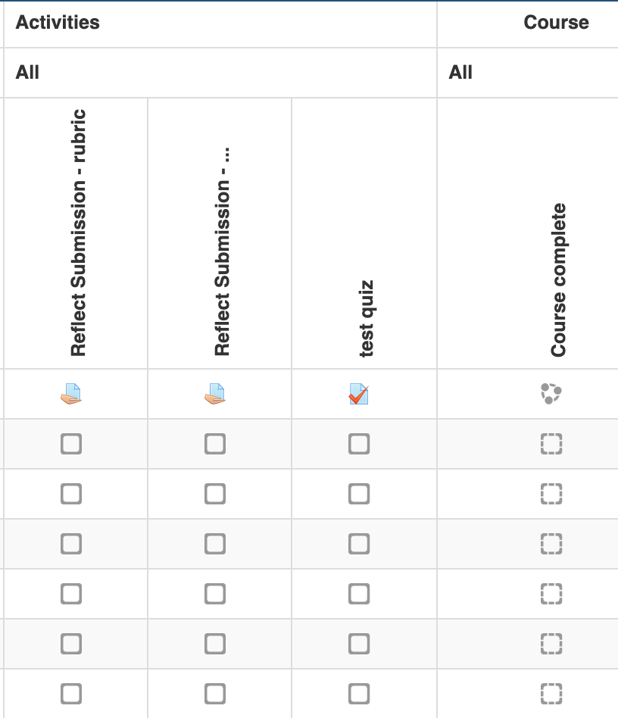
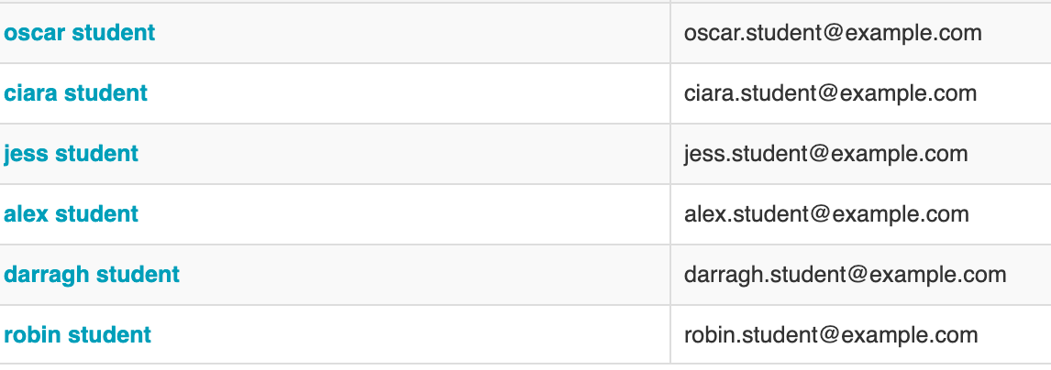
Completion reports

Slide 10
Key Insights on gamification
Students responded positively to gamified features such as Knowledge Check Quizzes, self monitoring progress tools
Students preferred to learn remotely using E-Learning activities.
Gamified activities that provided real world applications of the topic were useful in increasing students perceptions of course value and are linked to exam performance.
Students felt in control of their learning when they had the freedom to conjecture, hypothesis, explore and fail without negative consequence.
Course instructors feel that too much student control over learning may have negative outcomes if they are not appropriately monitored and assisted by a teaching professional.
Age* and gender agnostic

Slide 11
Conclusions
Gamification can work, but give it time

Slide 12
Quiz - case study
Activity
The Challenge:
Do online quizzes enable student engagement and learning or Are we just fooling ourselves?
The solution:
Mixture of formative & summative assignments and quantitative analysis of student performance

Slide 13
Logistics
Activity
x 8 - 1 for each topic
25 questions
unlimited attempts
Open once the topic is complete
Freedom to fail
4 per topic each topic
32 questions
one attempt
Controlled opening time
images from presentermedia.com

Slide 14
“My DCU”
Programme
Digital badges
Quizzes
Scavenger Hunts
Discussion Forums
Giveaways
‘ready to launch’
0 Points
a 'Newbie'
20 Points
an 'Explorer’
120 Points
a 'Pathfinder’
320 Points
a 'Discoverer’
600 Points

Slide 15
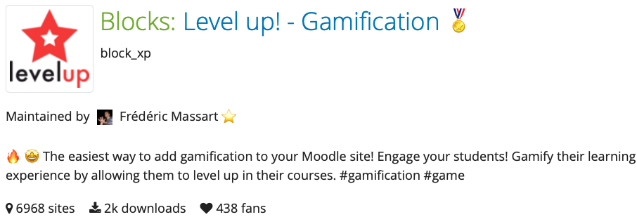
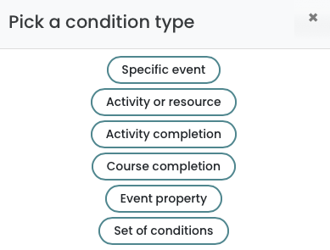
Level Up Plus - Moodle Plugin
Programme
Points awarded according to rules: Moodle events or Grades

