Slide 1
Peer-evaluation on Loop Discussion Forum
School of Applied Language & Intercultural Studies
(SALIS)
Dr. Aparajita Dey-Plissonneau
aparajita.dey-plissonneau@dcu.ie

Slide 2
Context & Design for learning
School of Applied Language & Intercultural Studies
(SALIS)
Module: FR376_2020/2021, French (Higher Intermediate)
Objectives: Methodological, Linguistic, Meta-level learning
Synchronous activity
Criteria & Methodology to help students with peer-evaluation
Lecturer feedback based on rubric via Fourm
Peer-evaluation via Loop Forum
Asynchronous activity

Slide 3
Criteria for peer-evaluation
School of Applied Language & Intercultural Studies
(SALIS)
Content
Multiple perspectives
Variety of arguments
Relevance of answers given to public
Linguistic quality
Grammatical structures
Vocabulary
Pronunciation
Interaction management
Time management of the group
Floor occupancy & balanced turn-taking
Spontaneity in interaction
Gestures for more effective communication
Lessons to be drawn and applied in one’s own future productions
Respond to 3 other peer evaluations

Slide 4
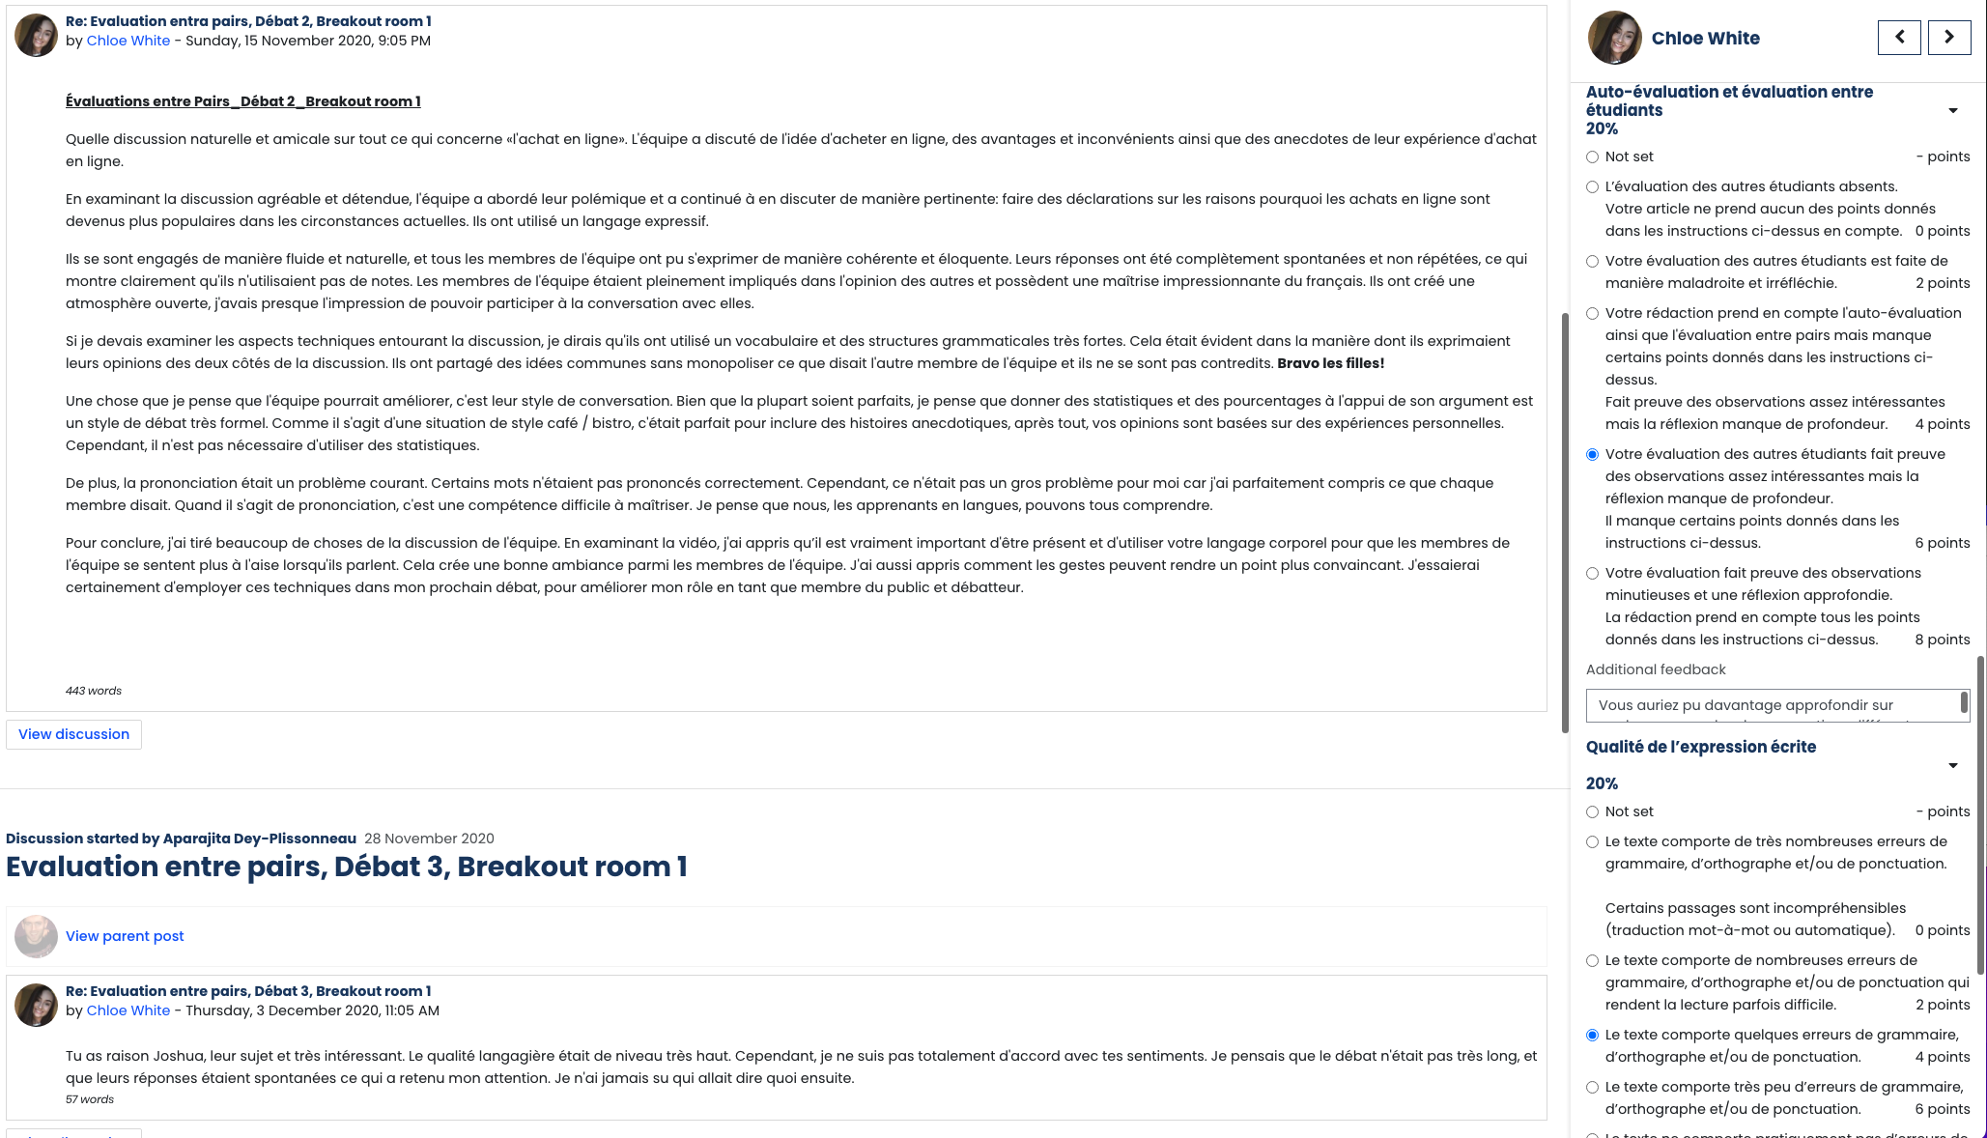
Using Rubrics on Loop Forum
School of Applied Language & Intercultural Studies
(SALIS)

Slide 5
Pros and Cons of the activity
Peer-evaluation -> marked
Peer-evaluation -> self-evaluation
Clear guidelines
Learner voice in assessment and learning activities
Technological affordance of recording
Lack of anonymity -> an issue
School of Applied Language & Intercultural Studies
(SALIS)

Slide 6
School of Applied Language & Intercultural Studies
(SALIS)
Thank you !
aparajita.dey-plissonneau@dcu.ie

Slide 7
The Problem
Taking 2 full weeks per year to grade EF331 (Topics in Applied Economics née Global Economic Issues )
100% CA – 2017 and 2018 write two essays
Pick two from list in 2017
Pick one from list and then common “secret essay” in 2018
Attendance really low and not much sense of engagement
better with secret essay version
“Referencing issues” pretty common
Over assessment a common complaint from EPL students

Slide 8
The Proposed Solution
Students only write one essay (due before reading week)
Rubric given and students told I will be following it strictly
The story of the course is tweaked so that the entire course is in service of this essay
Students then get someone else's (anonymised) work to assess
Students who score less than 45% on essay one write a second essay instead
Students own grade adjusted to reflect how accurately they graded their peer
For every 3% deviation, student loses 1 mark from their own essay 1 tally
Later changed to 4:1

Slide 9
The Actual Solution
Made an excellent rubric
Made an extraordinary Loop… thing

Slide 10
Why Might This Work?
Loss Aversion – people put a greater weight on losing something than gaining something
Rubric gives clear criteria for what a good essay looks like
Material really clearly linked to task at hand
Three elements will hopefully
increase attendance
Very high until the lecture after the essay was due
Then appallingly low (at times 6/110)
foster engagement and critical thinking
Survey and focus group evidence

Slide 11
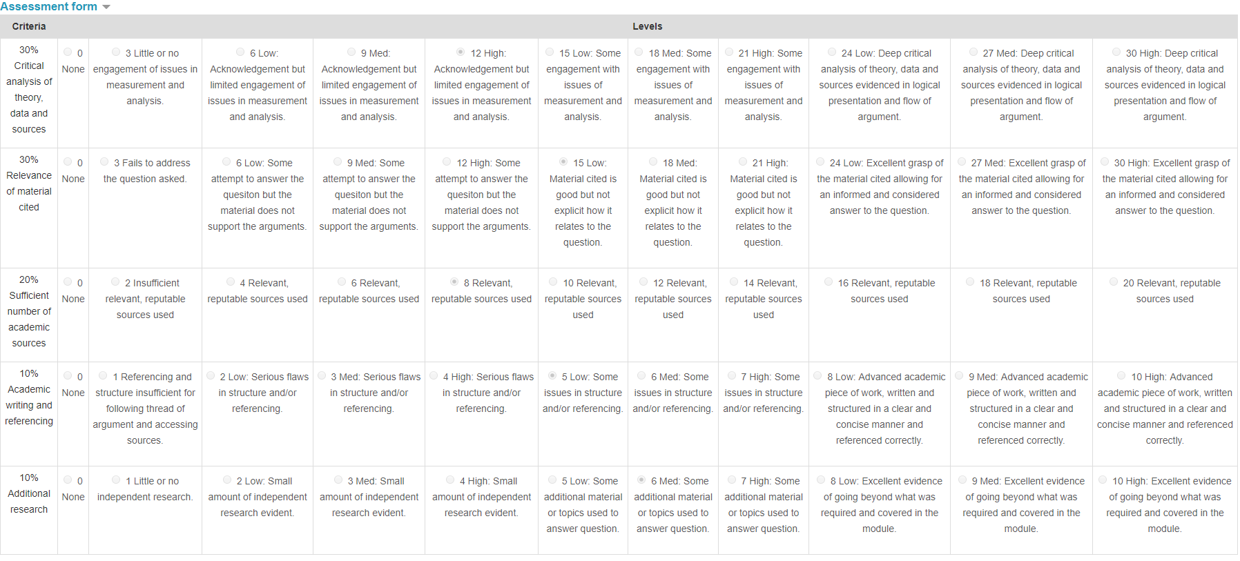

Slide 12
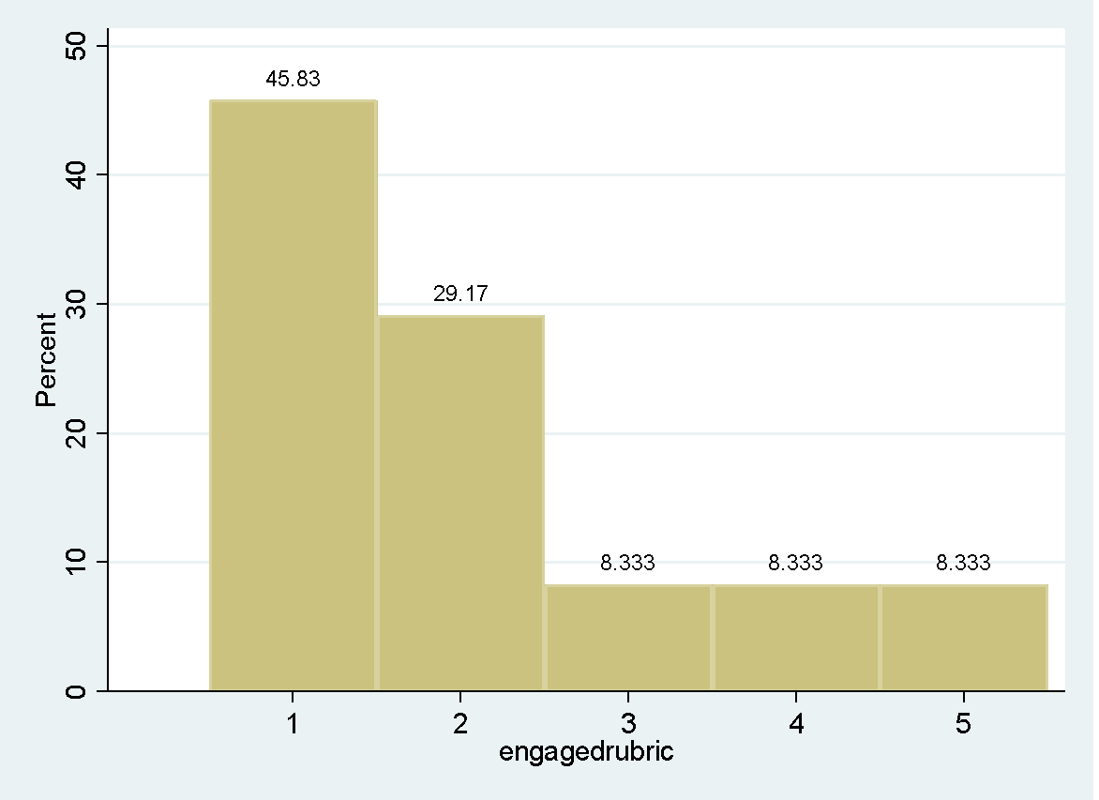
Did it Work? Engagement with Rubric
Most agree that they engaged with the rubric
Rubric clearly seen to be useful in terms of writing essay 1
( N= 48, 1= Strongly Agree, 5= Strongly Disagree)

Slide 13
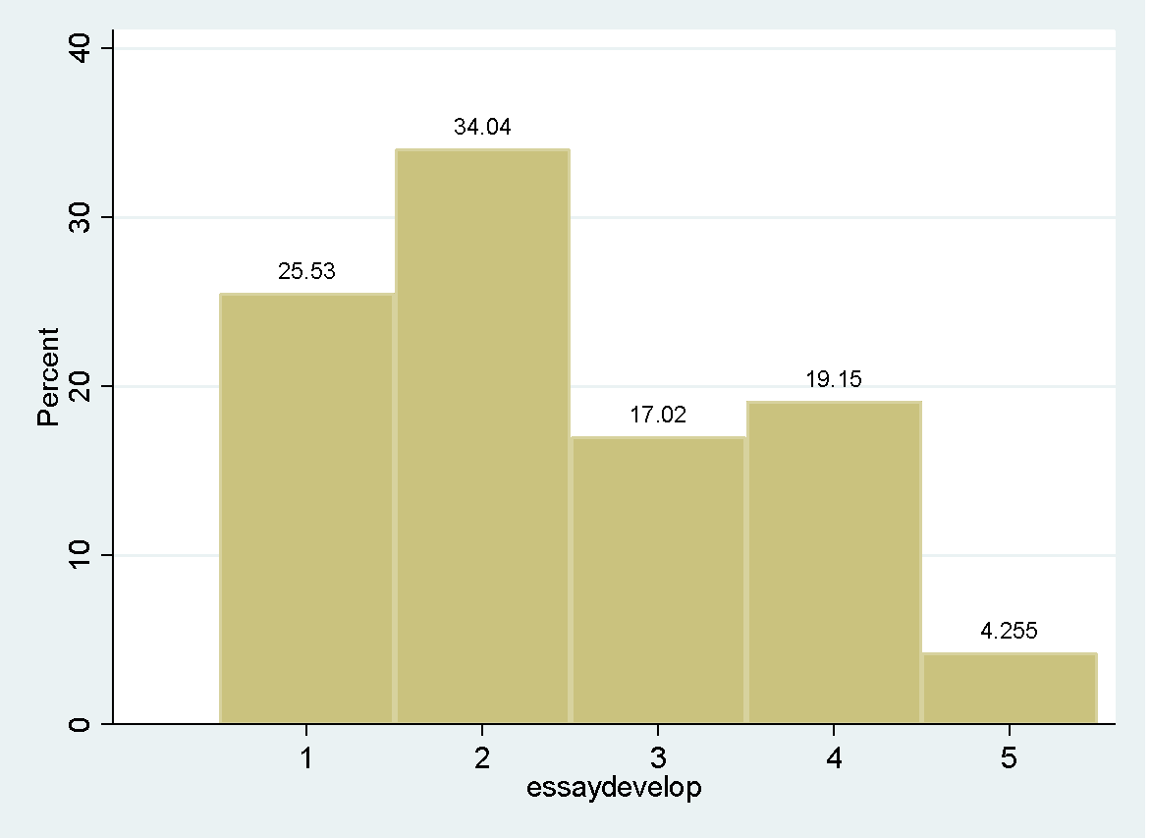
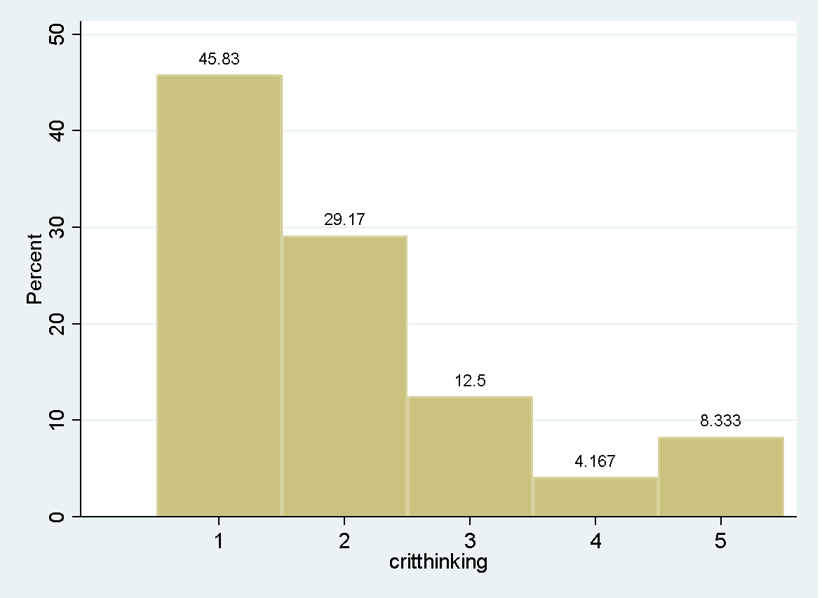
Did it Work? Critical Thinking
Takeaway: Most agreed that the assessment helped develop essay writing skills
Takeaway: Overwhelming majority agree it helped with critical thinking skills
( N= 48, 1= Strongly Agree, 5= Strongly Disagree)

Slide 14
Focus Group Word Cloud

Slide 16
Supporting Peer Assessment with the Moodle Workshop Activity
noel.murphy@dcu.ie

Slide 17
The Moodle Workshop Activity - overview
supports broad peer assessment of other student submissions
as well as instructor assessment of the original submissions
as well as instructor assessment of the peer assessment
with random or controlled selection of peer assessors
supports anonymous assessment (when appropriately configured*)
supports self-assessment, but this can also be excluded
Workshop activities have two grades that need to be weighted for the final student result:
Grade for submission
Grade for assessment
Workshop activities have four phases and a closed state:
Setup phase
Submission phase
Assessment phase
Grading evaluation phase
Closed state
docs.moodle.org/39/en/Workshop_activity Introduction, including 10min video

Slide 18
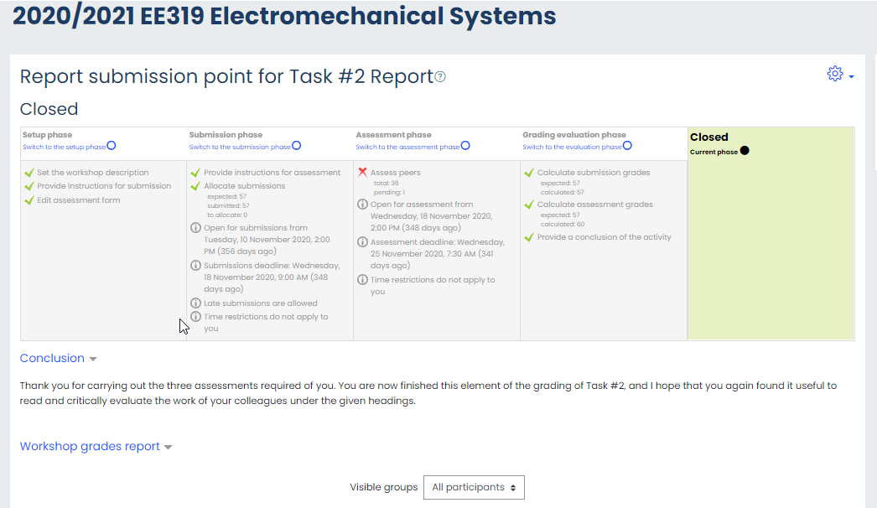
Example Workshop Activity - Phases
The Workshop activity has four phases and a closed state:
Setup phase
Submission phase
Assessment phase
Grading evaluation phase
Closed state

Slide 19
The Moodle Workshop Activity - Setup Phase
Turn on editing in your Moodle course page
Select “Add an activity or resource”
Select “Workshop”
Select “Edit Settings” and configure settings as desired, i.e. for
grading,
submission,
assessment,
overall feedback to the whole cohort,
availability of activity,
text matching,
activity completion, etc.
completed tasks in each phase are indicated with a green tick mark to guide the workshop development and progress
In the “Setup phase”, click “Edit assessment form”
to configure the type of assessment

Slide 20
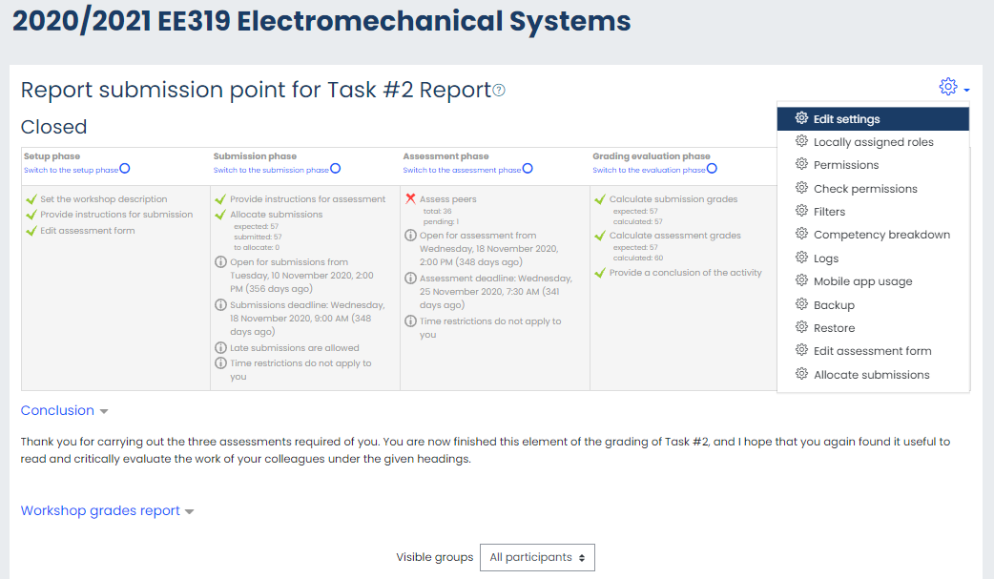
Example Workshop Activity - Phases

Slide 21
The Moodle Workshop Activity - Setup Phase
Submission Allocation:
Manual
suitable for small classes and well-known students;
drop-down menus for reviewers + reviewees
Random
suitable for large classes, and arm’s length allocation;
select number of reviews per submission or per reviewer
Scheduled …
Key Point:
To make the peer reviewing anonymous:
see docs.moodle.org/311/en/Workshop_FAQ
The Workshop activity is robust and fairly (Moodle) intuitive
- commit to using it and learn as you go

