Slide 1
Learning design approach to Moodle course development

Slide 2
Case Study
Development of EC912 Leading & Mentoring for Professional Development
Initial contact with TEU
ABC design team
Starting point agreement on learning outcomes
Tweet your course
Using ‘Pedagogy First’ approach - 6 Learning Activities
Storyboard the module
Linking moodle activities to support learning activities - balanced approach
Use ABC approach to structure moodle layout

Slide 3
Case Study
Benefits
Move from content only consideration to pedagogy
Encouraged move away from over reliance on powerpoint only and consider alternatives
Provided a reason to engage in moodle activities to enhance student learning and gain insight to UDL
A stepping stone from which to build, each semester experiment with a new activity
Before and after

Slide 4
DCU Studio
Est. August 2021
Learning & Media Design
Project Management
Head of Unit:
Mairéad nic Giolla Mhichíl
Contact: dcustudio@dcu.ie

Slide 5
Collaborative Design
Produce
Content shared
Moodle developed
Design
ABC Workshop
Decide activities & content
Agree deliverables
Development Cycle
Regular workshops
&
Shared workspaces
Review
Review content changes
Update deliverables

Slide 6
ABC & Moodle Activities
Acquisition
-Books
-Websites
-Video
-H5P
-Podcasts
-Lecture - live/recorded
Discussion
-Discussion forums
-Loop Board
-Interactive polling
-Chat tools
-Open Class Discussion
-Twitter
Collaboration
-Wiki Group project
-Peer Review/Workshop
-Glossary
-Workshop Activity
-Zoom breakout
Investigation
-Web quest
-Database
-Case study
-Lit review / analysis
-Annotated bibliography
-Lab work
Practice
-Quizzes
-Formative Activities
-Role play
-Simulations
-Self/Peer assessment
-H5P
Production
-Essay
-Report
-Reflective learning
-Infographic
-Blog
-Student video
This work is a derivative of the ABC Learning Design method by Clive Young and Nataša Perović, UCL (2015) and is licensed under CC BY-NC-SA 4.0. Original resources available at abc-ld.org.

Slide 7
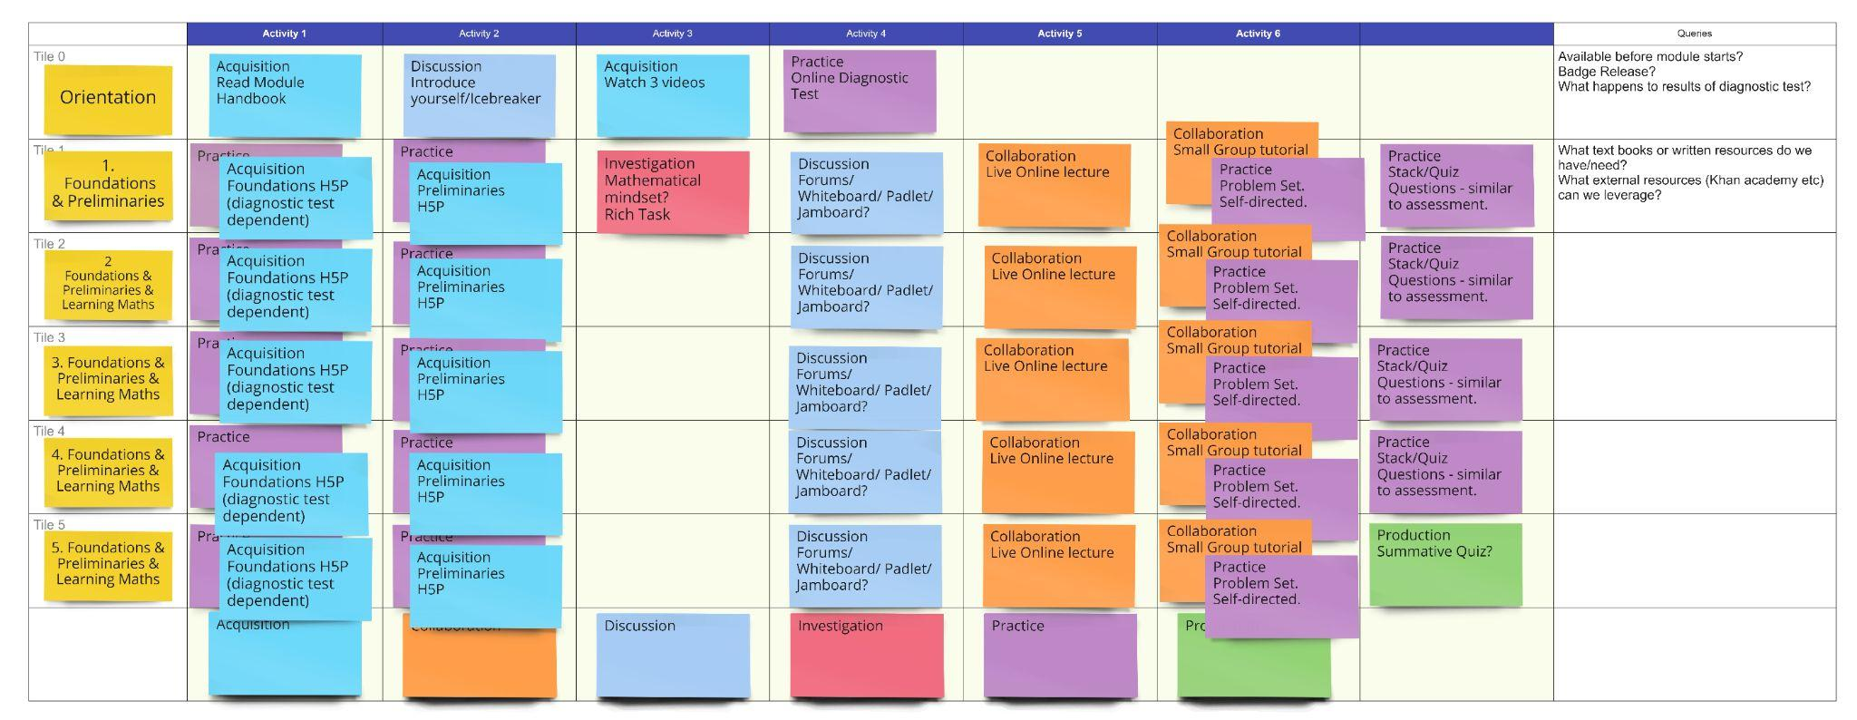
ABC Storyboard
This work is a derivative of the ABC Learning Design method by Clive Young and Nataša Perović, UCL (2015) and is licensed under CC BY-NC-SA 4.0. Original resources available at abc-ld.org.

Slide 8
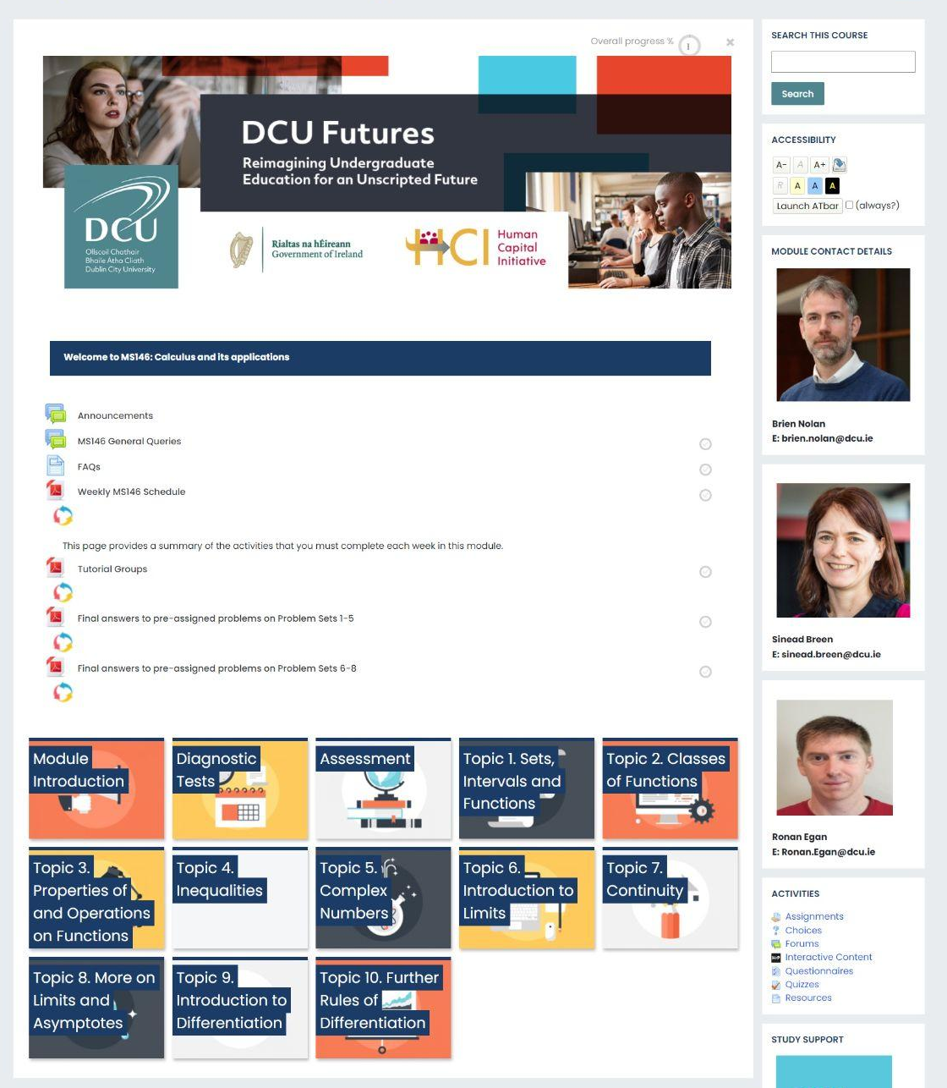
The Module Page
Clear & Consistent
Chunked Content
Social Presence
Accessibility

Slide 9
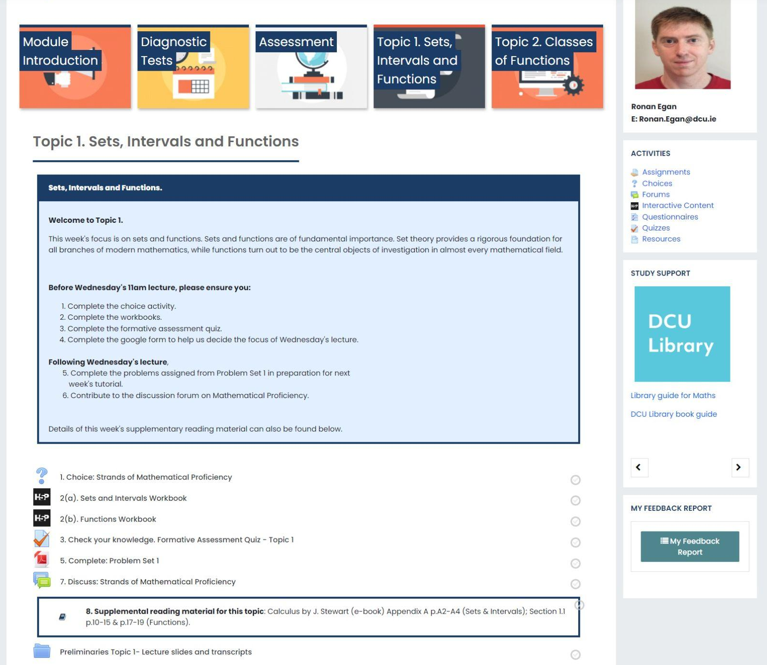
Topic Content
Clear information
Activity tracking
Student Scaffolding
Variety of activities
Acquire
Investigate
Practice
Discuss
Collaborate
Produce

Slide 10
Key observations
ABC is lightweight and accessible
ABC is a shared vocabulary
ABC promotes dialogue
ABC balances learning activities
ABC enhances asynchronous spaces
ABC creates roadmap for future iterations
ABC is about mixing and remixing your approach
ABC supports learning a little at a time
ABC community is brilliant!

Slide 11
Photo by Morvanic Lee on Unsplash

