Slide 1
Initial experiences of Loop Board for collaborative learning
Mark Glynn
Paula Lehane
Baidyanath Biswas
Rob Lowney

Slide 2
Background
Increase in use of digital tools for learning
Increase in use of collaborative tools
INDEx survey (2019) showed variety of these in use in DCU
Unknown if paid/freemium accounts being used
Concerns over privacy, ad tracking and accessibility

Slide 3
Development
Funding acquired for plugin development
Initial spec drafted between DCU learning technologists
“Post-it” board format
Anonymous posting
Organise between columns
Accept multiple formats
Export posts
Rating
Sorting
Focus group with lecturers - important to hear educators’ voice and coalface experience

Slide 4
Development

Slide 5
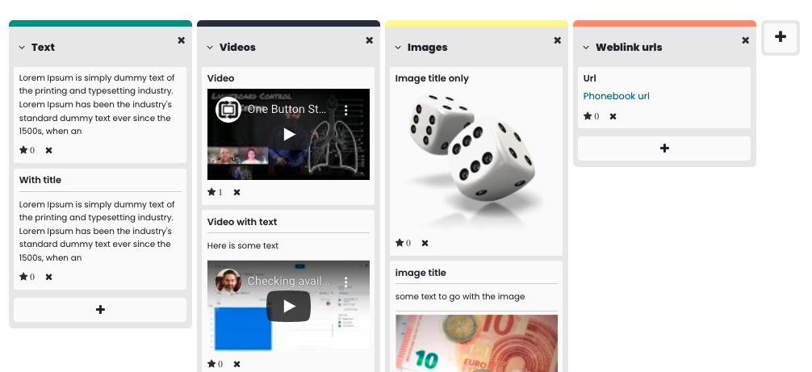
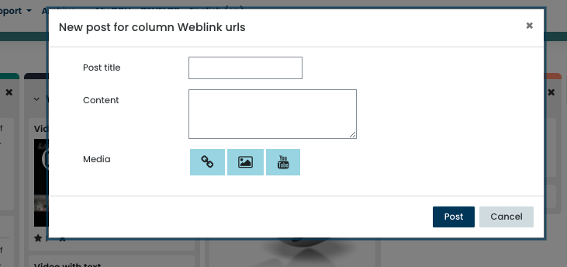
What does it look like?

Slide 6
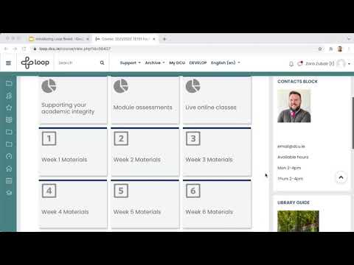
How to use
Add as activity
Configure settings
Title columns
Students start posting
Quick and easy!

Slide 7
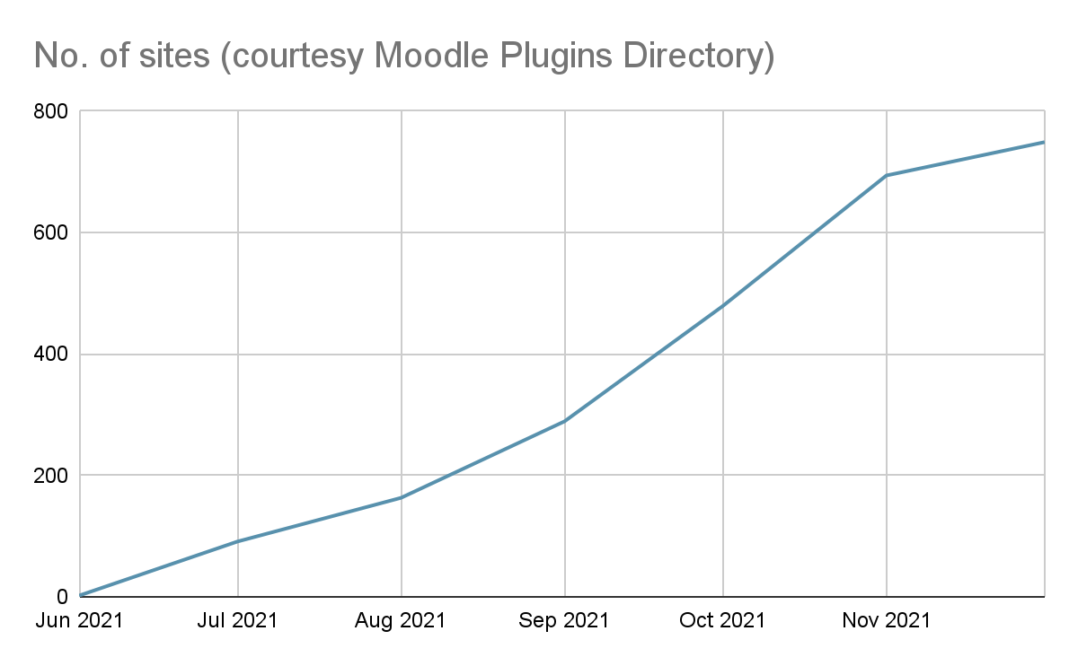
Current usage

Slide 8
Potential uses
Question Collection
Showcase
Exit Ticket
Existing / Prior knowledge
Reflections on learning
Weekly Plan
Book Review
First Reactions
Tips Sharing
Playlist of videos
Brainstorming
Sharing Bookmarks
Guest Wall
Student voting
SWOT Analysis
Evidence Gathering
Kanban Board
Pros and Cons discussion
Temperature Check
Goal Board
Group Project Work
Compliment Sharing
Wishlist
Note taking
Group work management
Book analysis
Where are you?
Problems and solutions
Pros and Cons discussion from multiple perspectives
Multidisciplinary understanding
Looking for examples
Full list of potential ideas

Slide 9
Resources
Foster learner collaboration with Board – a new Moodle plugin (Cooch, 2021)
Moodle Boards – a virtual post-it note activity added to Moodle (Digges, 2021)
Moodle Board is now available (Glynn, 2021)

Slide 10
DCU pilot
Available for all lecturers at start of 2021/2022 academic year
Piloted on 11 modules in particular, across four faculties
Evaluated at end of semester one
Anonymous surveys for staff and students
Largely Likert-scale with some open-ended questions
Drew on Laal & Ghodsi (2011) categories of collaborative learning benefits
Issued to 11 staff, 682 students
Response rate: staff 91%, students 6%

Slide 11
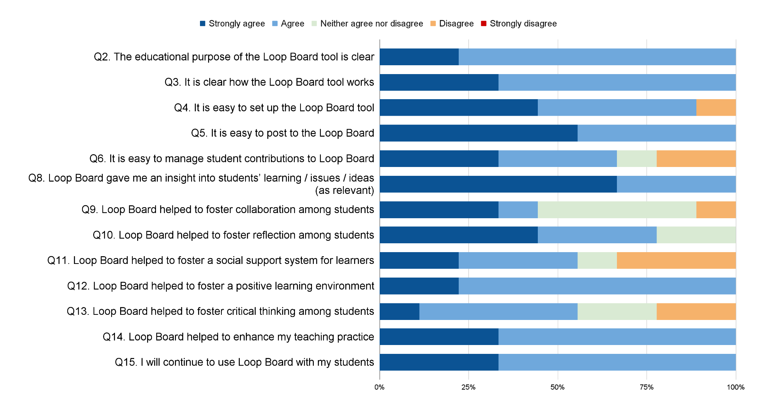
Staff findings

Slide 12
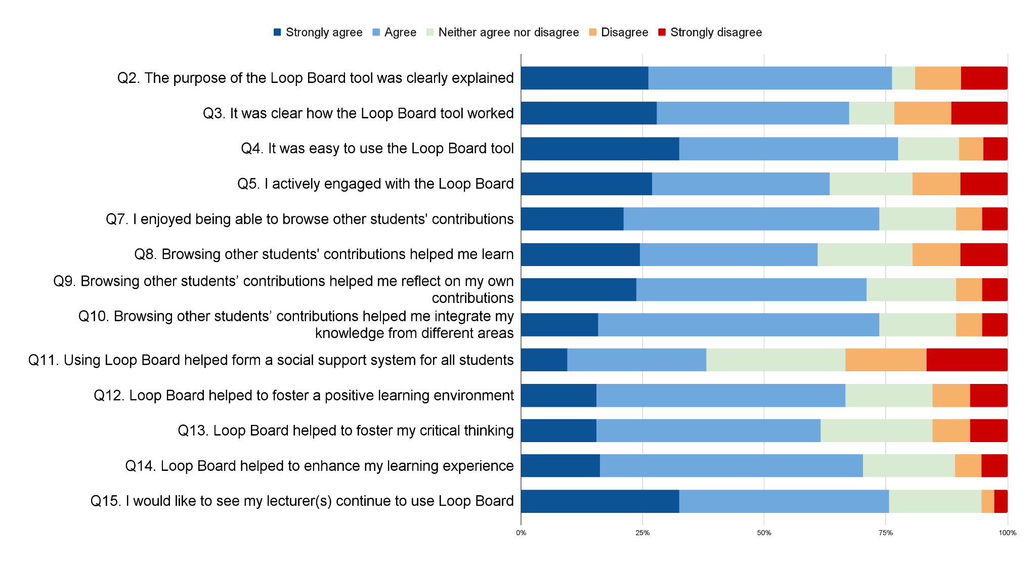
Student findings

Slide 13
Paula Lehane
Assistant Professor
DCU School of Inclusive and Special Education

Slide 14
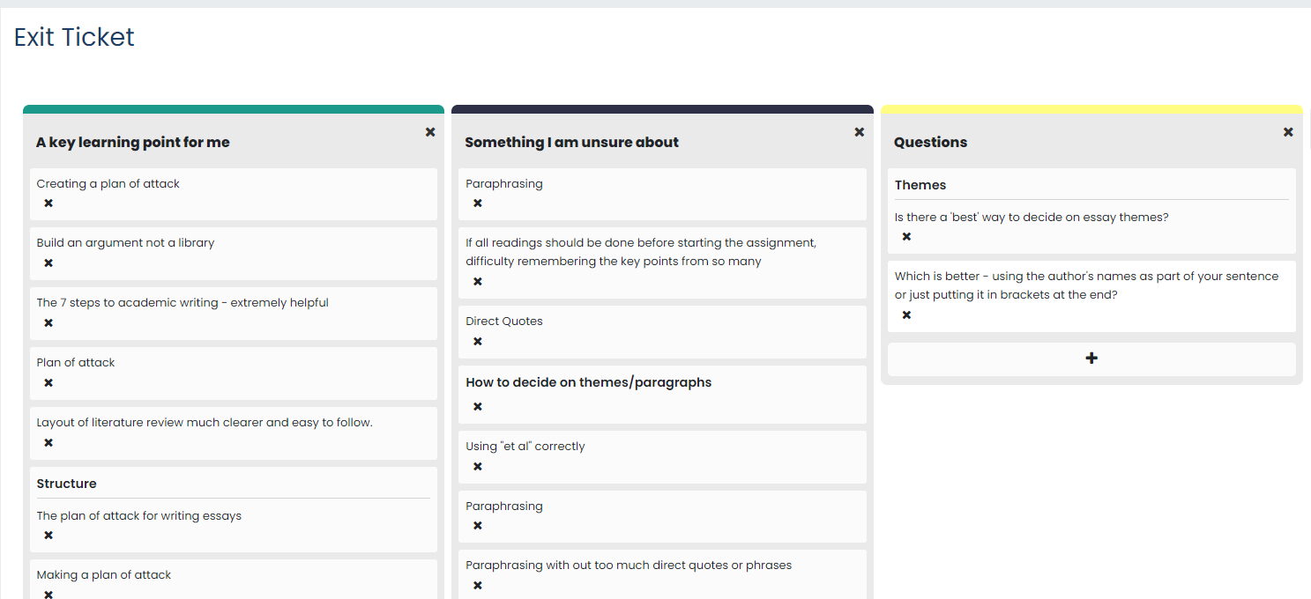

Slide 16
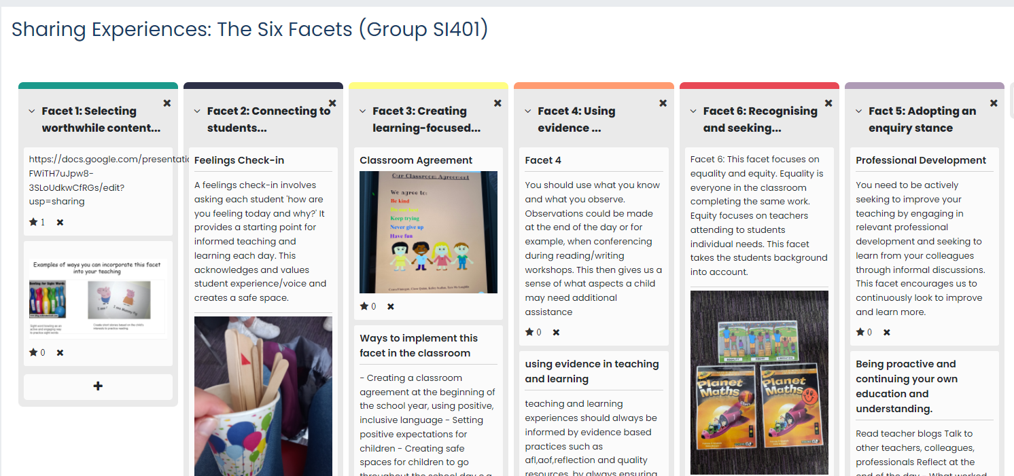

Slide 17
Baidyanath Biswas
Assistant Professor of Digital Business
DCU Business School

Slide 18
Where to next & Potential new features
Ability to set activity completion e.g. student must add X amount of notes to the board
A board per student setting (if not shared, and not groups)
CSV export report updated to include number of “likes”
Enable commenting functionality on each post

Slide 19
Contact
mark.glynn@dcu.ie

