Slide 1
One Small Thing
A few tips to consider to embed universal design for learning in Moodle
Suzanne Stone, SFHEA
Clare Gormley, SFHEA
Rob Lowney, SCMALT
DCU Teaching Enhancement Unit

Slide 2
UDL Guidelines
CAST, 2018. UDL Guidelines.
Notes:
Universal design for learning
Broad framework to reduce barriers to learning for learners
Awareness has grown in recent years - burgeoning UDL communities are springing up
Mantra of “One Small Thing” - UDL is a journey
When it comes to Moodle, more than just web accessibility
Guidelines developed by CAST
Three principles - Multiple means of engagement, representation, action and expression
Nine guidelines
31 checkpoints

Slide 3
Suzanne’s three tips
Access short pre-recorded clip

Slide 4
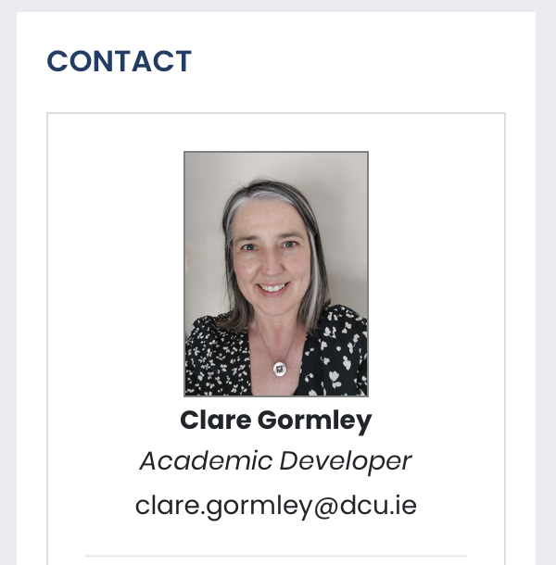
4. Course contact block
Display photo and contact details in prominent location on course page
Helps establish ‘teacher presence’ per Community of Inquiry Model (Garrison et al, 2000)
Aligns to UDL Checkpoint 8.3 Foster collaboration and community
Notes:
Clare
I want to share a few UDL tips with you that I’ve implemented in a module that I teach. The module is a blended one, so Moodle is used extensively. The students use it to access important learning resources and engage in a wide variety of activities such as quizzes, H5P interactive content, Moodle Workshop for peer assessment, discussion forums, and more. Because of this, it’s important to try to to embed UDL principles.
When it comes to learning with Moodle, whether in a fully online mode or a blended mode, it’s important to foster a sense of community between teachers and learners and between learners themselves. This helps learners feel like they belong, and a sense of belonging helps contribute towards student success. Furthermore, the Community of Inquiry model, a seminal model used in online learning design, tells us the importance of establishing ‘teacher presence’, of making the teacher visible and present in different ways in the online learning environment. A simple way of doing this is incorporating a static contact block in a prominent location on your course page. On my course page, this contact block appears in the top right corner. So when learners log in for the first and for subsequent times, they see my name, photograph and email address. They immediately know who the teacher is.
The block is just a simple HTML block with image and text. Very straightforward! It could also be used to share information like office hours, or a link to your calendar so students can see when you’re free and when you’re not.
Along similar lines, something as simple as uploading a photo to your Moodle profile can help to establish teacher presence. So many teachers don’t bother uploading a profile photo, but having one makes a big difference - because each time you post an announcement in a forum, or sent or message, or leave a comment somewhere on Moodle, your photo will appear, and that consistency again helps strengthen teacher presence and community.

Slide 5
5. Guide learners in engaging with content
Use labels to organise course and sections
Use ‘Description’ field to contextualise content
Use clear titles
Aligns to UDL Checkpoint 3.3 Guide information processing and visualization
Notes:
Clare
Whether you use Moodle for online modules, or blended ones, or even if you use it sparingly, just to share files and resources with students, you can never underestimate the importance of keeping your courses and sections well structured! We’ve all heard of the analogy of Moodle being like a filing cabinet, where students go to access files - now, that’s not something I personally ascribe to, as I like to ensure lots of activity and interactivity on my Moodle courses! - but even if it were just like a filing cabinet, imagine a filing cabinet with folders not in alphabetical order, or no tabs on the folders to tell you what’s in them, or no folders whatsoever! We’ve all seen Moodle courses that resemble that - lots of resources and activities dotted about. Some simple tips can help you guide your learners to find what they need and to understand what it entails - without having them spend energy looking through the resource itself to figure out what it is!
Labels - or “Text and Media Areas” as they’re now known in Moodle 4.1! - are very handy for organising resources and activities within a section. In my module, I use a label to organise resources and activities into those which leaners need to engage in before a workshop, during a workshop, and after a workshop. Using a little HTML code, these labels can be made to stand out, and even include an icon to help the student visualise what type of activities and resources are contained underneath.
Similarly, all Moodle activities and resources come with a description field, which is almost never used by your average teacher! I think it’s vital to use the description field. It’s an ideal place to insert a line or two about what the resource or activity is and how or why students should engage in it. I also recommend ticking the box to display the description on the course page - this means as a learners is scrolling through the course, they’ll immediately see this additional guidance and know what every item is about.
And of course - the simplest thing of all to do is to use clear and direct titles on your resources and activities.

Slide 6
6. Share slides before class
Use URL or file resource to link to your slides ahead of class and allow learners to customise to suit their needs
Follow good accessibility by e.g. using ALT text on and attributing images
Aligns to UDL Checkpoint 1.1 Offer ways of customizing the display of information
Notes:
Clare
For better or worse, a slide deck has become a teacher’s best friend! You’d be hard pressed to find a classroom or module where a teacher isn’t using presentation software at some point. And of course, our students have come to expect slide presentations as a key learning resource, something which presents the key points of the learning at hand, something which they can revisit afterwards, to help them revise. In fact, some institutions have policies which require teachers to give students a copy of their slides, if they have used them.
Slides and readings are probably the two most popular types of resources which teachers upload to Moodle, but very often teachers upload their slides after class. I would encourage you to think about making your slides available before class. This serves two purposes - firstly, students who have particular needs or preferences can access the slides and customise how they are presented - changing font size or colour perhaps, or using a text-to-speech tool. It could make it easier for them to engage with the slides and follow along if the slides are more suited to them. Secondly, giving advance access means students can follow along on their own devices if they wish, make notes and so on. This also acts as a useful contingency if something goes wrong with the projector in the room and you can’t present, as happened in a workshop of mine a few months ago. The projector was kaput, and I was unable to display my slides, so instead, I asked the students to access the slides on whatever device they had - a laptop, or tablet or phone, and some students shared - and we followed along together. In the end of module feedback, some students responded they actually preferred engaging with the slides this way rather than looking up at the screen in the room.
When working with slides, it’s also important to remember to include descriptive text on any images that you use, so a student using a screenreader can understand what’s being presented in the image. Both Google Slides and PowerPoint make it very easy to enter ALT text.

Slide 7
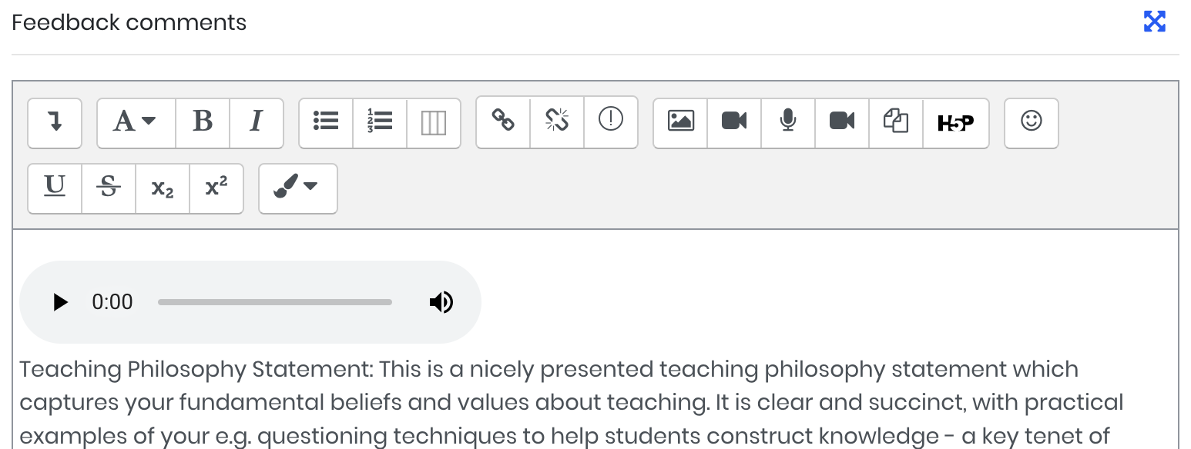
7. Assignment audio feedback
Use audio recorder tool to provide feedback on e.g. assignment submission
Can be done in combination with text/video
Useful for communicating tone
Aligns to UDL Checkpoint 1.3 Offer alternatives for visual information
Notes:
Clare
The last tip from me before I pass you back to Rob. One of the UDL principles is to provide multiple means of engagement, and one of the most common ways educators try to enact this principle is by providing a variety of text, video or audio-based material. But very often when it comes to graded activities or assignments on Moodle, teachers still rely on text-based feedback only. I’d encourage you to explore audio or video based feedback. This can be easily created using Moodle’s built-in recording features available in any rich-text area, which lets you make a recording of up to 2 minutes duration. Audio feedback is an area of interest for me, and something I practise when grading my students’ assignments.
Audio feedback has a number of benefits, including:
Greater understanding of feedback (Killingback et al, 2019)
Better sense of belonging (Killingback et al, 2019; Dixon, 2015)
Voice can be more nuanced than written word (Hennessy and Forrester, 2014)
Leads to more conversational and supportive language in feedback (Borup et al, 2015)
We can speak faster than we can type (1 min spoken = 6 min written) (Lunt and Curran, 2010)
From an accessibility perspective, Emery and Atkinson (2009) said that audio feedback enables students to listen to and pace their own learning, making it useful to students with specific learning needs
Lunt and Curran (2010) found audio feedback preferable for students with reading/sight issues
Knauf (2016 p.442) noted ‘as one of a number of possible forms of feedback, audio feedback can increase the variety of channels of communication used, and help pave the way towards an inclusive, diversity-sensitive university.’
Because the recording is taking place within a rich-text area, you can even combine a brief audio clip praising or reassuring the student alongside written feedback which perhaps lists some specificities, and maybe even includes hyperlinks to additional resources or guidance. Using a combination of different formats here can really bring feedback to life, and includes something to suit all learners.
But enough from me for now!

Slide 8
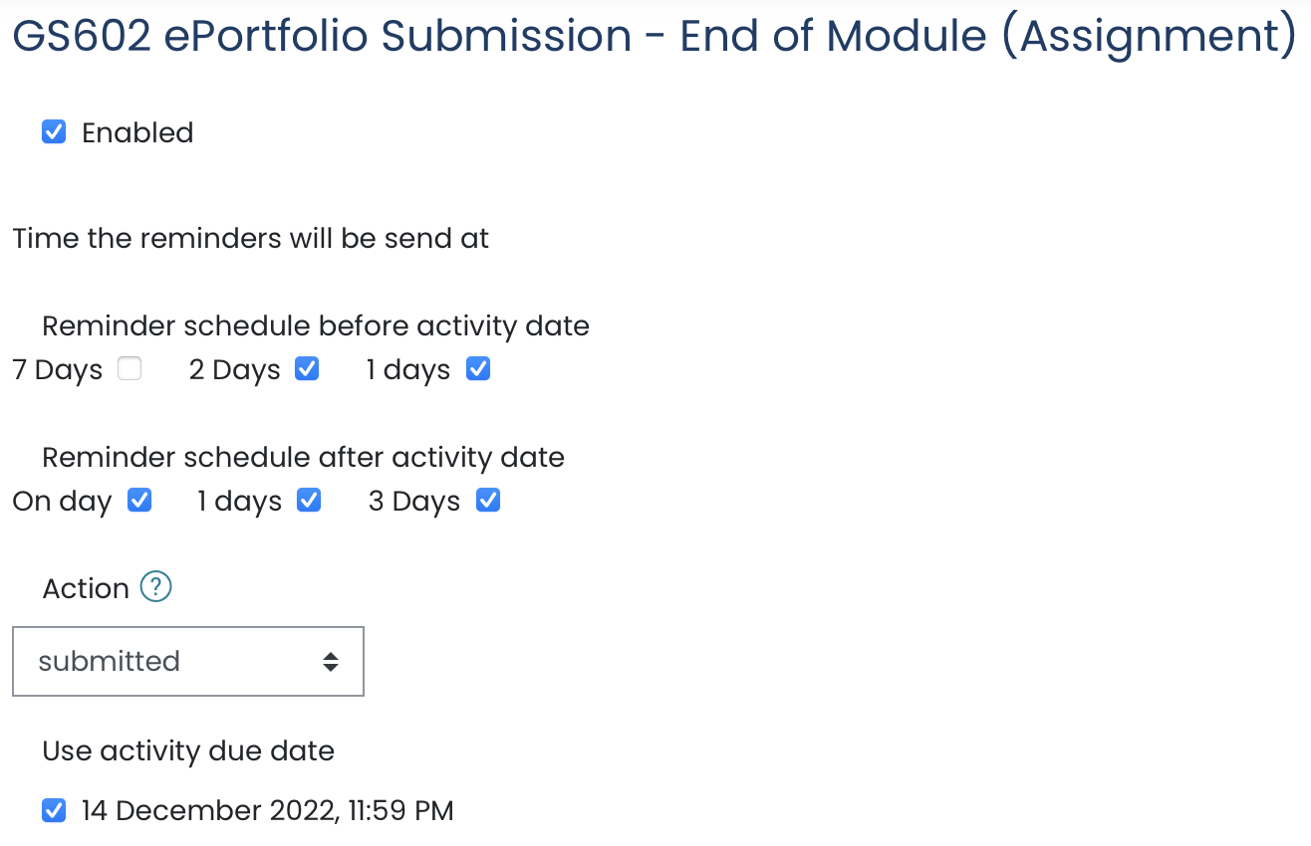
8. Issue reminders for upcoming deadlines
Can use Calendar block, announcements forum or messages
Bespoke Reminders block available to automate process
Aligns to UDL Checkpoint 8.1 Heighten salience of goals and objectives
Notes:
Rob
Students juggle many different tasks and goals in any one module, never mind across several
With continuous assessment, often juggling many different deadlines in any one week of the semester
Some additional guidance and nudging around important deadlines can help students stay on track
A few ways to do this:
Almost all activities with deadlines appear in the Moodle calendar, so display the calendar block on the course and draw students’ attention to it
Can even create manual Calendar events which act as de facto reminders
Consider using forums or messages to issue reminders - messages can be sent to those who haven’t participated as per the Activity Participation report
We use a bespoke block called Reminders - can configure auto reminders to go out before and after a deadline

Slide 9
9. Custom roles
Provide ability for Disability Service or supports to access Moodle through custom roles, e.g. Note Taker or Mentor
Aligns to UDL Checkpoint 7.1 Optimize individual choice and autonomy
Notes:
Rob
Great strength of Moodle is it’s flexibility and potential for growth
We’ve been sharing course tips, but there are some useful system features that can help promote UDL
Roles are a great way to cater for different types of people
We have default roles, e.g. Student, Teacher
Consider custom roles that might help a student who needs it to engage, e.g. Parent or Mentor
At DCU we created the Note Taker role

Slide 10
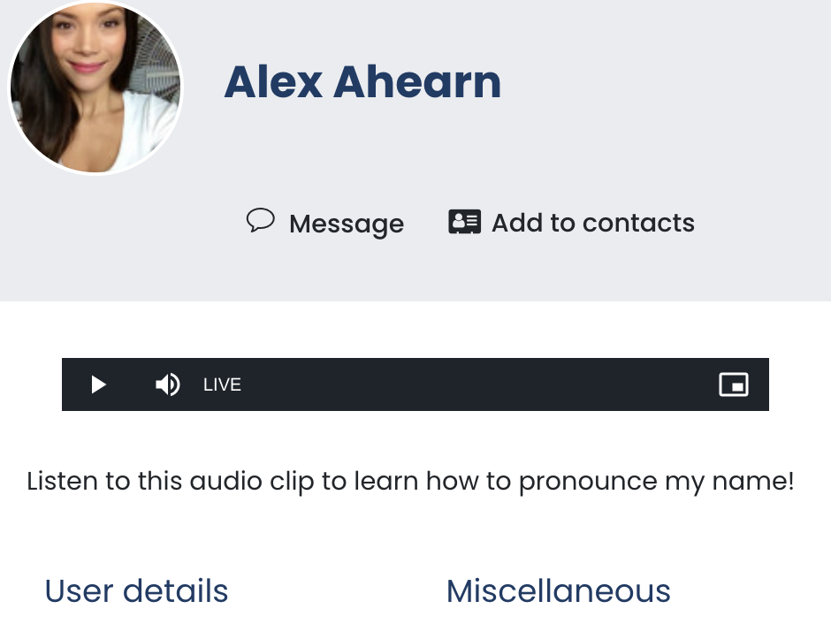
10. Profile fields
Allow learners to express information about themselves via profile fields and custom fields
E.g. audio record their name pronunciation or use a custom field for pronouns
Aligns to UDL Checkpoint 8.3 Foster collaboration and community
Notes:
Rob
A learner can express so much about themselves in their profile, which often goes very underutlised
Well-populated profiles can help learners get to know each other, identify common interests, and foster community
Consider promoting profiles among students
Profile description field is a rich text area, so can even include video/audio introductions. Another great way to foster diversity is asking students to record a pronunciation of their names in their profile description
The ability to add custom profile fields is also useful. At DCU we created the pronoun field.

Slide 11
Summary
Assignment marking guides and rubrics
Highlight assistive tech
Discussion forums
Course contact block
Guide learners in engaging with content
Share slides before class
Assignment audio feedback
Issue reminders for upcoming deadlines
Custom roles
Profile fields

