Slide 1
This work is licensed under a Creative Commons Attribution-NonCommercial-ShareAlike 4.0 International License.
Moodle Munch
Translating Policy to Practice:
A Universal Design for Learning Moodle toolkit
Teaching Enhancement Unit (TEU)
Notes:
Image by www_slon_pics from Pixabay

Slide 2
Overview
Introduction to UDL
Link to DigCompEdu #5 & INDEx survey
Overview of Toolkit
Development of Toolkit
Feedback from Pilot Group
Next Steps/Sharing Toolkit
Teaching Enhancement Unit (TEU)

Slide 3
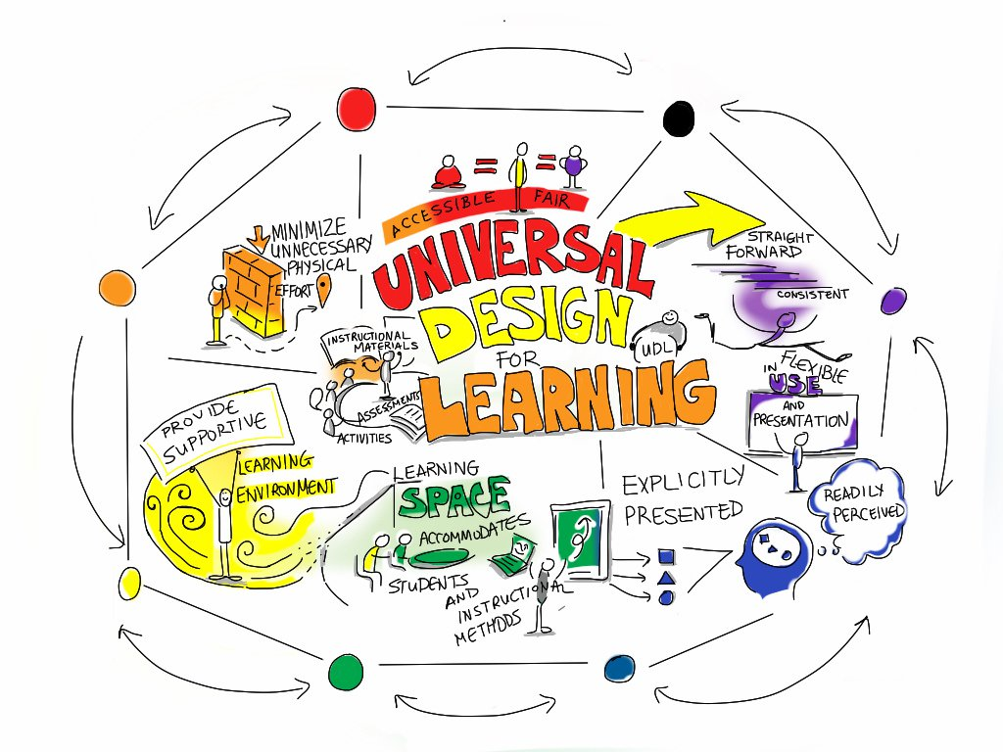
Universal Design for Learning
A Framework for Inclusive Practice
Teaching Enhancement Unit (TEU)
Notes:
Image: Universal Design for Learning by Giulia Forsythe on Flickr

Slide 4
Flexible ways of learning
Flexible study resources & facilities
Flexible assessments
http://udloncampus.cast.org/home#.Vo_kv2fnnIU
Teaching Enhancement Unit (TEU)
Notes:
http://udloncampus.cast.org/home

Slide 5
Some Potential Benefits of UDL
An effective curriculum and environment that allows students to learn their way.
Variety and choice built into teaching and learning.
Better outcomes for all students, not just students with disabilities, neurodivergence or international students.
Teaching Enhancement Unit (TEU)

Slide 6
UDL at DCU
Strategic Plan 2017-2022
“To enhance the inclusivity of the learning experience, we will promote the principles
of Universal Design in the design and delivery of all our programmes”
Development of UDL Policy in DCU
UDL Guidelines
Staff Development & Support
Teaching Enhancement Unit (TEU)
Notes:
Directly linked to the University’s Strategic Plan 2017-2022, in particular, strategic goal 1.1: Curriculum Reform.
The policy also connects with the Teaching and Learning Constituent Strategy where UDL is specifically referenced
‘To enhance the inclusivity of the learning experience, we will promote the principles of Universal Design in the design and delivery of all our programmes (pg. 4)’.

Slide 7
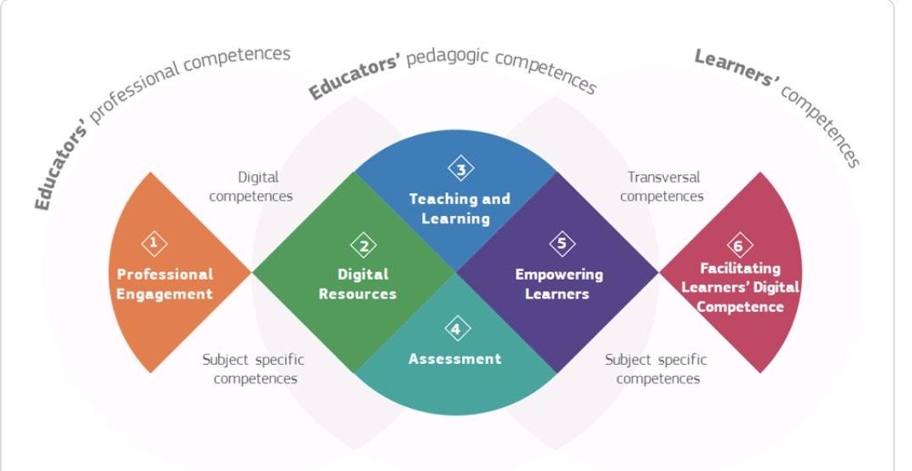
DigCompEdu Framework #5 Empowering learners
Teaching Enhancement Unit (TEU)

Slide 8
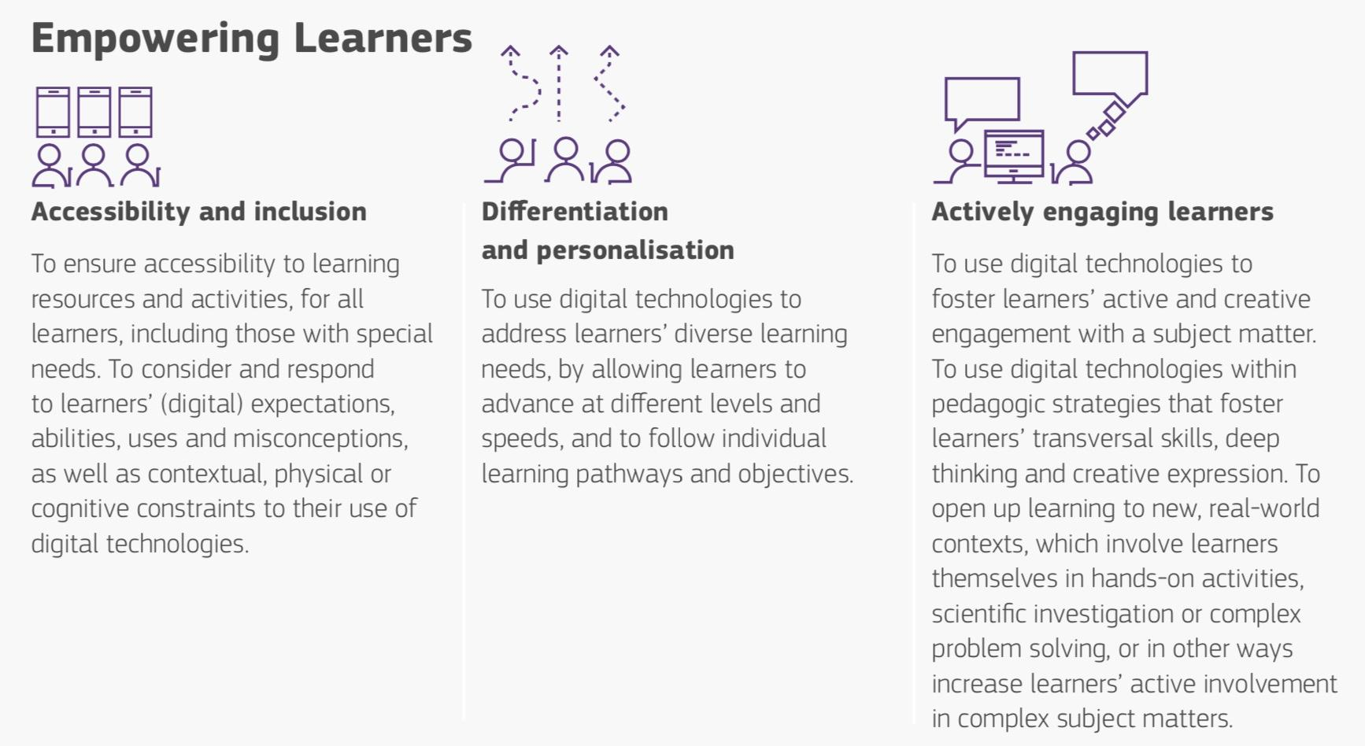
DigCompEdu Framework #5 Empowering learners
Teaching Enhancement Unit (TEU)

Slide 9
DigCompEdu Framework #5 Empowering learners
Teaching Enhancement Unit (TEU)

Slide 10
Students calling for:
Consistency in VLE
Improved navigation/signposting
Teaching Enhancement Unit (TEU)
Notes:
Timeliness of uploads to the VLE was requested by many, e.g., posting learning materials to the VLE before class or soon afterward.

Slide 11
The Toolkit
Why? To translate policy into practice
What?
Overview of UDL (text/video)
Moodle Page Template
UDL Checklist/s
Teaching Enhancement Unit (TEU)

Slide 12
Check box style
Teaching Enhancement Unit (TEU)
Notes:
]

Slide 13
Practice Example style
Teaching Enhancement Unit (TEU)

Slide 14
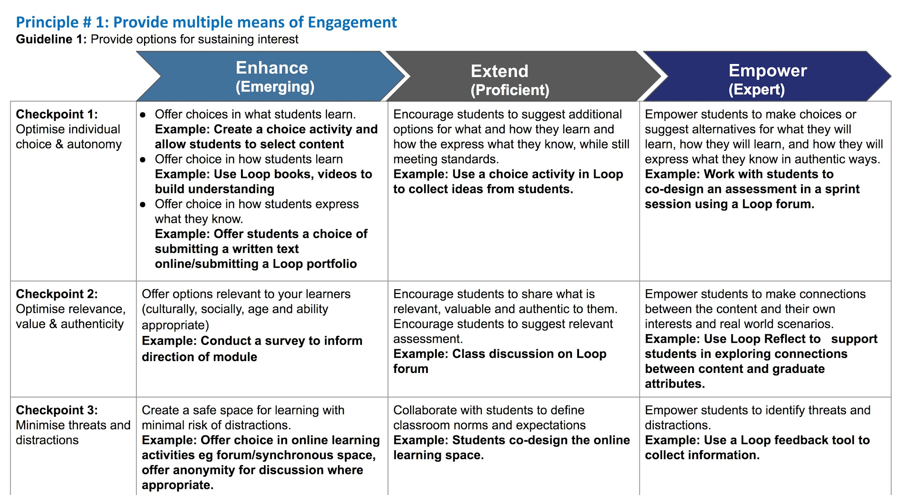
Progression Rubric Style
Adapted from UDL Progression Rubric, design by Melissa Toland,
Teaching Enhancement Unit (TEU)
Notes:
to focus groups for consideration; adapted based on focus group data; pilot group (karen will speak to later) suggested keeping all three types of checklist (speaks to UDL - flexibility)

Slide 15
UDL Toolkit Development
REFLECT
Moving from policy to practice
PLAN
Sketch outline of Toolkit
Embedding UDL Principles into VLE Practice
OBSERVE
Pilot Toolkit and Gather Feedback
ACT
Engage with those who teach
Teaching Enhancement Unit (TEU)

Slide 16
Implementation: Pilot group
Process
What worked well
Pilot with 3 participants who participated in the focus group
2.5 hour semi structured support session
Scaffolded approach BUT….
Allowing plenty of time!
Small group worked well
Continuing with participants of focus group
Teaching Enhancement Unit (TEU)

Slide 17
Pilot Group Response
“I completely changed all of my Loop pages….As a result the pages are much tidier and I think clearer”
“The addition of the module handbook structure on each page is great ... consistency across module pages”
“I set up a book of tasks for students to engage with on a weekly basis.”
Teaching Enhancement Unit (TEU)

Slide 18
Next Steps
Further development of toolkit
Offer to staff as self-directed toolkit/scaffolded process
Sharing of toolkit for Moodle users
Teaching Enhancement Unit (TEU)

Slide 19
Thank you!
karen.buckley@dcu.ie
suzanne.stone@dcu.ie
We welcome feedback!
Toolkit available through creative commons - June
Teaching Enhancement Unit (TEU)

Slide 20
Resources:
CAST Universal Design for Learning General Information Available @ http://www.cast.org/our-work/about-udl.html#.Xrqq6xNKjq0
UDL Toland, Melissa (2018) UDL Implementation Rubric available @ https://www.novakeducation.com/wp-content/uploads/2019/02/UDL_ImplementationRubric_MelissaToland.pdf
Rhode Island Modified UDL Educator Checklist – Version 1.2 (11/08/09) (Adapted from CAST UDL Guidelines: http://udlguidelines.wordpress.com/introduction/ ) Available @ http://technologyforudi.weebly.com/uploads/1/1/2/3/11235865/udleducatorchecklist.pdf
3E Framework, developed by Keith Smith, Napier University available @ https://3eeducation.org/3e-framework/
Teaching Enhancement Unit (TEU)

