Slide 1
THE ABCS OF H5P & ME
DR ALISON EGAN
MARINO INSTITUTE OF EDUCATION

Slide 2
MOODLE MUNCH – JUNE 2020
PHD PRE-SERVICE TEACHERS EXPERIENCES WITH TECHNOLOGY – A QUANTITATIVE APPROACH
EDUCATIONAL TECHNOLOGIST SINCE 2003
FIRST PODCAST CREATED FOR LAW SOCIETY – 1 HOUR’S DURATION!!
ONLINE IRISH COURSE FOR SOLICITORS (MASTER’S THESIS)
MOVED TO MARINO INSTITUTE OF EDUCATION
11.5 YEARS AGO …… DIRECTOR OF IT & ELEARNING

Slide 3
PLAN OF ACTION
WHAT IS H5P AND WHY WOULD YOU USE IT?
SIGN UP FOR AN ACCOUNT
INTEGRATION INTO VLE
TRY IT OUT

Slide 4
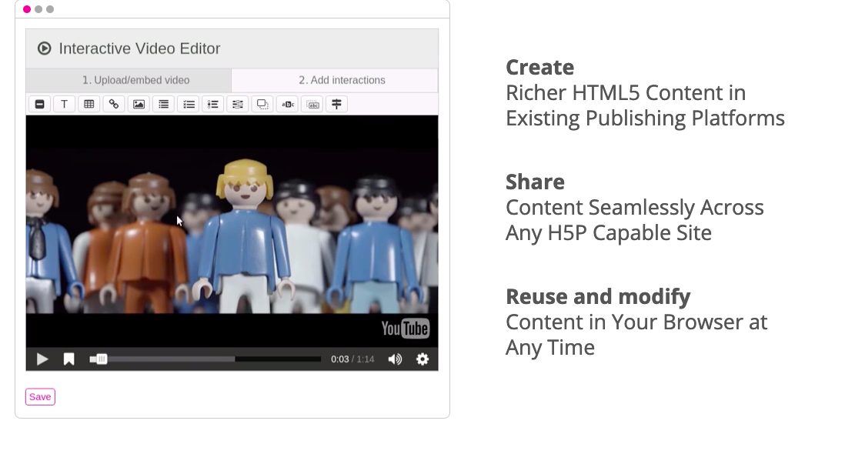
https://h5p.org/
H5P is described by Hart (2017) as a content development tool and an instructional tool as it can be used to create both interactive content and instructional content such as quizzes.
H5P stands for HTML 5 Package and as the name suggests is HTML5-based.

Slide 6
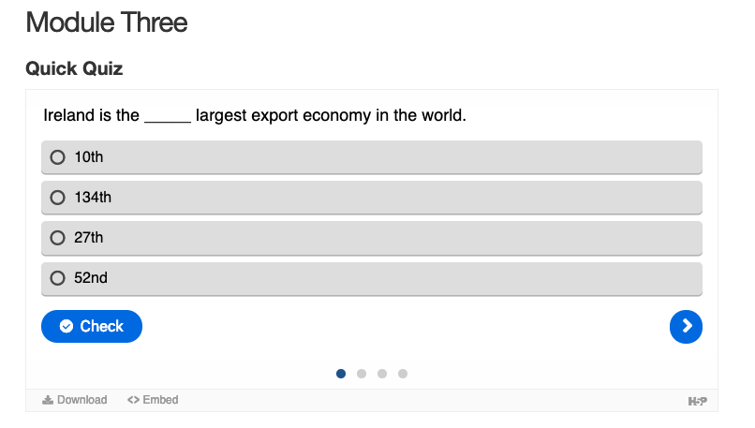
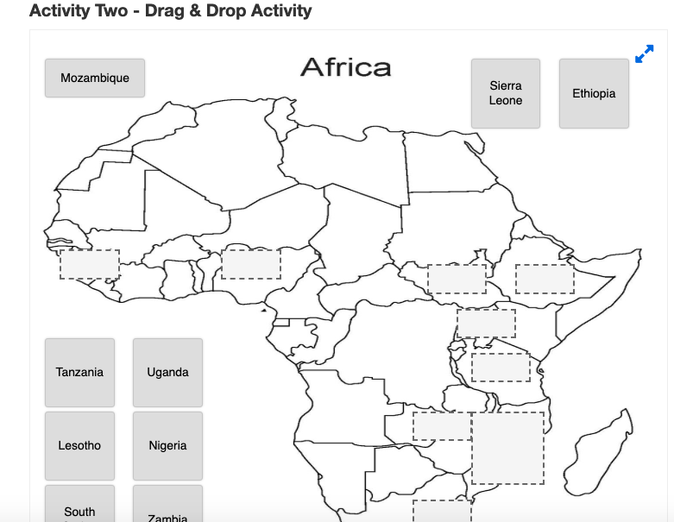
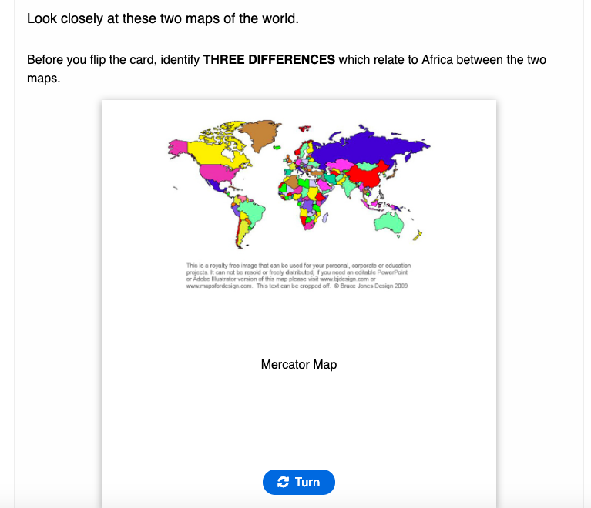
HOW I’VE USED IT
INSTANT FEEDBACK FOR STUDENTS
SELF-PACED LEARNING
SELF-ASSESSMENT METHOD
MY EXAMPLES
DRAG/DROP
FLIP CARDS
MULTIPLE CHOICE

Slide 7
https://h5p.org/

Slide 10
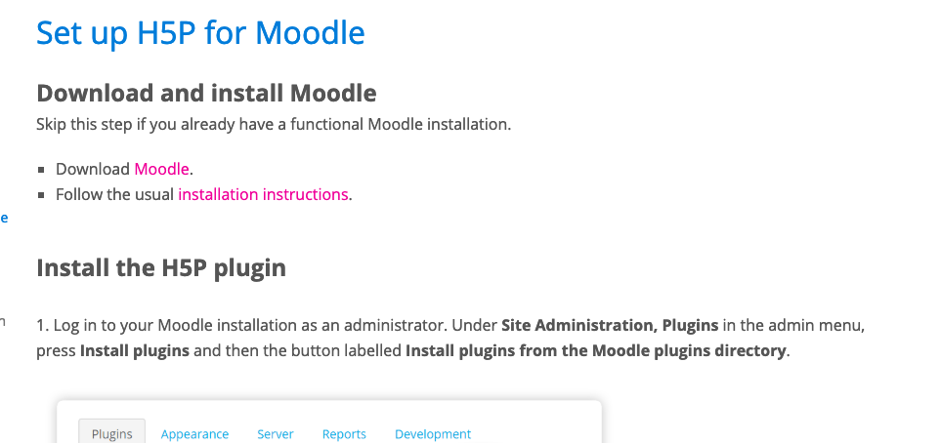

Slide 11
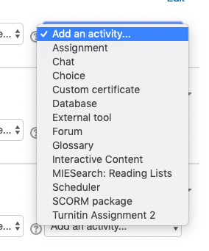

Slide 12
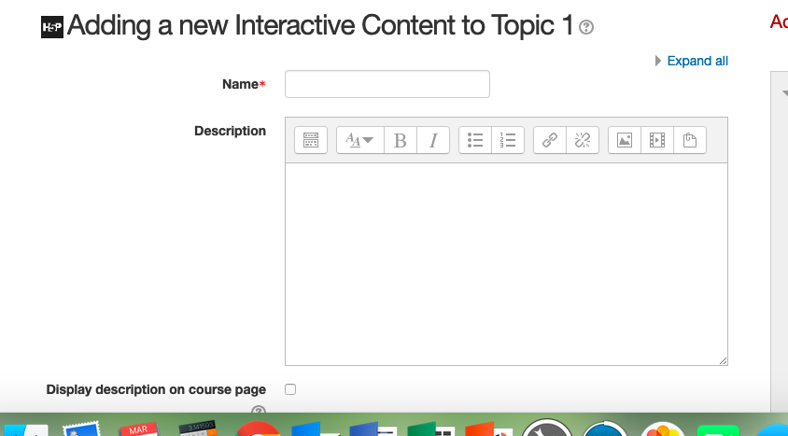

Slide 14
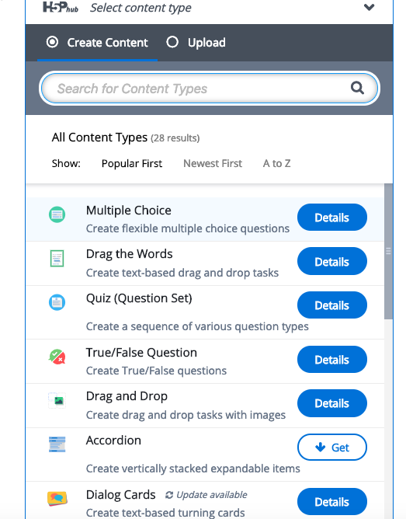

Slide 15
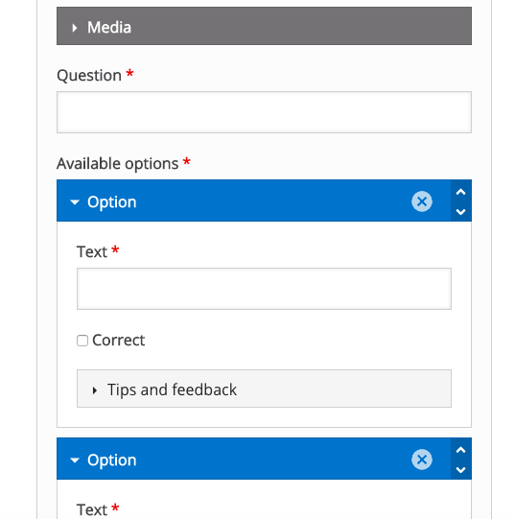

Slide 16
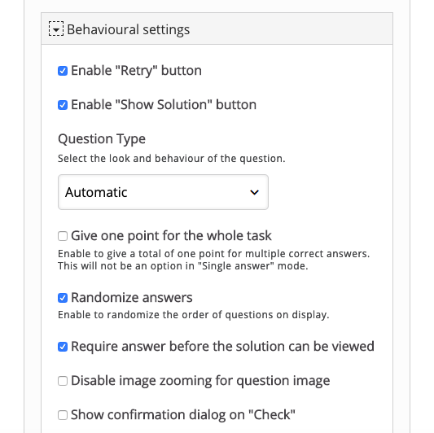

Slide 18
EMBEDDED CONTENT IN VLE - BOOK

Slide 19
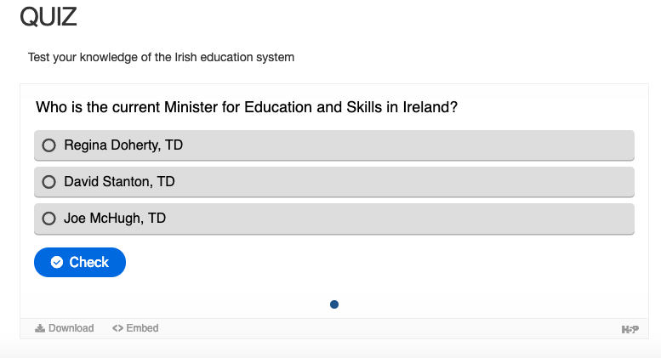
EMBEDDED CONTENT IN VLE - WEBPAGE

Slide 20
CREATE ONE H5P INTERACTION IN YOUR MOODLE
EASY WAYS TO START OUT
MULTIPLE CHOICE
TRUE/FALSE QUESTIONS
DIALOG CARDS
GUESS THE ANSWER
SEE HOW EASY IT IS…..

Slide 21
FINAL THOUGHTS…..
STUDENTS & STAFF LOVE IT
IDEAL FOR SELF-ASSESSMENT
IT’S FREE!!!
TRY ONE

Slide 22
THE ABCS OF H5P & ME – QUESTIONS?
DR. ALISON EGAN
MARINO INSTITUTE OF EDUCATION

