Slide 1
Discover DCU
Innovative Student Orientations
June 2020

Slide 2
Today
The background to the Discover project
Project timeline
Why H5P and moodle
Usage and feedback

Slide 3
1. Background
Discover DCU is a series of 8 short interactive courses designed to help students settle in and introduce them to the tools and skills needed to succeed at university.
Cross-university collaboration; Student Support, Teaching Enhancement Unit, Open Education, Library, ISS, Registry, DCU Healthy.

Slide 4
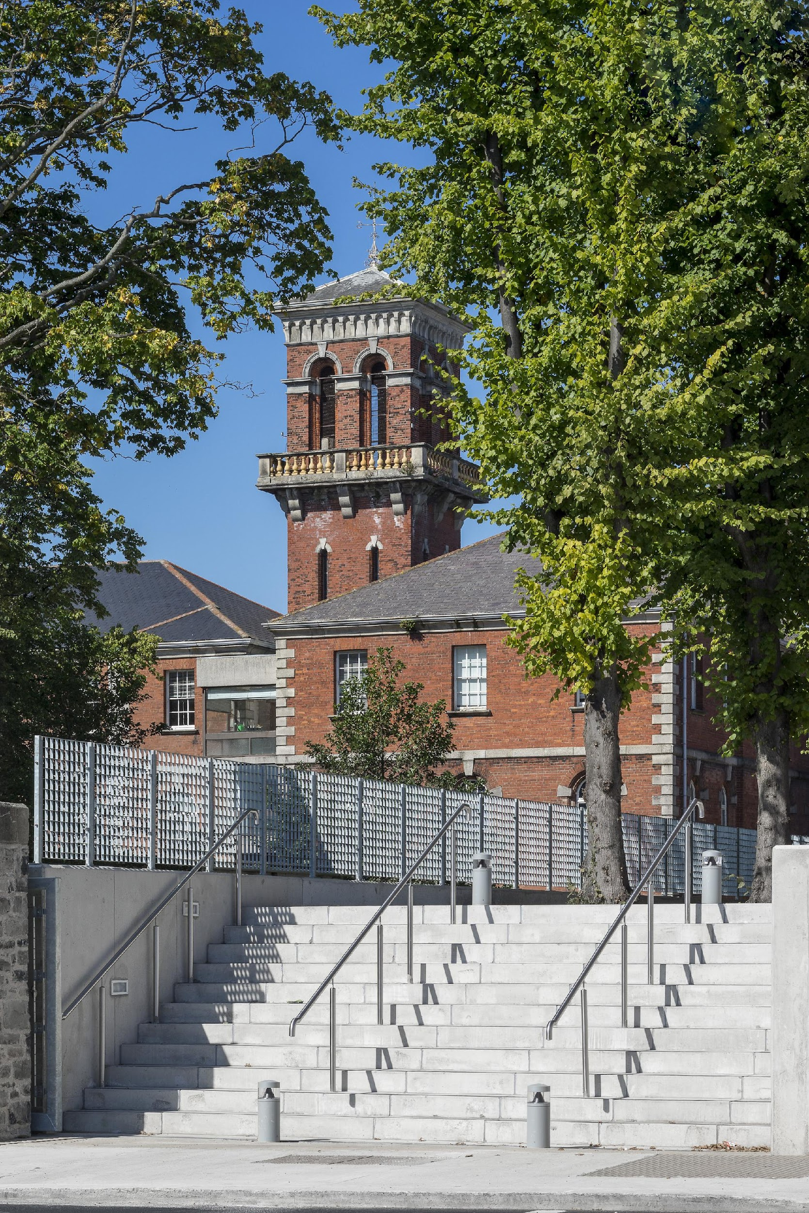
Why Discover DCU?
Incorporation
Move towards online learning
Buy it or build it

Slide 5
Unique benefits
Students have access at offer stage
Material is online 24/7, interactive and accessible
Information is tailored to DCU students
Use of technology early
Usage can be monitored, recorded and reviewed
Feeds into the new DCU Engagement award

Slide 6
2. Timeline
March to August 2017 | Academic year 2017/18 | Academic year 2018/19 | Academic year 2019/20 | Academic year 2020/21
Discover DCU series is drafted. Storyboard designed for each course and transferred to H5P. | First Discover DCU series of 8 courses piloted to whole student body. | Promote pre-orientation courses to students who receive first round offers. | Integrate Discover DCU to DCU Student Engagement Award. Winner of DCU President’s Award for Innovation. | Enhanced content to move orientation online during ongoing Covid-19 situation. New courses added.
 | Revise all courses based on student feedback. → | Revise all courses based on student feedback. → | Revise all courses based on student feedback. → | Revise all courses based on student feedback. →

Slide 7
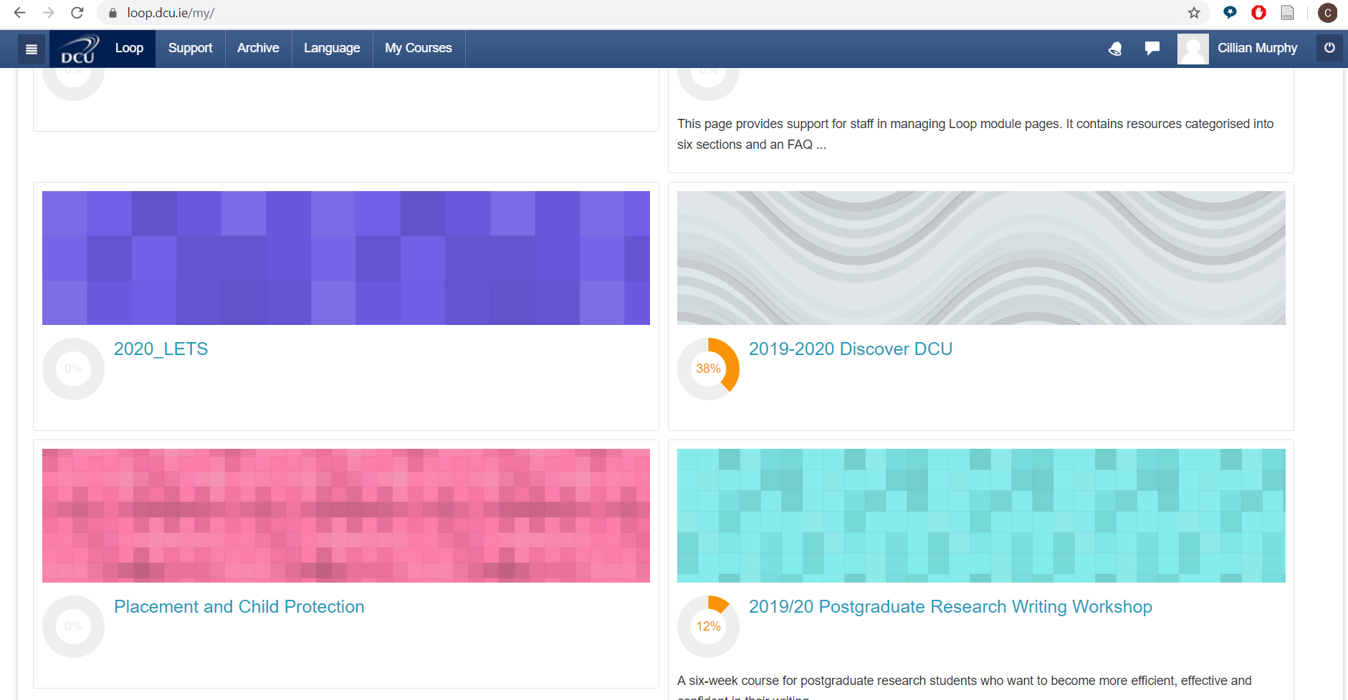
3. Why H5P and moodle
H5P
H5P is a free and open technology
H5P content is responsive and mobile friendly
H5P has plugins for WordPress, Moodle, Drupal and several other publishing systems.
Source: https://h5p.org/
Presentation content type
Moodle
It’s what we already had!
Facilitates usage tracking and stats by faculty / year etc
Gets students used to moodle / provides a tool in the VLE that doesn’t require another platform or entry gate
Select from your current courses

Slide 8
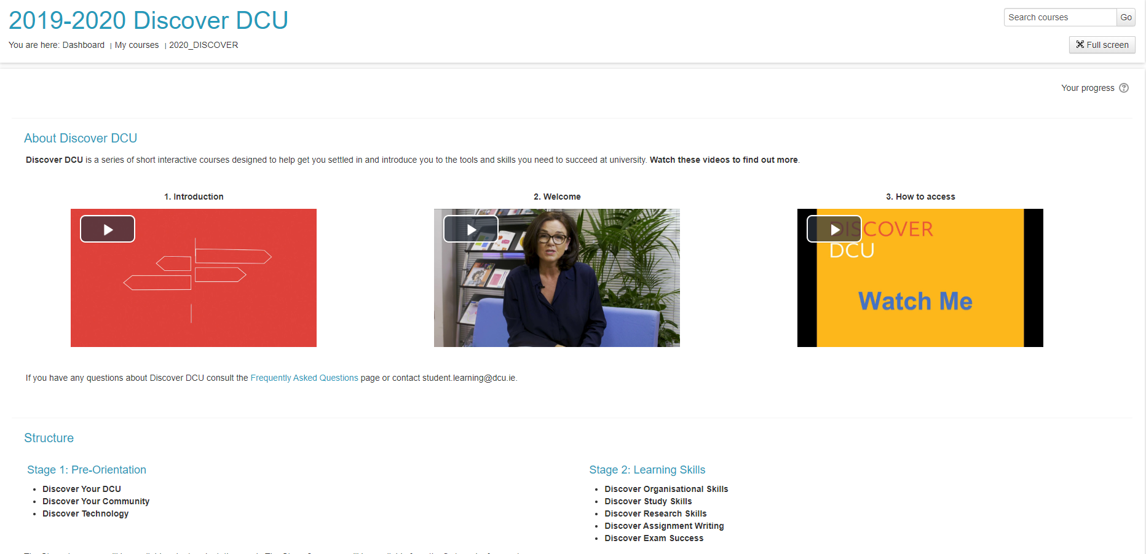
Moodle design

Slide 9
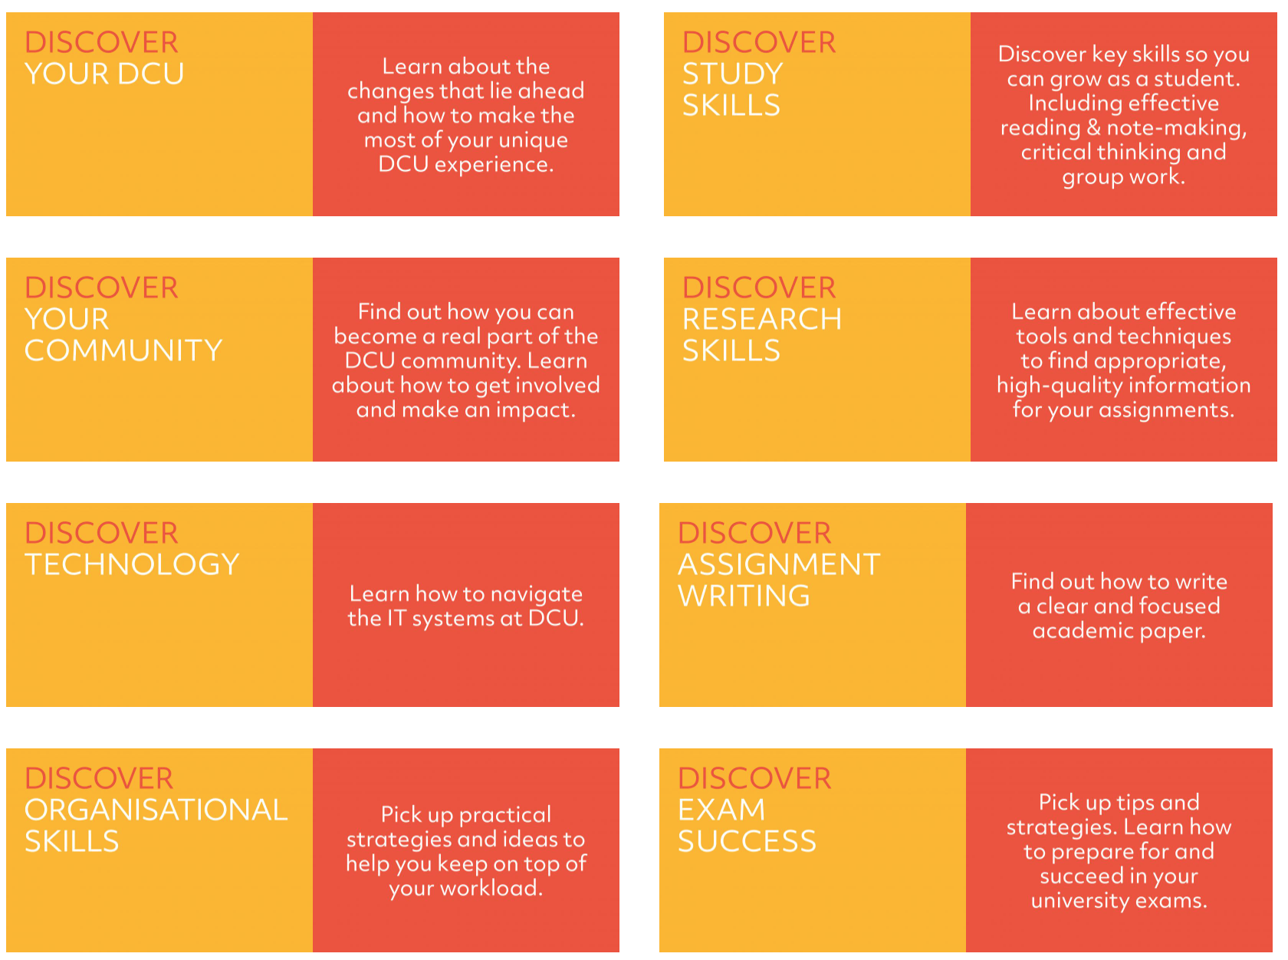

Slide 10
DCU Engagement Award
Certs can be downloaded and added to Loop Reflect (E-portfolio)

Slide 11
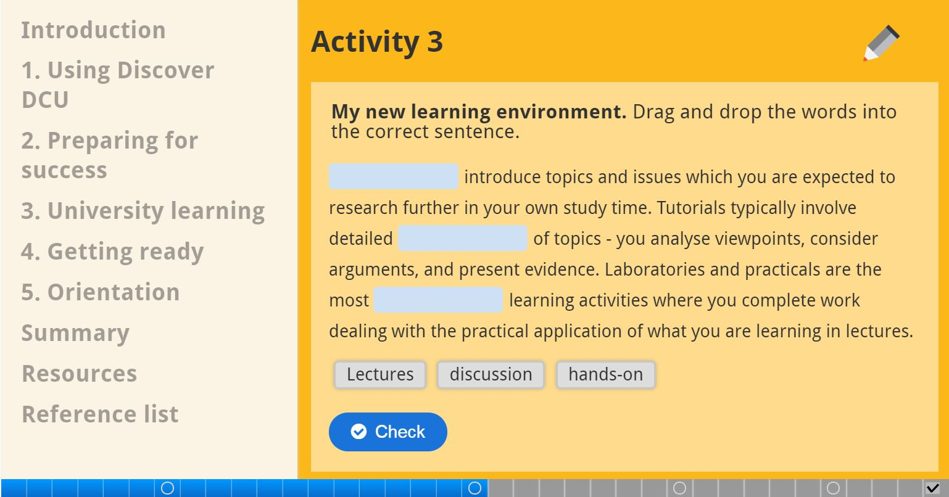
H5P design

Slide 12
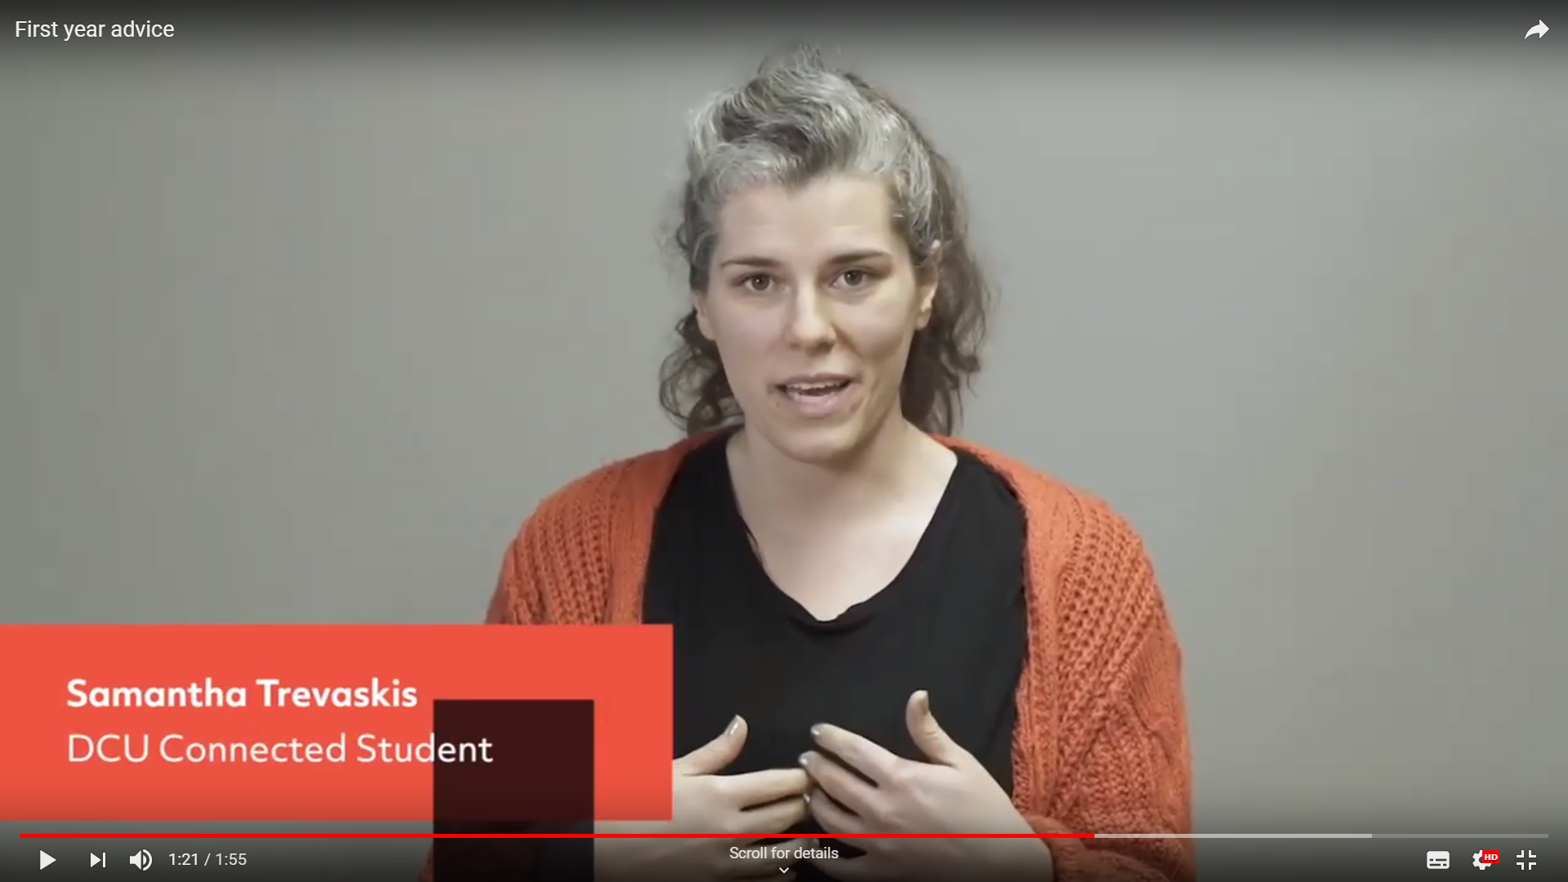
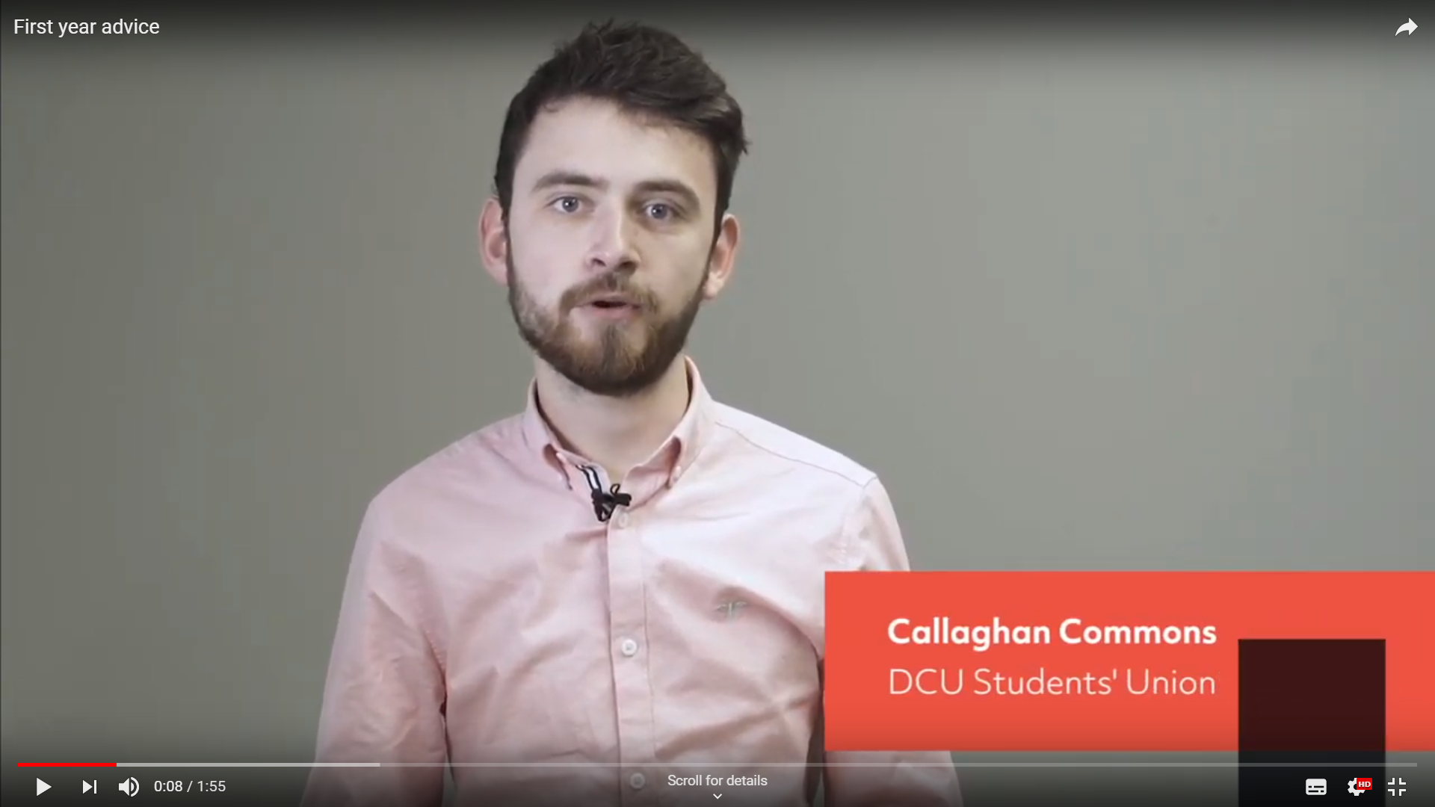
Student voice
Notes:
Focus on increased diversity of student voices: mature, connected, SU, cross-campus

Slide 13
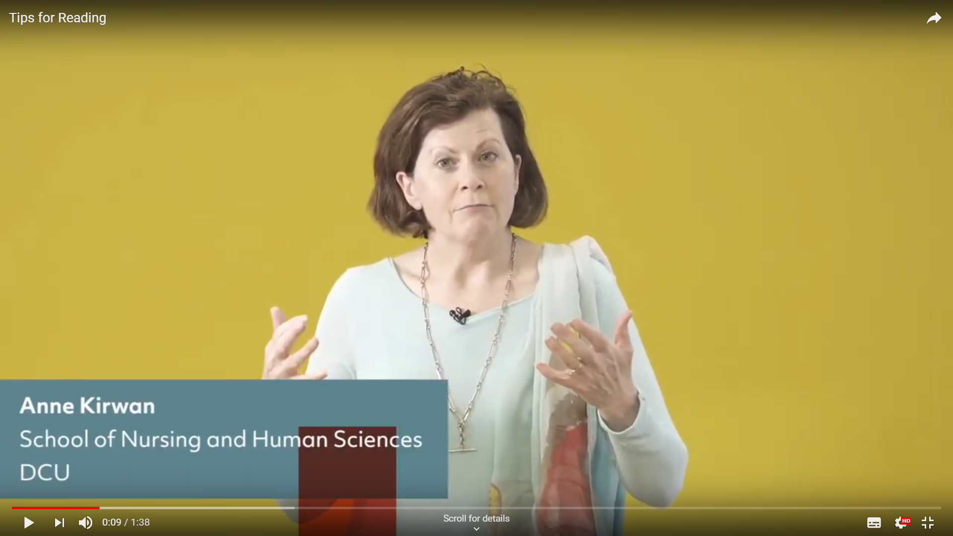
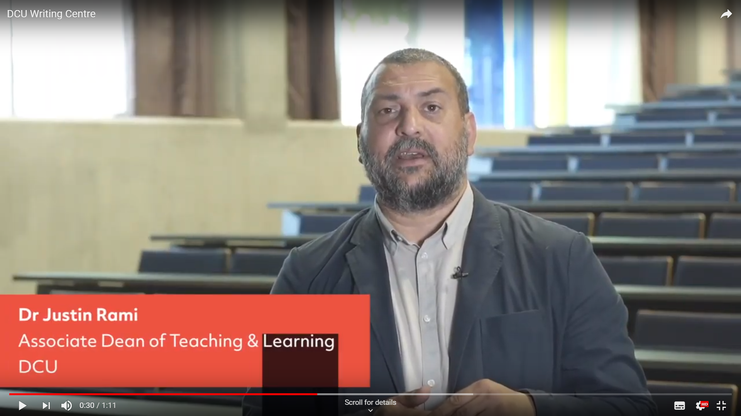
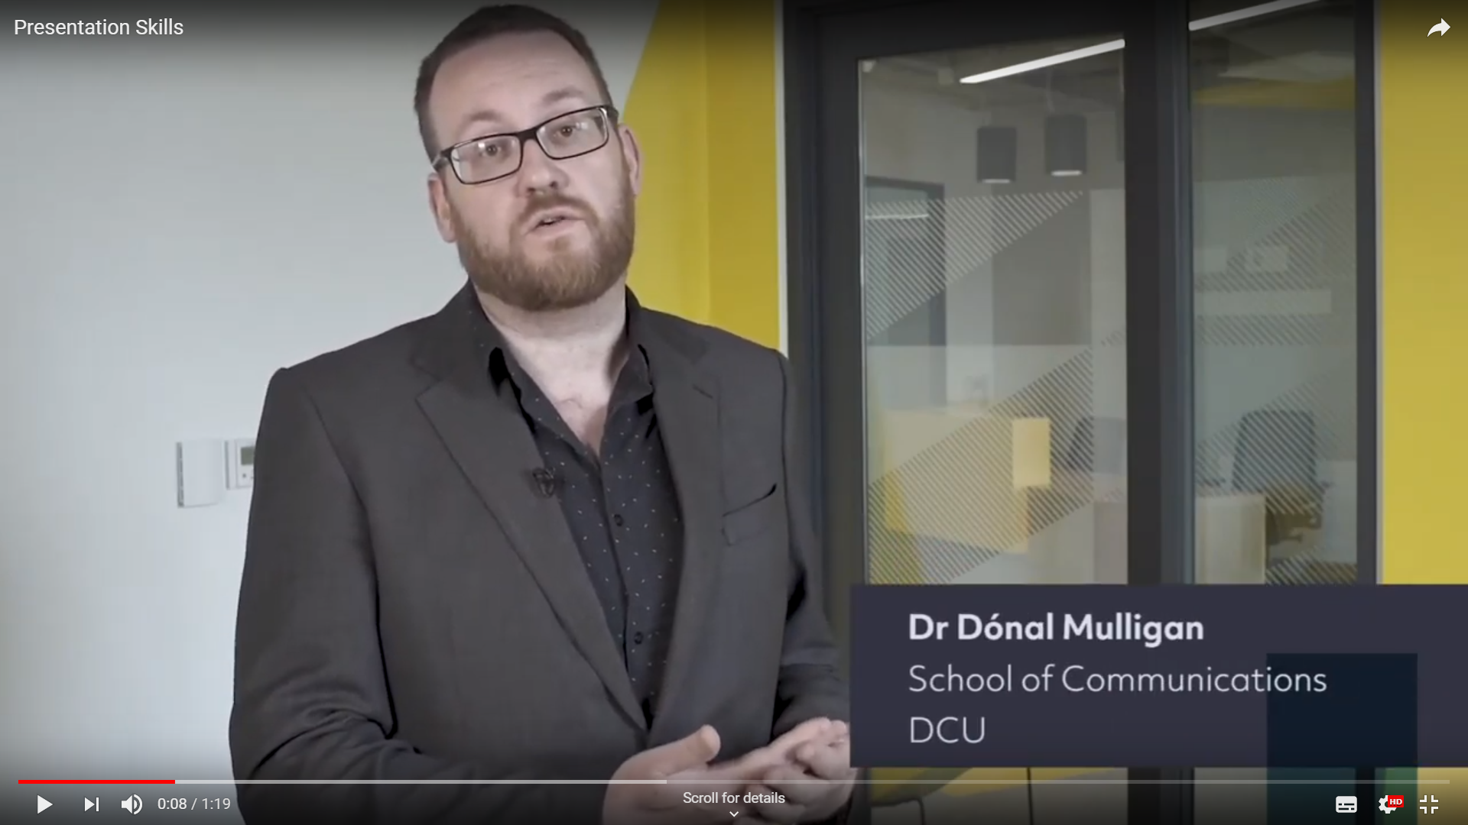
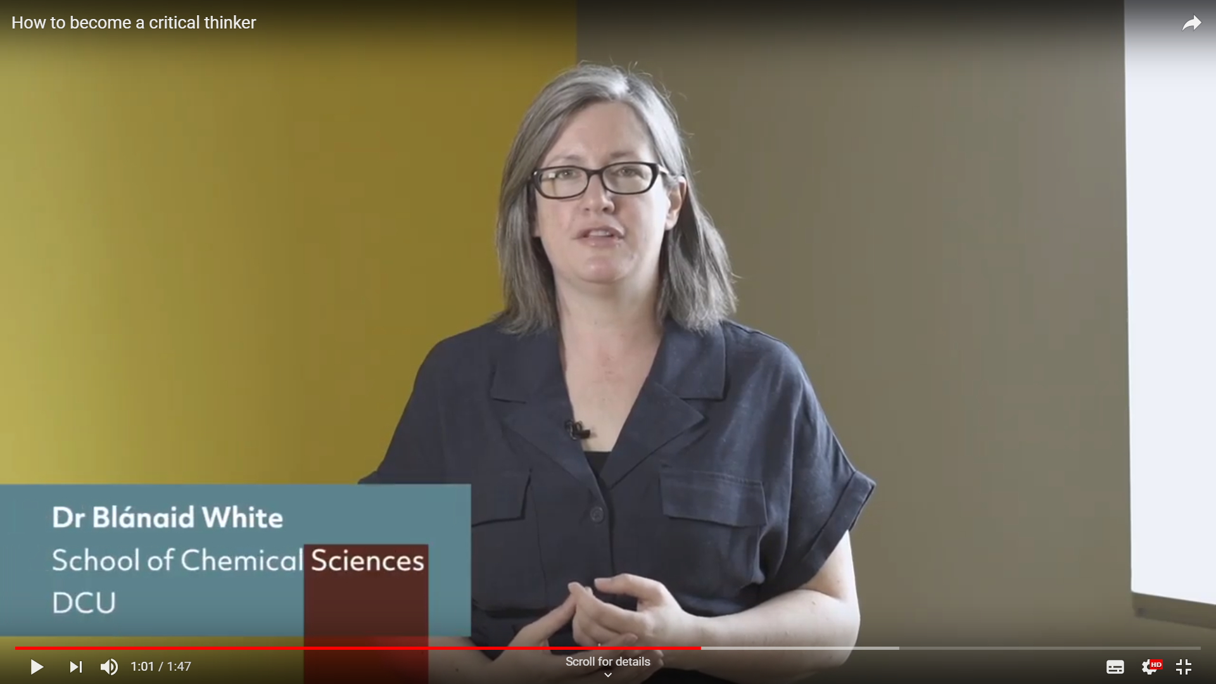
Staff voice

Slide 14
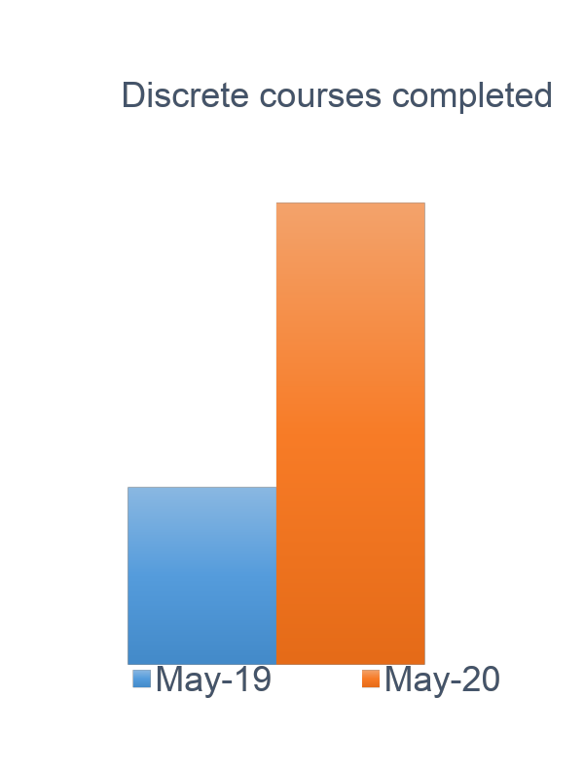
4. Usage and feedback
1537
students have engaged
with the courses
in 2019-20*

Slide 15
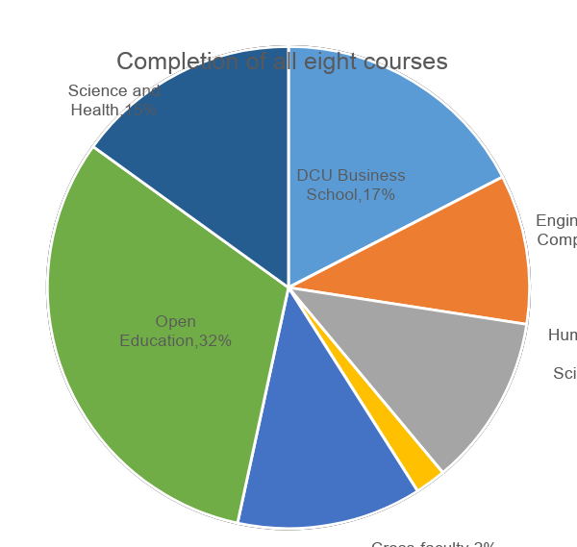
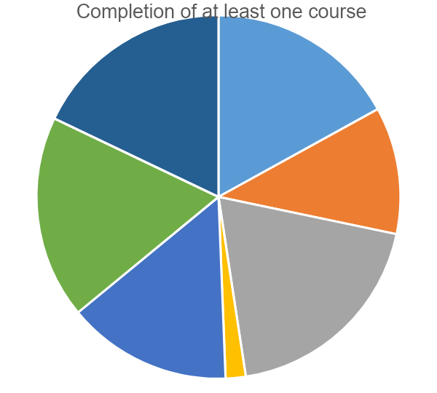
Faculty representation

Slide 16
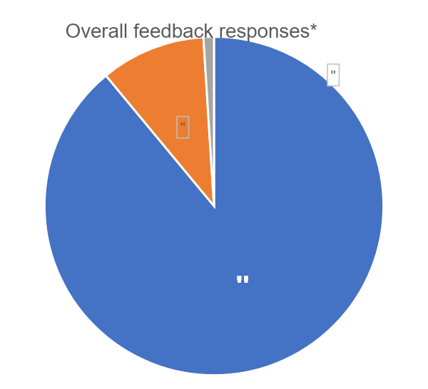
Feedback
Very helpful loved the videos and interviews with students.
Although I will be starting my studies online, I now feel part of a community.
I found this course really easy to understand and it made me feel at ease... I would highly recommend everyone to do this as I'm sure it would make the transition from Secondary School to DCU that little more easy.
As a mature student and single father to an 8-year-old, using my time efficiently will be critical and this whole course has been of great help.

Slide 17
Questions

